Slide 1
How to perform meta-analysis when you don’t have data for the 2X2 table but you have either RR or RR AND you can find sample size for each arm of the study (to use RR) and prevalence of the disease in the control group (to use OR)

Slide 2
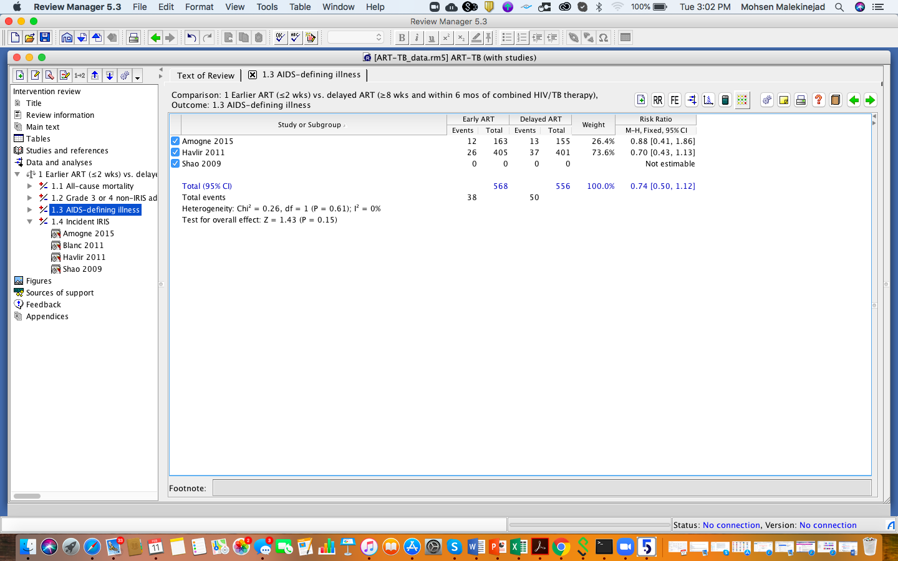
Add the study reference (example Shao 2009) that you don’t have 2X2 table to your meta-analysis model

Slide 3
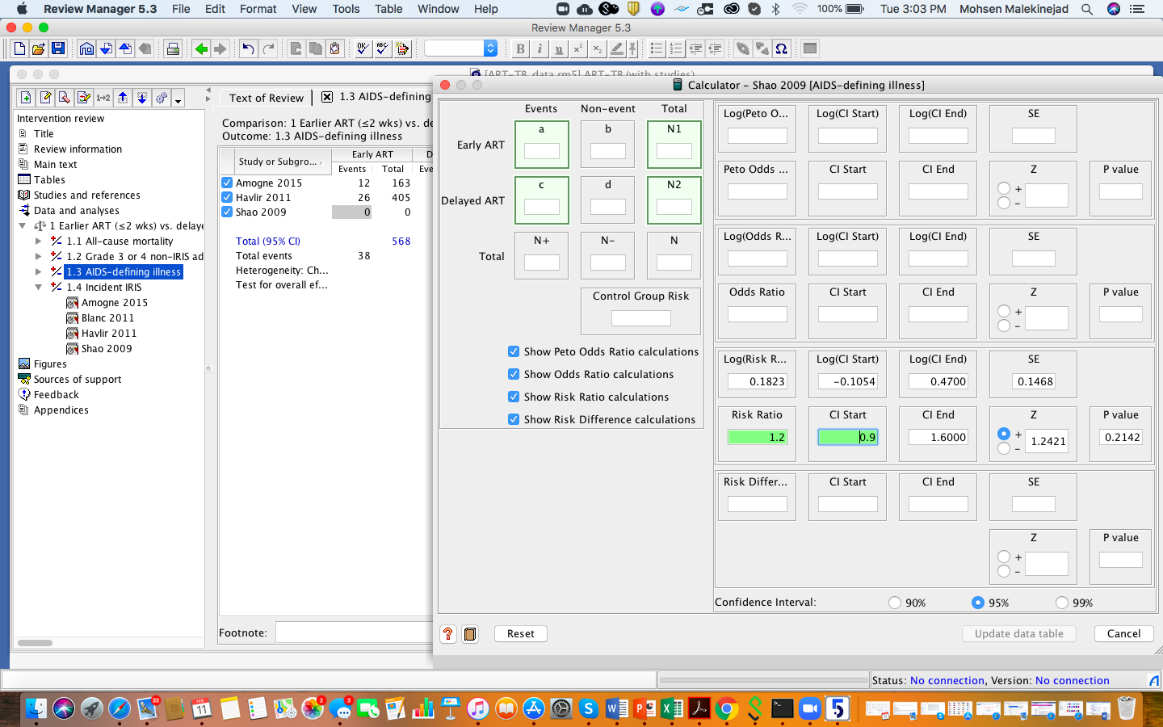
If you have RR, Open the calculator for the Shao 2009 and add RR and lower or upper bound of the 95%CI

Slide 4
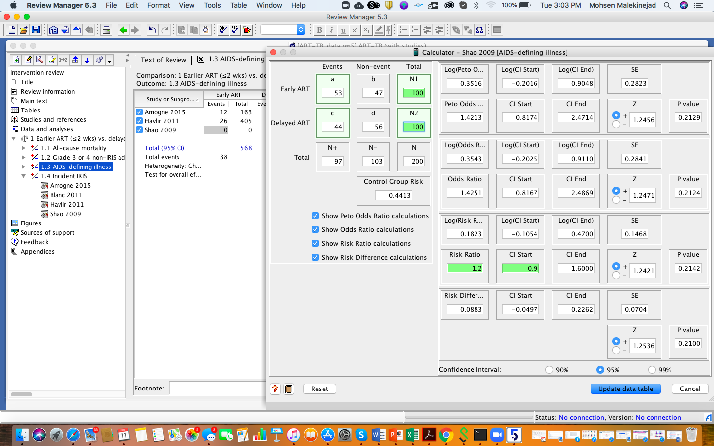
Then Add number of people for intervention and control group to proper cells – you can usually find these data in methods and results – as you enter those numbers , the rest of the calculator will be populated and you can add data for the study to your model

Slide 5
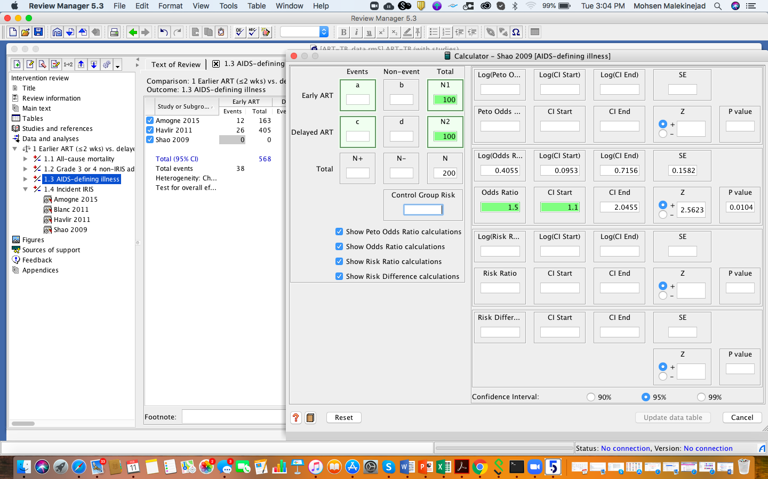
If you have OR data, adding sample size for each arm is not enough – try to find control group risk (i.e., prevalence if the disease or health condition in the control group – if you cant’ find from the study, you can impute from the literature or assume but make a note of that in your analysis.

Slide 6
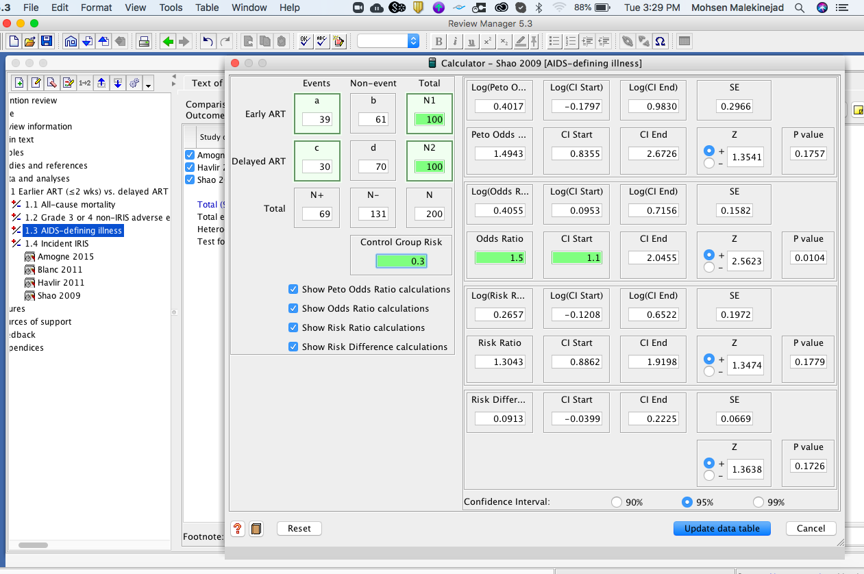
Once I added 0.3 as a risk in the control group, the rest of the cells completed and the ”update data table” button activated

Slide 7
