Slide 1
Correlation and Linear Regression
Biostat 200: Introduction to Biostatistics
Ali Mirzazadeh, MD, MPH, PhD
Associate Professor, University of California, San Francisco
(ali.mirzazadeh@ucsf.edu)

Slide 2
Learning objectives for participants
Explore Relationships Between Numerical Variables
Use scatter plots, Pearson’s, and Spearman’s correlation coefficients.
Understand Linear Regression Analysis Identify applications and assumptions.
Interpret Regression Outputs Analyze coefficients, significance, and model fit.

Slide 3
Examples of Relationships
Examples of positive correlation would be
Correlation between height and weight among children
Episodes of a television show watched and total hours TV viewing time
Number of drinks and blood alcohol level
Examples of negative correlation would be
Height above sea level and the rate of malaria
Number of absences and student's grades at school
Examples of zero correlation would be
Height of students and their average exam scores
Individuals' social security number and their annual income

Slide 4
Understanding Relationships
Does the value of one variable tell us something about the value of the other?
Does a change in one variable’s value predict a consistent change in the value of the other?
How reliable/significant are these relationships?

Slide 5
Clinical Example: BMI &HDL
We are interested to assess the relationship between body mass index (BMI) and high-density lipoprotein (HDL or “good” cholesterol) among adult population (18y+) in the United States.
Data: NHANES 2015 data
Participants included in this analysis: 3,400 adult people

Slide 6
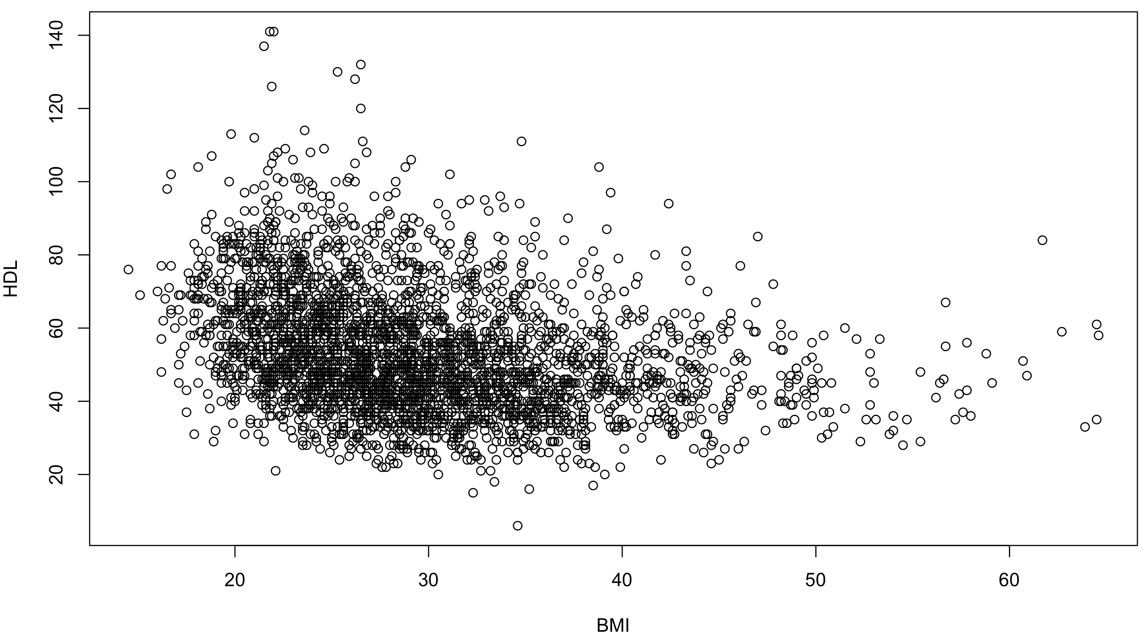
Two-Way Scatter Plot
Start with a scatter plot.
X-Axis: BMI
Y-Axis: HDL (mg/dL)
Tells us whether a linear model looks reasonable and gives a visual estimate of relationship.
The HDL (“good” cholesterol ) tends to decrease as the BMI increases.
To what degree their relationship fits to a straight line?
A participant
(BMI = 38.9, HDL = 96)

Slide 7
Correlation tells us whether there is a linear relationship or not
The correlation analysis calculates a coefficient that evaluates only the degree
to which a given set of quantitative data (e.g., BMI and HDL) fits a straight line.
Assumptions
Each variable should be continuous numerical
Each participant or observation should have values for both variables
Not having outliers in either variable
Linearity, the shape of the values formed by the scatterplot should follow a “straight line” relationship.

Slide 8
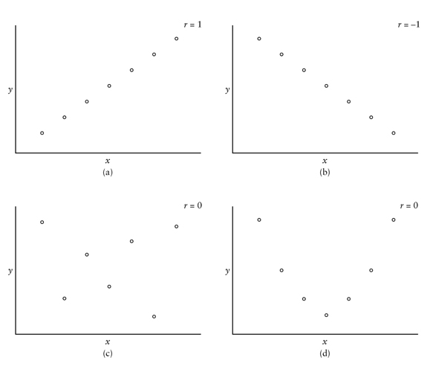
Interpreting Correlation Coefficient (r)
r = 1
r = -1
Correlation Coefficient has no units of measurement
Correlation Coefficient ranges from -1 to 1
Positive r mean both variables increase together
Negative r means variables move in opposite directions
r=-1 is exact negative linear relationship
r=1 is exact positive linear relationship
r = 0
r = 0
r=0 is no LINEAR relationship. Other mathematical relations possible

Slide 9
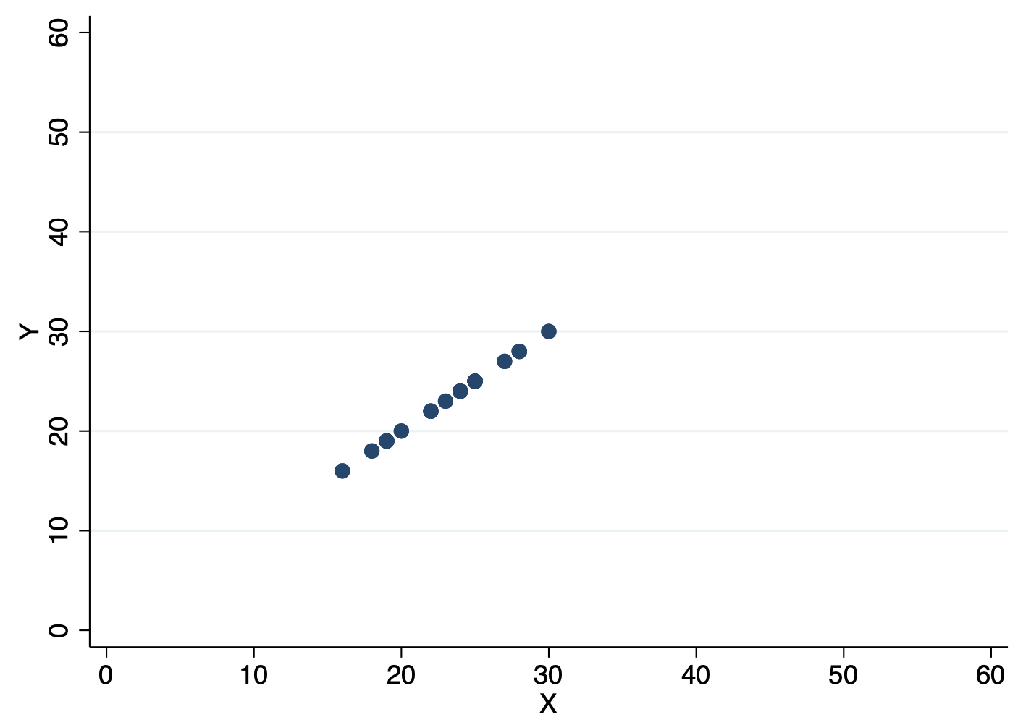
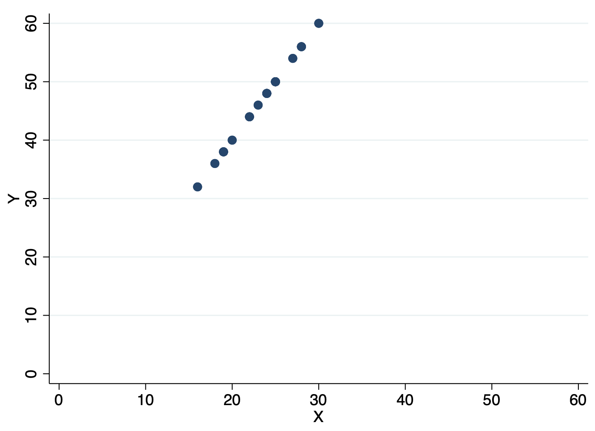
Which one has a higher correlation coefficient?
1
1
r = ?
r = ?

Slide 10
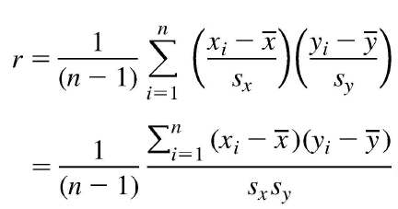
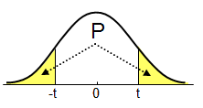
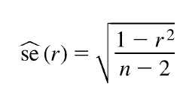
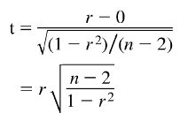
Pearson Correlation Coefficient What is this statistics?
$$H_{0}: ρ=0$$
$$H_{A}: ρ≠0$$
n: number of paired data (x, y)
S_{x} and S_{y} are the sample standard division of the x and y variables
$\overline{x}$ and $\overline{y}$ are the sample mean of the x and y variables
with no missing
= -0.305
= 0.017
< 0.0001
→ <0.0001 x 2 →
< 0.0002 (P-value)
= -18.26
df = n – 2 = 3234

Slide 11
Correlation analysis
The Pearson's Correlation Coefficient (r) between HDL and BMI is -0.305
Test the r between HDL and BMI
Null hypothesis: there is no such correlation in the underlying population between HDL and BMI
Since the p-value <0.002 is less than the significance level of 0.05, then we reject the null hypothesis
Conclusion “in words”: There is an inverse linear association between HDL and BMI, such that as BMI increases, HDL decreases.
P-value
r

Slide 12
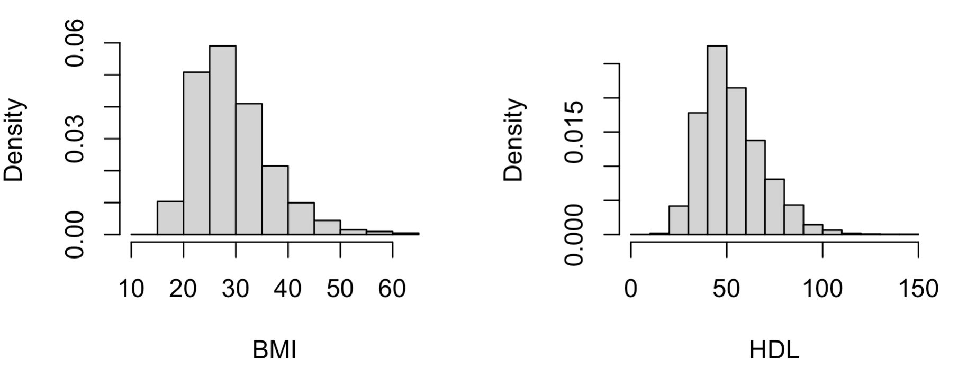
Correlation analysis
Check assumptions with scatter plot
Pair of values
Continuous
Linearity
Both variables are roughly normally distributed.
No outliers

Slide 13
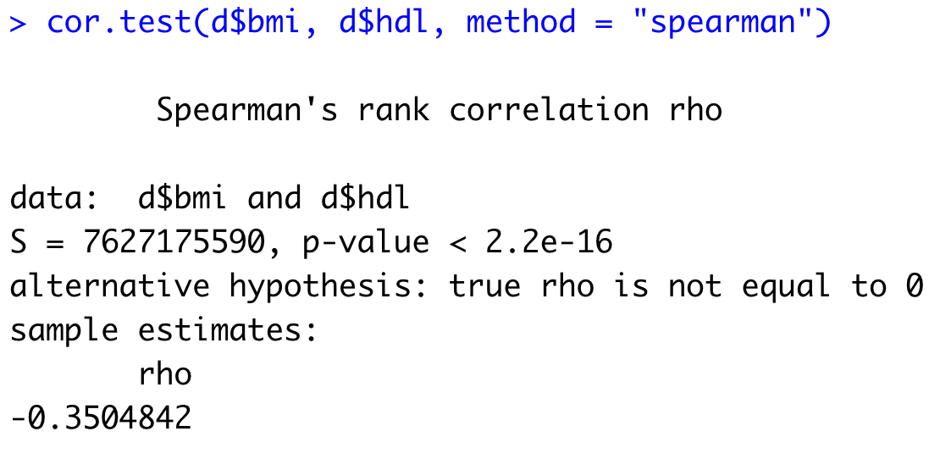
Non-Parametric Correlation Analysis
Used for data with:
Outliers
Ordinal variables
Report the Spearman’s rank correlation coefficient ( rs ), instead of the Pearson's Correlation Coefficient (r) in this case
P-value
r_{s}
Interpretation Practice
Null hypothesis: NO correlation between HDL and BMI in underlying population
Significance: p-value <0.001 is less than the significance level of 0.05, REJECT the null hypothesis
Conclusion: HDL and BMI are inversely correlated -> Higher BMI ranks are associated with lower HDL ranks.

Slide 14
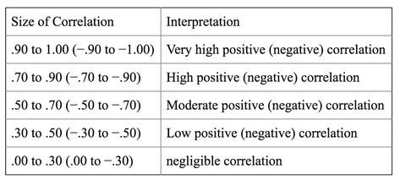
Rule of thumb for interpreting the size of a correlation coefficient
Hinkle DE, Wiersma W, Jurs SG. Applied Statistics for the Behavioral Sciences. 5th ed. Boston: Houghton Mifflin; 2003

Slide 15
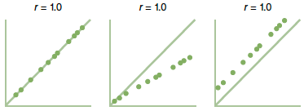
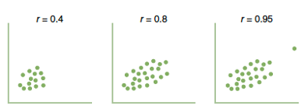
Limitations of correlation analysis
It only tells us whether there is a linear relationship between two variables (parametric) or the ranks of two variables (non-parametric)
It does not tell us about the strength of the association between two variables
The sample correlation coefficient is highly sensitive to extreme values
The estimated correlation should never be extrapolated beyond the observed ranges of the variables
A high correlation between two variables does not in itself imply a cause‐and‐effect relationship.
Extreme value
Source: Epidemiology Beyond the Basic

Slide 16
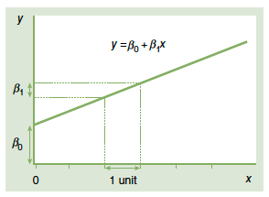
Strength of the association in a linear relationship
e.g., HDL
The correlation coefficient value contains no information about the strength of the association between the two variables.
The strength is represented by the slope of a line, such as the amount of increase to be expected in the HDL per unit increase in BMI
e.g., BMI
Source: Epidemiology Beyond the Basic

Slide 17
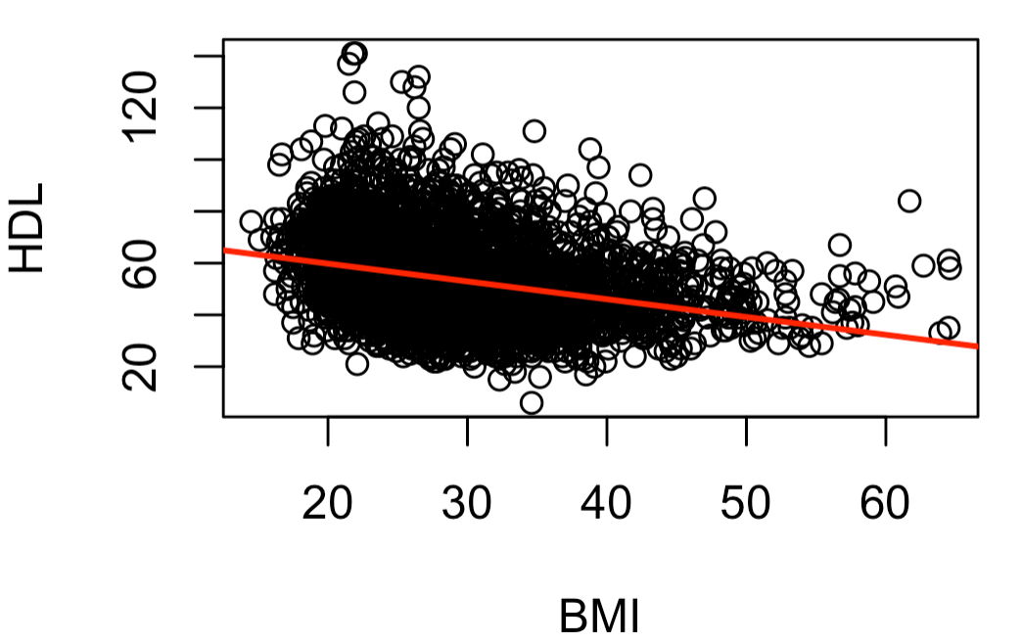
Simple Linear Regression
The simple linear regression analysis enables us to investigate the change in the mean of Y (dependent variable) as a linear function of X (independent variable).
Intercept
Example: How much does the mean HDL change for each unit increase in BMI in US adult population?
Fitting a straight line to the scatter plot between HDL and BMI:
Slope = ΔHDL / ΔBMI
Mean (HDL | BMI) = 73.5 - 0.68 x BMI
b₀ (Intercept)
b₁ (Slope)

Slide 18
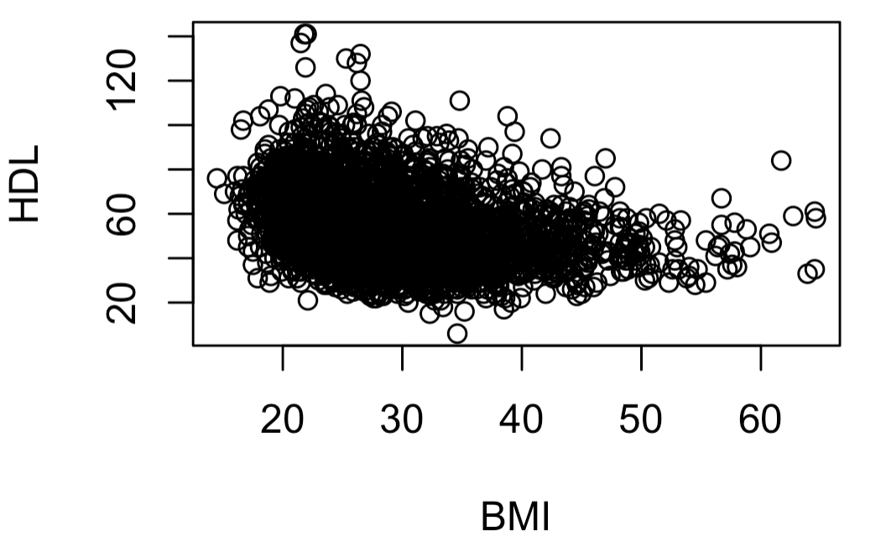
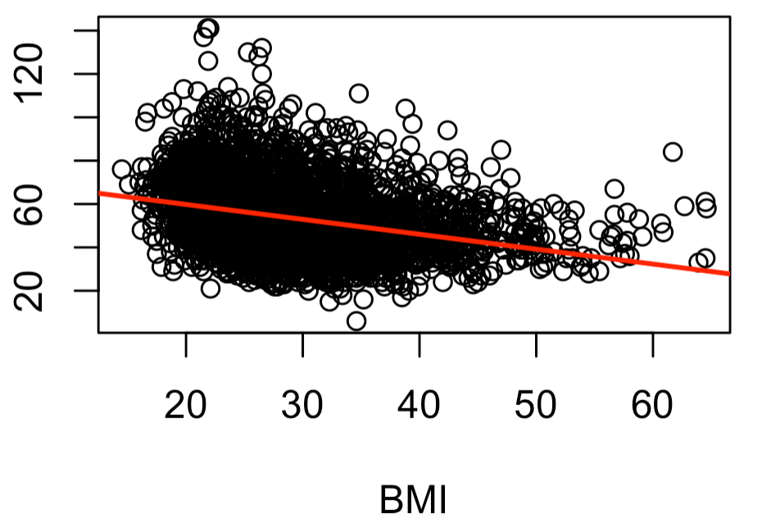
Simple Linear Regression
How do we find the line that fits best to the data?
A mathematical technique called “least squares”. The least squares regression line is constructed so that the error sum of squares is minimized
Observed HDL
e_{i}
(residual)
Fitted HDL

Slide 19
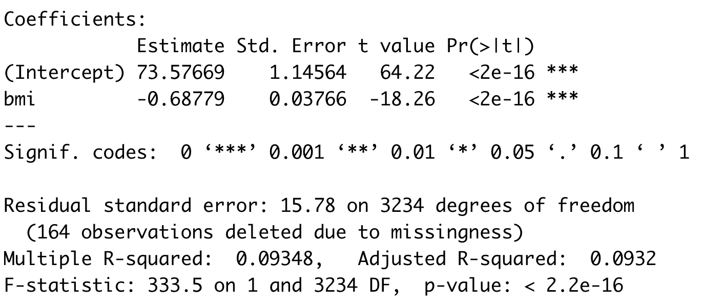
Simple Linear Regression
Example: How much does the mean HDL change for each unit increase in BMI in US adult population?
Mean (HDL | BMI) = 73.5 - 0.68 x BMI
b₀ (Intercept)
b₁ (Slope)
Significance Test for each Variable in Model
Null Hypothesis: b₁ = 0
Alternative Hypothesis: b₁≠0
Reject Null Hypothesis whenever p<.05
“Interpretation: For each 1 unit increase in BMI, mean HDL decreases by 0.68 mg/dL

Slide 20
Evaluating the linear model
After generating the regression line, does it fit the observed data?
Coefficient of determination (r²): it is the square of the Pearson correlation coefficient (r) which ranges between 0 and 1.
Plots of the residuals
Approximately 9.32% of the variation in the outcome variable can be explained by the predictor (in this case, possibly "bmi").

Slide 21
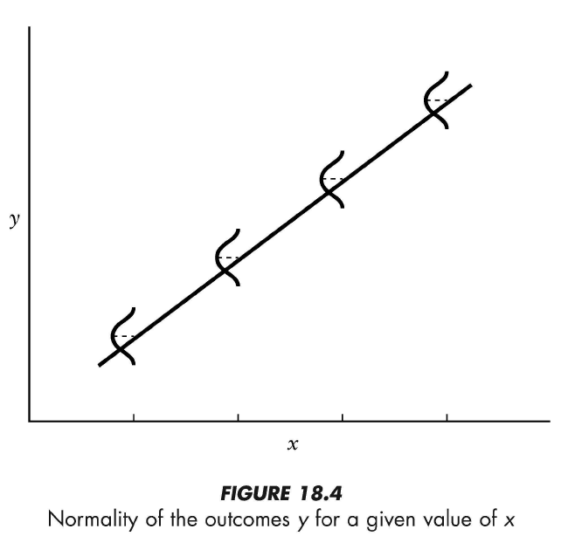
Regression assumptions
Linearity of the data. The relationship between the predictor (x) and the outcome (y) is assumed to be linear.
Normality of residuals. The residual errors are assumed to be normally distributed.
Homogeneity of residuals variance. The residuals are assumed to have a constant variance (homoscedasticity)
Independence of residuals. There is not a relationship between the residuals and the variable

Slide 22
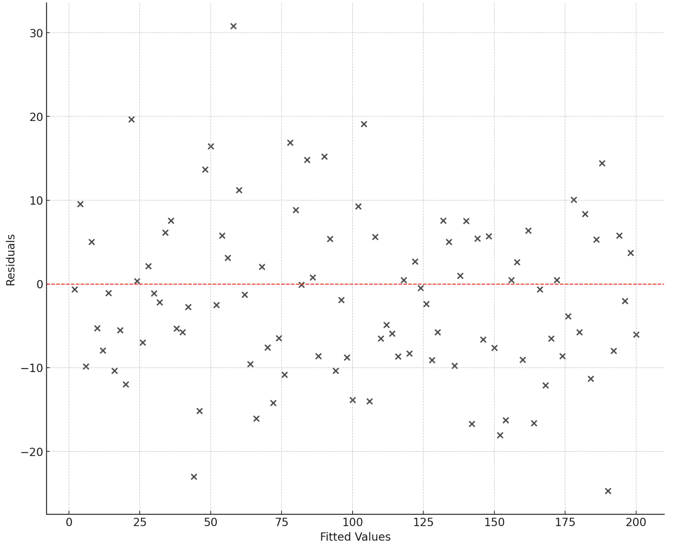
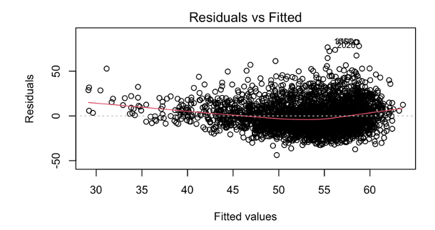
Residuals vs Fitted Plot
What it should be: Residuals vs Fitted (Ideal)
No relationship between residual values and fitted outcome values.
Used to check the linear relationship assumptions.
A horizontal line, without distinct patterns is an indication for a linear relationship.
This is almost good in our example
What we see for BMI and HDL: Right-Skewed Distribution

Slide 23
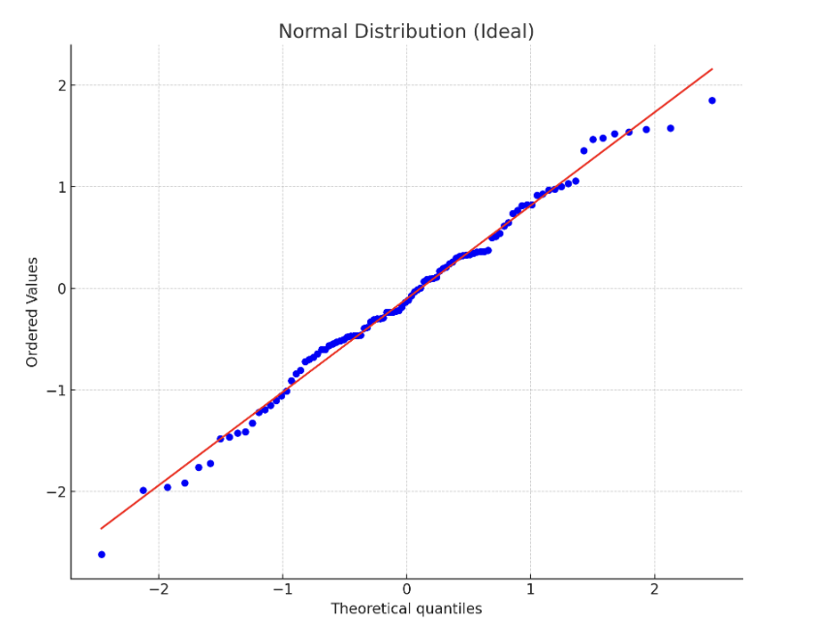
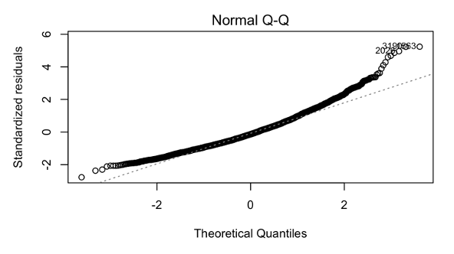
Normal Q-Q Plot
What it should be: Normal Distribution (Ideal)
Used to examine whether the residuals are normally distributed.
It’s good if residuals points follow the straight dashed line.
Deviance from diagonal=deviance from normality
This is not good in our example
What we see for BMI and HDL: Right-Skewed Distribution

Slide 24
Categorical Predictors in Linear Regression
Predictors in Linear Regression can be in any form, continuous or categorical
You just need to specify whether they are continuous or categorical in your analysis
Some example of categorical predictors are
Gender
Race
Age groups
BMI groups (Normal, Overweight, Obese)
…

Slide 25
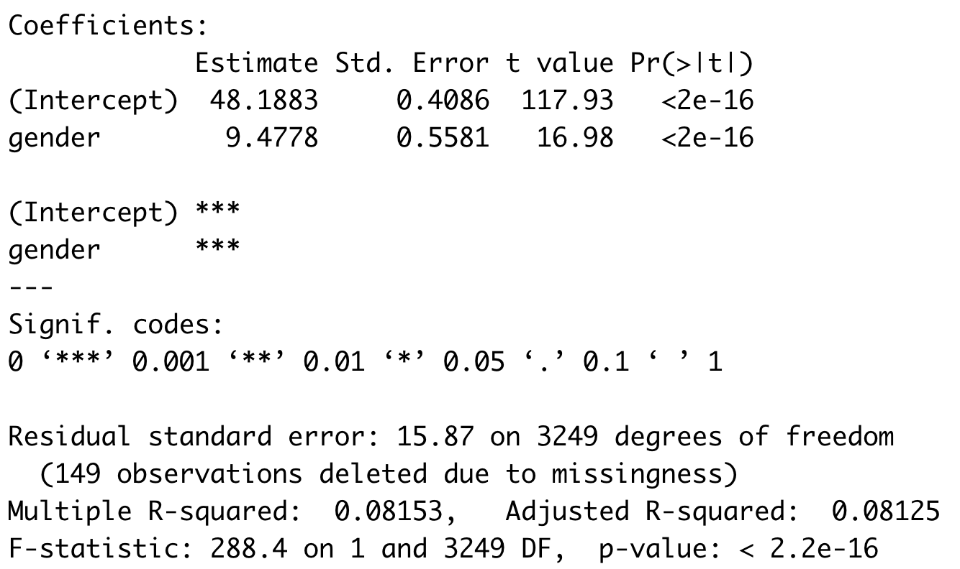
Linear Regression: Categorical Predictors
.
Control group (base) -> male
HDL of female individuals on average is 9.47 mg/dL higher than male individuals.

Slide 26
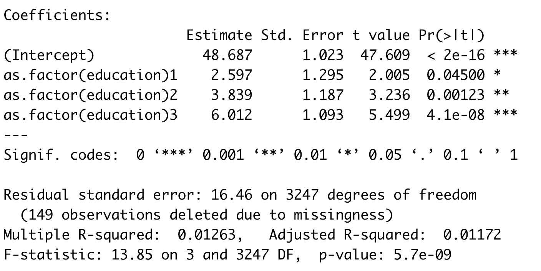
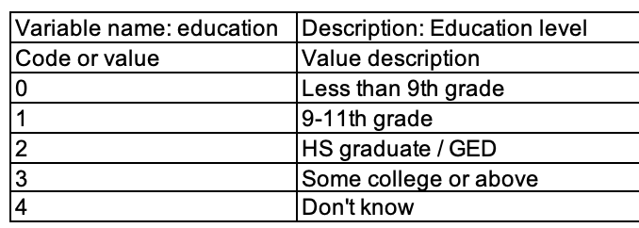
Linear Regression: Categorical Predictors
Control group (base) -> less than 9th grade
HDL of individuals with 9-11th grade on average is 2.59 mg/dL higher than control group.

Slide 27
Multiple Linear Regression
Used for handling more than one variable (predictor) in the model
When accounting for age as well as BMI:
What is the relationship of BMI to HDL?
Does the effect of BMI get bigger, smaller or stay the same?
Is there still a statistically significant association?
What is the role (effect) of third variable (e.g., gender) on relationship between your main predictor (e.g., BMI) and your outcome (e.g., HDL)?
No effect
Confounding effect
Interaction effect

Slide 28
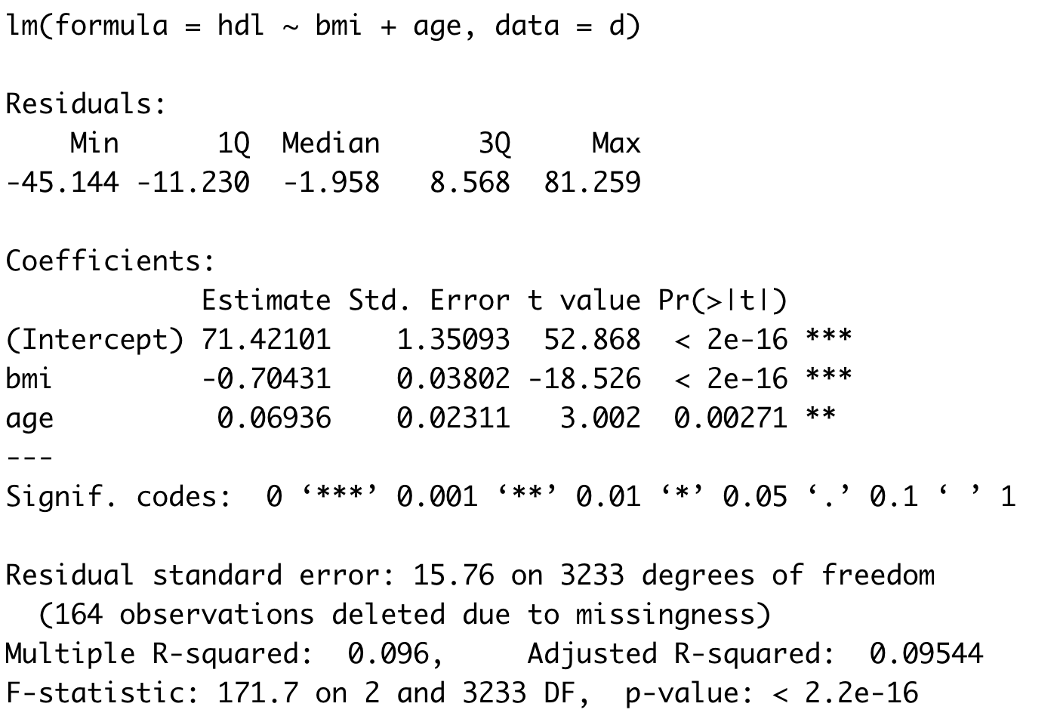
Multiple Linear Regression
Example: change in mean HDL that corresponds to change in BMI in US adult population, accounting for Age
Mean (HDL | BMI) = 71.4 - 0.70 x BMI + 0.07 x Age
Null Hypothesis: Adj. b₁ = 0
Alternative Hypothesis: Adj. b₁ <> 0
Since the p-value <0.001 is less than the significance level of 0.05, then we reject the null hypothesis.
In words: For each unit increase in BMI, average HDL decreases by 0.70 units, when age is held constant.
It was -0.68 before adjusting for age (Adjusted and Unadjusted b₁ are very similar)

Slide 29
Assess confounding in a linear regression model
Crude Beta
For BMI
Unadjusted B = -0.68
Adjusted B = -0.70
Since the Adjusted B is not that different from unadjusted B, then Age is not a confounder for the relationship between BMI and HDL.
How much difference considered to be important?
10% or mor change from unadjusted B
Adj. Beta

Slide 30
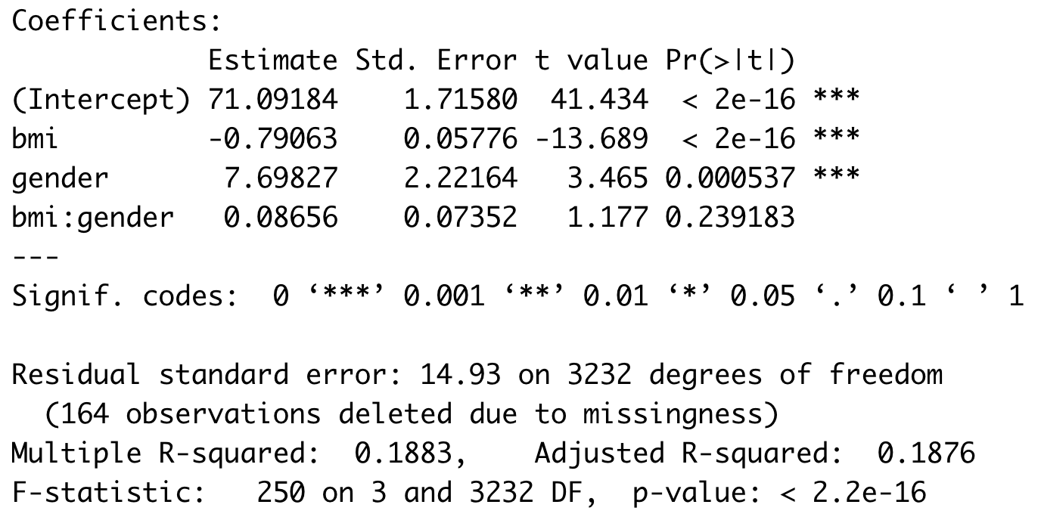
Assess interaction in a linear regression model
E[HDL | BMI, Gender] = B₀ + B₁ x BMI + B₂ x Gender + B₃ x BMI x Gender
Main effect for BMI
B = -0.79
Main effect for gender
B = 7.69
Interaction effect
B = 0.086
If the interaction effect was significant, then you should report two B coefficients for BMI
Beta for BMI among male -> -0.79
Beta for BMI among female ->
(-0.79) + (0.08) = -0.71

Slide 31
When there is a significant interaction (p-value <0.1) in a model
E[HDL | BMI, Gender] = B₀ + B₁ x BMI + B₂ x Gender + B₃ x BMI x Gender
Among Men:
Gender | BMI | Intercept | BMI | Gender | BMI:Gender
Men (0) | K+1 | 1 | K+1 | 0 | K+1 x 0
Men (0) | K | 1 | K | 0 | K x 0
 | Diff. | 0 | 1 | 0 | 0
Beta (effect) for one additional BMI among men -> (B₁ x 1) = -0.79
Among Women:
Gender | BMI | Intercept | BMI | Gender | BMI:Gender
Women (1) | K+1 | 1 | K+1 | 1 | K+1
Women (1) | K | 1 | K | 1 | K
 | Diff. | 0 | 1 | 0 | 1
Beta (effect) for one additional BMI among women -> (B₁ x 1) + (B₃ x 1) = (-0.79) + (0.08) = -0.71

Slide 32
Conclusion
Correlation analysis only tells us whether there is a linear relationship between two variables
But it does not tell us about the strength of the association
Linear regression is to assess a linear relationship between
Dependent variable: Continuous (weight, blood pressure, HDL)
Independent variables: Continuous and/or categorical
Linear regression is an important tool for statistical analysis that can be used for
Relationship description
Adjustment for potential confounding effects, and account for interaction (i.e., effect modifications)
Prediction

Slide 33
Lab 9: Demonstrate your facility with applying correlation and linear regression analysis, calculate the appropriate coefficients, and evaluate the assumptions

Slide 34
Assignment 9: Demonstrate understanding of correlation and linear regression analysis, interpret results from papers that used them

Slide 35
Suggested Readings
Marcello Pagano, Kimberlee Gauvreau. (2018) Principles of Biostatistics, Chapters 17, 18

