Slide 2
Program Title
Epi 245 Final Presentation
Spring 2014
<name>
<date>

Slide 3
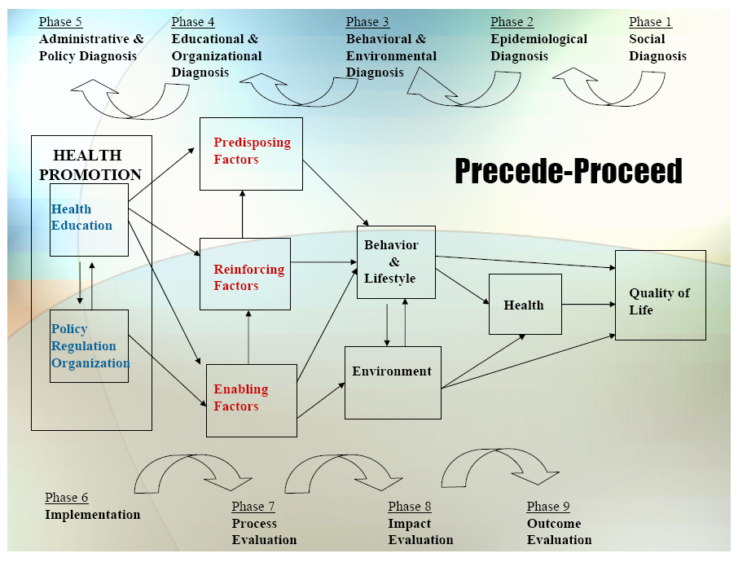

Slide 4
1. Social Diagnosis
Health outcome
  Identify community
  Describe community engagement activities
    See Community Engagement session
  Justify selection of this health outcome as a priority
    See Building the Case for Translation session

Slide 5
2. Epidemiological Diagnosis
“I propose to improve <health outcome> through a program that improve <process/care gap>”
Define and describe the major process/care gaps that influence your health outcome
  Which process/care gaps have greatest impact on health outcome? See Building the Case for Translation session
  Describe your process for prioritizing which process/care gap you will focus on in your intervention program
    Changeability; effect size; access to at-risk populations; guidelines/national recognition as a priority area
Conclude with a single process/care gap that you is the priority for your intervention

Slide 6
3. Behavioral and Environmental Diagnosis
What individual behaviors contribute to target process/care gap?
  See Individual Behavior Change Strategies session
    Especially “Theory at a Glance” reading.
What organizational/environmental factors influence process/care gap?
  See Organizational Culture and Behavior session

Slide 7
3. Behavioral Decision Matrix
 | More Important | Less Important
More Changeable | High Priority for Program Focus | Low Priority Except to Demonstrate Change for Political Purposes
Less Changeable | Priority for Innovative Program; Evaluation Crucial | No Program
**Place behavioral, organizational and environmental constructs into matrix above.

Slide 8
4. Educational and Organizational Diagnosis
Predisposing Factors contributing to behavior change target(s)…
Enabling Factors…
Reinforcing Factors…
**see PER Worksheet from Implementation Frameworks Session

Slide 9
Phase 4: PER Factor Decision Matrix
 | More Important | Less Important
More Changeable | High Priority for Program Focus | Low Priority Except to Demonstrate Change for Political Purposes
Less Changeable | Priority for Innovative Program; Evaluation Crucial | No Program
**Place major predisposing, enabling and reinforcing factors into matrix above.

Slide 10
5. Administrative and Policy Diagnosis
Resources
Admin/Organizational Concerns addressed
  See Organizational Culture session
  Structure, Culture, Governance, Environment

Slide 11
6. Implementation
Inputs/Activities (see Implementation Frameworks session)
  Predisposing
  Enabling
  Reinforcing
Timetable
PDSA Plan (see Implementation Frameworks session)

Slide 12
Process Evaluation
Defining treatment/intervention fidelity?
  See Program Evaluation session
What intermediate outcomes will you measure to ensure your intervention activities are having their intended effects?

Slide 13
Outcome/Impact Evaluation
Unit of Allocation (who gets intervention)
Unit of Analysis
Study Design
Effect Size Detection Desired
Sample Size

