Slide 1
The CRANIUM Study
Epi 245 Final Presentation
Spring 2014
Christina Mangurian, MD
Assistant Professor of Clinical Psychiatry
May 29, 2014

Slide 2
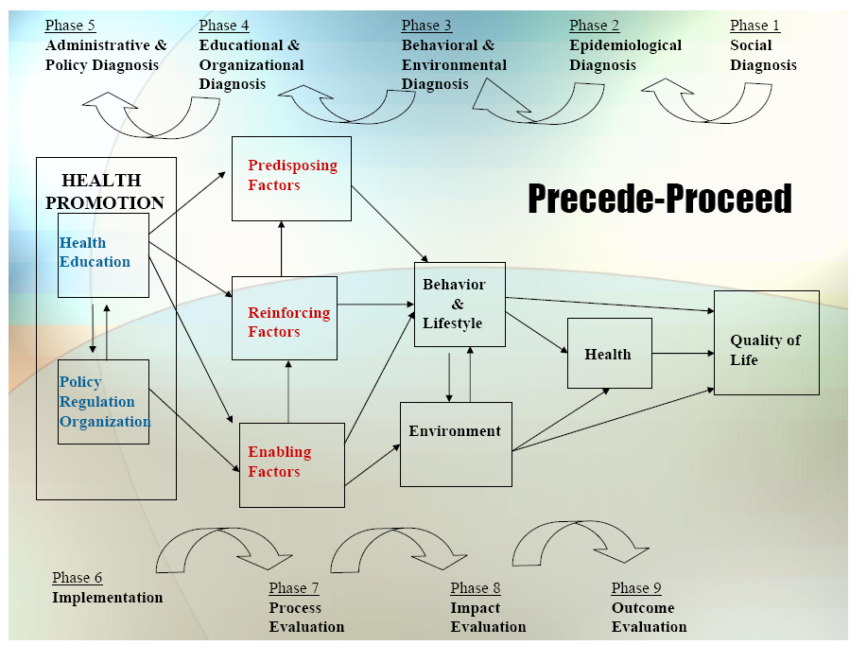


Slide 3
1. Social Diagnosis
Diabetes management
  People with severe mental illness served in community mental health clinics.
  Gap
    Diabetes treatment rates are low--even if diagnosed, people with comorbid SMI are unlikely to be treated (~40% untreated)
  Community Engagement Activities
    Stakeholder Workgroup (psychiatrists, PCPs, patients, administrators)
    Community Advisory Board (patients, caregivers, psychiatrists, PCPs, clinical diabetes educators, SF DPH administrators, payors)

Slide 4
2. Epidemiological Diagnosis
I propose improving diabetes management through a program that expands the scope of practice of community psychiatrists.
The major care gap influencing diabetes management is:
  Diabetes screening rates are still only about 30%--even 10 years after publication of ADA/APA guidelines!
  Prioritize diabetes screening linked to preliminary treatment in community mental health clinics
    Target: Increasing DM screening by an additional 30%
    Population: SMI in CMHCs
    Guideline-concordant.
The number of psychiatrists prescribing metformin to people with co-morbid DM and SMI is a priority.

Slide 5
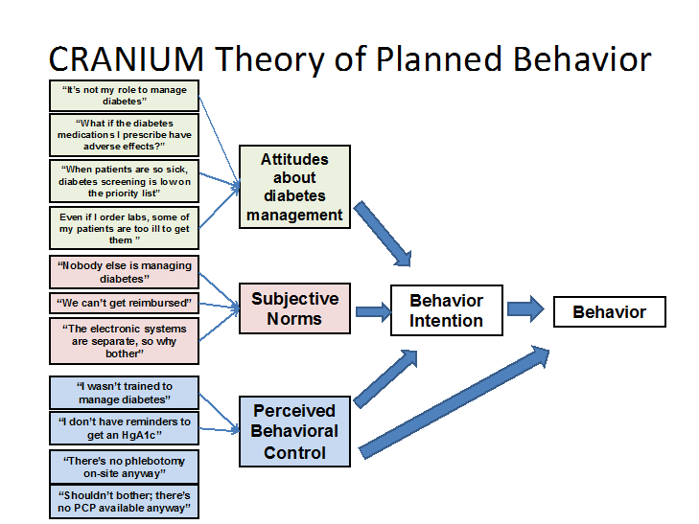
3. Behavioral & Environmental Diagnosis
What individual behaviors contribute to target process/care gap?

Slide 6
3. Behavioral and Environmental Diagnosis
Several organizational and environmental factors influence the care gap
  Lack of training
  Confusion re: scope of practice
  Reimbursement issues

Slide 7
3. Behavioral Decision Matrix
 | More Important | Less Important
More Changeable | Lack of training | Confusion re: scope of practice
Less Changeable | Reimbursement issues

Slide 8
4. Educational and Organizational Diagnosis
Predisposing Factors contributing to behavior change target(s) include:
  Psychiatrists don’t know how to prescribe metformin
  Psychiatrists are worried metformin will cause side effects
  Psychiatrists do want to help their patients be healthy
Enabling Factors:
  CRANIUM will provide education, PCP e-consultant, and a registry to enable change
Reinforcing Factor
  CRANIUM will provide a lottery for an iPad if an MD prescribes metformin for newly dx DM; performance monitoring; and reminders to screen (posters) to help reinforce changes.

Slide 9
Phase 4: PER Factor Decision Matrix
 | More Important | Less Important
More Changeable | Education Registry | Reminders (posters) Performance Monitoring
Less Changeable | PCP eConsult | N/A

Slide 10
5. Administrative and Policy Diagnosis
Resources
  Pre-existing relationship with CBHS (CL and PPF)
  Behavioral Health Home Medical Director
  Engaged physicians at Citywide Focus
Administrative and Organizational Concerns addressed
  CBHS/DPH priorities will be incorporated
  Scope of Practice will be addressed
  Metformin on formulary
  Reimbursement—Medi-Cal.

Slide 11
6. Implementation
Inputs/Activities
  Predisposing: Education and PCP eConsult so that they know how to prescribe metformin
  Enabling: Education and eConsult so that they are able to prescribe. Metformin on formulary so they have access to the medication. Registry to help eliminate a barrier.
  Reinforcing: Reminders to screen; lottery for iPad; performance monitoring
Timetable:
  Pilot in September 2014.
PDSA Plan
  Will be over 1 year (not 6mo) period, and will include patient and physician surveys.

Slide 12
Process Evaluation
Process measures
  Proportion of patients with documentation of annual metabolic screening visit by their psychiatrist (AVATAR)
  Proportion of psychiatrists who watched the on-line CRANIUM metformin education videos.
  Satisfaction with metabolic screening visit and eConsult (psychiatrist survey)
  Satisfaction with and acceptability of metabolic screening visit (consumers)
Intermediate Outcomes
  Proportion of psychiatrists who know the indications and side effects of metformin (on-line survey)
  Proportion of psychiatrists who visited the CRANIUM website (which has the metformin algorithm)

Slide 13
Outcome Evaluation
Unit of Allocation: Clinic
Unit of Analysis: Client-level (DM screening)
Study Design: Cluster Randomized Trial
Effect Size Detection Desired: 0.2
Sample Size: 7,800

