Slide 1
A Surgeon’s Toolbox for Geriatric Patients
Epi 245 Final Presentation
Spring 2014
Jessica Cohan
May 29, 2014

Slide 2
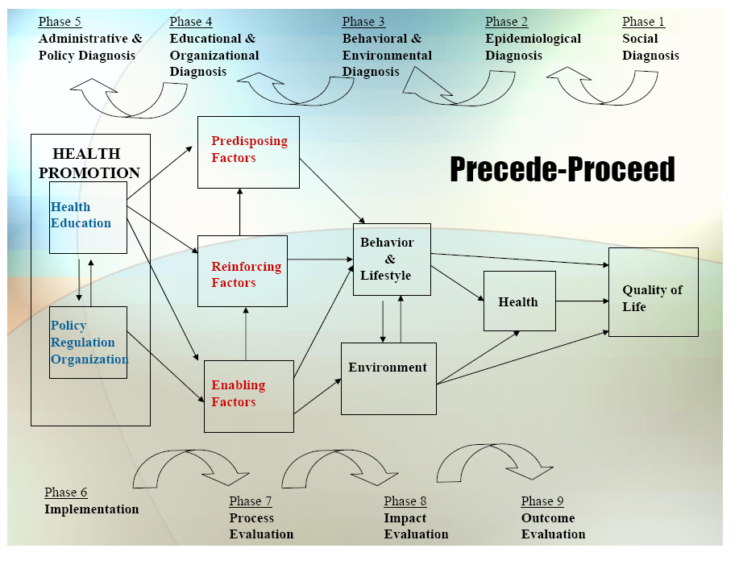

Slide 3
1. Social Diagnosis
Facilitating shared decision making
  Target: Patients 65 years and older who are considering surgery.
  Gap: Patients do not have a meaningful understanding of surgical risks
    Shared decision making reduces variation, ensures patient-centered decision making
  Community Engagement
    Patients/Family/Caregivers: How to have this discussion?
    Surgeons: How to incorporate into clinic flow

Slide 4
2. Epidemiological Diagnosis
I propose to improve patient-centered care through a program to improve shared decision making
The decision to have surgery should incorporate best evidence and patient preference.
  Focus on elderly, high risk patients
  1/3 of elderly patients undergo surgery during the last year of life
  Avoid risk of “wrong patient” surgery
Improve patient satisfaction
  A administratively important surrogate measure for improving the decision making process.

Slide 5
3. Behavioral and Environmental Diagnosis
Barriers to Behavioral Change:
  Lack of knowledge
    Risk calculators, discussion tools
  Perceived lack of control
    Time, patient engagement
Organizational/Environment Barriers
  No cultural or financial recognition

Slide 6
3. Behavioral Decision Matrix
 | More Important | Less Important
More Changeable | Surgeon knowledge | Perceived lack of control
Less Changeable | Surgeon adapting preoperative discussion Financial/Institutional incentives

Slide 7
4. Educational and Organizational Diagnosis
Predisposing Factors
  Know what tools are available
  Believe shared decision making is important
  Intend to improve accuracy of patient expectations
  Accept if surgery is not consistent with the patient’s preferences
Enabling Factors
  Skill: Have meaningful discussions involving uncertainty
  Access: online risk calculators
  Utilize: “best case, worst case” framework
Reinforcing Factors
  Links embedded in EMR
  Use of a “best practice advisory”
  Feedback information regarding use of the toolbox

Slide 8
Phase 4: PER Factor Decision Matrix
 | More Important | Less Important
More Changeable | Know about and use available tools | Links embedded in EMR
Less Changeable | Have meaningful discussions of risks and expected outcomes Accept if surgery inappropriate for a patient based on his/her preferences | Believe SDM is important

Slide 9
5. Administrative and Policy Diagnosis
Resources
  Calculators are validated and familiar to surgeons
  EMR “Surgeon Champion” engaged
  Part of a larger geriatric surgery initiative with institutional backing
Admin/Organizational Concerns addressed
  Will work within the bounds of the EMR

Slide 10
6. Implementation
Inputs/Activities
  Predisposing Factors
    Educate Surgeons: Know what tools are available
  Enabling Factors
    Access: online risk calculators and discussion framework tool
  Reinforcing Factors
    Links embedded in EMR
    Feedback information regarding use of the toolbox
Timetable
  Implement Aug 1
PDSA Plan
  Feedback data on toolbox use monthly
  Begin collection of patient and physician satisfaction surveys immediately, plan to analyze Q3 months

Slide 11
Process Evaluation
Process
  Surgeon use of toolbox (qualitative/quantitative)
Intermediate Outcomes:
  Patient satisfaction (CG-CAHPS)
  Surgeon satisfaction (survey)

Slide 12
Outcome/Impact Evaluation
Unit of Allocation: Institution
Unit of Analysis: Patient (nested)
Study Design: Before/After
Effect Size Detection Desired: 1-point increase on communication questions in CG-CAHPS.
  “How often did this provider explain things in a way that was easy to understand?”
  “How often did this provider listen carefully to you?”
Sample Size: TBD based on each individual clinic’s baseline performance and variation. For example:
  Example: baseline clinic score is 3 and goal is to increase by 1 point
  Power 80% and p=.05
  Standard deviation = 1.5
  Need total 37 measurements pre- and 37 measurements post-

