Slide 1
Reproductive Healthcare for Adolescents with Rheumatic Conditions taking Teratogenic Medications
Nicole Ling, MD
Pediatric Rheumatology Fellow
May 29, 2014
Epi 245 Final Presentation

Slide 2
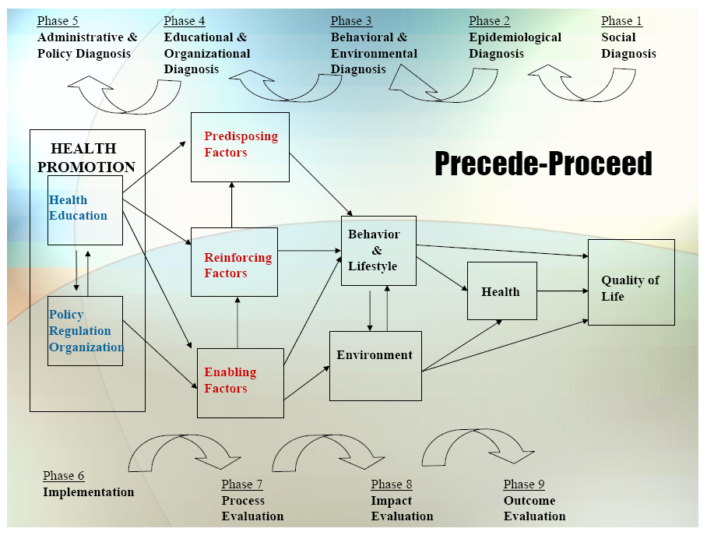

Slide 3
1. Social Diagnosis
Provision of Reproductive Healthcare
  For Adolescent young women w/ rheumatic diseases taking teratogenic medications
  Community Engagement
    Stakeholders: pediatric rheumatologists, primary care providers, patients and their families
    Activities: Data validation with study participants (member checking) and community advisor board with stakeholders to prioritize areas for intervention.
  Gap
    Provision of counseling and prescription of contraception has been shown to be lacking in adult patients on teratogenic medications.

Slide 4
2. Epidemiological Diagnosis
I propose to improve provision of reproductive healthcare for our patients after identifying barriers to providing this care with qualitative interviews.
Lack of reproductive healthcare
  Contraception is prescribed at rates for women on teratogenic medications compared to those that are not ~17%
  Counseling is also a gap in provision of care
  Will attempt to identify barriers and facilitators to care to identify specific targets for future intervention.
Process gap for your intervention will be prioritized after qualitative work is done

Slide 5
3. Behavioral and Environmental Diagnosis
What individual behaviors contribute to target process/care gap?
  Theory of planned behavior and social cognitive theory, including behavioral intention, attitude, subjective norm, perceived behavioral control, behavioral capability, expectations, self–efficacy, observational learning and reinforcements.
  Lack of training/knowledge, comfort, time/reimbursement
What organizational/environmental factors influence process/care gap?
  Hospital policy, institutional culture, neighborhoods and communities, living conditions, social relationships, individual risk factors.

Slide 6
3. Behavioral Decision Matrix
 | More Important | Less Important
More Changeable | Provider knowledge Resources available for easy referral for care | Definition of concrete roles for subspecialty and primary care providers
Less Changeable | Lack of time and reimbursement | No Program
Final decision matrix to be performed after qualitative work is done.

Slide 7
4. Educational & Organizational Diagnosis
PREDISPOSING | ENABLING | REINFORCING
KNOW | BE ABLE TO DO (skills) | REMINDED
Which medications are teratogenic? | Discuss sexual health and family planning with adolescents in a confidential manner. | Alert in EHR for teratogenic medications
Based on the individual and their diagnosis, what are the options, side effects and monitoring available for contraception? | Identify and prescribe appropriate methods of pregnancy prevention. | Alert in EHR when teratogenic med is on active med list and contraception is not listed
BELIEVE/VALUE | ACCESS TO | POSITIVE REINFORCEMENT
Pregnant pt with rheumatic disease have poor outcomes. Additionally, outcomes are even worse when they are taking teratogenic medications. | Resources to other providers for family planning and contraception (ie. implenon, IUD’s etc) | Dashboard display in EHR when issue is documented to be addressed (like meaningful use checklist)
I CAN work within this medical system to provide and AM responsible for providing reproductive, confidential care to my patients. | Parents (some) and involved primary care providers | Appreciative teens/patients
INTENTION | ACCESS REMOVED | NEGATIVE REINFORCEMENT
To counsel all patients on teratogenic medications | Time constraints in clinic visits | Dashboard display in EHR (if suboptimal documentation/performance) when compared to peers
To offer long term contraceptive options for teens that are or may become sexually active | Lack of reimbursement for extra effort/time | Pregnant teens/patients
To prevent unintended pregnancy in the population | Parents (some) | SOCIAL SUPPORT
 | Difficulty when trying to reach other medical care providers for the patient | Other providers in division/ancillary health staff.
Notes:
Diagnoses to be determined, but examples include

Slide 8
Phase 4: PER Factor Decision Matrix
 | More Important | Less Important
More Changeable | Resources to other providers for family planning and contraception (ie. implenon, IUD’s etc) | Dashboard display in EHR when issue is documented to be addressed (like meaningful use checklist)
Less Changeable | Difficulty when trying to reach other medical care providers for the patient | No Program
Will rely on community advisory board to help make these decisions.

Slide 9
5. Administrative and Policy Diagnosis
Resources
  Lupus Liason
  Society for Family Planning grant (projected)
Admin/Organizational Concerns addressed
  Sufficient revenue generation to be sustainable
  Physical space for encounters to occur obtained
  Reimbursement for services under CCS (California Children’s Services) umbrella

Slide 10
6. Implementation
Inputs/Activities
  Predisposing – ensuring adequate knowledge for providers responsible for provision of reproductive health care
  Enabling – sufficient time constraints of clinic visit removed, reimbursement sustainable
  Reinforcing – Social support for clinicians
Timetable: Winter 2015
PDSA Plan – Pilot over short period of time, frequent assessment (quarterly)
Notes:
NP in clinic to provide care

Slide 11
Process Evaluation
Process Indicators:
  All appropriate pts identified?
  All appropriate pts participated?
Outcome indicators:
  All patients counselled re: medications?
  Was contraceptive counseling performed?
  Upregs sent?
  Patients more aware ?
  Improved prescription rates of contraception?
Intermediate Outcome measures:
  Clinic accepted by parents, patients and physicians?

Slide 12
Outcome/Impact Evaluation
Unit of Allocation: patients in lupus clinic
Unit of Analysis: patients
Study Design: interrupted time series
Effect Size Detection Desired: 20% increase in patient knowledge/satisfaction scores
Sample Size:
  ratio of required sample sizes is 1.32 times calculated for non-correlated, analyses

