Slide 1
Education Tool to engage hard to reach populations in
HIV Vaccine Research
Epi 245 Final Presentation
Spring 2014
Jessica Cruz Whitley
May 29, 2014

Slide 2
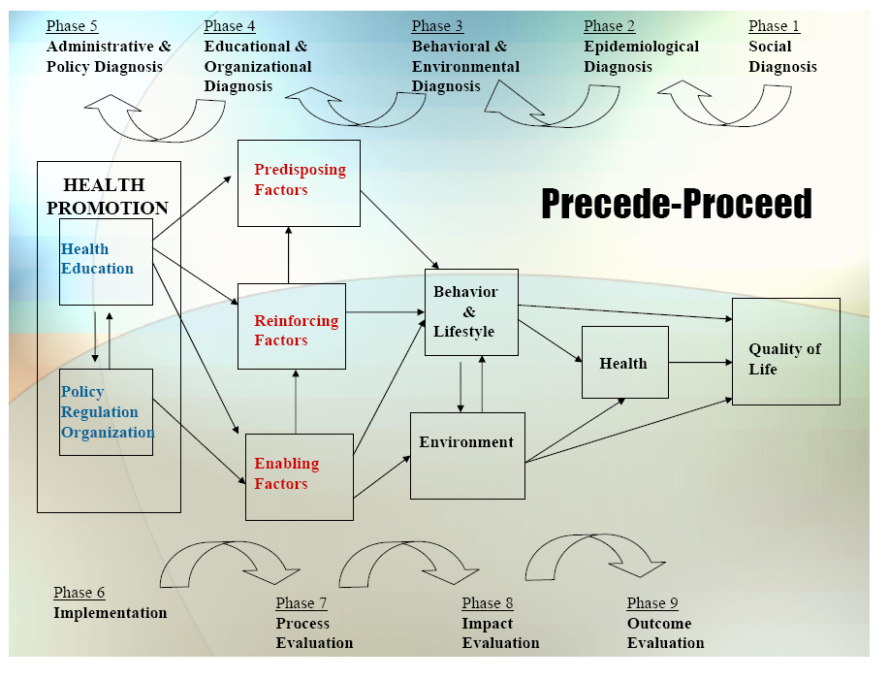

Slide 3
1. Social Diagnosis
Health outcome
  Community
    High risk population for HIV
    Bridge HIV social media subscribers
    Community Advisory Board
    Youreka Science
  Engagement
    Video script development
    Focus groups
    Online survey
  Lots of misconceptions regarding HIV vaccines. Best to provide clear broken down information.

Slide 4
2. Epidemiological Diagnosis
I propose to increase the recruitment of high-risk populations in vaccine research through an intervention that improves delivery of educational information.
Process gap:
  Misconceptions regarding HIV vaccines and lack of information communication about research.
The priority for this project is to create an easily accessible educational video that can be spread widely.
Notes:
HIV vaccine research studies have noted that recruitment should first focus on building awareness of HIV vaccine research through effective information dissemination along with facilitation of learning opportunities in order to foster support for HIV vaccines among minority populations.
Misconceptions regarding HIV vaccines are common and differ by race/ethnicity with minority participants reporting concerns about safety of the vaccine and mistrust of the government and government-sponsored HIV/AIDS research.^{1,7} One of the most commonly reported reasons for not participating in clinical research by minorities has been lack of information communication about the research.⁸
In the U.S., substantial racial/ethnic and sexual risk behavior disparities exist in HIV infections. HIV disproportionately affects Latinos, Blacks, and transgender people. The epidemic is particularly intense among young Black MSM who has a rapidly increasing incidence of HIV.⁹⁻¹⁰ Latinos and Blacks have been disproportionally underrepresented in HIV vaccine clinical trials. In the phase IIb STEP Study, 37% of eligible minorities were interested in participating after pre-screening, but only 25% were enrolled, highlighting the need to sustain participation among eligible minorities.¹¹ Most recently, the HVTN conducted a phase IIb efficacy trial of a vaccine regimen in at-risk populations in the U.S. with the study population comprised of only 16% Blacks and 8% Latinos.¹²

Slide 5
3. Behavioral and Environmental Diagnosis
Lack of knowledge of HIV and/or HIV vaccine research, fear of HIV, fear of research in general
Family dynamics, confidentiality concerns, prior misconceptions
Work or school obligations, lack of access to greater health prevention services

Slide 6
3. Behavioral Decision Matrix
 | More Important | Less Important
More Changeable | Lack of information about HIV vaccine research | Confidentiality concern, prior misconceptions
Less Changeable | Work or school obligations | Policy/organizational factors that influence access to preventative services

Slide 7
4. Educational and Organizational Diagnosis
Predisposing Factors
  What is HIV vaccine research and what has been done
  Address the need for more diversity
  Address issues of mistrust in research
  Benefits/risks of HIV vaccine research
Enabling Factors
  Describing the enrollment process
  Provide a phone number to contact if interested
Reinforcing Factors
  Provide quotes from actual participant advocates
  Provide data about what previous data looks like and the need for diverse groups of participants

Slide 8
Phase 4: PER Factor Decision Matrix
 | More Important | Less Important
More Changeable | Predisposing factors such as knowledge | Enabling factors
Less Changeable | Predisposing factors such as addressing mistrust of research in general | Reinforcing factors such as follow-up and reminding.
*

Slide 9
5. Administrative and Policy Diagnosis
Resources
  Gay and Lesbian community organizations
  Youtube, Twitter, facebook, other social media
Admin/Organizational Concerns
  Wide distribution of video
  Incorporation into gay and lesbian organizations

Slide 10
6. Implementation
Inputs/Activities
  Predisposing: Development of educational video addressing what is clinical research and what is vaccine research and specifically what is HIV vaccine research.
Timetable
  Month 1: Work with CAG to create script for videos, develop focus group guides, online survey questions, and create video.
  Month 2: Evaluate the video via focus groups and online survey questions.
  Month 3: Revise video script and re-create video.
  Month 4: Post video to youtube and other social media sites, send to Bridge social media subscribers

Slide 11
Process Evaluation
Treatment/intervention fidelity
  Overall outcome would be increased enrollment by high risk population in HIV vaccine research. Could be tracked by asking interview question on enrollment of a trial if educational video was the source of their interest in vaccine research.
Intermediate process
  At the end of the video, there will be a phone number that viewers can contact if they want to learn more about HIV vaccine research. We can possibly track how many people call that number and cite the video as their source.

Slide 12
Outcome/Impact Evaluation
Tough to assess this for my project.
This is a mass-education project with no set tailored population for the intervention to conduct a study.

