Slide 1
Operating Wisely:
Reducing OR turnover times and improving satisfaction
Epi 245 final presentation
May 29, 2014
Lindsay Hampson, IHPS Fellow/Urology Resident

Slide 2
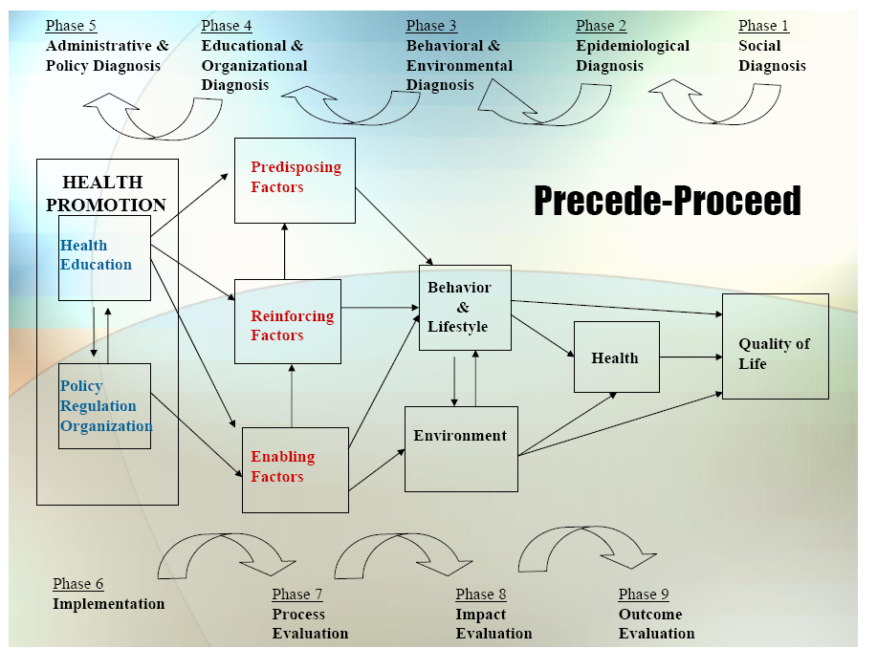

Slide 3
1. Social Diagnosis
The Problem: prolonged and unpredictable OR turnover times
Results in case delays, which translates into:
  Longer patient wait times on the day-of surgery
  Increased wait times for add-on cases
  Longer OR days
  Increased staffing needs
  Increased costs
Call to action
  Need joint anesthesia & surgeon leadership and buy-in for success
  Need to involve all stakeholders in the process for identifying areas of improvement and determining what changes can be successfully implemented

Slide 4
2. Epidemiological Diagnosis
Goal: decrease costs and improve care through systems-based changes designed to streamline OR turnover and ultimately decrease and standardize OR turnover times
Other hospitals have designed similar interventions, showing significant reductions in turnover times
Potential Impact:
  Increase % of on-time case starts
  Decrease wait-times for add-on cases
  Increase patient/provider satisfaction
  Increase number of cases per month
  Decrease use of non-block time
  Decrease need for overtime staff
  Decrease surgery scheduling wait times
  Cost savings due to cases being scheduled within block time with scheduled staffing

Slide 5
2. Epidemiological Diagnosis
Current Urology turnover times
  Parnassus: 65 minutes, Mount Zion: 36 minutes
  Goal turnover time: 30 minutes, 15 minutes
  Scheduled turnovers per day: Parnassus: 20 per day, MZ: 8 per day
Potential Estimated Cost Savings for the Urology Service:
SITE (current mean) | EST. COST SAVINGS OF 30 MINUTE TURNOVER TIME |  |  | EST. COST SAVINGS OF 15 MINUTE TURNOVER TIME
 | One case | Weekly | Yearly | One case | Weekly | Yearly
Parnassus (65 minutes) | $2,415 | $241,500 | $12,558,000 | $3,450 | $345,000 | $17,940,000
Mount Zion (36 minutes) | $414 | $16,560 | $861,120 | $1,449 | $57,960 | $3,013,920
* Estimated Cost Savings Based on OR time cost of $69/minute

Slide 6
3. Behavioral & Environmental Diagnosis
What individual behaviors contribute to target process/care gap? → identify stakeholders
Group | Individual Contributors
Surgery | Attending surgeon, resident surgeon
Anesthesia | Attending anesthesiologist, resident/CRNA, anesthesia tech
Nursing | Periop team: preop nurse, PACU nurse
 | OR team: circulating nurse, surgery scrub tech
Housekeeping | Housekeeping staff
Radiology | Radiology tech
Patient | Patients, family members
Scheduling | Surgery schedulers
Hospital administration | Finance, medical center administration

Slide 7
3. Behavioral & Environmental Diagnosis
What individual behaviors contribute to target process/care gap?
  Reciprocal Determination: using data to identify problem-areas
    Identify areas of potential behavior change
  Goal Setting: set turnover time goals
    Setting achievable goals that can result in impactful changes
  Self-Efficacy & Behavioral Capacity: ability to enact change
    Perceived ability to decrease times
  Reinforcement: provide feedback
    Feedback with OR times and showing ability for behavior change

Slide 8
3. Behavioral & Environmental Diagnosis
What organizational/environmental factors influence process/care gap?
  Clinical Quality Performance: unanticipated harms
    Track perioperative complications and other services’ OR times to ensure interventions don’t lead to increased complications or negatively impact other ORs
  Patient Satisfaction: less “choice” in scheduling
    Educate schedulers about how to address patient concerns
    Track patient satisfaction scores
  Organizational Learning: resistance to change
    Educate/invest OR staff in involvement in a common goal
    Develop incentives/rewards for improvement
  Financial Performance: resistance to improved productivity
    Develop rewards/incentives to motivate increased productivity

Slide 9
3. Behavioral Decision Matrix
 | More Important | Less Important
More Changeable | Goal setting Reinforcing | Unanticipated harms Incentives
Less Changeable | Self-efficacy Resistance to change

Slide 10
4. Educational/Organizational Diagnosis
PER WORKSHEET
PREDISPOSING | ENABLING | REINFORCING
KNOW | BE ABLE TO DO | REMINDED
Turnover time & goals | Be part of a team | Weekly posting of TT
Current beliefs of OR staff | Be open to change | Monthly report to chair
BELIEVE/VALUE | ACCESS TO | POSITIVE REINFORCEMENT
Benefit/value of reducing TT | Ways to reduce turnover times | Reward for meeting goals
Barriers to reducing TT | Real-time data | Improved efficiency
INTENTION | ACCESS REMOVED | NEGATIVE REINFORCEMENT
Increase efficiency | Combine job responsibilities | Increased workload
Improve on-time surgery |  | Increased focus/attention
OTHER |  | SOCIAL SUPPORT
Monitor complication rate |  | Stakeholder committee
Monitor non-urology TT

Slide 11
Phase 4: PER Factor Decision Matrix
 | More Important | Less Important
More Change-able | Assess current staff beliefs Evaluate current problems Determine goals Provide real-time feedback Create reward/incentive Stakeholder committee | Monitor complication rate Monitor non-urology TT
Less Change-able | Increase staff efficiency Belief in benefit of reducing TT Openness to change Team mentality

Slide 12
5. Administrative and Policy Diagnosis
Buy-in
  Administration/Organizational: CaringWisely, cost-savings
  Urology: Peter Carroll (chair), Max Meng (quality improvement)
  Anesthesia: Michael Gropper (chair), Errol Lobo (clin. operations)
  Nursing: Wayne Little (periop), Lauren Aichele (urology OR)
Scope
  Start small: study and intervene in urology ORs only
  If successful, expand to other services/entire OR
  Develop a framework to implement at Mission Bay

Slide 13
6. Implementation
Phase 1: Evaluation (Months 1-3)
  Evaluate current turnover times and identify delays
  Evaluate staff to determine their self-efficacy, buy-in
  Form stakeholder committee to review data and determine goals and specific intervention
Phase 2: Systems-Based Change Implementation
  Implement changes identified in phase 1
  Months 3-9
Phase 3: Incentives
  Determine and institute incentives
  Months 6-9

Slide 14
Possible Interventions
Update surgeon preference cards
Change case scheduling methodology
Informed consent in clinic
Set up OR equipment during induction
Allow housekeeping to clean after dressing placed
Nursing patient evaluation by preop nurse only
Anesthesia evaluation of next patient during case
Case carts brought to sub-sterile room before cleanup

Slide 15
Process Evaluation
Stakeholder group will continue to meet regularly throughout the process to review data/concerns
Real-time feedback will be provided
  Weekly to OR staff/surgeons/anesthesia
  Monthly to department chairs
Monitor
  Complication rates, turnover times of non-urology ORs, patient/staff satisfaction
Intermediate outcomes
  % of consents obtained in clinic, % of preference cards updated, etc.

Slide 16
Outcome/Impact Evaluation
Site: Each site (Parnassus, Mount Zion) urology pod
Unit of Analysis: change in mean OR turnover time (weekly, monthly)
  Can look at subgroups by staff, by OR, by day of the week, etc.
Study Design: randomized controlled trial
  Intervention: Urology ORs
  Control: other ORs
Site/Goal TT | Effect Size | 50% Int. | 50% Control | Total SS | 30% Int. | 70% Control | Total SS
Parnassus: 30 | 55% | 52 | 52 | 104 | 37 | 86 | 123
Parnassus: 15 | 75% | 28 | 28 | 56 | 20 | 47 | 67
Mt Zion: 30 | 17% | 543 | 543 | 1086 | 388 | 905 | 1293
Mt Zion: 15 | 58% | 47 | 47 | 94 | 33 | 78 | 111

