Slide 1
Preventing Suicide & Depression in Older Adults: Utilizing the PCP workforce
Grace C. Niu
May 29, 2014

Slide 2
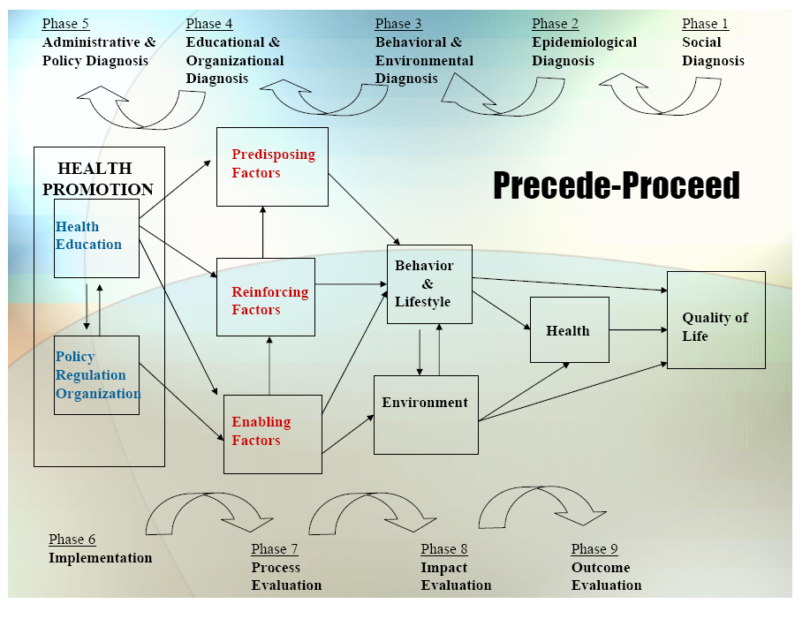

Slide 3
1. Social Diagnosis
Depression care for adults over 60 yrs.
  Target: PCPs including physicians, nurse practitioners, and physician’s assistants
  Gap
    Age biases in detecting and treating depression and suicidal ideation (80 for YAs vs. 60% for OAs)
  Community engagement activities
    Provide education first to hospital administrators, directors, department heads; Community advisory board made up of hospital system administrators

Slide 4
2. Epidemiological Diagnosis
I propose to improve depression care for older adults through a program that educates PCPs on the importance of conducting depression screenings in OAs
Major process/care gaps that influence depression care
  Access to depression tx in primary care clinics—case for integrated behavioral health
  Assessment by non mental health providers
  Medicare billing issues related to time and assessment
Conducting routine brief depression screenings especially in adults over 60 yrs old

Slide 5
3. Behavioral and Environmental Diagnosis
Barriers to Behavioral Change:
  Lack of knowledge about efficacy of depression tx is a commonly cited reason for under-treatment
  Time Concerns: Too many patients to see and little time to ask questions about depression and suicide
  Not knowing how to talk about depression or suicidal ideation
Organizational/Environmental factors influence process/care gap?
  Unknown referral path/support from practice setting or hospital system

Slide 6
3. Behavioral Decision Matrix
 | More Important | Less Important
More Changeable | Knowledge about efficacy of depression tx Clarify referral process | Learning skills to talk about depression and suicide to OAs
Less Changeable | Time management concerns

Slide 7
4. Educational and Organizational Diagnosis
Predisposing Factors
  Know the current situation: Large % of OAs who commit suicide visit a PCP within weeks of suicide.
  Believe depression in OAs is treatable not normal aging
  Intend to improve overall care for older adults
Enabling Factors…
  Be able to ask targeted questions and make referrals
  Have access to behavioral health staff
Reinforcing Factors…
  Reminders to conduct routine screenings for OAs
  Use of screening reflects well on performance reviews
  Provide support by listening to concerns
**see PER Worksheet from Implementation Frameworks Session

Slide 8
Phase 4: PER Factor Decision Matrix
 | More Important | Less Important
More Changeable | Know that many OAs who commit suicide visit a PCP within weeks of suicide. Believe depression in OAs is not a normal part of aging | Performance reviews Tracking providers on screening use
Less Changeable | Automatic reminders to conduct screenings Strengthening referral path | No Program

Slide 9
5. Administrative and Policy Diagnosis
Resources
  Pre-existing relationship with Kaiser director of behavioral Health
  Part of larger “Zero Suicide” initiative
  Engaged Kaiser’s Chief Medical Officer and UCSF Family Medicine Director
Admin/Organizational Concerns
  Hospital Systems concern of brand tarnishing
  Incorporating hospital system wide initiatives
  Forming a mission statement with board of advisors

Slide 10
6. Implementation
Inputs/Activities
  Predisposing: Education around facts of depression in OAs so they are aware of their roles in and know depression can be treated
  Enabling: electronic screening tool in system so that they are able to conduct depression screenings on a routine basis for patient over the age of 60. Alert sent to referral parties through system charts to help eliminate a barrier.
  Reinforcing: Reminders to screen; performance reviews
Timetable:
  Pilot in August 2014.
PDSA Plan
  Carried out over a 1 year period, and will include patient and physician surveys for feedback purposes.

Slide 11
Process Evaluation
Defining treatment/intervention fidelity
  Record of who (directors, administrators, department heads) participates in conference calls
  Record which PCPs attended the training and specify whether learning objectives were met.
  Tracking of whether screenings are administered to patients over 60 via EMR (3x yearly)
  Documentation of follow-up treatment referrals/plans for those positive on depression
  Patient surveys of inquiring of whether they were screened and referred
Intermediate Outcomes
  Lower patient depression scores
  Increase in # of referrals or use of referral path

Slide 12
Outcome/Impact Evaluation
Unit of Allocation: Different clinics within larger hospital system
Unit of Analysis: Patient-Depression scores over time in patients over 60
Study Design: Interrupted Time Series
Effect Size Detection Desired: 0.10
Sample Size: 875 in each clinic

