Slide 1
Reducing Night Time Vitals
Epi 245 Final Presentation
Spring 2014
Victoria Tang
May 29, 2014

Slide 2
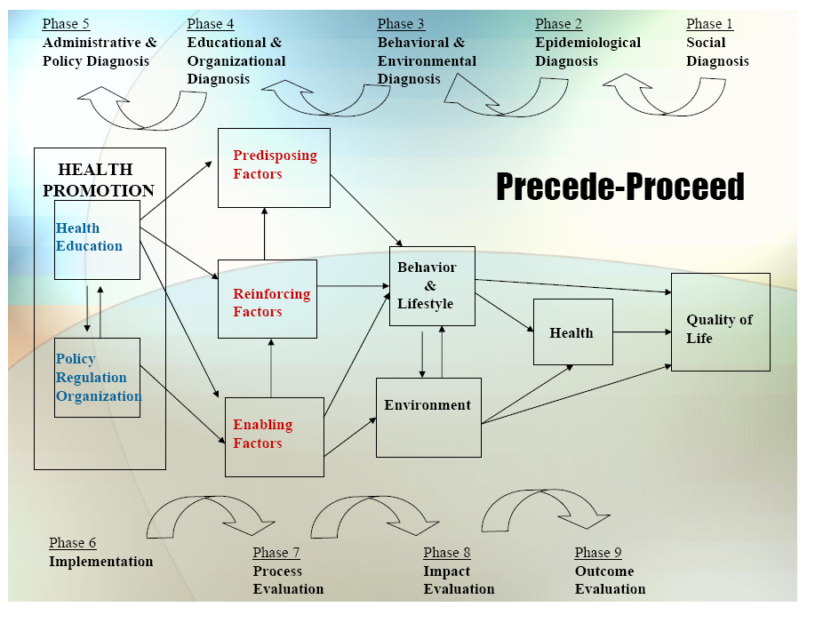

Slide 3
1. Social Diagnosis
Decreasing unnecessary night time vitals
  Target: Medically low risk patients awaiting placement
  Gap: Not all hospitalized patients benefit from night time vital sign monitoring
    Unnecessary resource utilization
    Disruption increases risk for delirium, causes patient dissatisfaction
  Community Engagement
    Hospitalists and Staff: How to change behavior and what are the barriers

Slide 4
2. Epidemiological Diagnosis
I propose to improve patient-centered care through a program that will decrease sleep disturbances while in the hospital
Process gap:
  The collection of night time vitals should be targeted
The priority of this project is to reduce night time vitals in medically low risk hospitalized patients

Slide 5
3. Behavioral and Environmental Diagnosis
Individual behaviors contributing to target process/care gap include:
  Lack of knowledge
  Lack of priority
  Fear
  Not in the routine
Organizational/environmental factors that influence process/care gap include:
  Lack of targeting mechanism to low risk population

Slide 6
3. Behavioral Decision Matrix
 | More Important | Less Important
More Changeable | Lack of knowledge, not a priority | Not in the routine
Less Changeable | Lack of targeting mechanism | No Program

Slide 7
4. Educational and Organizational Diagnosis
Target Behavior | Stop checking nighttime vitals in low-risk patients
Target Audience | Hospitalists, nursing aides
Other Key Individuals | Patients, nurses, administrators
PREDISPOSING | ENABLING | REINFORCING
KNOW | BE ABLE TO DO (skills) | REMINDED
Disruption of sleep increases risk of delirium in hospitalized patients. | Recognize medically low-risk patient does not need nighttime vitals | Signs on doors for the nursing aides and sign-out reminders to hospitalists
BELIEVE/VALUE | ACCESS TO | POSITIVE REINFORCEMENT
Nighttime vitals is “better and more” care; however, most nighttime vitals collected on low-risk patients require no change in care. | Use of some risk calculator such as Vitalpac™ Early Warning Score (ViEWS) | Assurance that patients will sleep better and may be more engaged in their care
INTENTION | ACCESS REMOVED | NEGATIVE REINFORCEMENT
Decrease disruption of nighttime sleep in hospitalized patients | Nighttime vitals in low-risk hospitalized patients. | patient dissatisfaction
OTHER |  | SOCIAL SUPPORT
 |  | Peer pressure from staff and patients
Predisposing Factors contributing to behavior change target(s)…
Enabling Factors…
Reinforcing Factors…
**see PER Worksheet from Implementation Frameworks Session

Slide 8
Phase 4: PER Factor Decision Matrix
 | More Important | Less Important
More Changeable | Predisposing factors such as knowledge, | Enabling factors such as use of risk tool
Less Changeable | Reinforcing factors such as door signs | Predisposing factor such as fear of providing “decreased care”

Slide 9
5. Administrative and Policy Diagnosis
Resources
  Hospitalist group support
  Patient advocacy
  Nursing staff
Admin/Organizational Concerns addressed
  Correctly ID’ing medically low-risk patients

Slide 10
6. Implementation
Inputs/Activities
  Predisposing: knowledge/education
  Enabling: risk tool
  Reinforcing: door signs/cprs reminder tool
Timetable: Winter 2014
PDSA Plan
  Frequent assessment of targeting, performance

Slide 11
Process Evaluation
Process Indicator:
  Proportion of providers who consider targeting their use of night time vitals
Outcome Indicators:
  % low risk patients with nighttime vitals
Intermediate Indicators:
  Use of the risk tool and order placement

Slide 12
Outcome/Impact Evaluation
Unit of Allocation: medically low-risk pt
Unit of Analysis: whether they had night time vitals
Study Design: interrupted time series
Effect Size Detection Desired: 20%
Sample Size: 124 with desired effect size

