Slide 1
The Kanyakla Study
Epi 245 Final Presentation
Spring 2014
Matt Hickey
29 May 2014

Slide 2
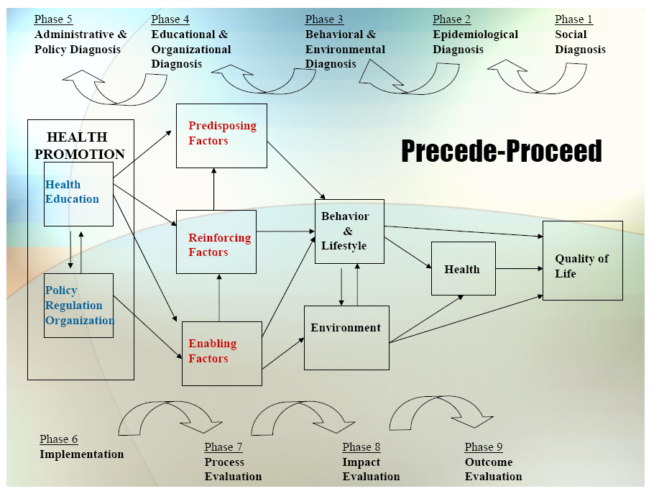

Slide 3
1. Social Diagnosis
Health outcome: HIV morbidity and mortality
Island communities, Lake Victoria, Kenya
Community engagement activities
  Pilot study, focus groups with participants
  Meetings with CHWs, clinicians, local government and MOH
Outcome gap
  Antiretroviral therapy (ART) adverted ~1 million deaths in 2012 alone
  Despite progress, there were still 1.5 million AIDS related deaths in 2012
    AIDS-related mortality strongly related to retention in care
Notes:
ART=antiretroviral therapy
Viral load often used as a surrogate for HIV morbidity and mortality
Community stakeholders: community members, patients, CHWs, clnicians, local government, MOH
Reference:
WHO (2013). Global Update on HIV Treatment 2013: Results, Impact and Opportunities. Geneva, Switzerland, World Health Organization.

Slide 4
2. Epidemiological Diagnosis
“I propose to improve HIV-related mortality through a social network program that improves engagement in HIV care”
Process gaps that influence your health outcome
  HIV-related mortality is strongly reduced by ART
  Effective ART requires consistent engagement in clinical care
  Engagement in care is a major priority area in HIV care, also a measurable process outcome
Goal: improve engagement in care, as measured by clinic appointment attendance
Notes:
Engagement = connectedness to clinic and to HIV treatment (i.e. attending appointments and taking medications)

Slide 5
3. Behavioral and Environmental Diagnosis
What individual behaviors contribute to target process/care gap?
  Competing livelihoods, poverty, stigma, denial
What organizational/environmental factors influence process/care gap?
  Clinical care delivery – availability and quality of services, clinician attituedes
  Poor infrastructure, community-wide stigma

Slide 6
3. Behavioral Decision Matrix
 | More Important | Less Important
More Changeable | HIV-related stigma Denial of HIV status Clinician attitudes
Less Changeable | Infrastructure Poverty Competing livelihoods Clinical service delivery (e.g. drug shortages)

Slide 7
4. Educational and Organizational Diagnosis
Predisposing Factors
  HIV-related knowledge, perceived importance of clinic visits
  Beliefs and values related to HIV and medical care
  Intention to attend clinic visits
Enabling Factors
  Self-care, medication-taking skills
  Access to social capital
Reinforcing Factors
  Reminders
  Positive peer pressure to remain healthy
  Social support provided by social networks

Slide 8
Phase 4: PER Factor Decision Matrix
 | More Important | Less Important
More Changeable | HIV-related knowledge Understanding of importance of clinic visits Positive peer pressure to influence intention Self care skills Expansion of existing social capital Group reminders for clinic appointments
Less Changeable | Values and beliefs related to HIV and medical care Access to social capital

Slide 9
5. Administrative and Policy Diagnosis
Resources
  Grant from Segal Family Foundation
  Community-based research department
  Community health worker network
Admin/Organizational Concerns addressed
  Building study team composed of investigators from various stakeholder groups
  Fostering relationships with other stakeholders and with our funder

Slide 10
6. Implementation
Inputs/Activities
  Predisposing
    Group education sessions focused on HIV-related knowledge and discussion of importance of clinic attendance
  Enabling
    Group HIV status disclosure provides stimulous for support in clinic attendance
  Reinforcing
    Group functions as reminder, positive peer pressure
Timetable
  Dec 1 2014
PDSA Plan
  Pilot study experience
Notes:
Intervention acts more directly on earlier phases, less directly as time goes on

Slide 11
Process Evaluation
Defining treatment/intervention fidelity?
  Acceptability, adoption, participation in group sessions, participation in group HIV status disclosure
What intermediate outcomes will you measure to ensure your intervention activities are having their intended effects?
  Initial outcomes
    HIV-related knowledge, social support
    Opportunity to attend clinic visits (barriers/facilitators)
  Intermediate outcomes
    Attendance of clinic visits
  Long-term outcome
    Virologic suppression

Slide 12
Outcome/Impact Evaluation
Unit of Allocation
  Individual patients + their social networks
Unit of Analysis
  Individual patients
Study Design
  Individual, parallel groups RCT
Effect Size Detection Desired
  50% reduction in 90-day gaps in care
    Baseline rate of 27% over 12 months -> reduced by 50%
Sample Size
  Alpha 0.05, Beta 0.8 = 142 patients/arm
  Estimated 360 total patients meet study criteria and will be willing to enroll
  Will enroll 180 or all eligible to allow for attrition and errors in calc
Notes:
Cluster RCT was considered, but sample size requirement was problematic.
Also considered first forming groups, then randomizing groups, but decided that this might ailenate participants in control group too much.

