Slide 1
A post-hospitalization follow up phone call intervention in the safety net
Epi 245 Final Presentation
Spring 2014
Brian Chan, MD MPH
Primary care research fellowship
May 29, 2014

Slide 2
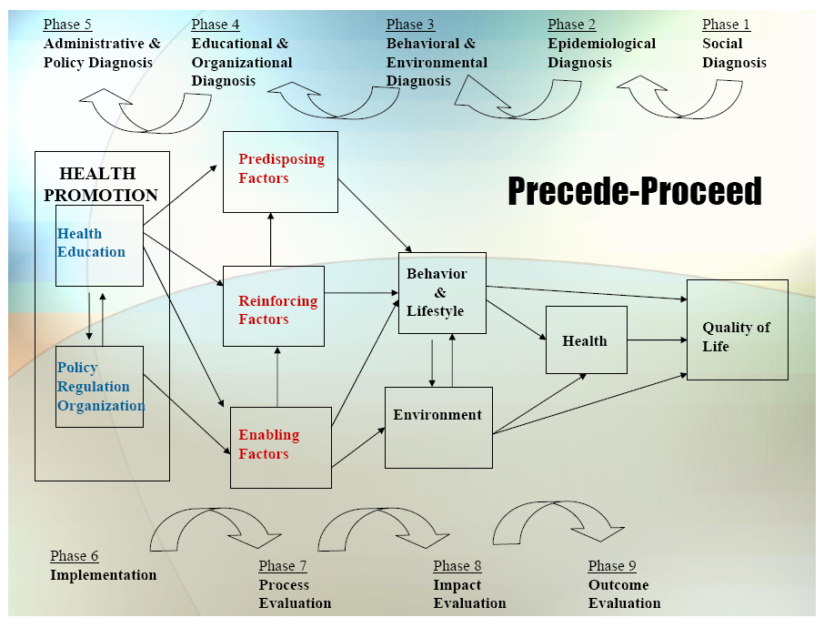

Slide 3
1. Social Diagnosis
30 day readmission rate
  Elderly community dwelling safety net populations discharged from non-surgical services
  Community Engagement Activities (idealized)
    Stakeholder Workgroup (hospitalists, PCPs, PCPs, patients & their families, hospital and clinic administrators)
    Community Advisory Board (patients, caregivers, hospital care coordinators, physicians)
  Outcome Gap
    Safety net hospital have 30% higher readmit rate vs non-safety net

Slide 4
2. Epidemiological Diagnosis
I propose improving 30 day readmission rates through a program that improves communication gap between hospital discharge and outpatient follow up.
Process/Care Gaps:
  Estimated only 50% of recently discharged patients get evaluated by outpatient clinician within 7-14 days
  SFGH- post-discharge f/up appointment rate 42%
    Target: Increase number of patients reached by phone within 3 days post discharge
    Population: non-surgical elderly adults at GMC
    Guideline-concordant.
Conclude that ability to increase percentage of patients reached by clinical staff within 3 days is priority process gap

Slide 5
3. Behavioral & Environmental Diagnosis
What individual behaviors contribute to target process/care gap?
Behavioral intention: operationalize physician/clinical team desire to follow up with patients even after leaving service or discharge to home
Attitude toward behavior:
"most care teams think- once pt is off the service, no longer our responsibility"
Subjective norm:: "the culture is such that following up with discharged patients is not as important as current inpatient issues"
perceived behavioral control:
a) physician care teams have ability to conduct f/up calls
b) BUT, do care teams believe f/up calls can make a difference in pts after hospital care
Behavior: implement f/up dc phone call to patient

Slide 6
3. Behavioral and Environmental Diagnosis
Several organizational and environmental factors influence the care gap
  Lack of awareness from hospital staff re: scope of practice between “inpatient” and “outpatient”
  Reimbursement issues
  Difficulties with execution
    Which staff will make the call
    Lack of patient telephone/access
    Language barriers

Slide 7
3. Behavioral Decision Matrix
 | More Important | Less Important
More Changeable | Execution | Promoting a culture of transitional care “safe-landing”
Less Changeable | Reimbursement issues | Lack of patient telephone/access

Slide 8
4. Educational and Organizational Diagnosis
Predisposing Factors contributing to behavior change target(s) include:
  KNOW: Inpatient teams should know what 2-3 main problems may arise upon discharge to home.
  BELIEF/VALUE: Physicians believe that continuity of information/follow up is good for patient care
  INTENTION: Discover problems or issues that arise before requiring readmission/ED visit
Enabling Factors:
  Post-discharge phone call will provide training, work-flow for how follow phone call program can be made
Reinforcing Factor
  Metrics can be reported monthly for # of calls attempted/ # calls completed/ readmissions

Slide 9
Phase 4: PER Factor Decision Matrix
 | More Important | Less Important
More Changeable | Improving culture/awareness Formalized work-flow for phone call program | Metrics for performance
Less Changeable | Additional burdens on clinic staff/case managers program will cause | N/A

Slide 10
5. Administrative and Policy Diagnosis
Resources
  Support from hospital administration/GMC clinic directors/staf
  SFGH foundation
  Physician champions
Administrative and Organizational Concerns addressed
  SFGH/DPH priorities will be incorporated
  Scope of Practice/roles of clinical care team addressed
  Reimbursement – transitional care billing code

Slide 11
6. Implementation
Inputs/Activities
    Pre-disposing- Conferences/education promoting “safe-landing” culture
    Enabling- Built in work flow for post-d/c phone calls
    Reinforcing- clinical alerts, transitional care billing payments, performance metrics
Timetable:
  Ideally would like to plan and implement a pilot in 2015
PDSA Plan
  Once pilot initiated, would do periodic survey of patient/families, physician/case managers to assess impact of intervention.

Slide 12
Process Evaluation
Process measures
  Percentage of discharged patients who received phone call
  Percentage/number of completed phone call
  Number of minutes spent on phone with patient/families
Intermediate Outcomes
  Content of the phone calls
  Percentage phone call led to change in clinical plan (medication changes, readmission, earlier or later clinic appt)
  percentage of primary care providers/clinic aware of issues arising from post-discharge follow up call (if any) – assess via survey/ required documentation of phone call and action by medical home team.
  percentage of discharging physician aware of issues arising from post-discharge follow up call (if any) – survey.

Slide 13
Outcome Evaluation
Unit of Allocation: Discharge ward/service (6)
Unit of Analysis: Patient-level
Study Design: Cluster Randomized Trial
Effect Size Detection Desired:
  10% reduction in readmission
Sample Size:
  Assume ICC 0.3, Deff=20.8, 8,300 patients (1400 patients/cluster) needed

