Slide 1
Designing effective health behavior change interventions
Adithya Cattamanchi, MD, MAS
Epi 246 – Fall 2014

Slide 2
The evidence-practice gap
Consistent failure to translate evidence into routine practice
  50% of patients do not receive recommended care
  30% of medical spending is on unnecessary care
Closing evidence-practice gap critical to optimizing patient care, outcomes and costs
Asch SM. NEJM 2006;
Dartmouth Atlas of Healthcare
Notes:
NEJM study: Data from medical records and telephone interviews of a random sample of people living in 12 communities to assess the quality of care received by those who had made at least one visit to a health care provider during the previous two years. We constructed aggregate scores from 439 indicators of the quality of care for 30 chronic and acute conditions and for disease prevention. Overall, participants received 54.9 percent of recommended care. Even after adjustment, there was only moderate variation in quality-of-care scores among sociodemographic subgroups. The differences among sociodemographic subgroups in the observed quality of health care are small in comparison with the gap for each subgroup between observed and desirable quality of health care.
Cost of unnecacaryor harmful care: 450-900 billion dollars

Slide 3
Traditional approach to evidence translation
ISLAGIATT Principle
It Seemed Like A Good Idea At The Time
Martin Eccles

Slide 4
Behavioral approach to evidence translation
Implementation depends on stakeholder behavior
Improving care requires changing behavior
Changing behavior requires understanding determinants of current behavior and how behavior changes
Notes:
Higher likelihood of designing interventions that work
Better understanding of why an intervention did or did not work, or whether it could work in another setting

Slide 5
Logic Model
Personal Determinants
Behavioral
Factors / Behavioral Risk
Health
Problems
Environmental
Factors / Environmental Risk
Contextual Determinants
Societal
Community
Organizational
Interpersonal
Notes:
The behavioral approach requires that intervention design and evaluation be based on a model that explicitly depicts the system under study.
This is no different than drug development– the physiologic pathway needs to be defined, key targets along the pathway need to be selected, compounds are designed that inhibit or promote key targets, preliminary studies verify that the drug has its intended action, safety and short term impact are assessed and finally a health outcome is assessed in a large trial. Similarly, for implementation science, we need to define the behavioral and environmental risk factors for the problem we are trying to address, and their determinants. This then guides the choice of intervention components and evaluation of whether the intervention modifies the risk factors as predicted and, ultimately, improves the health problem. Without starting with some sort of logic model to depict the problem, you’re just shooting in the dark and hoping you hit your target. Sometimes you get lucky but most of the time you’ll miss. And in either case, you won’t know why.

Slide 6
Steps in Planned Health Promotion
Step 1: Analysis of health and quality of life
Step 2: Analysis of behavioral/environmental risk factors
Step 3: Analysis of determinants of risk
Step 4: Design of intervention that targets key determinants
Step 5: Evaluation of intervention
Notes:
Health promotion efforts should be planned, and the steps involved in planning flow from the logic model.
Ask: How many people feel comfortable moving through these steps or have an approach for doing so?

Slide 7
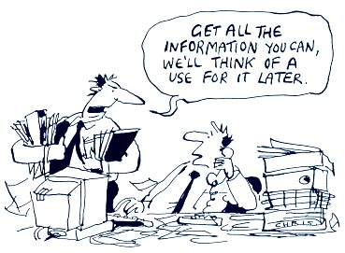
Notes:
Questions often asked include:
When do I use theory?
Which theory should I use?
How do you get from identifying determinants to designing an intervention?

Slide 8
Planning models/frameworks
Step-by-step guide for intervention development and evaluation
Incorporate use of theory
  Define problem
  Design intervention
  Evaluate intervention
Notes:
Planning models/frameworks provide a step by step guide for intervention development and evaluation.
These are different than theories, which are a set of ideas that seek to explain something. A theory can be proven to be true or false, or to apply or not apply in a given situation.
A planning model in contrast is more of a blueprint. It incorporates the use of theory to define a problem and guide intervention design and development.

Slide 9
Objectives
Understand planning models useful for designing effective behavior change interventions
  Behavior Change Wheel
  PRECEDE-PROCEED
  Intervention Mapping
Understand key steps involved in designing effective behavior change interventions
Understand the role and use of behavioral theory

Slide 10
Behavior Change Wheel
Synthesis of 19 behavior change frameworks
  None were comprehensive
  Few conceptually coherent
  Few linked to a general theory of behavior change
Proposed advantages of BCW
  Incorporates common features of prior frameworks
  Identifies concrete and distinct intervention functions to guide design
  Linked to a behavior change theory that can be applied in any setting
Michie S. Imp Sci 2011
Notes:
Comprehensive – it should apply to every intervention that has been or could be developed
Conceptually coherent – it should have distinct categories to describe determinants and intervention types
Behavioral theory either lacking or focused (beliefs/perceptions, unconscious biases/motivations, social environement)

Slide 11
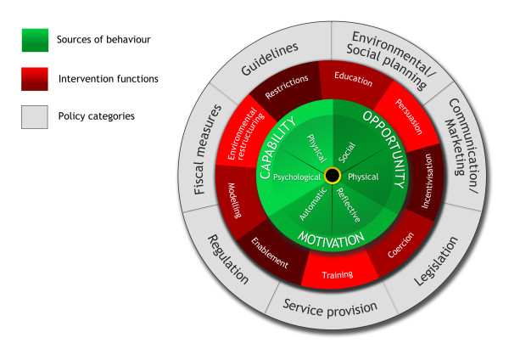
Michie S. Imp Sci 2011
Notes:
BCW consists of three layers. The hub identifies determinants of behavior that could prove fruitful targets of intervention based on the COM-B model. Surrounding the hub is a layer of nine intervention functions to choose from depending on behavioral determinants arrived at using the COM-B model. The outer layer, the rim of the wheel, identifies seven types of policy one can use to deliver the intervention functions.

Slide 12
Using the BCW
Stage 1: Understand the behavior
Stage 2: Identify intervention
options
Stage 2: Identify content and implementation options
Define the problem in behavioral terms
Select target behavior(s)
Specify the target behavior(s)
Identify what needs to change
Select:
Intervention functions
Policy categories
Select:
Behavior change techniques
Mode of delivery
Remaining slide content adapted from:
Michie S et al. The BCW – A Guide to Designing Interventions. Silverback Publishing. 2014.
Michie S. The Behaviour Change Wheel: a method for designing effective interventions. Implementation Science Summer School, Dublin 2012

Slide 13
Step 1 – Define the problem in behavioral terms
State key specific behaviors needed to achieve the health outcome of interest
EXAMPLE
Problem: High infection rates in hospitals
Specific behaviors involved:
  Cleansing hands with alcohol rub (hand hygiene)
  Using protective clothing
  Cleaning/disinfecting surfaces
  Maintaining proper isolation

Slide 14
Step 2 – Select target behaviors
Nurse Hand Hygiene Behavior
Senior doctors’ hand hygiene behavior
Patients asking if they washed their hands
Hospital staff ensuring availability of gel in dispensers
Criteria for selecting target behaviors
  Likely impact if behavior changed
  How easy is it likely to be to change the behavior
  Centrality of the behavior (likelihood of positive spillover effects on other behaviors)
  Ease of measurement
Notes:
Behaviors do not occur on a vacuum. Target behavior may be influenced by other behaviors of the same or other individuals

Slide 15
Step 3 – Specify the target behavior(s)
Who needs to do what differently, when, where, how, with whom?
Target behavior | Clean hands using alcohol gel
Who? | Nurses
When/How often? | Start of each shift After using bathroom Every time before entering patient room Every time after exiting patient room
Where? | Hospital Wards
How? | Rinse with alcohol gel and air dry
With whom? | Alone

Slide 16
Step 4 – Identify what needs to change
Psychological or physical ability to enact the behavior
Capability
Reflective or autonomic mechanisms that activate or inhibit the behavior
Motivation
Behavior
Physical and social environment that enables the behavior
Opportunity
Michie S. Imp Sci 2011
Notes:
The central tenet of the model is that for any behavior to occur:
There must be the capability to do it. The person or people must have both the physical capability (physical skills, strength, or stamina) and the psychological capability (knowledge and psychological skills, strength and stamina).
There must be the opportunity for the behavior to occur. Opportunity can be physical (what environment allows or facilitates in terms of time, triggers, resources, location, physical barriers) or social (interpersonal influences, social cues and social norms)
There must be sufficient strong motivation. Motivation can be reflective (involve self-conscious planning and beliefs about what is good and bad) or autonomic (processes involving wants and needs, desires, impulses, reflexive responses).
These components interact such that changing capability or opportunity may influence motivation, and motivation could influence capability or opportunity by changing behavior.
Summary: Changing the incidence of any behavior of an individual, group or organization involves changing one or more factors related to capability, opportunity and motivation relating to the behavior itself or behaviors that compete with or support it.

Slide 17
COM-B Components
COM-B Model Component | Example
Physical Capability | Having the physical stamina to go running
Psychological Capability | Knowledge of the health benefits of cardiovascular activity
Physical Opportunity | Being able to go running because one owns appropriate shoes
Social Opportunity | Being able to go running because there is a neighborhood running group
Reflective Motivation | Belief that running is good for health
Automatic Motivation | Feeling anticipated pleasure from the “high” associated with running

Slide 18
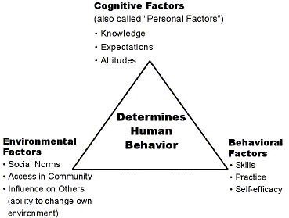
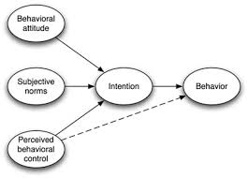
COM-B vs. other theories
Attitude: Psychological capability, Reflexive Motivation
Norms: Social opportunity
Control: Psychological capability
Cognitive : Psychological capability
Env: Physical and social opportunity
Behavioral: Physical and psychological capability
Notes:
Models of individual health behavior (TPB)
The theory states that attitude toward behavior, subjective norms, and perceived behavioral control, together shape an individual's behavioral intentions and behaviors.
Behavioral beliefs and attitude toward behavior - Behavioral belief reflects an individual's belief about consequences of particular behavior. Attitude toward behavior reflects individual's positive or negative evaluation of self-performance of the particular behavior.
Normative beliefs and subjective norms - Normative belief is an individual's perception of social normative pressures, or relevant others' beliefs that he or she should or should not perform such behavior. Subjective norm: an individual's perception about the particular behavior, which is influenced by the judgment of significant others. Control beliefs: an individual's beliefs about the presence of factors that may facilitate or impede performance of the behavior.
Models of interpersonal health behavior (SCT)
Social cognitive theory explains behavior in terms of triadic reciprocality ("reciprocal determinism") in which behavior, cognitive and other interpersonal factors, and environmental events all operate as interacting determinants of one another. SCT describes behavior as dynamically determined and fluid, influenced by both personal factors and the environment. Changes in any of these three factors are hypothesized to render changes in the others.

Slide 19
How to identify what needs to change
Collect data from as many relevant sources (“stakeholders”) as possible
Use variety of methods
  Literature review; Records review; Protocol review; Interviews/focus groups; Direct observation
Triangulate information from different sources/methods

Slide 20
COM-B Diagnosis: Hand hygiene example
COM-B Component | What needs to happen for target behavior to occur? | Is there a need for change?
Capability – Physical | Have physical skills to clean hands | No – staff already have these skills
Capability – Psychological | Know correct technique to clean hands | No – knowledge is sufficient
Opportunity – Physical | Have alcohol gel available | No – alcohol gel available consistently
Opportunity – Social | See senior doctors clean their hands | Yes – doctors are terrible at cleansing hands
Motivation – Reflexive | Believe that hand hygiene will require improved cognitive and self-regulation skills | Yes – staff do not recognize the value of these skills
Motivation – Autonomic | Have established routines and habits for hand cleansing | Yes – change needed to establish habits
Behavioral Diagnosis: Social opportunity, Reflexive motivation and autonomic motivation need to change in order for target behavior to occur

Slide 21
Small Group Exercise
Complete BCW Worksheet 3 (Specify target behavior
Complete BCW Worksheet 4: COM-B Diagnosis) or consider how you will collect data

Slide 22
Using the BCW
Stage 1: Understand the behavior
Stage 2: Identify intervention
options
Stage 2: Identify content and implementation options
Define the problem in behavioral terms
Select target behavior(s)
Specify the target behavior(s)
Identify what needs to change
Identify:
Intervention functions
Policy categories
Identify:
Behavior change techniques
Mode of delivery

Slide 23
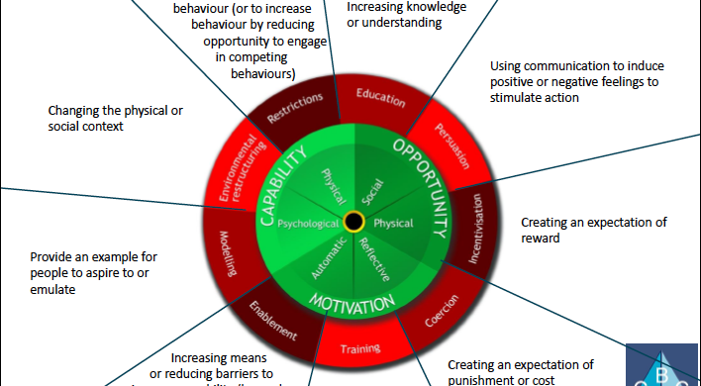
Step 5 – Identify intervention functions
BCW links COM-B diagnosis to intervention functions
Intervention function = Broad categories of means by which an intervention can change behavior

Slide 24
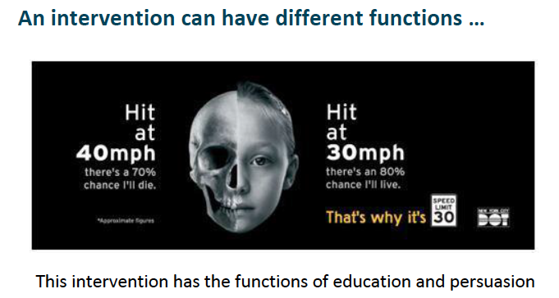

Slide 25
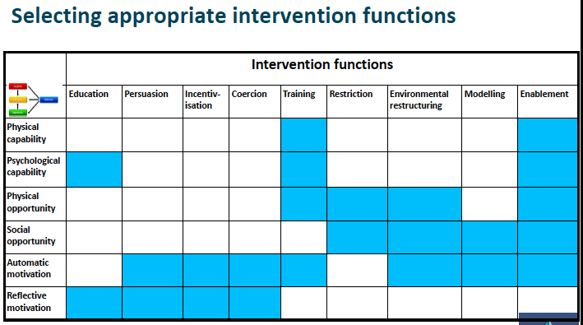

Slide 26
Intervention functions: Hand hygiene example
COM-B Diagnosis | Intervention Function
Social Opportunity -- Do not see senior doctors clean their hands | Restriction Environmental restructuring Modeling Enablement
Reflexive Motivation -- Do not believe that hand hygiene will require improved cognitive and self-regulation skills | Education Persuasion Modeling Enablement
Autonomic Motivation -- Do not have established routines and habits for hand cleansing | Training Incentivisation Coercion Environmental restructuring

Slide 27
Step 6 – Identify policy categories
Types of decisions made by authorities that help to support and enact the interventions
BCW synthesis of 19 frameworks
  Identified seven distinct policy categories
  Suggested which policy categories effective in supporting different intervention functions

Slide 28
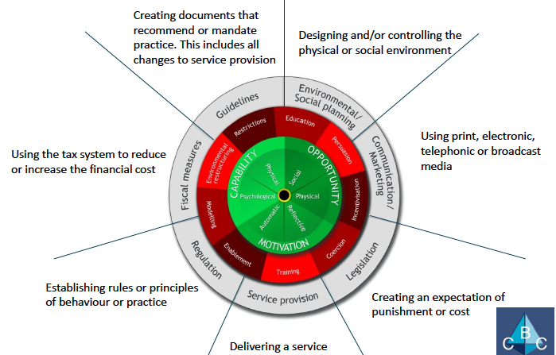
Policy categories

Slide 29
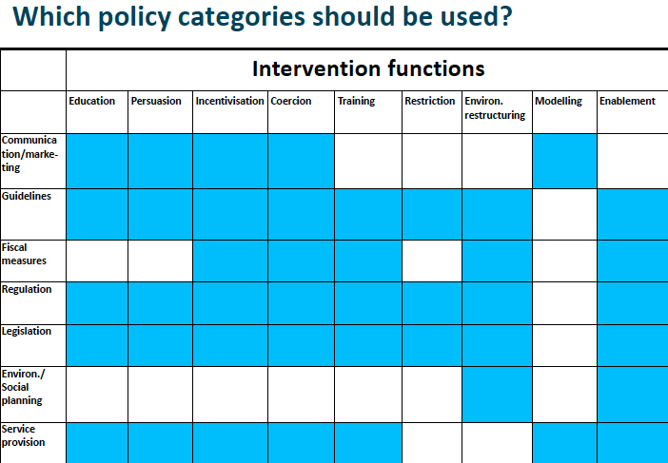

Slide 30
Selecting policy categories
Requires judgment
Use evidence where available
APEASE criteria
  Affordability
  Practicality
  Effectiveness/cost-effectiveness
  Acceptability
  Side-effects/safety
  Equity

Slide 31
Policy categories: Hand hygiene example
Intervention Function | Potential Policy Categories | APEASE Criteria
Incentivisation | Communications/marketing | Yes
 | Guidelines | No – already exist
 | Fiscal Measures | No – not practical
 | Regulation | Not in short-term
 | Legislation | No – not practical
 | Service Provision | Yes
Enablement | Guidelines | No – already exist
 | Fiscal Measures | No – not practical
 | Regulation | Not in short-term
 | Legislation | No – not practical
 | Service Provision | Yes
 | Environmental/social planning | No - not practical

Slide 32
Using the BCW
Stage 1: Understand the behavior
Stage 2: Identify intervention
options
Stage 2: Identify content and implementation options
Define the problem in behavioral terms
Select target behavior(s)
Specify the target behavior(s)
Identify what needs to change
Identify:
Intervention functions
Policy categories
Identify:
Behavior change techniques
Mode of delivery

Slide 33
Step 7 – Identify behavior change techniques
Goal: Translate intervention functions into specific techniques to change behavior
BCT: An active component of an intervention designed to change behavior
  Active component = Observable, Replicable, Irreducible
Systematic review used to develop a BCT taxonomy
  93 distinct BCTs grouped into 16 categories
  BCTs appropriate for each of the 9 intervention functions (as judged by 4 experts) identified

Slide 34
BCT Taxonomy Example
No. | Label | Definition | Example
1. Goals and Planning
1.1 | Goal setting (behavior) | Set or agree on a goal defined in terms of the behavior to be achieved | Agree on a dialy walking goal (e.g., 3 miles) and reach agreement about the goal Set the goal of eating 5 pieces of fruit per day

Slide 35
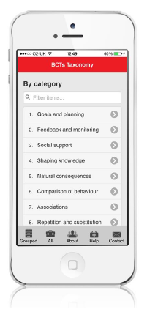

The BCT Taxonomy Resources
http://www.bct-taxonomy.com/
Criteria for selecting BCTs
  Start with list of BCTs appropriate for the selected intervention function
  Narrow list of possible BCTs
    Use APEASE criteria
    Stakeholder consultation
    Consider BCTs used more vs. less frequently
BCTTv1 App

Slide 36
Identify BCT(s) – Hand Hygiene Example
COM-B component | Intervention function | Policy Category | BCT
Reflexive Motivation Autonomic Motivation | Incentivization | Service Provision | 1. Feedback on behavior 2. Non-specific reward 3. Goal setting (behavior)
Social Opportunity Autonomic Motivation | Enablement
Summary: Deliver selected BCTs through changes in service provision to incentivize and enable nurses to cleanse their hands with alcohol gel

Slide 37
Step 8 – Identify Mode of Delivery
BCT reflects intervention content
Mode of delivery reflects how BCT is put in place
Bottom line: Consider full range of options and then select based on stakeholder consultation, APEASE criteria

Slide 38
Identify Modes of Delivery –
Hand Hygiene Example
COM-B component | Intervention function | Policy Category | BCT
Reflexive Motivation Autonomic Motivation | Incentivisation | Service Provision | 1. Feedback on behavior Ward coordinator observed nurses individually and provided feedback in group meetings on % hand washing 2. Non-specific reward If compliance 100%, certificate given and noted at annual appraisal 3. Goal setting (behavior) If <100% compliance, goal set and agreed upon with ward coordinator
Social Opportunity Autonomic Motivation | Enablement

Slide 39
BCW Summary
Stage 1: Understand the behavior
Stage 2: Identify intervention
options
Stage 2: Identify content and implementation options
Define the problem in behavioral terms
Select target behavior(s)
Specify the target behavior(s)
Identify what needs to change
Identify:
Intervention functions
Policy categories
Identify:
Behavior change techniques
Mode of delivery
Step-by-step guide to intervention design
Linked to a generally applicable theory of behavior
A focus on identifying and addressing mechanism of action (i.e., behavioral determinants)

Slide 40
PRECEDE-PROCEED
Phase 3
Educational &
ecological
assessment
Phase 2
Epidemiological, Behavioral and Environmental Assessment
Phase 1
Social
assessment
Phase 4a
Intervention
Alignment
←Planning tasks (PRECEDE): Specifying measurable objectives and baselines.
Predisposing
Health
Program
Genetics
Phase 4b
Administrative
& Policy
Assessment
Educational
strategies
Reinforcing
Behavior
Quality of
life
Health
Policy
regulation
organization
Environment
Enabling
→Evaluation Tasks (PROCEED): Monitoring & Continuous Quality Improvement
Input
Process
Output
Short-term
impact
Longer-term
health outcome
Short-term
social impact
Long-term
social impact
Phase 5
Implementation
Phase 6
Process evaluation
Phases 7-8
Impact and outcome evaluation
Notes:
The PRECEDE-PROCEED framework is an approach to planning that examines the factors contributing to behavior change. These include: Predisposing factors—th individual’s knowledge, attitudes, behavior, beliefs, and values before intervention that affect willingness to change Enabling factors—factors in the environment or community of an individual that facilitate or present obstacles to change Reinforcing factors—the positive or negative effects of adopting the behavior (including social support) that influence continuing the behavior These factors require that individuals be considered in the context of their community and social structures, and not in isolation, when planning communication or health education strategies.

Slide 41
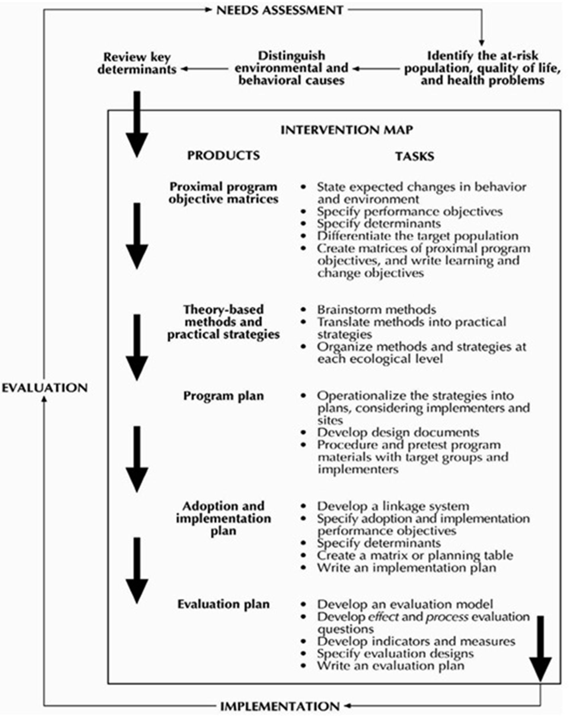
Intervention Mapping
Notes:
Intervention Mapping is a protocol for developing theory-based and evidence-based health promotion programs. Intervention Mapping describes the process of health promotion program planning in six steps:
1. the needs assessment based on the PRECEDE-PROCEED model
2. the definition of performance and change objectives based upon scientific analyses of health problems and problem causing factors
3. the selection of theory-based intervention methods and practical applications to change (determinants of) health-related behavior;
4. the production of program components, design and production;
5. the anticipation of program adoption, implementation and sustainability; and
6. the anticipation of process and effect evaluation.
Intervention Mapping is characterized by three perspectives: an ecological approach, participation of all stakeholders, and the use of theories and evidence. Although Intervention Mapping is presented as a series of steps, the authors see the planning process as iterative rather than linear. Program planners move back and forth between tasks and steps. The process is also cumulative: each step is based on previous steps, and inattention to a particular step may lead to mistakes and inadequate decisions.

