Slide 1
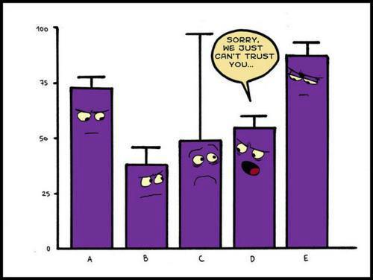
How To Create Bar Graphs with Error Bars in STATA...its complicated
Biostatistics 212
September 8, 2014

Slide 2
RCT Data Using QOL Questionnaire
NF1 patients with plexiform neurofibromas
Stratified by Disease Grade (mild, intermediate, severe)
Randomized to Treatment using Placebo vs. Drug
Outcome-QOL Score (physical, emotional, cognitive)
Display means, 95% CI by grade & treatment
Use the collapse command to make the mean and standard deviation by treatment and grade
collapse (mean) “meanyvar”= yvar(sd) “sdyvar”=yvar(count) n=yvar, by(xvar1 xvar2)
Generate the upper & lower values of the CI for the mean
= (mean + (1.96 x SE)) to (mean – (1.96 x SE))
generate “hiyvar” = meanyvar + 1.96*(sdyvar / sqrt(n))
generate “lowyvar” = meanyvar - 1.96*(sdyvar / sqrt(n))

Slide 3
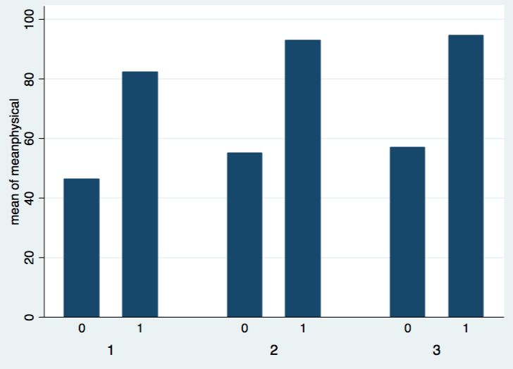
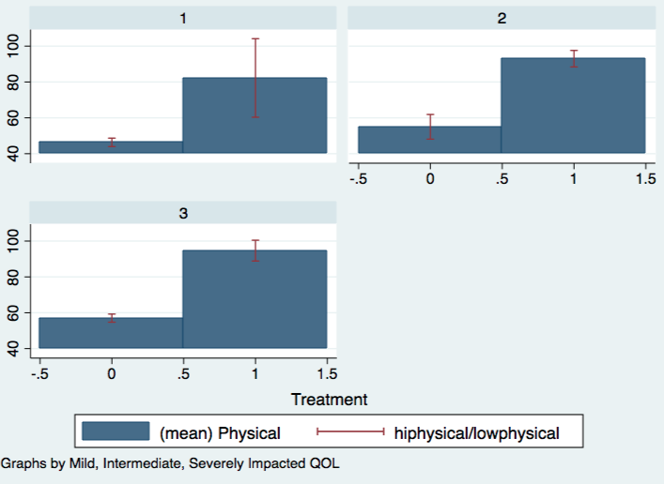
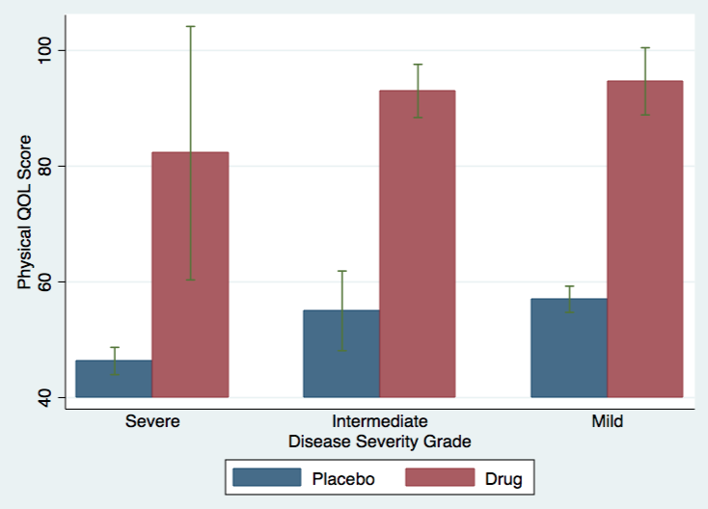
graph bar meanyvar, over(xvar1) over(xvar2)
graph twoway (bar meanyvar xvar1) (rcap
“hiyvar” “lowyvar” xvar1), by(xvar2)

Slide 4
Online References
DEMO
do file and general commands
http://www.ats.ucla.edu/stat/stata/faq/barcap.htm (step-by-step, excellent resource)
http://blogs.worldbank.org/impactevaluations/tools-trade-graphing-impacts-standard-error-bars (uses Excel to manipulate data first)

