Slide 1
Vitamin D supplementation for HIV-infected patients on stable Antiretroviral therapy (ART) in resource-limited settings – VIDHA study
Vivian Avelino-Silva

Slide 2
Background
Besides beneficial effect on bone health, vitamin D has immunomodulatory effects that have recently been explored for the management of inflammatory diseases
Residual excess morbidity and mortality among ART-suppressed HIV-infected patients is at least partially explained by a state of persistent inflammation

Slide 3
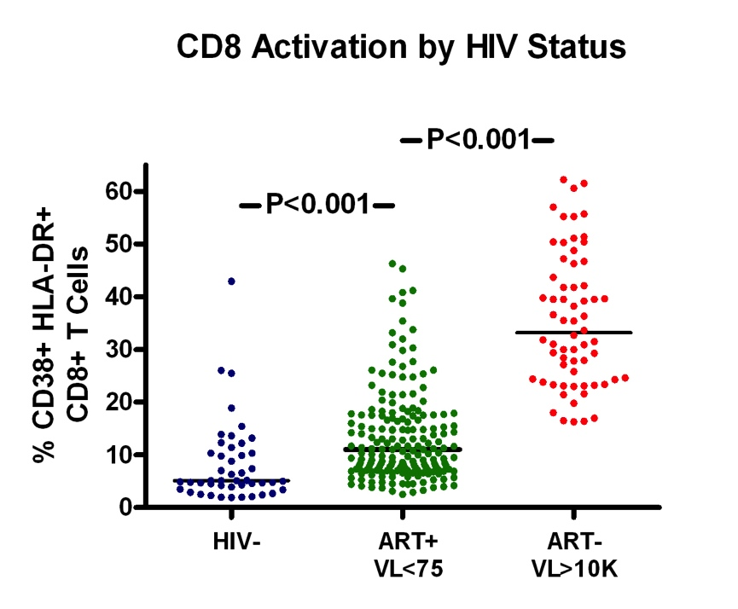
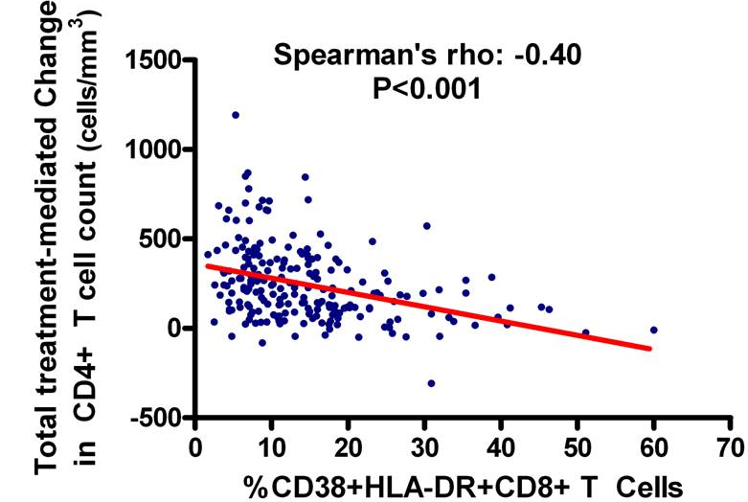
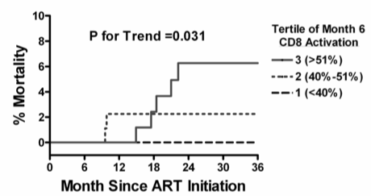

Slide 4
Inflammation Predicts Disease in Treated HIV Infection
Mortality (Kuller, PLoS Med, 2008; Tien, JAIDS, 2010; Justice, CID 2012)
Cardiovascular Disease (Duprez, Atherosclerosis, 2009)
Cancer (Breen, Cancer Epi Bio Prev, 2010; Borges, AIDS, 2013)
Venous Thromboembolism (Musselwhite, AIDS, 2011)
Type II Diabetes (Brown, Diabetes Care, 2010)
Cognitive Dysfunction (Burdo, AIDS, 2013; Letendre CROI 2012, Abs#82)
Frailty (Erlandson, JID, 2013)

Slide 5
Background
Among HIV-infected patients, observational studies suggest that vitamin D levels are inversely correlated with disease progression, non-aids morbidity and mortality
Confounding? Reverse causation?

Slide 6
Vitamin D
Immune activation
Immune activation
Sun exposure
Vitamin D
Coinfections
Low-level HIV replication
Microbial translocation
Immune activation
Vitamin D

Slide 7
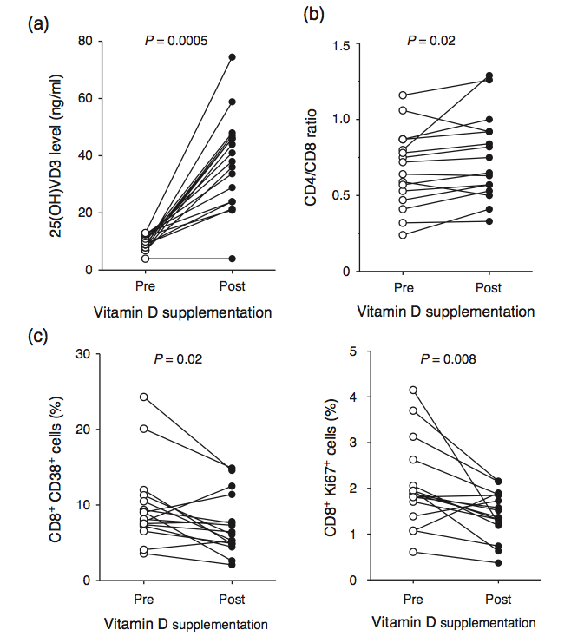
One small observational study (single arm, before-after) demonstrated reduction in CD8+ T cell activation among patients with deficient levels who received vitamin D supplementation

Slide 8
Research question
Is vitamin D supplementation (cholecalciferol 4,000 IU/day) use for 12 weeks, as compared to placebo, associated with reduced CD8+ T-cell activation among virologically-suppressed, HIV-infected patients in Uganda?
Double blind, placebo-controlled randomized trial

Slide 9
Ethical issues and design
Vitamin D not measured or supplemented as standard of care in Uganda
Our research question addresses immunomodulatory effect, not necessarily related to the referent levels for bone health
Is it ethical to randomize patients with deficient levels to placebo?

Slide 10
Ethical issues and design
Option 1: not measure vitamin D at baseline, simply randomize to placebo or vitamin D
  At trial conclusion, as benefit to participants, measure vitamin D and provide supplementation to those with deficient levels, regardless of group allocation
  Need to store samples for future subgroup analysis by baseline vitamin D
Option 2: measure vitamin D at baseline, and plan a crossover design as to allow supplementation for all participants at some timepoint
  Caveat: we don’t know washout period for this effect of vitamin D
Option 3: measure vitamin D at baseline, and provide to all participants with deficient levels standard dose supplementation, plus study medication
  Caveat: may dilute the effect of intervention and decrease power

