Slide 1
Oral Care for dependent geriatric population
Final Presentation: EPI 245
Amruta Hendre
Spring 2015

Slide 2
Outcomes
Improved Oral and General Health
Improved Quality of Life
Justification
Poor oral hygiene leads to
Poor Health Outcomes
Pain and Suffering
Loss of Teeth
Malnourishment

Slide 3
Evidence
Training Nurses and auxiliary staff to perform daily oral care improve health outcomes in dependent geriatric population.
Training modules requires adaptation to patient population.

Slide 4
The case for translation
Quality Of Care Issue
Safety:
Deaths related to aspiration pneumonia,
Malnourishment, Poor management of chronic diseases
Quality Gap: No oral care routine
Knowledge, work overload
Reducing quality gap will result in:
Improved oral/general health
Cost reduction per patient/increase pt turnover
Improved QOL

Slide 5
Community Engagement
Stake Holders:
Hospital, Dental unit, Nurses, CNA’s, Patients
Vested Interest:
Hospital: cost, turnover, reputation
Dental: turnover
CNA’s : certificate
Patient: Feeling of wellbeing, diet

Slide 6
Plan to Engage Communities:
Focus groups
Offering to be on the CAB
Food and gift cards for their time
Certificate for training, C.E/Teaching credits
Creating in unit posts such as ‘oral care advisor’ and having them rotate through it
Encouraging peer support, Partnering CNA’s
Acknowledgement/ stake in publications
Participation in public talks

Slide 7
Evidence translation: Facilitators and Barriers
Individual behaviors contributing to care gap:
Attiude, knowledge & skills of CNA’s
Organizational/environmental factors influencing are gap:
lack of - oral standard of care guidelines
- support staff
- insentives

Slide 8
Behavioral/environmental targets
 |  | High impact | Lower impact
 | More Changeable | Skills | Support, incentives
 | Less Changeable | Attitudes | No Program
Notes:
Which of the behavioral/environmental factors will you target to facilitate evidence translation? Limit to one or a few.
Likely impact if changed
How easy is it likely to change
Centrality (likelihood of positive spillover effects on other factors)
Ease of measurement

Slide 9
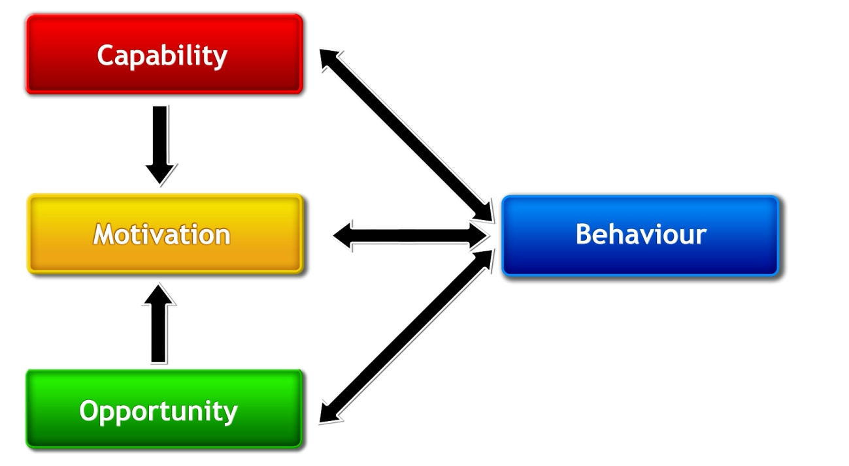
Determinants of change
Notes:
Capacity: tooth brushing skills, ability to use dental products, knowledge: do they know why OH is important and sideeffects
Motivation: Reward for brushing,ce/teaching credits, leadership role
Opportunity: make changes and to take control of the situation, staff support, provide necessary materials
Behavior: provide daily oral care

Slide 10
Targets of implementation strategy
 | More Important | Less Important
More Changeable | Ability to brush teeth and use dental products | Reward for brushing patient’s teeth
Less Changeable | Providing electrical/ battery operated brushes | No Program
Notes:
Which determinants of the selected behavioral/environmental factor(s) will you target?

Slide 11
Implementation strategy
Potential intervention:
Training, education, incentives, modeling
Justification for Intervention:
Reduce no of deaths related to aspiration pneumonia
Management of chronic diseases
Reduce dental emergencies, infections, tooth loss
Improved diet
Hospital cost savings

Slide 12
Process Evaluation
Intervention Fidelity
Training modules along with strategies and techniques discovered can be reproduced and adapted to individual circumstances.
Intermediate Outcome measures
Number of: training sessions, CNA’s who attended, times oral care provided/week/pt, problem solving done by peers or dental staff

Slide 13
Impact Evaluation
Unit of Allocation : Dependent geriatric population
Unit of Analysis: Improved oral and general health
Study Design: Stepped wedge
Effect Size Detection Desired: 20%
Sample Size: 200

