Slide 1
Housekeeping
Moving forward, make a working iterative document with each (new) assignment attached to the end
You can update as you go and I am happy to provide feedback, just let me know what you updated when you post
You can take out Elvin’s instructions, just leave the questions
I know you have a lot to say! But please try to be succinct (try to cut the gap statement to a page-ish or less)

Slide 2
Your topics
IPT in HIV/TB coinfection in Uganda
HIV care engagement in young sex workers
Diabetic foot screening
PreP for women seen in family planning clinics
Vitamin D supplementation for pediatric MS
  Hypertension management in Zambia
  Dedicated care (ACE units) for older inpatients at UCSF
  Use of interpreter services in the hospital setting/UCSF
  ICU best-practices at UCSF
  Electronic data registries to improve outcomes in CKD
  Contraceptive counseling and use among poor/minority women

Slide 3
Identifying a gap
Identify an under-utilized, evidence-based intervention AND project the effects of underuse on health outcomes, cost, etc.
Identify a gap along a care continuum AND project the effects of that gap on health outcomes
Try to be specific and give data if you have it

Slide 4
Models and frameworks
MANY implementation science theories and frameworks; can be useful for
  Identifying determinants of a behavior
  Explaining a causal model
  Selecting intervention methods
  Evaluating results
  Reporting the ‘active ingredients’ of an intervention
                Bartholomew, 2011

Slide 5
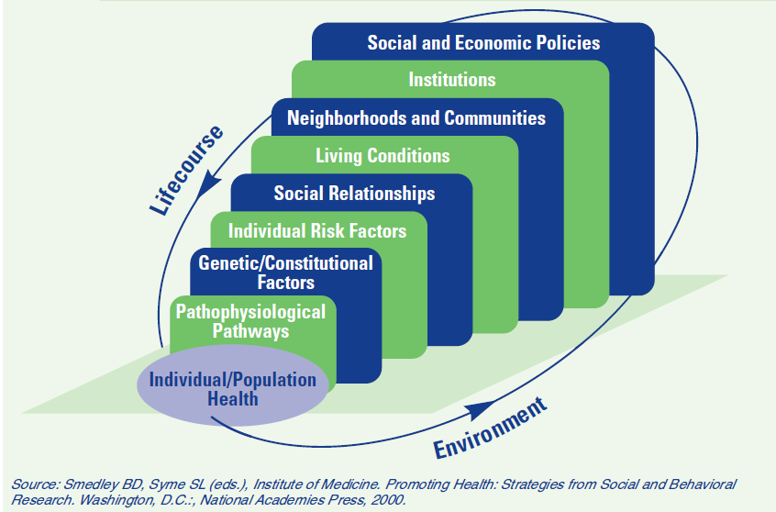
Socio-ecologic theory
Notes:
Governance, systems, organizations, health care workers, patients, communities

Slide 6
COM-B
A model of behavior change that is at the core of the behavior change wheel
3 conditions inform behavior and behavior change (Capability, Opportunity, Motivation)
Identifying barriers and facilitators of behavior in these domains (a behavioral ‘diagnosis’) can lead to rational development of an intervention and policies that target that gap

Slide 7
COM-B
Who needs to do what differently (to close the gap)—and when, where, how often, and with whom?
What factors in the environment affect the behavior?

Slide 8
Capability | Physical | Can they physically do it?
 | Psychological | Do they know what they should do?
 |  | Do they know how to do it?
 |  | Do they remember to do it?
 |  | Are there things that they use to monitor whether they do it?
Motivation | Reflective | Do they think it is part of their job/role to do it?
 |  | Are they confident in doing it?
 |  | Do they think it is something that can be done?
 |  | Do they think there are benefits/harms associated with doing/not doing it?
 |  | Do they intend to do it?
 |  | Is there something else they want to do that interferes with doing it?
 | Automatic | Is there anything that might support them in doing it?
 |  | Does doing it provoke an emotional response
Opportunity | Physical | What aspects of the environment (physical, resources) influence whether or not they do it?
 | Social | How might views/opinions of others influence their decision to do it?

Slide 9
Linking the ‘diagnosis’ to an intervention
Capability | Intervention Functions
 | Physical | Training, Enablement
 | Psychological | Education, Training, Enablement
Motivation | Reflective | Education, Persuasion, Incentivization, Coercion
 | Automatic | Persuasion, Incentivization, Coercion, Restructuring, Enablement
Opportunity | Physical | Restriction, Environmental Restructuring, Enablement
 | Social | Restriction, Restructuring, Enablement

Slide 10
CFIR

Slide 11
CFIR

Slide 12
CFIR

Slide 13
CFIR

Slide 14
Overview / next steps
Define the evidence-practice gap
Analyze the gap – make a ‘diagnosis’
Design a study to understand/address the gap
Methods to do so. . .

Slide 15
Is this the gap?
Or is this the gap?
Is there a common diagnosis across these steps?
How important is this gap within the overall cascade?
Screened
Diagnosed
Initiated
Adherent
Controlled
Pregnant women
with depression
Retained in care
Offered treatment
(of those with depression)
Notes:
Depends on how much of the gap is due to this step (is it the critical problem or a small one?)
Depends on whether there is data about this step’s contribution to non-treatment consequences

Slide 16
Strategy A – Focus on Screening
Strategy B – Make Screening Part
of a Larger Story
Gap
  Even though screening for depression during pregnancy has been shown to improvement outcomes by X, only 12% of women are screened and estimates suggest that as a result 90% of per-partum depression is untreated in the USA.
Analysis
  Existing data suggest that even though providers of antenatal care have many opportunies to intervene and are motivated to address depression, they do not feel comfortable with treatment options – including CBT and or anti-depressive medications, and lack perceived self efficacy to engage in depression management.
Intervention
  We propose an opinion leader led training – led by a prominent OB GYN rather than a psychiatrist – on the integrating screening and subsequent first step referrals
Gap:
  500,000 women in the US experience peri-partum depression each year. Even though effective treatment exists, the CDC estimates that only 10% ever receive treatment. As a result, uncontrolled depression leads to X, Y and Z in maternal and child outcomes.
Gap analysis:
  Existing data suggest only 12% of women who are pregnant are screened, even though virtually 100% of them visit health care providers during pregnancy – representing an enormous lost opportunity. Although screening in and of itself may not be sufficient for treatment, diagnosis is always a necessary component and a target for this project.
Intervention
  Existing data shows that doctors providing antenatal care are aware of the need, but do not have self efficacy to respond to depression…
Notes:
A
Depends on whether that first statement is true
In HIV – we have some of these quantified – retention for example
More focused
B
Forces you to think about screening in context of other activities (is it the crucial link?)
Is it the crucial link? If so – needs some kind of justification
But might also ask you to consider your problem in broader terms
Understanding gaps in screening or screening and offer and uptake of treatment?
If you want to develop an intervention – do you want to focus on screening or one that is multi-pronged?
Bottom line – the intervention of interest might be a part of a larger gap – consider reframing that way

