Slide 1
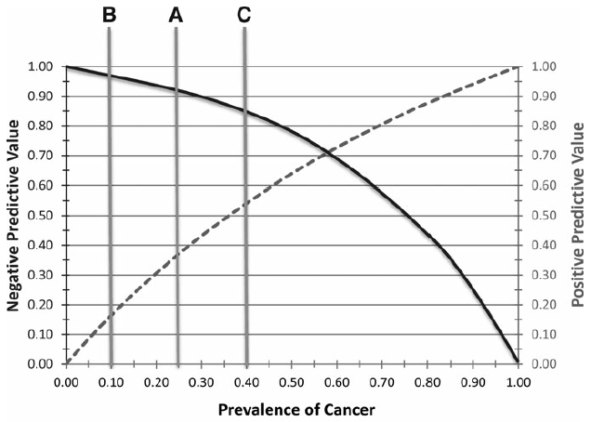
PPV & NPV depend on Prevalence/ Pretest Probability
Ferris RL, et al. Thyroid. 25:760, 2015

Slide 2
Imaging directed parathyroidectomy
= imaging selected parathyroidectomy
Arici et al: Surgery 129:720, 2001
+MIBI alone
  90% success with focused approach
+US alone
  85% success with focused approach
+MIBI and +US
  96% success with focused approach
Positive MIBI and US selected those likely to have a solitary adenoma

Slide 3
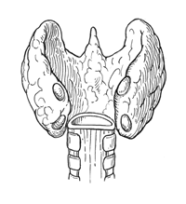
Poor man’s “intraoperative PTH”
(Bayesian, “Play the odds”)
Sestamibi scan and ultrasound
2 positive studies – 1 gland (F)
1 positive study – 2 glands (U)
No positive study – 4 glands (B)
To evaluate the probability of a hypothesis, the Bayesian probabilistic specifies some prior probability, which is then updated in the light of new relevant data.
U
F
B

