Slide 1
#19 RCT - Case Presentation
By Matthew Low, Edward Viloria, Daniel Kang, Sean Lin,
Mark Watanabe
May 12, 2017

Slide 2
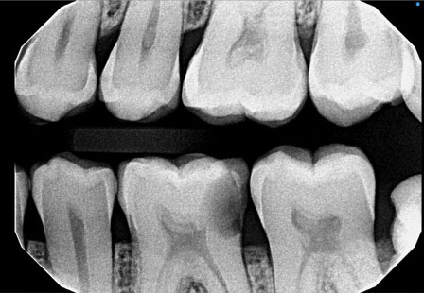
What to do?
Diag
Pulpal diagnosis: Partial Necrosis
Periapical diagnosis: Symptomatic Apical Periodontitis

Slide 3
Treatment options
RCT, Crown lengthening, Crown
  Cost: $538 + $500 + $660 = $1638
  Pros: Retain natural tooth
  Cons: Removing bone compromises adjacent teeth
Extraction and restore with
  Implant ($1900)
    Pros: High success rates, does not compromise adjacent teeth
    Cons: Cost, time involved
  Bridge ($1980)
    Pros: Shorter time than implants
    Cons: Cutting sound abutment teeth
  No treatment
    Pros: No added cost
    Cons: Esthetics, super-eruption of opposing teeth, shifting of adjacent teeth

Slide 4
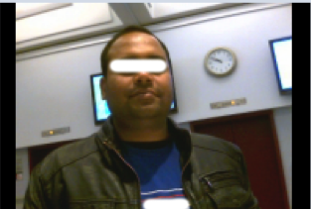
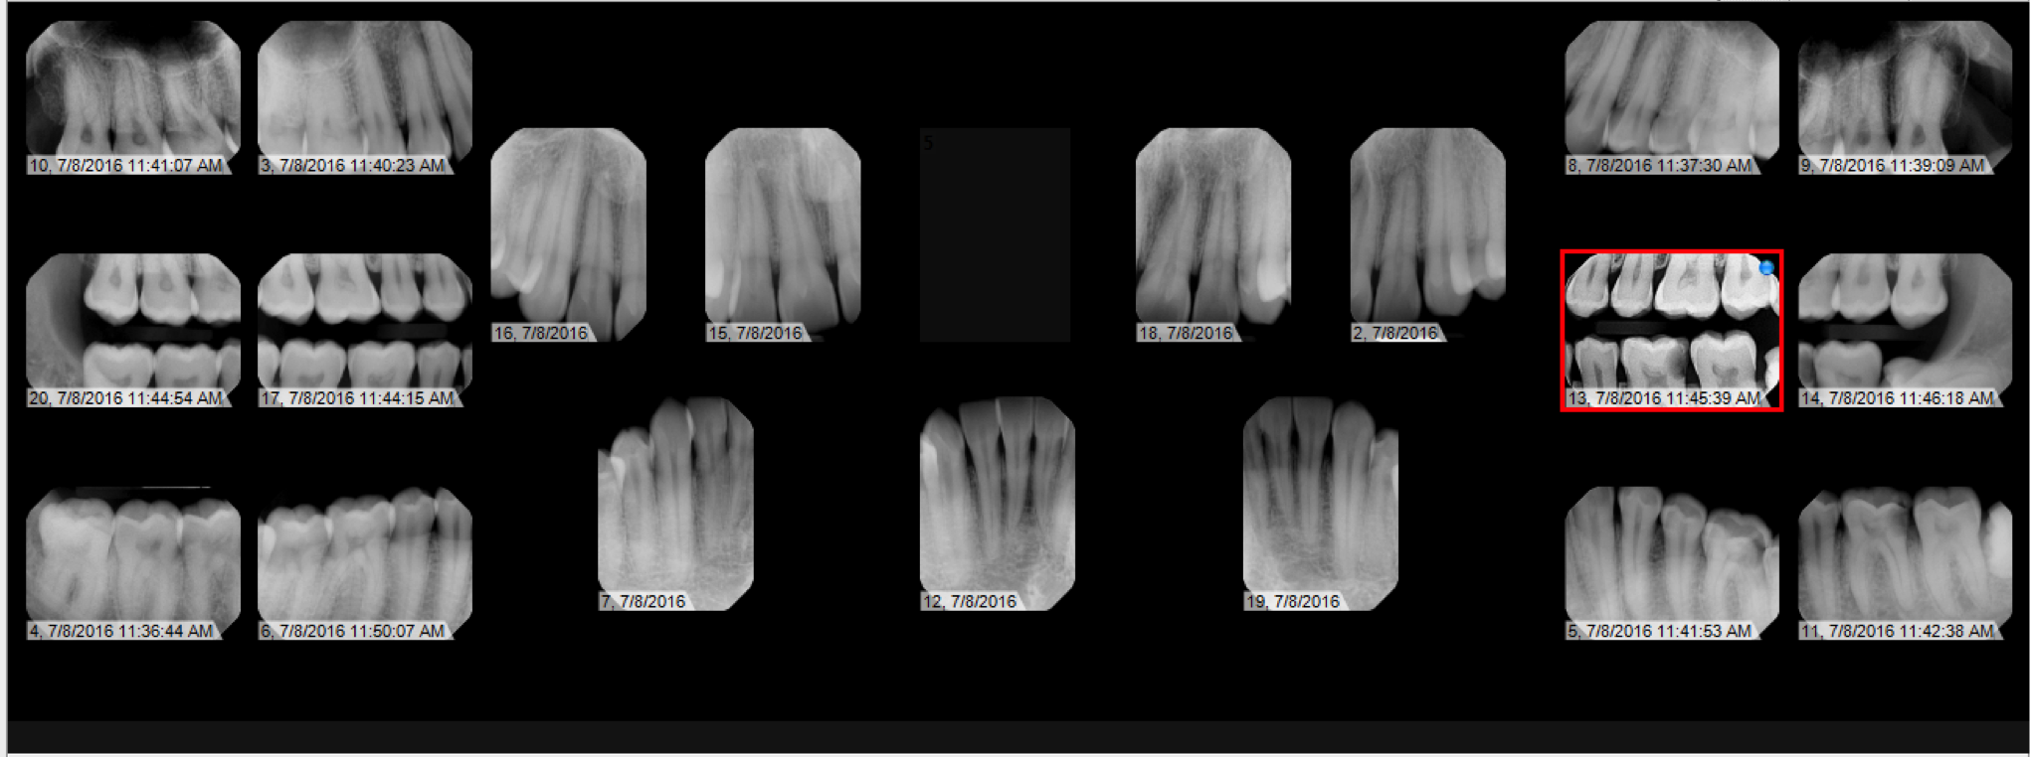
Complete comprehensive exam
36 yo male
Discuss treatment options
Address patient’s CC

Slide 5
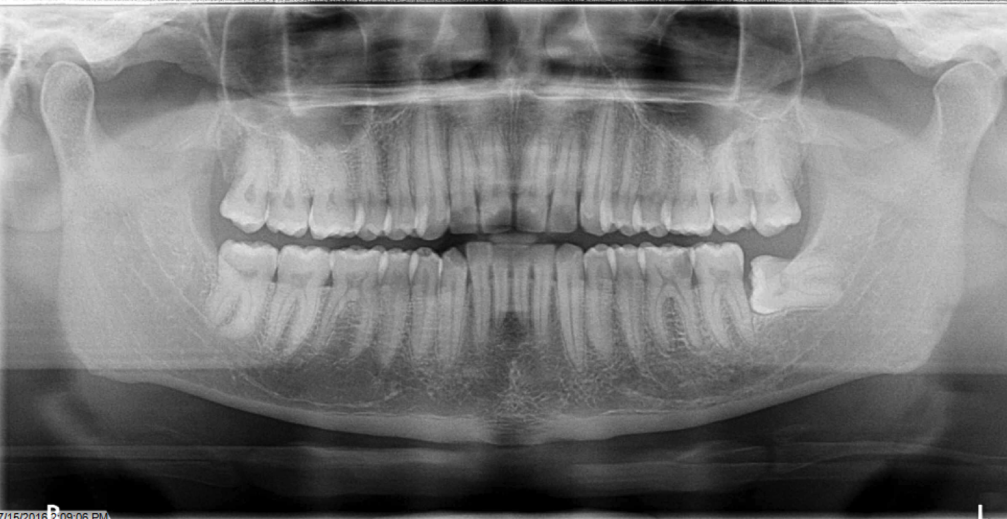
Complete necessary referrals
OS Referral EXT #16, 17

Slide 6
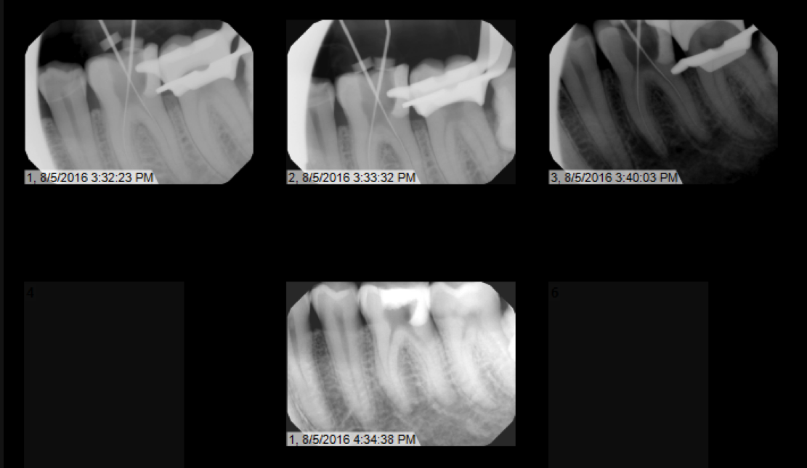
Remove Caries and Reestablish Distal Wall
Obtain Working Length
WL:
MB: 22.0 mm
ML: 22.0mm
DB: 23.0 mm
DL: 23.5mm
MAF:
MB: 35
ML: 35
DB: 40
DL: 35

Slide 7
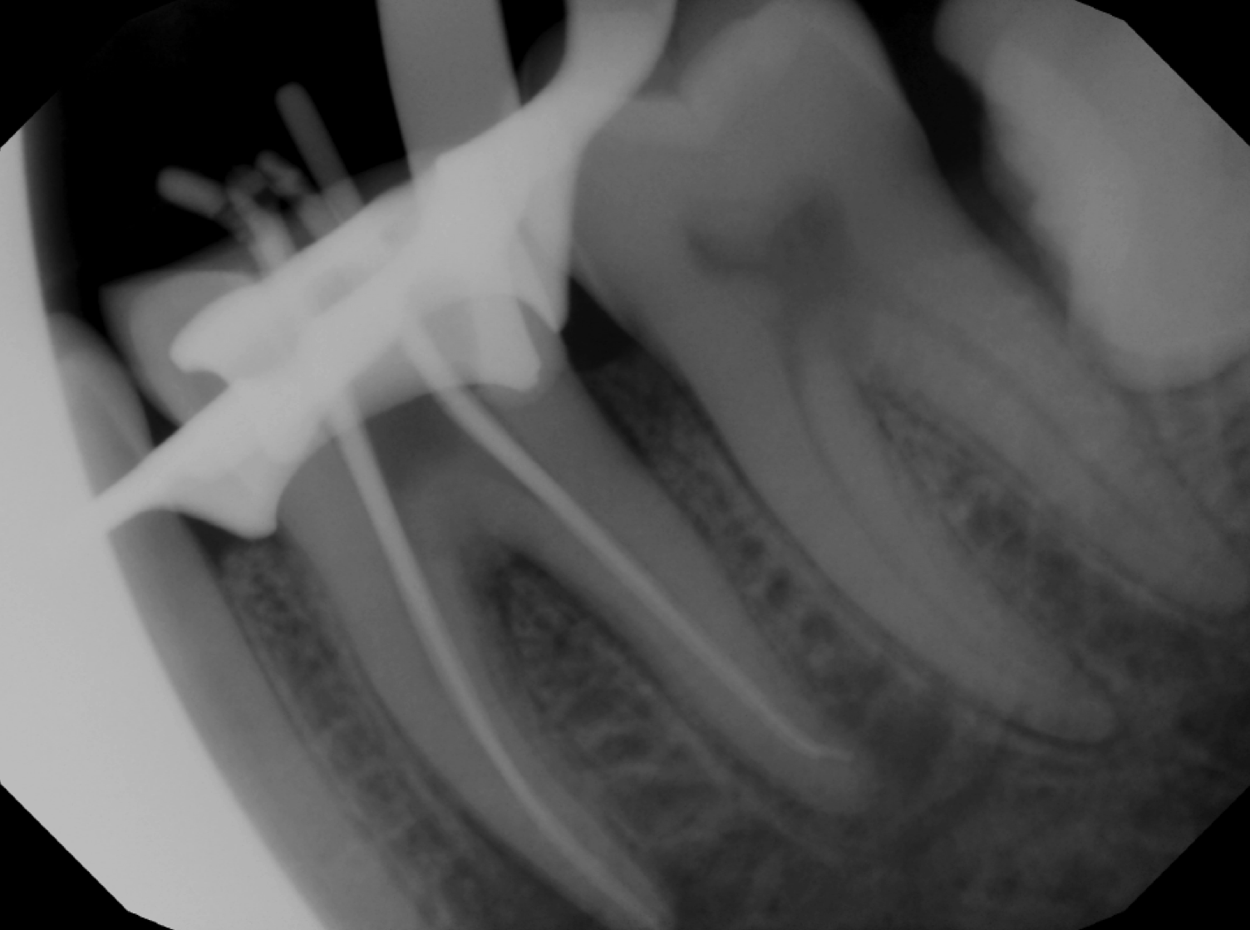
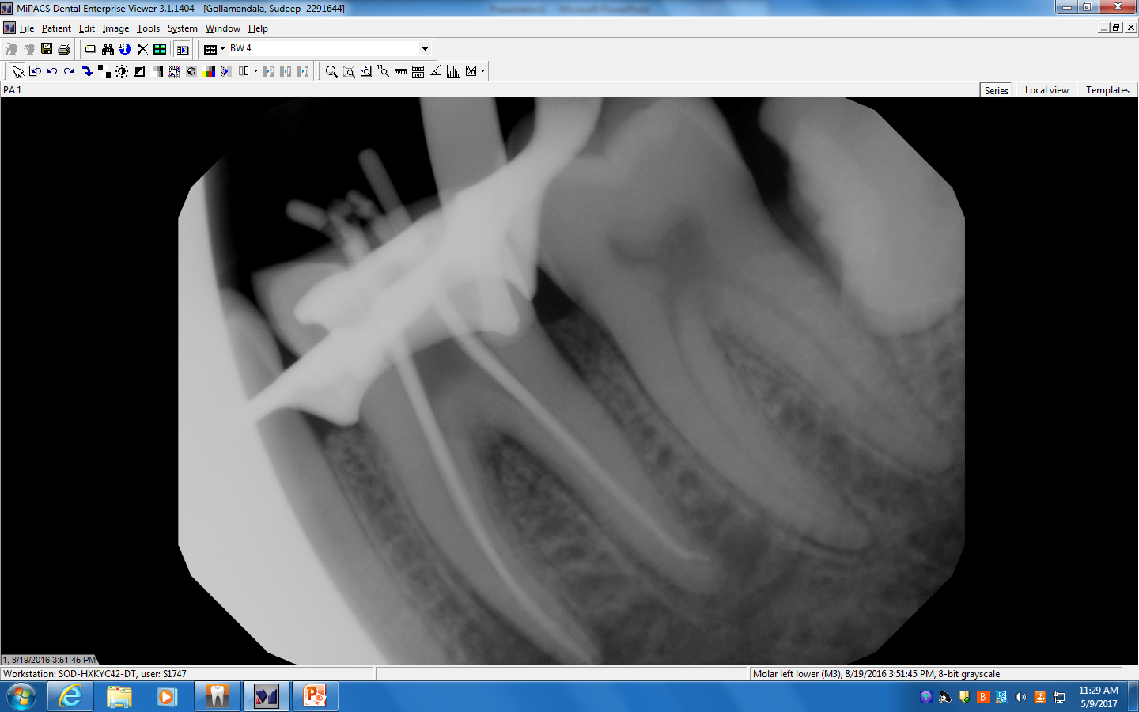
Cone Fit

Slide 8
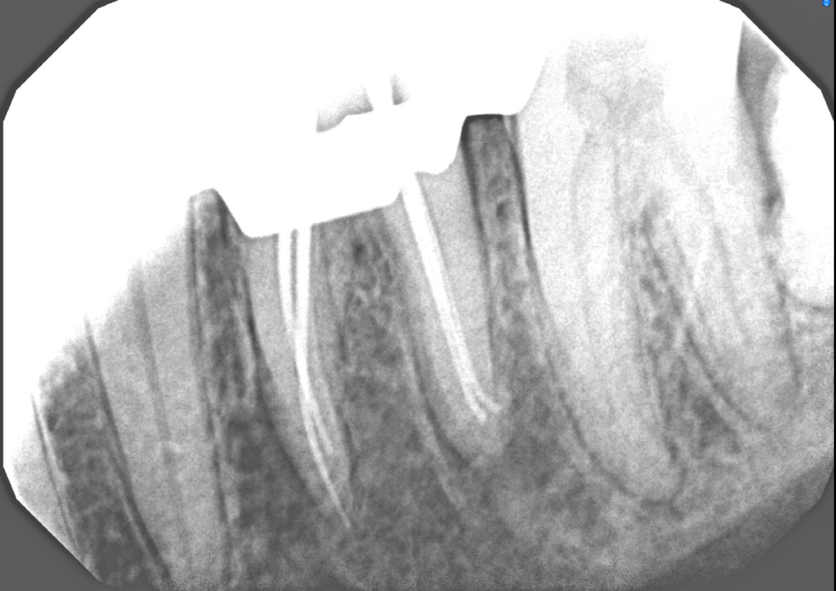
Obtain adequate Tug-back

Slide 9
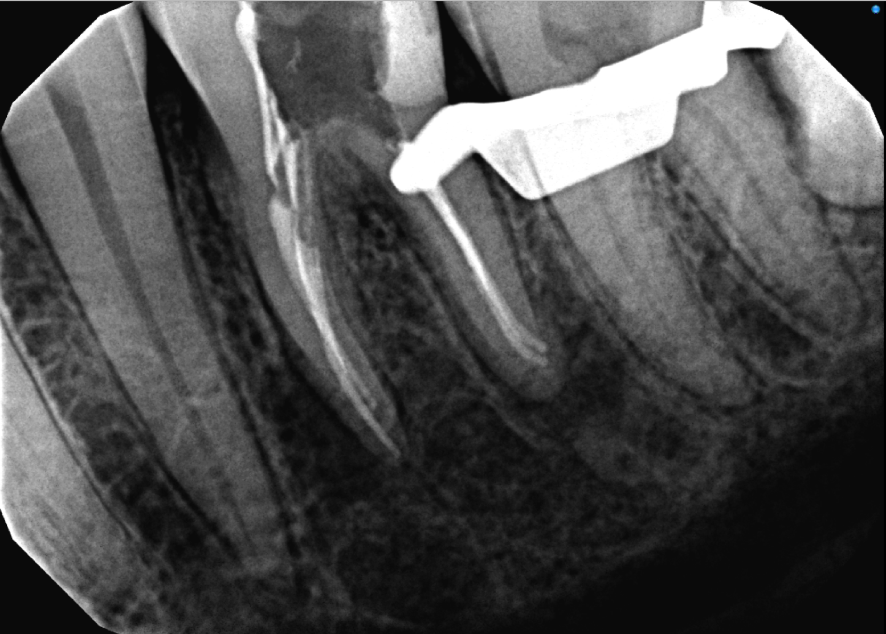
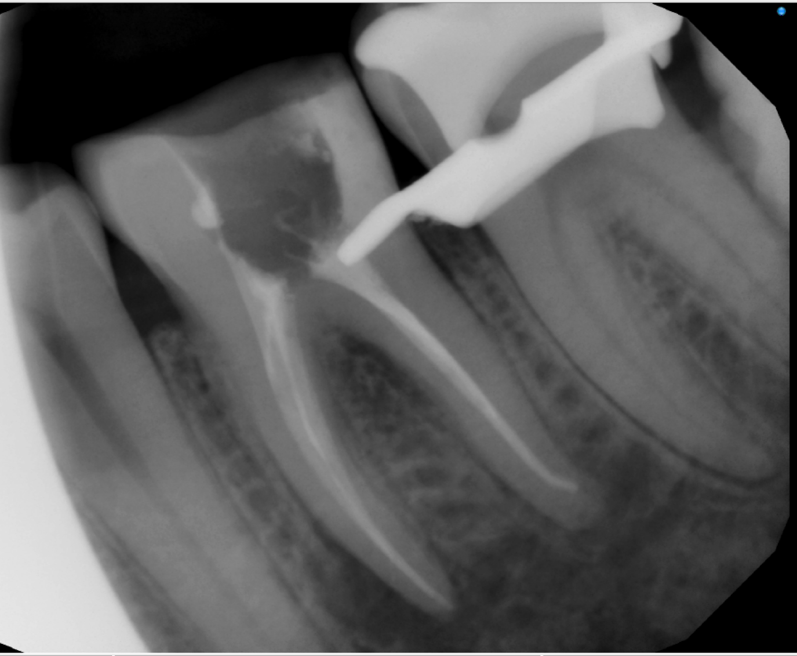
Down pack/ Back pack

Slide 10
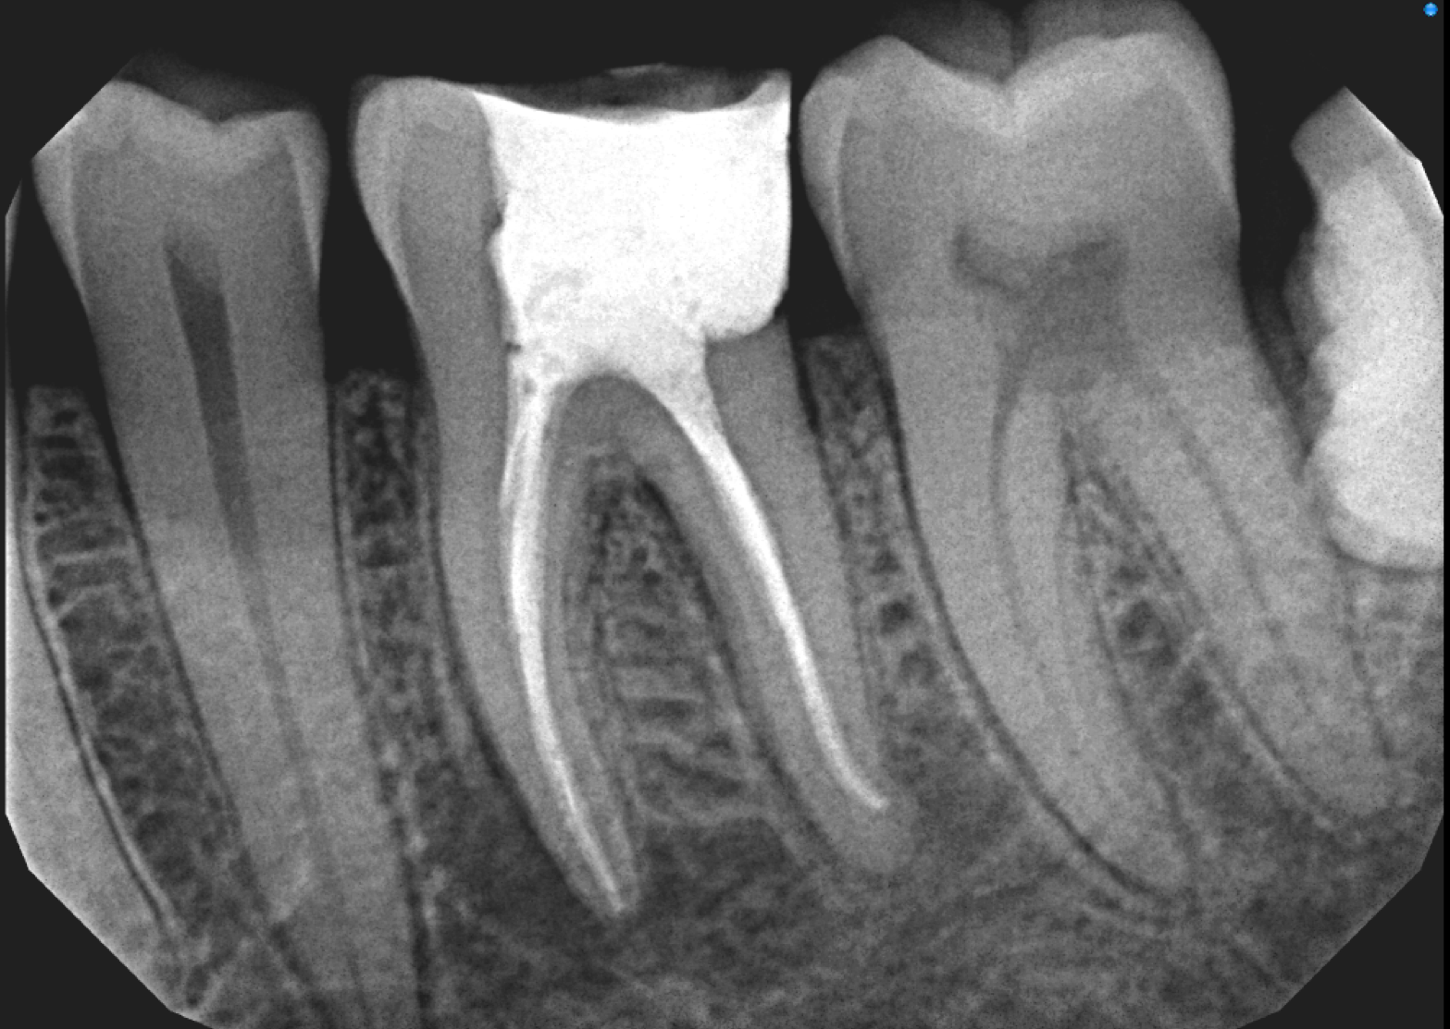
Prepare for Final Restoration
Cr-lengthening
Definitive full coronal restoration

Slide 11
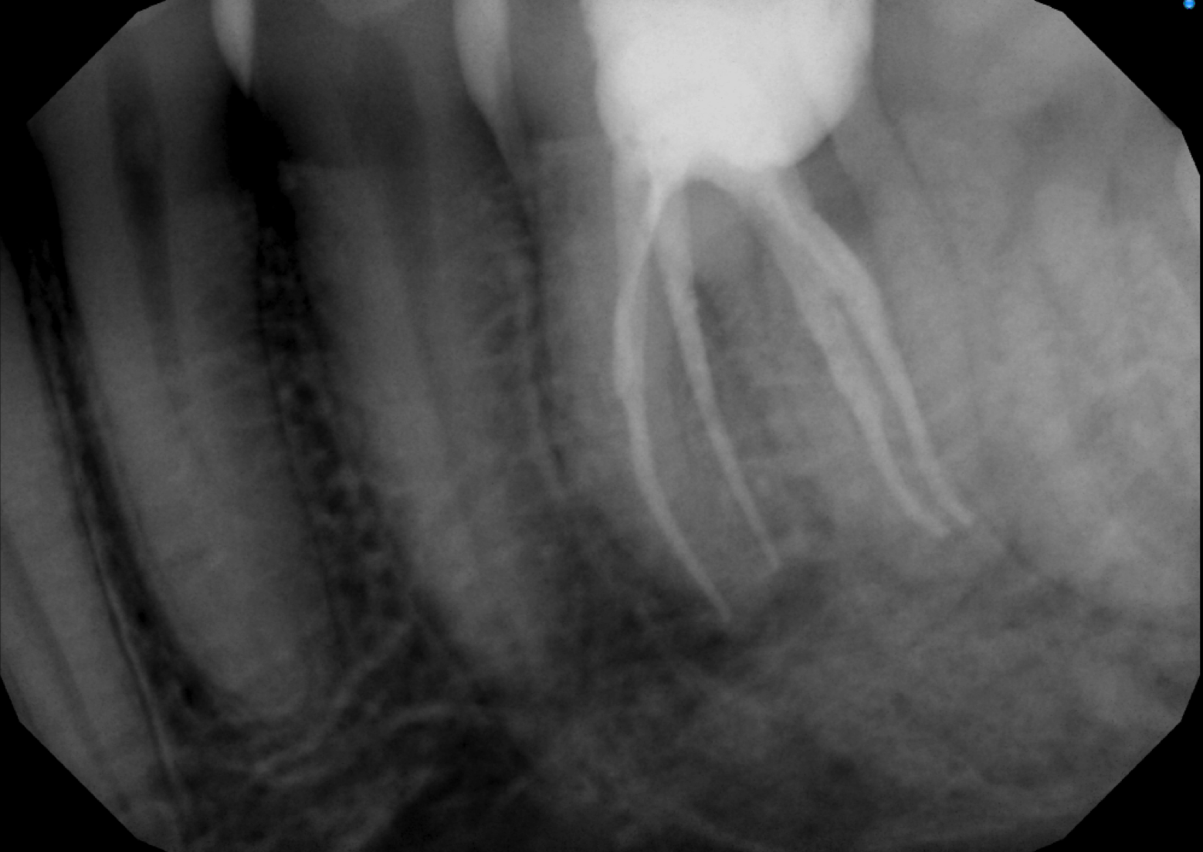
Angled View

