Slide 1
Clinical Presentation
Erika Martinez, Jin Woo Park, Ricardo Jara Castro, Jenny Garcia

Slide 2
Patient information
39 year old female presented for COE with CC: moderate pain on tooth #13 with cold and percussion, main concern is to save the tooth.
Med HX: Healthy, non-contributory, NKDA, not taking any medications.
Soc HX: no history or current use of tobacco, alcohol, or recreational drugs
Dent HX: irregular dental care. Last dental visit was 2006, recent EXT tooth #2 (a month ago).

Slide 3
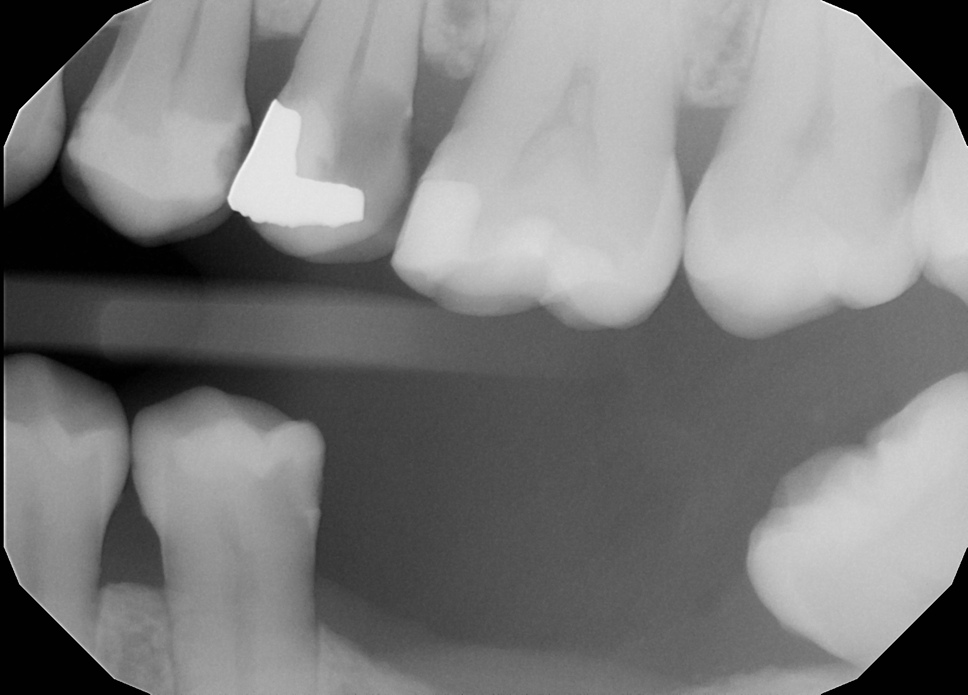
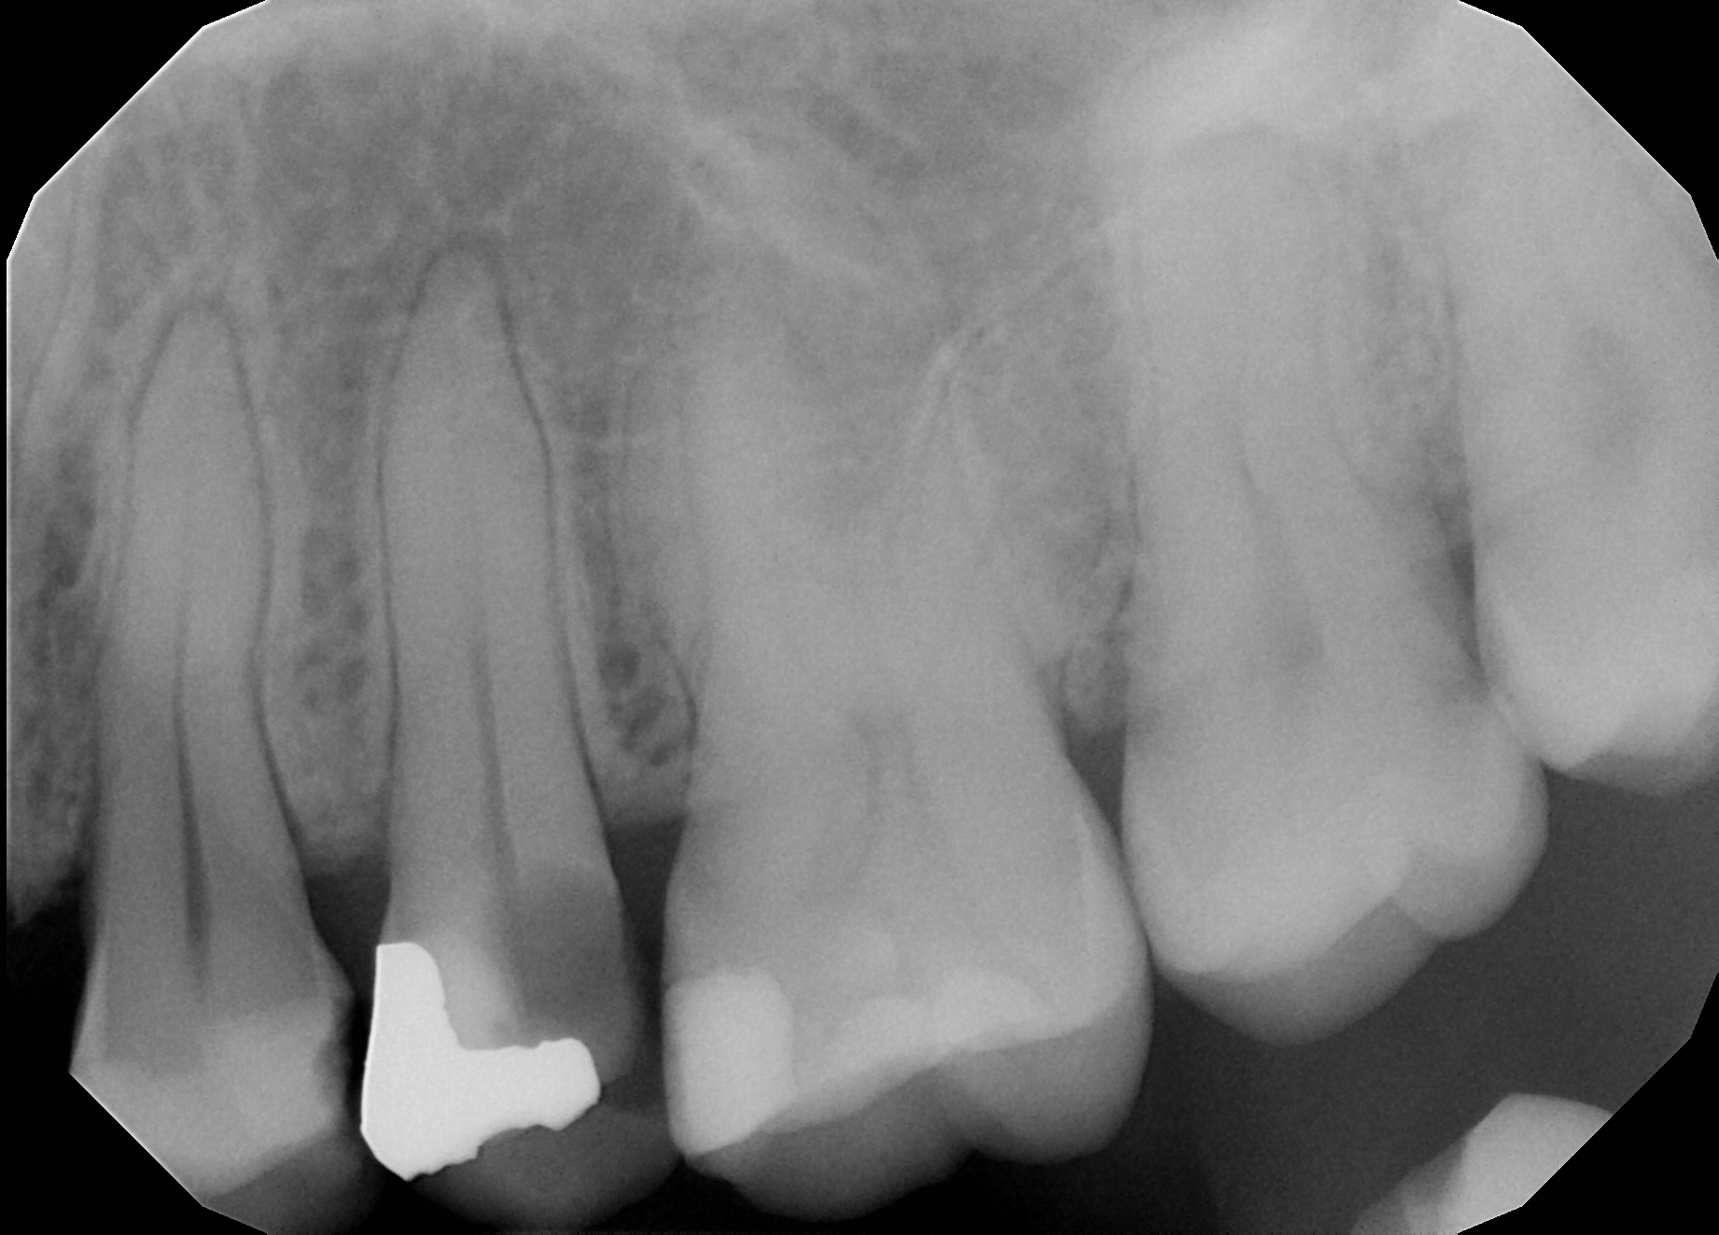
Initial radiographs

Slide 4
Treatment Plan
Initial plan was to do a sedative fill to determine restorability.
MO-amalgam was removed along with distal caries. Tooth was deemed restorable, thus the following treatment plan for #13 was developed
  RCT for tooth #13
  Core B/U
  PFM crown

Slide 5
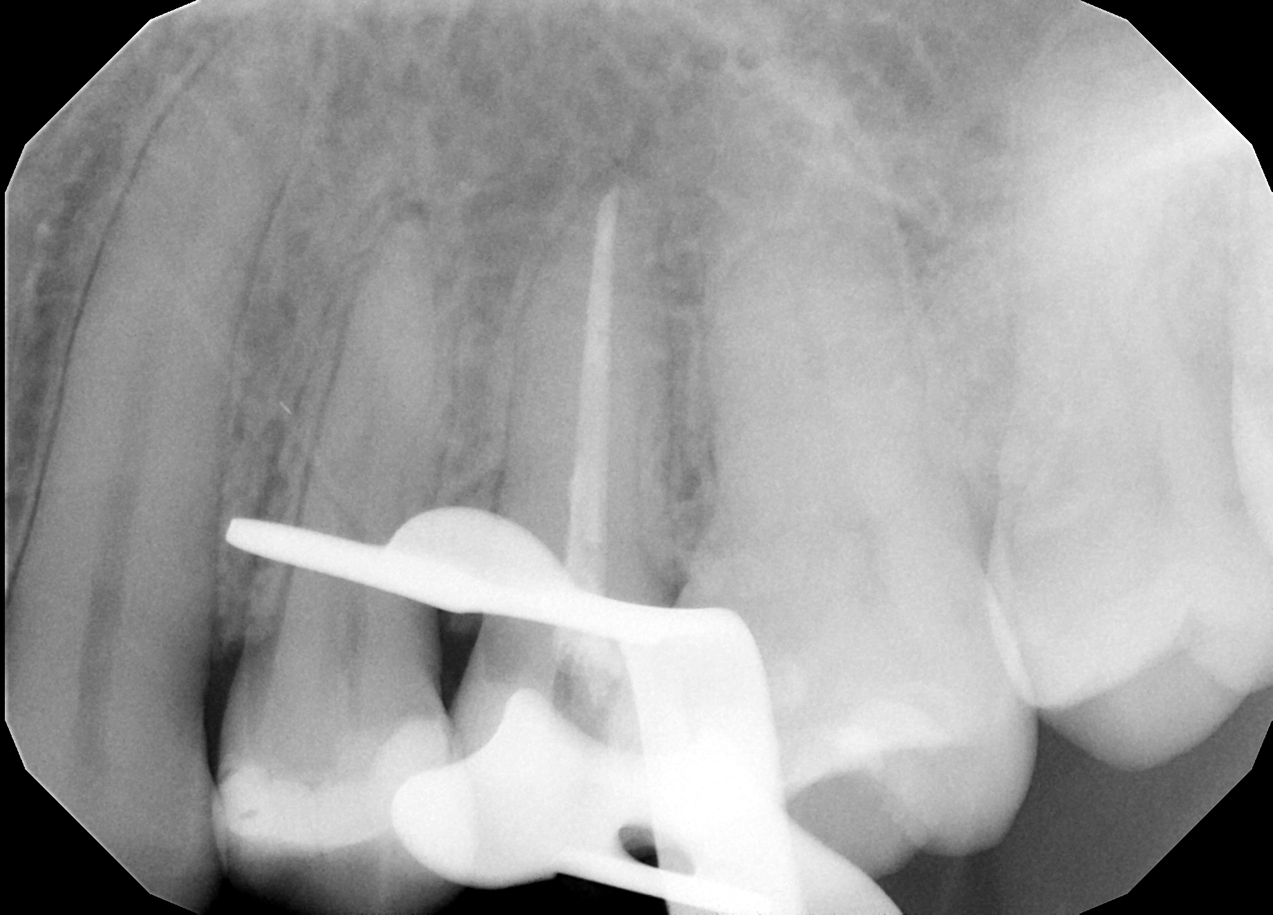
Treatment was as follows:
RCT was completed
Core build up was placed
Final impression of prep was sent to lab

Slide 6
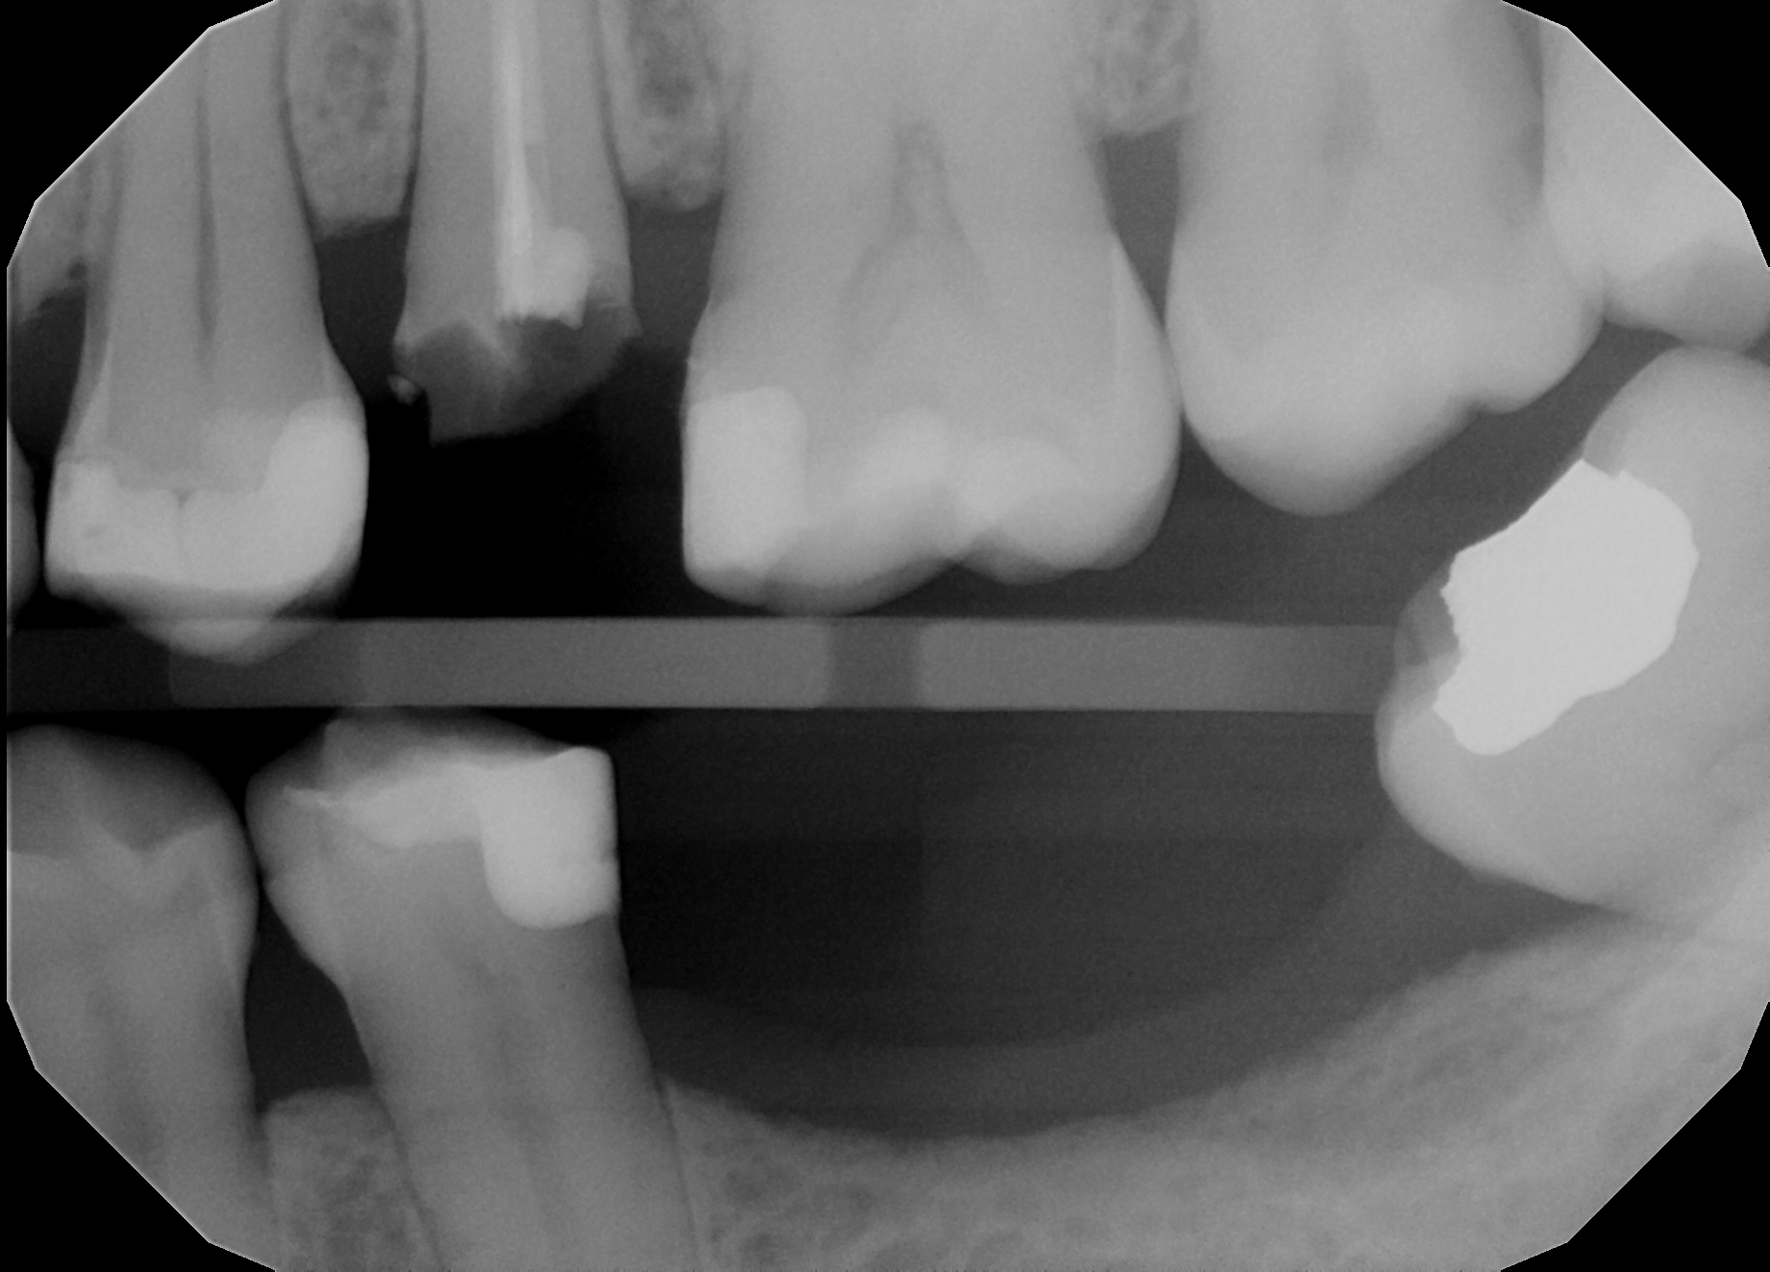
Day of delivery!
When removing the temporary crown this happened:

Slide 7
What to do now?
BREATHE! BREATHE!! And BREATHE some more!!!
Take radiograph to determine how far the tooth is broken
Measure perio pockets to determine if there is enough tooth structure to not invade biological width and have enough ferrule.
Tooth was deemed yet again restorable and proceeded with a post and core!

Slide 8
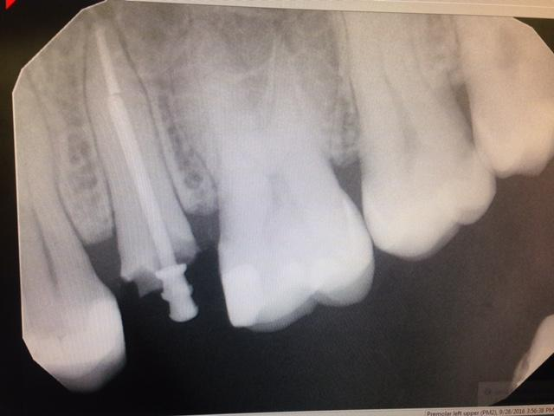
Post and Core
Technique:
Remove gutta percha until ⅓ is left near apex, using indicated bur
Using prefabricated post remove excess of it until perfect fit (using radiographs to assess)
Cement post with GI
Gingivectomy using laser on distal portion
Place comp core
Notes:
Erikas part:
Post n core vs core

Slide 9
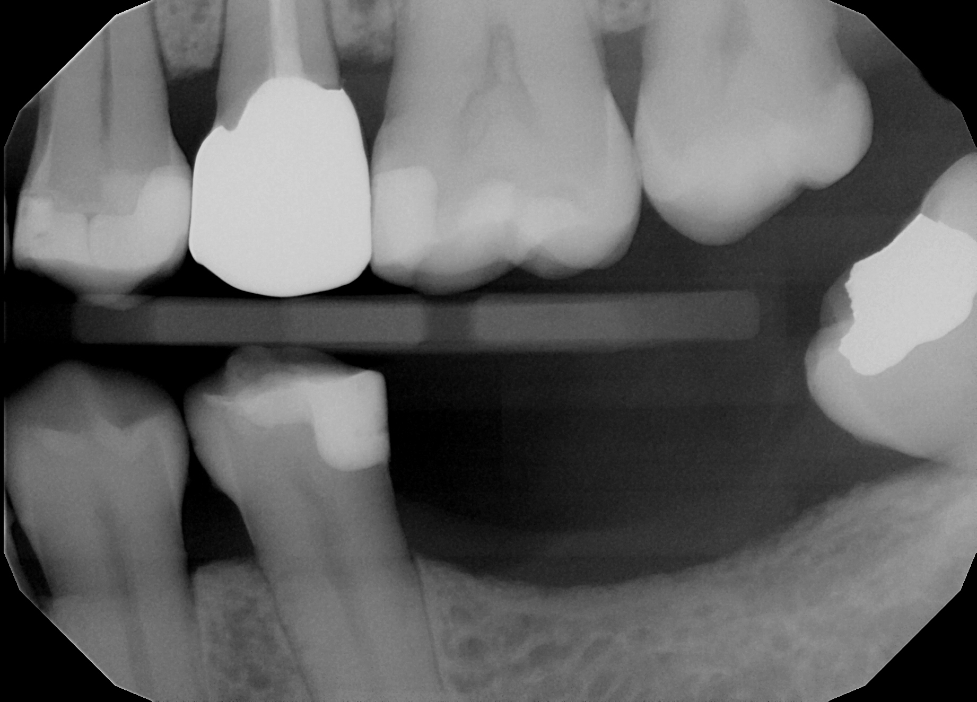
Resolution
Final impression was taken
PFM crown was delivered!
Patient was satisfied!

Slide 10
Reflection: How could I have prevented this from happening
With a better understanding of tooth structure, if the post and core was done before starting the crown prep the probability of the tooth fracturing like it did would have been lowered.
Knowing when a post and core is needed vs only build-up
Instead of using a crown bridge removal forceps use a spoon or a smaller instrument to get underneath the crown to remove it.

Slide 11
Build up: Post & core vs core
Post is needed to retain core when 0-1 walls are remaining.
Core can be used w/o post if 2-4 walls are remaining.
Can add retention wells or troughs for core in addition to post.
Place post in the largest and straightest canal:
Maxillary molar: palatal canal
Mandibular molar: distal canal
Notes:
Erika’s part
0-1 wall: need post
2-4 walls: just core
Post: ⅓ width of tooth, ⅔ length of canal (4mm apical gutta percha should remain)
Fiber post vs prefab metal:
Can bond prefab with cement (ex. Resin cement) or GI. GI was used in this case
Core materials:
Amalgam: strong and well adapted to tooth structure.
Composite: bonds to tooth
RMGI (FujiIILC): must have significant tooth support for crown.

Slide 12
Post Types:
Active: engage into canal walls and dentin surface with threads, like a screw, but it causes stress and lead to tooth fracture.
Passive: do not put stress on walls when inserted since simply retained by luting agents like cement w/o engaging into canal walls.
Passive posts are preferred

Slide 13
Preformed Posts: used 90% of time
Parallel or Tapered:
Parallel: Preferred. Distributes stresses evenly.
Tapered: Fits better into canals but creates internal stresses and wedging occurs.
Metal or Non-metal:
Metal: stainless steel, titanium alloy
Small diameter sizes, very strong but can fracture
Non-metal: ceramic, resin, carbon fiber
Only large diameter, more flexible, translucent (aesthetics)
Notes:
Custom-formed posts: woven fiber and resin that is custom built to fit the canal.
Cast posts: cast in metal (gold, base metal, noble metal). Core and post are 1 piece. Do not use. Use if wide, flaring canal where preformed post would not adapt to canal walls or in badly broken tooth where there is insufficient tooth structure to secure the core.
Non-metal: distributes forces thru out tooth so, less fracture.

Slide 14
Metal post vs. Fiber post
Unfortunately, there is not enough evidence currently to compare the longevity of restorations between two groups.
Some studies^{1,2,3} have shown that fiber post retained crown restoration had lesser chances of failures as compared to a metal post.
However, the most important determining factor for longevity of restoration is dependent upon the presence of ferrule
[1] Gbadebo OS, Ajayi DM, Oyekunle OO, Shaba PO. Randomized clinical study comparing metallic and glass fiber post in restoration of endodontically treated teeth. Indian J Dent Res 2014;25:58-63. Back to cited text no. 1
[2] Preethi G, Kala M. Clinical evaluation of carbon fiber reinforced carbon endodontic post, glass fiber reinforced post with cast post and core: A one year comparative clinical study. J Conserv Dent 2008;11:162-7.
[3] Shashikala K, Sharma S. Clinical and radiological evaluation of cast metal and quartz fiber posts in endodontically restored teeth. Endodontology 2011;3:37 46

Slide 15
Ferrule Effect
In vitro fracture resistance study¹ on endodontically treated central incisors with different ferrule height shows that 2.0mm of ferrule all around the crown shows the most favorable outcome.
The group with 0.5mm ferrule needed 25% less load than the group with 2.0mm ferrule or the group with regular crown before fracture
[1]J Prosthet Dent. 2005 Apr;93(4):331-6. In vitro fracture resistance of endodontically treated central incisors with varying ferrule heights and configurations. Tan PL1, Aquilino SA, Gratton DG, Stanford CM, Tan SC, Johnson WT, Dawson D.

Slide 16
Clinical discussion about ferrule
Ideally, we would like to achieve 2.0mm ferrule all around the crown margin.
However, if the ferrule on the buccal and lingual walls is 2.0mm or more and is less than 2.0 mm on the proximal walls, it has the BETTER outcome than the other way around.
Here are options if we do not have it clinically
See if soft tissue crown lengthening with laser or blade could expose more tooth structure to prep on to
Consider surgical hard tissue crown lengthening

Slide 17
Recap on post, core, and crown
Posts used only for the retention of core materials when there is one or no walls left.
Post retention improves with increases in post LENGTH, rather than diameter.
Remaining tooth structure is more important than post length in avoiding tooth fracture.
Use the smallest post that can engage up to the apical seal of 5mm.
Adhesive fixation is preferable to cemented posts and cores since it produces a higher fracture resistance.
The 2mm ferrule rather than the type of post usage is the better indicating factor for the success rate of endodontically treated teeth.

Slide 18
Biological Width
BW: Junctional Epithelium (JE) + Connective Tissue Attachment (supracrestal) = about 2mm
(i) Junctional Epithelium: contains collagen IV + hemidesmosomes
(ii) Connective Tissue: contains sharpey’s fibers (collagen type III) that insert from CT into cementum

Slide 19
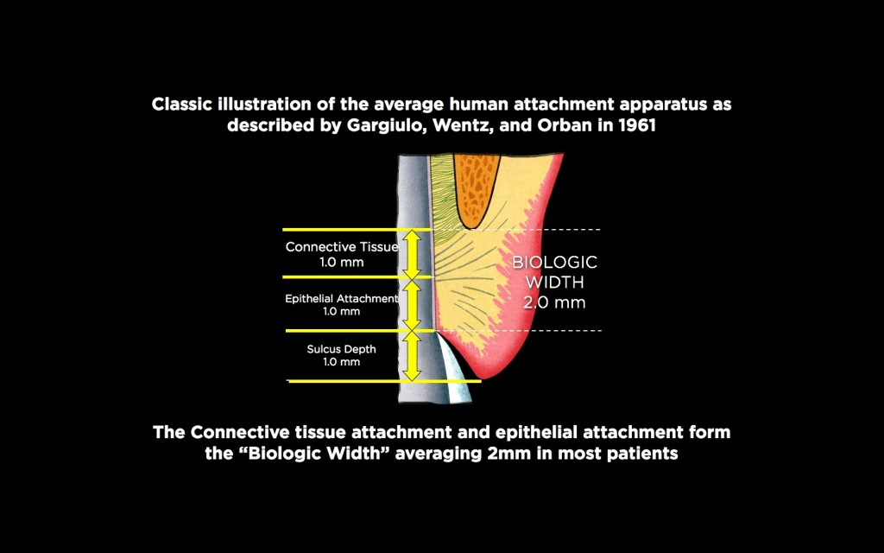
https://www.speareducation.com/spear-review/2014/12/biologic-width-part

Slide 20
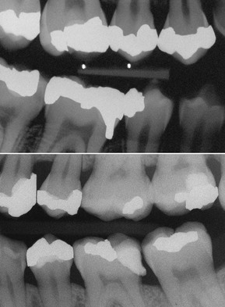
Function and Violation of Biologic Width
(i) Function of Biologic Width: serves to protect periodontium ALL around tooth
(ii) Violation of Biologic Width (e.g. restoration is placed too subgingivally) → resulting in bone resorption and other perio health issues
**Ideally: place margin of restoration supragingivally or at the gingival margin. If subgingivally, make sure restoration is 3mm above alveolar bone
https://pocketdentistry.com/1-diagnosis-and-treatment-planning-in-restorative-dentistry/

Slide 21
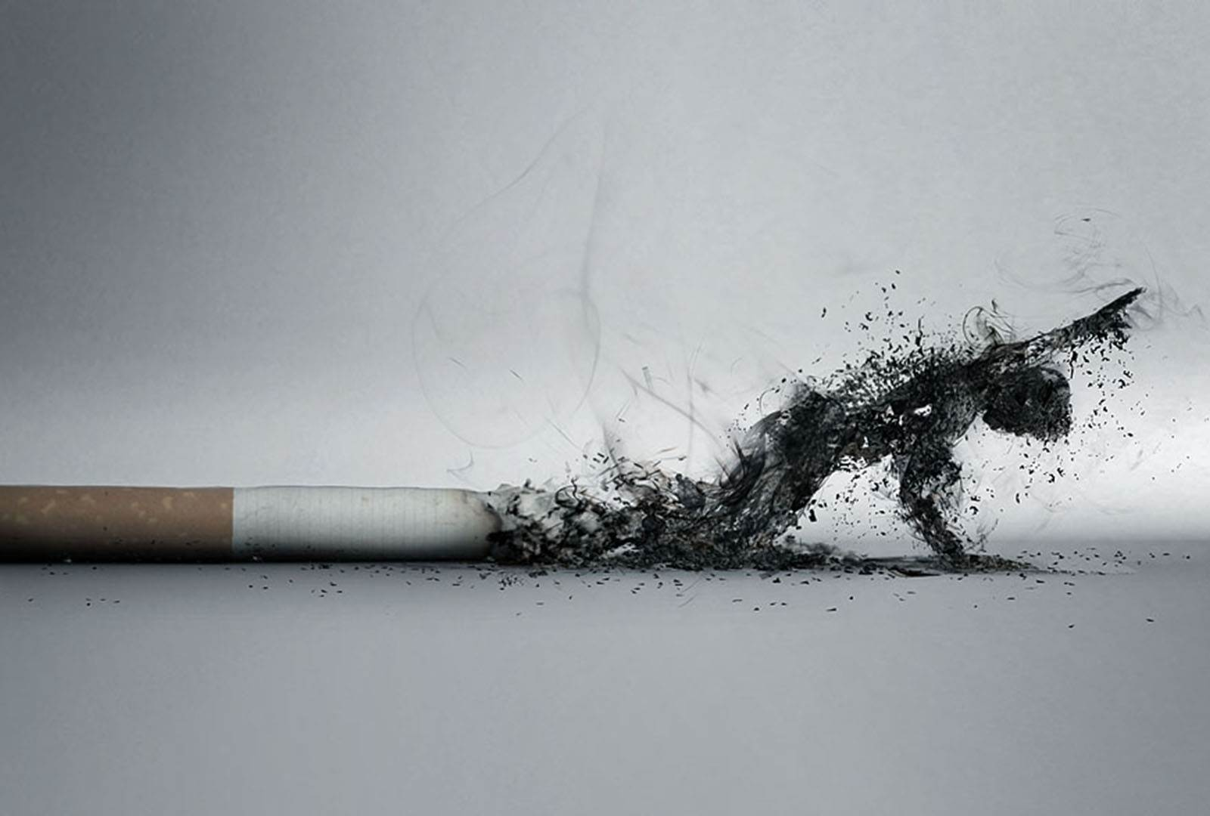
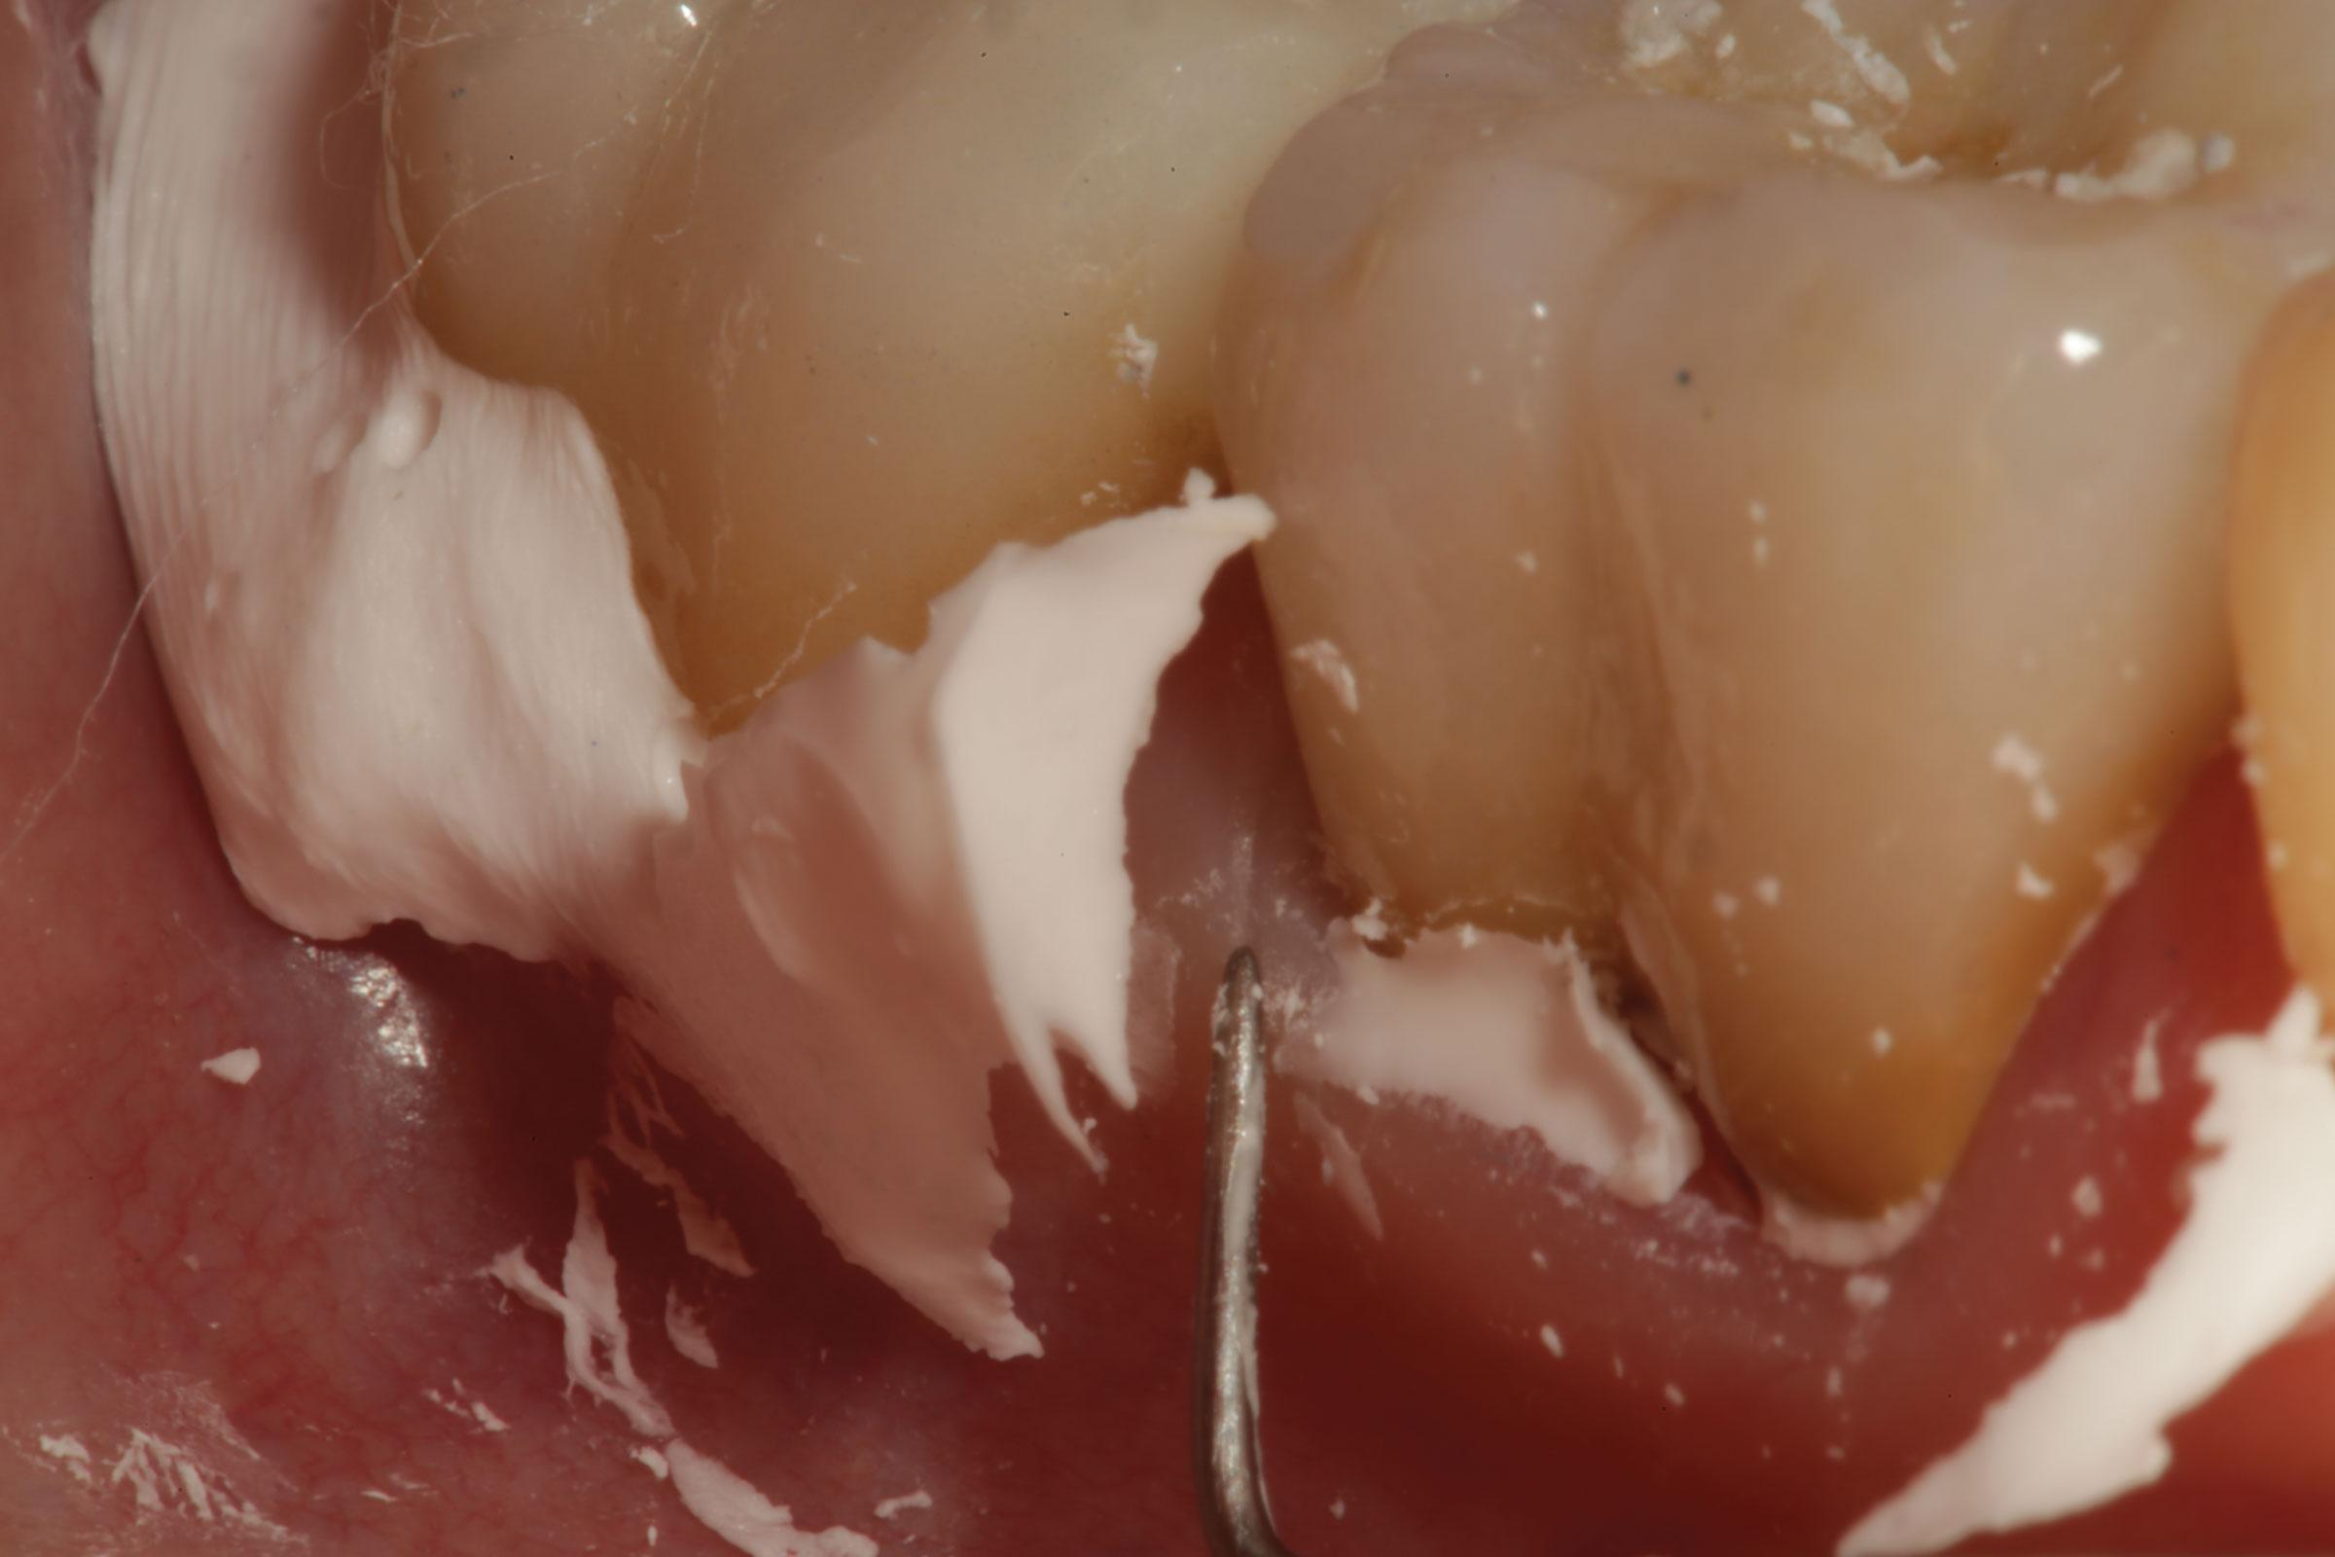
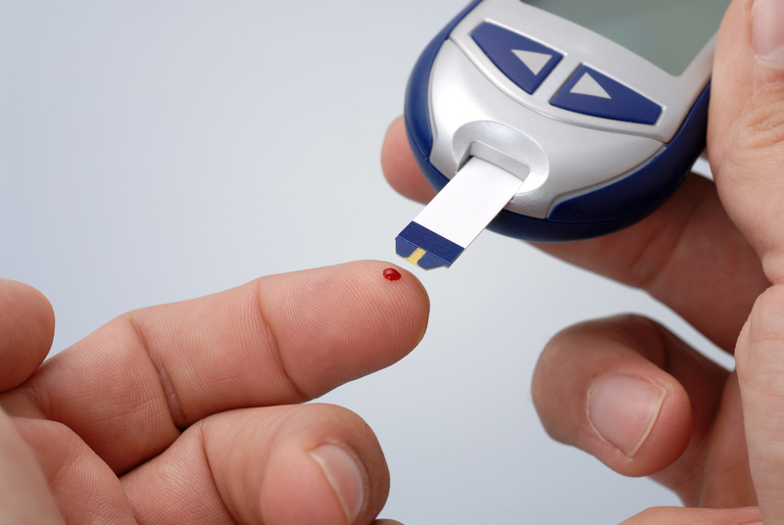
...may also cause violation of Biologic Width
(i) Diabetes
(ii) Smoking
(iii) Excess cement
**All these lead to inflammation and subsequent bone loss
http://www.dentistrytoday.com/articles/10134

Slide 22
Take away
Before starting any procedure have an end goal and think about possible complications that could occur along the way.
When accessing restorability of a tooth and making final decisions on permanent restorations take into account:
  Sound tooth structure remaining
    Need for build up? Post & core?
    Biological width violated once there is proper ferrule?

Slide 23
Reference
Dr Rising’s Post and Core Endo Lecture. Spring 2015
Gargiulo AW, Wentz FM, Orban B. Dimensions and relations of the dentogingival junction in humans. J Periodontol. 1961;32:261–7
Nugala B, Kumar BS, Sahitya S, Krishna PM. Biologic width and its importance in periodontal and restorative dentistry. J Conservative Dentistry. 2012;15(1):12-17
K.D. Jorgensen, G.F. Petersen. The grain size of zinc phosphate cements. Acta Odontol Scand, 21 (1963), pp. 255–270

Slide 24
Thank you

