Slide 1
saving a tooth:
Orthodontic extrusion
Post & Core build up
crown
lauren frisch
Masha Naanaa
Gina Nguyen
Kay rodriguez
Scott shames
Adam wandell

Slide 2

Clinical Presentation

Slide 3
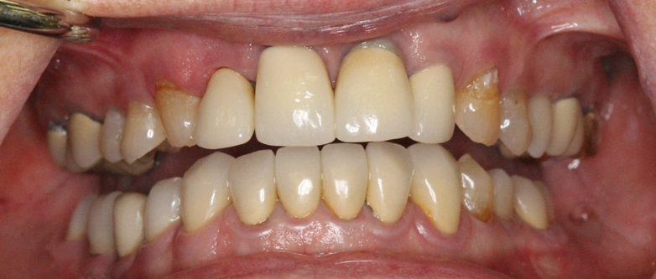
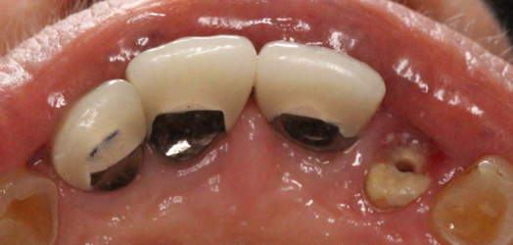
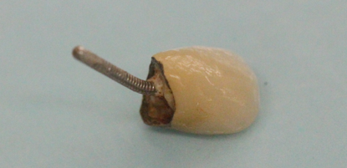
Initial Presentation

Slide 4
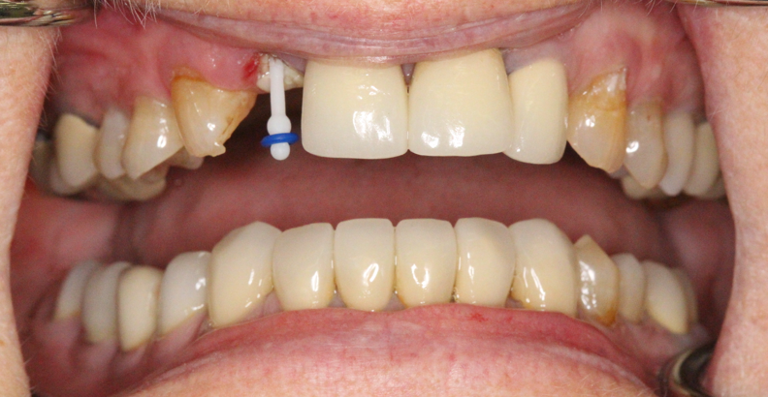
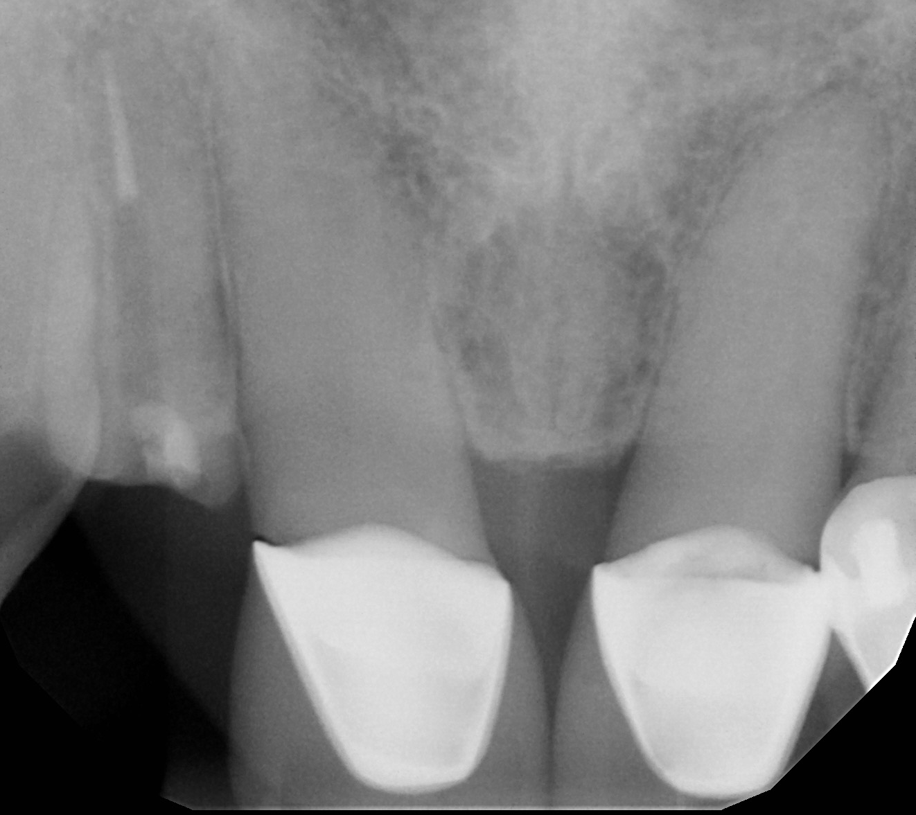
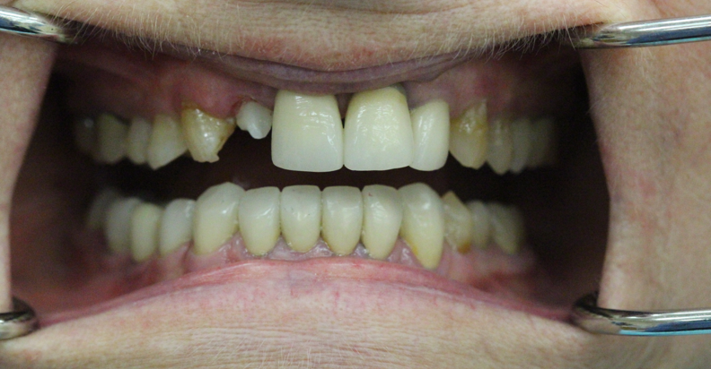
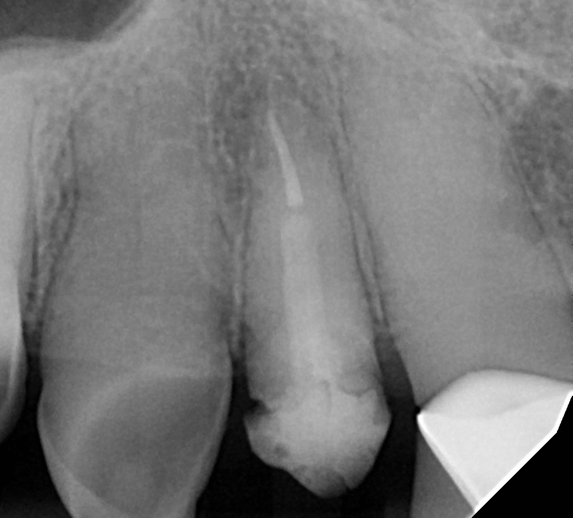
Post & Core → Orthodontic Extrusion → Temporary → Stabilize → Final Restoration

Slide 5
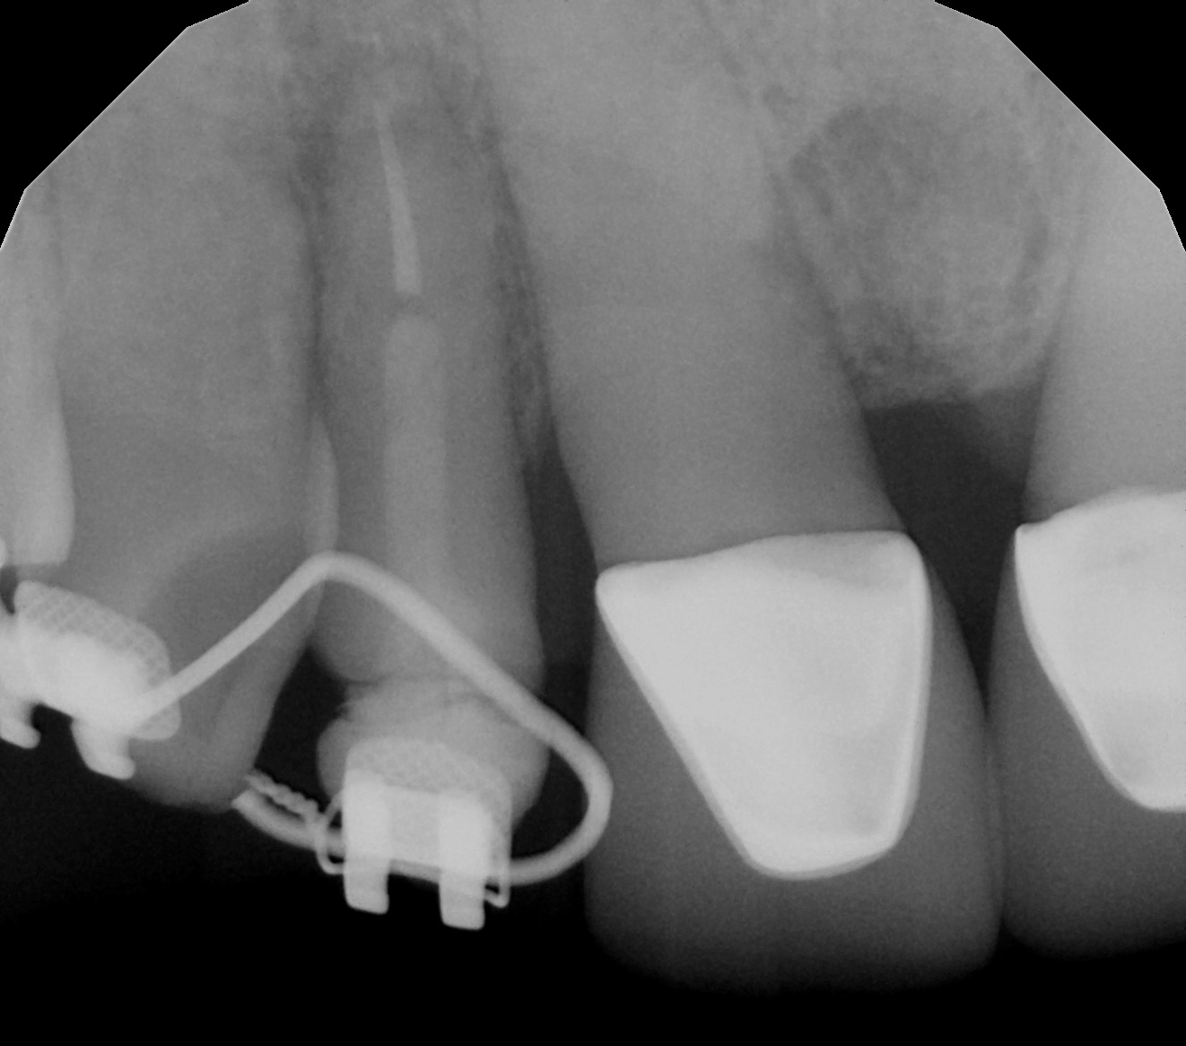
Post & Core → Orthodontic Extrusion → Temporary → Stabilize → Final Restoration

Slide 6
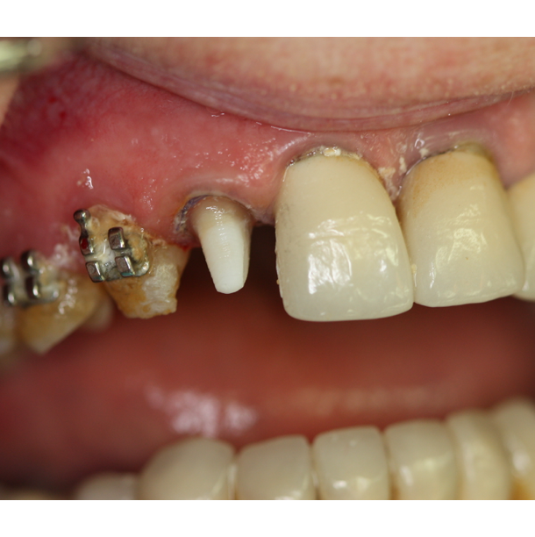
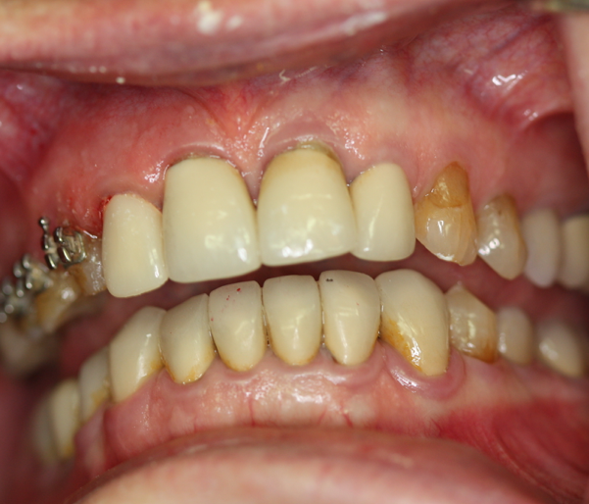
Post & Core → Orthodontic Extrusion → Temporary → Stabilize → Final Restoration

Slide 7
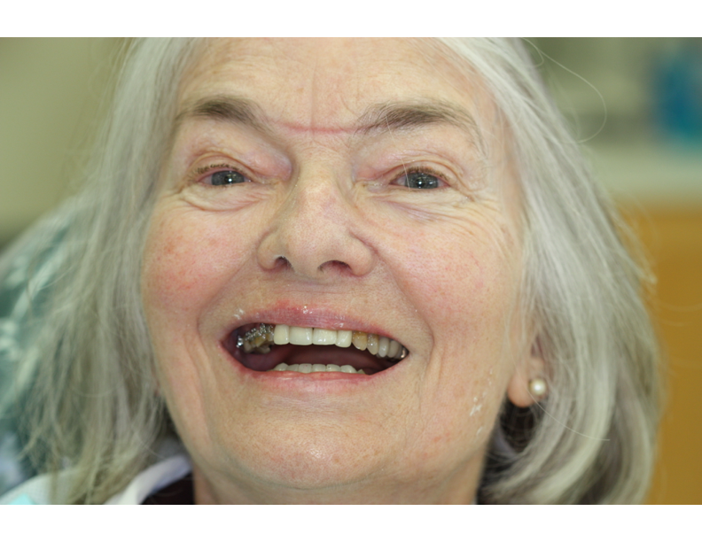

Post & Core → Orthodontic Extrusion → Temporary → Stabilize → Final Restoration

Slide 8

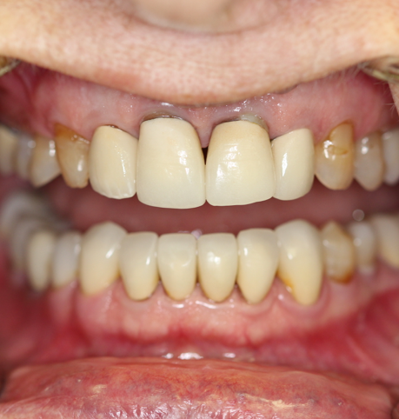
Post & Core → Orthodontic Extrusion → Temporary → Stabilize → Final Restoration

Slide 9
Clinical Decisions:
Crown lengthening versus Orthodontic Extrusion
Prefabricated posts versus Custom posts
Cementation of Post
Definitive Restoration Selection

Slide 10
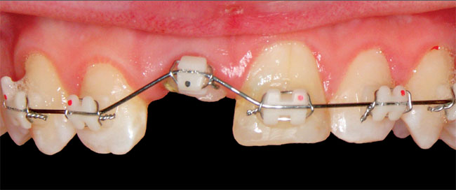
How should I expose more tooth structure?
Crown Lengthening versus Orthodontic Extrusion

Slide 11
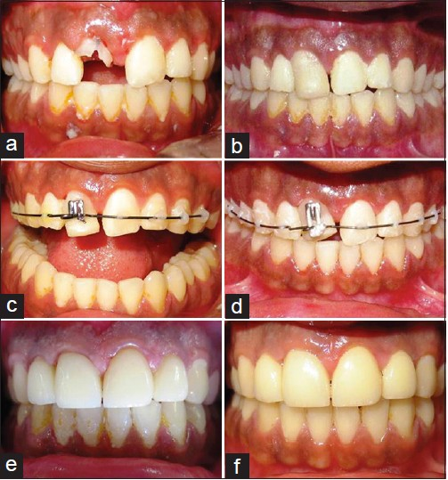
Creating Ferrule:
Ortho Extrusion Vs. Crown Lengthening
Orthodontic Extrusion
+ Creates ferrule without significantly reducing the crown-root ratio or invading biologic width
+ Maintains an even gingival contour: Ideal for anterior teeth
+ More esthetic than a pontic:
Optimal for high smile lines
+ Improves alveolar bone prior to extraction and implant
- Time: 6 months extrusion, 4-6 months of stabilization to avoid relapse

Slide 12
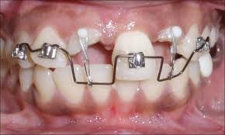
Creating Ferrule:
Ortho Extrusion Vs. Crown Lengthening
Goals:
1:1 crown to root ratio
~ 4mm forced eruption (2.5 mm from crestal bone, 1.5mm of erupted tooth structure)
Broader roots provide better emergence profiles
Orthodontic Extrusion Technique:
Heavy traction = fast eruption and max PDL strength
  Fast eruption prevents new crestal bone from forming near new CEJ (need 4 mm of tooth above crestal bone)
Fiberectomy or crown lengthening prevents bone formation near new CEJ
Bond teeth on either side of erupting tooth
  Single rooted tooth: 1 on either side
  Multirooted tooth: 2 on either side
Stabilize with bonded retainers for 4-6 months to prevent apical relapse

Slide 13
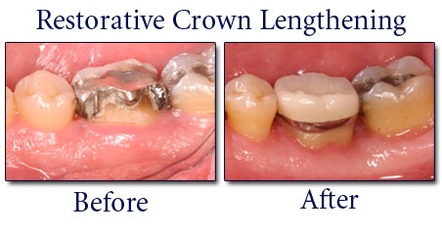
Creating Ferrule:
Ortho Extrusion vs Crown Lengthening
Crown lengthening
+ Faster results chairside (8-12 weeks for maturation of gingival tissue to prevent exposure of crown margins)
+ Multiple adjacent teeth needing crown lengthening can be done at once
- Uneven gingival contour
- Less favorable crown to root ratio: tooth must have long roots to maintain bone support
- Tooth may become more mobile
- Less bone support if implant is needed in the future

Slide 14
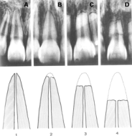
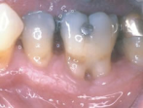
Risks of orthodontic extrusion
High forces exerted on tooth may lead to root resorption
Short roots (C:R < 1:1) do not allow support of restoration.
Exposure of furcation
Esthetic result may be unsatisfactory
Wearing orthodontic bracket and wires may not be esthetic for some.
Length of extrusion and immediate need to restore space.
Periodontal surgery still may be needed at the end of extrusion to fix any discrepancies.
Relapse if no fiberectomy is performed or if there is an inadequate stabilization period

Slide 15
Benefits of orthodontic extrusion
Does not impinge on biologic width
Conservative
No loss of bone or periodontal support as seen in surgical crown lengthening.
More favorable crown-root ratio
Relatively easy movement
Cost-effective
Avoid a fixed bridge and damage to adjacent teeth.
Retains periodontal support

Slide 16

Alternatives
Extraction and do nothing
Extraction with fixed bridge
Extraction with removable prosthesis.
Extraction with implant
Crown lengthening with post, core and crown.
Orthodontic Extrusion with Crown Lengthening and post, core and crown.

Slide 17
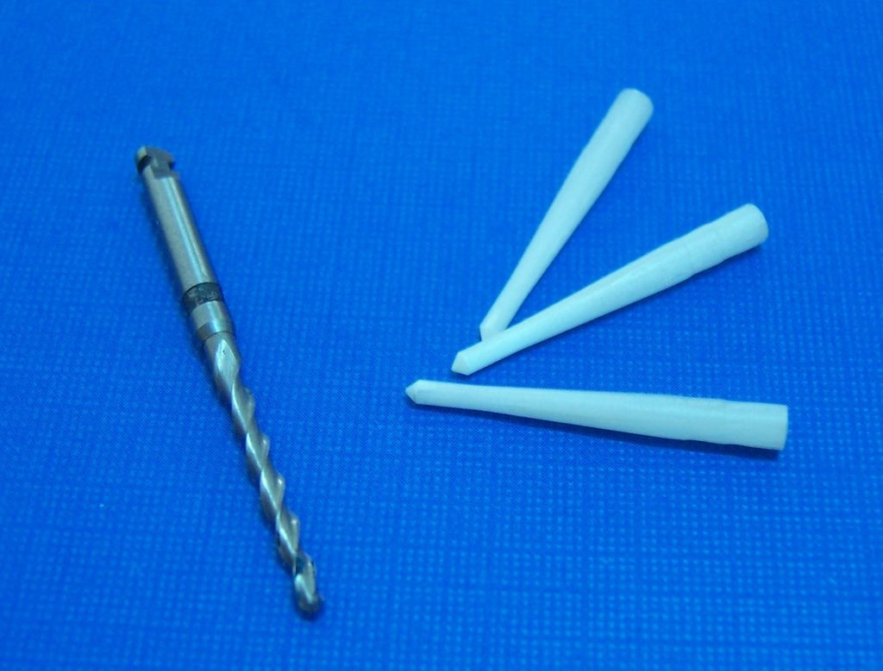
When should i place a post?

Slide 18
Answer According to AAE: “When there is extensive loss of coronal tooth structure”
Examples:
Anterior teeth with less than 4mm of ferrule
Mandibular Molars with extensive loss in Distal Canal
Maxillary Molars with extensive coronal loss in Palatal Canal

Slide 19
Rules for Placing a post
Retain minimum 4mm of gutta percha apically
Remove little (if any) dentin beyond what is needed
Consider retrievability when selecting which type of post to use
Do not contaminate the canal

Slide 20
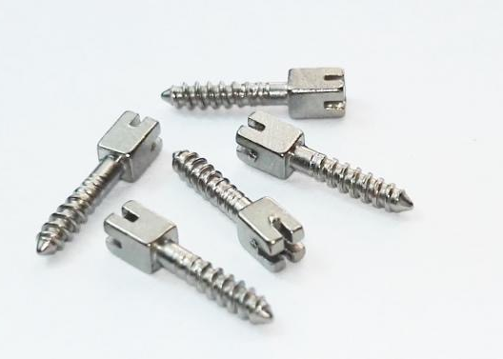
METAL POSTS
Widely used for the past 20 years
Can be removed if re-treatement is necessary
All metals are usually acceptable except Titanium
  Titanium alloys are weak and not suitable for thin posts, and are hard to see radiographically

Slide 21
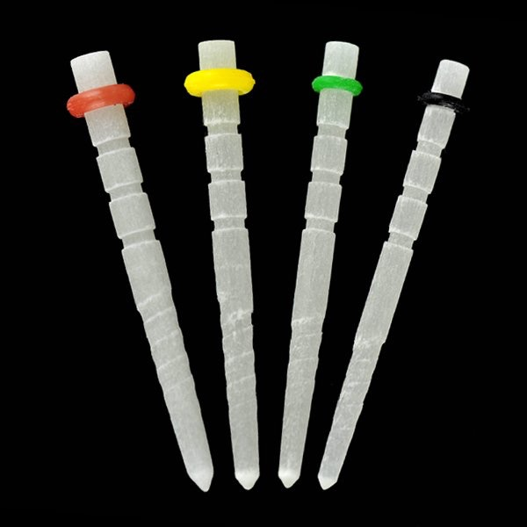
Fiber posts
Similar modulus of elasticity to dentin (made of carbon or quartz)
  They can flex when under stress = less root fracture
  Some studies show they strengthen the root when placed with resin cement
May flex under load causing leakage under the crown

Slide 22
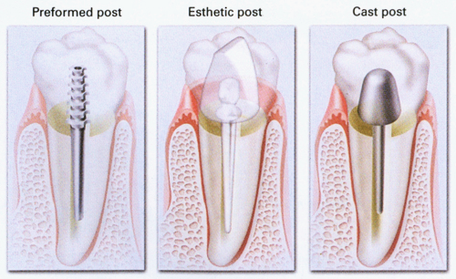
Prefabricated posts
-vS-
custom posts

Slide 23
Prefabricated Posts
Pros:
Can choose between many different materials, as well as it being an active or passive post (active is more retentive but introduces more stress into the root)
Can be completed in one appointment
Less expensive - no laboratory fee
In esthetic area, can choose to use a fiber post
Cons:
Application is limited when considerable coronal tooth structure is lost
Possibility of chemical reaction when post and core are made of dissimilar metals
Contraindicated when tooth is to act as an abutment
Root is designed to accept the post, rather than the post being designed to fit the root

Slide 24
Custom Posts
Pros:
It requires minimal removal of tooth structure
Provides a better geometric adaptation to extremely tapered canals
If multiple teeth require posts, it is more efficient to take an impression and fabricate them all in a laboratory
Can angle core in relation to post when the tooth is misaligned
Indicated for small teeth, when minimal coronal tooth structure is available
Cons:
It requires two appointments
Temporization in between appointments
Temporary post/crown is not particularly effective in preventing contamination of root canal system
Laboratory fee associated with fabricating the post and core
Metal material may show through esthetic ceramic restorations

Slide 25
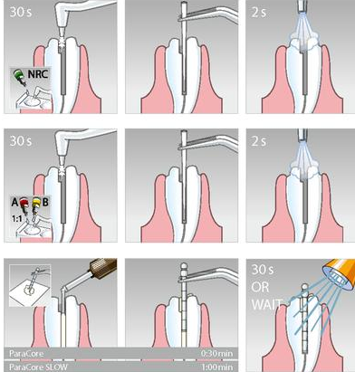
Post Cementation Method
Dry post space with paper points.
Place choice of cement over post and post hole with paper point or endodontic explorer.
  If cement is only placed onto the post, there is reduced retention
  To ensure that the post is completely seated, measure the post space with periodontal probe and confirm that post is inserted by the same amount

Slide 26
Types of Cement
Zinc Phosphate
  Traditional and oldest cement
  Retention depends on mechanical interlocking
  Superior retention to polycarboxylate cement when tapered posts are used
Polycarboxylate
  First cement used with potential for adhesion to tooth structure
  Compared to zinc phosphate, it has lower compressive strength and equal tensile strength
Glass Ionomer
  Releases fluoride and chemically adheres to tooth structure
  Compared to resin composites, it has a lower compressive strength, tensile strength and hardness
Resin-Modified Glass Ionomer
  Improved properties compared to traditional glass ionomer
Composite Resin
  If smear layer is removed from walls of post space preparation, then superior retention is achieved due to micromechanical retention
Notes:
*use temp cement for temp posts..

Slide 27
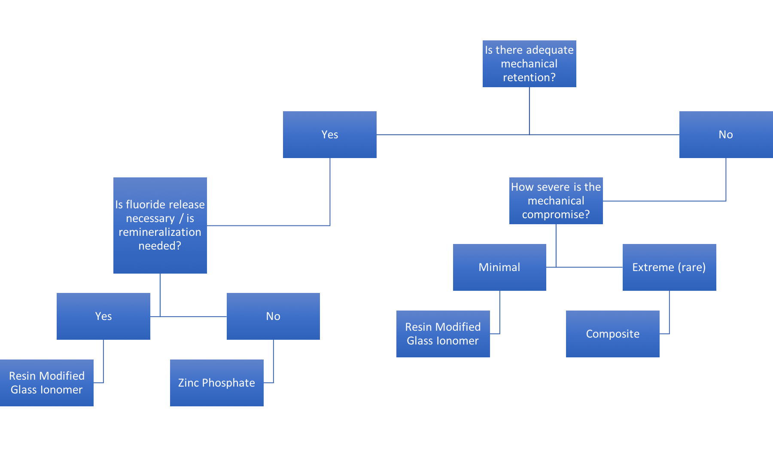
selecting a cement
Overall, If a post has adequate length and resistance form, satisfactory retention and seal can probably be attained with any of the luting agents and post systems.

Slide 28
self-reflection
WHAT I DID WELL
The patient was satisfied with the esthetic result; PFM crown matched adjacent crowns
Orthodontic extrusion moved the tooth into an ideal position for me to create a crown without surrounding bone loss
No signs of relapse…yet. I am happy that I waited 6 months to start on the final restoration
WHAT I WOULD CHANGE NEXT TIME
I would have used a custom post and core for the narrow canal to be better adapted
I would have had the patient on a tighter periodontal recall (lots of plaque / debris built up in the brackets
Initially, the fiber post we placed was intended to be a temporary until the orthodontic extrusion was completed. I would have cemented the “temporary” post with fuji IX instead of fuji II (which does NOT come out)

