Slide 1
PCC 146.02
Clinical Case Presentation
Prajna Banan I1704
Gurnoor Dutt I1710
Akshaya Pallod I1718
Rehnisha Patel I1719
Chaitali Thakker I1724

Slide 2
ESTHETIC DENTISTRY
Art and science of dentistry applied to create or enhance beauty of an individual within functional and physiological limits.
Treatment options
Orthodontic treatment
Composite restorations
Veneers
Crowns

Slide 3
Diagnostic work up
Necessary to evaluate, visualize and predict the functional and esthetic outcome prior to performing clinical procedures
Includes:
Photography
Diagnostic models
Wax up

Slide 4
PHOTOGRAPHY
Smile analysis:
Repose, Mid-smile and full smile pictures
Evaluate crown height, gingival architecture, relationship of zenith and incisal edges
Gray scale photo:
Characterization and surface texture evaluation:
Helps determine overall value

Slide 5
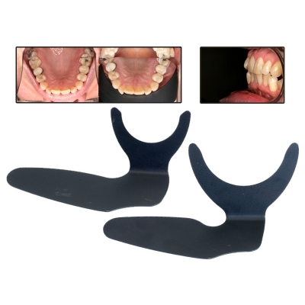
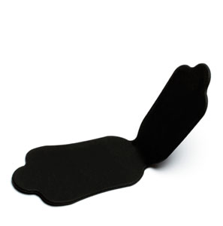
Shade analysis and diagramming
Use neutral gray background to reduce the influence of surrounding colors . Contrasters are available in the market
The overall lifelike, esthetic result of an all-ceramic restoration is influenced by the following factors:
shade of the preparation,
shade of the restoration (ingot/block, layering material) and
shade of the cementation material

Slide 6
Diagnostic Models
To evaluate occlusion
To create wax up- Can be used as template for temporary restorations
Helps to plan modifications in the treatment such as prep designs
Helps in presenting case to the patient

Slide 7
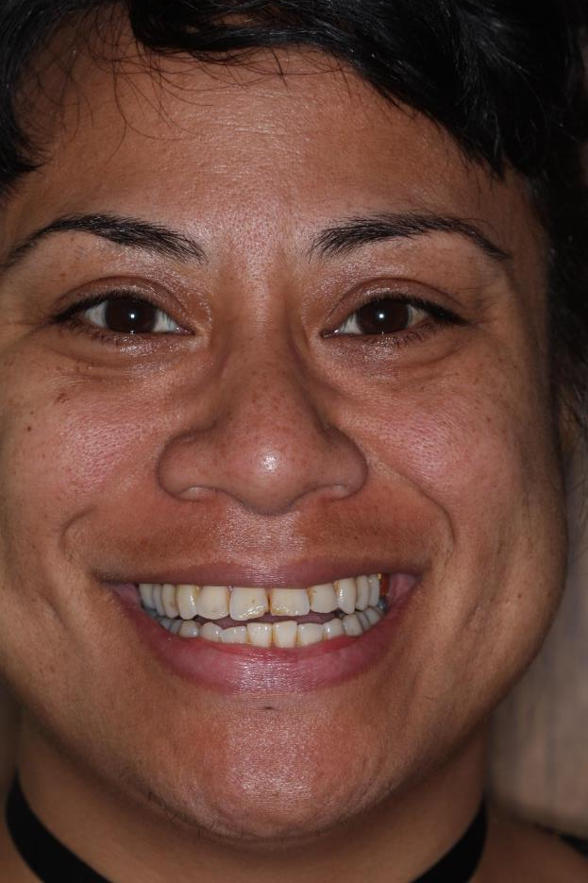
CASE 1 : Lithium Disilicate Veneers on #8 and #9
40 year old female presented to the clinic with chief complain of
“ I don’t like the way my front teeth look. I also want to get my cavities checked.”
Med Hx : Anxiety.
Past dental history in regard to #8 and #9:
Hx of composite restorations. Patient was not happy with frequent staining of the restorations. The restorations also failed twice.
Social hx :
Smokes marijuana. High consumption of coffee.
Patient worked as a dental technician before.
Treatment options:
No Treatment
Direct composite
Veneers
Patient chose veneers after discussing all the RBAC.
Plan : Photographs, Diagnostic models, Wax up, Check occlusion
(MIP, incisal guidance and lateral excursion). Present the case to the patient and address any concerns. Discuss the RBAC of treatment options again and reconfirm patient’s choice. Obtain informed consent.

Slide 8
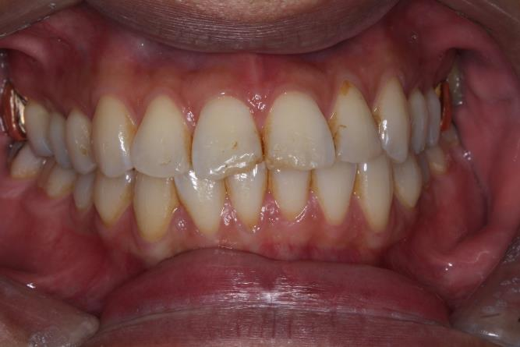
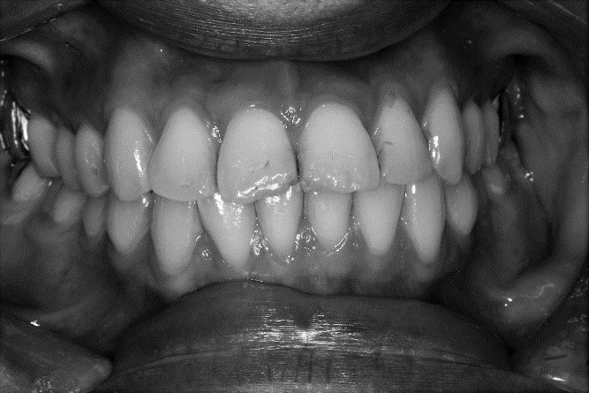
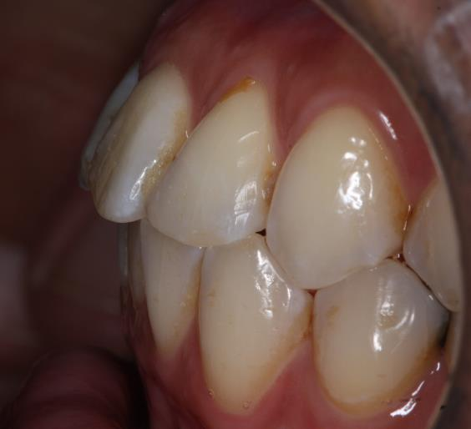
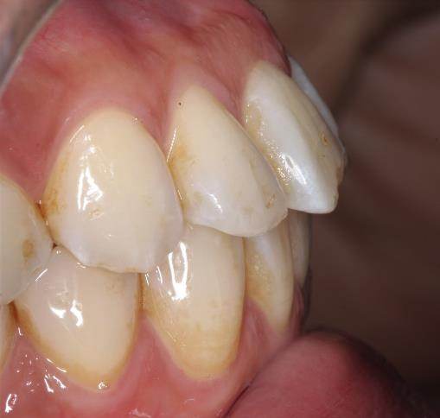
PRE-OP PHOTOGRAPHS
Notes:
Clinical assessment : Enamel surface cracks on #8 and #9. Enamel fractures on MI . Decalcification on mesial interproximal surface.

Slide 9
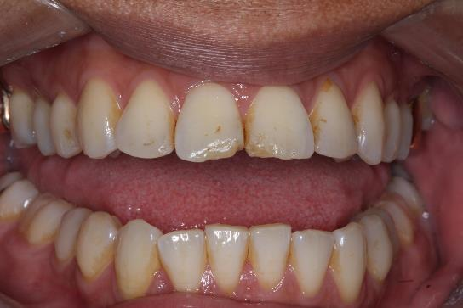
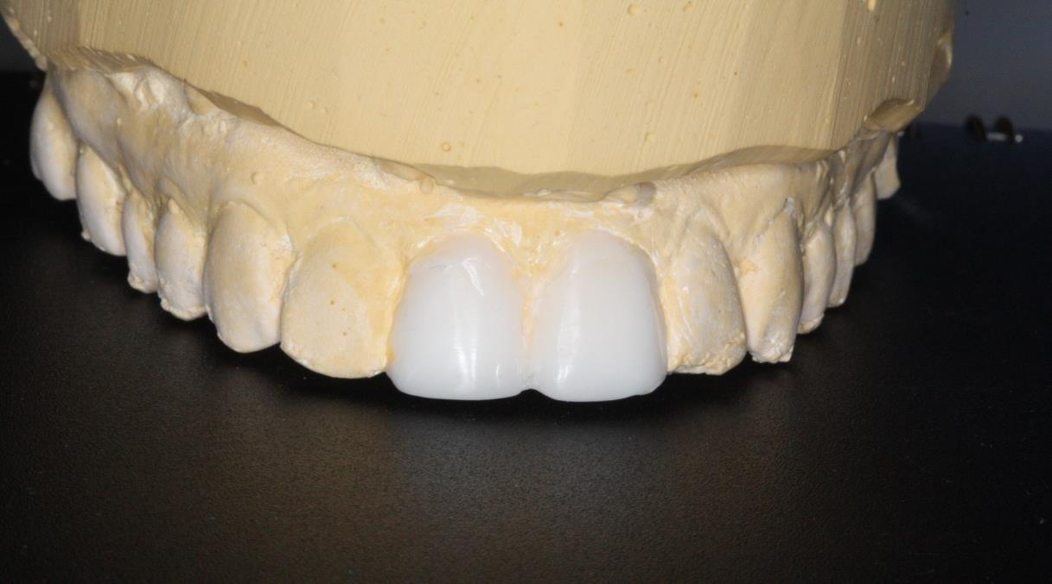
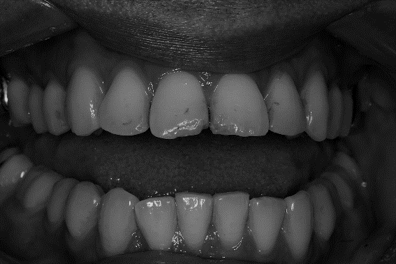

Slide 10
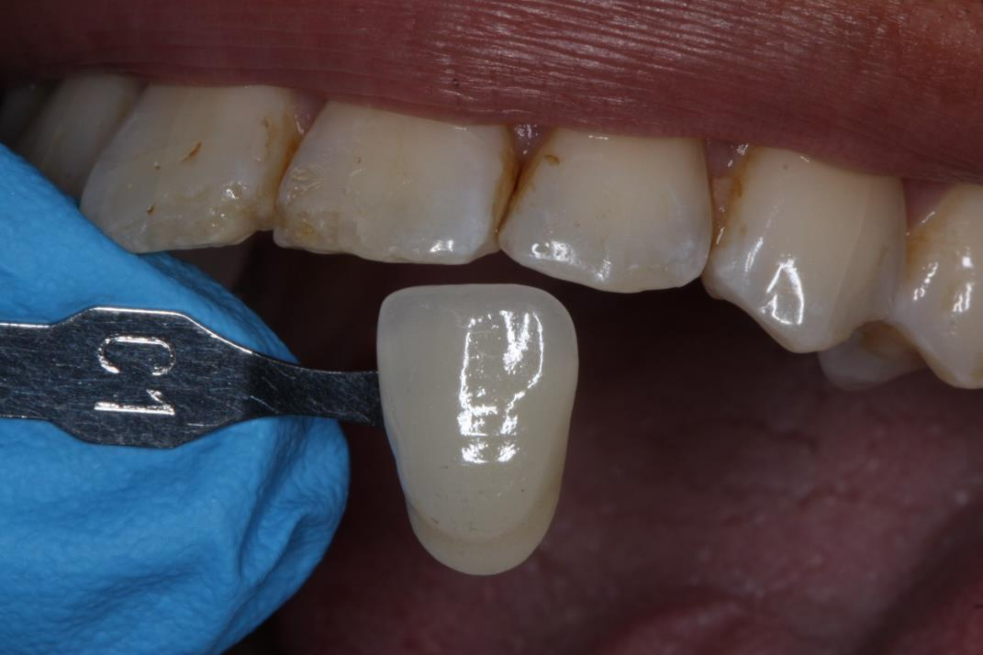
Shade selection
Notes:
Document the shade and obtain patient’s consent

Slide 11
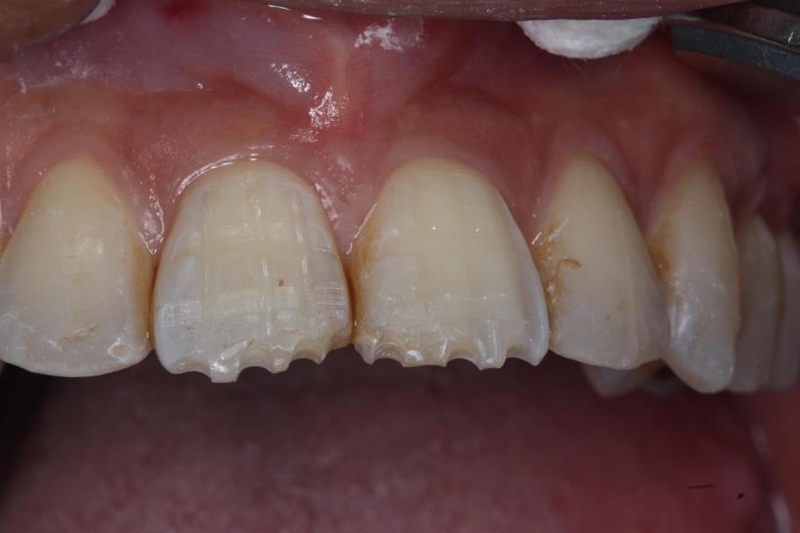
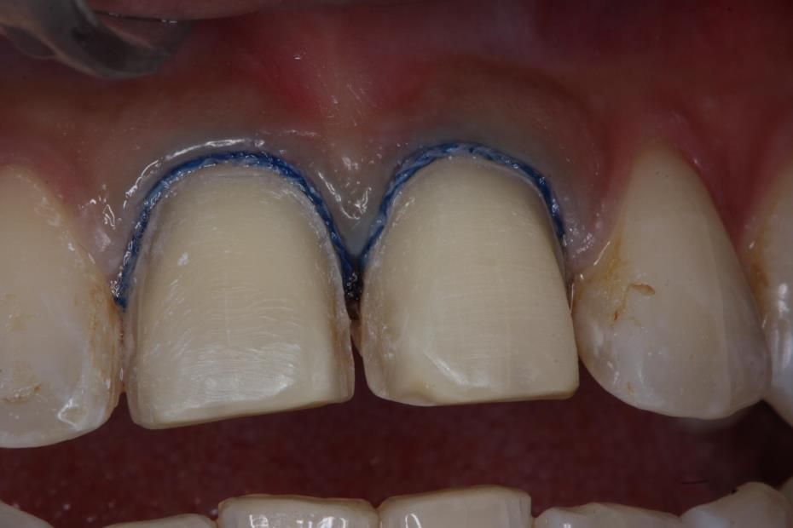
Retraction with gingival cord
Depth Grooves
Note all edges are rounded off .

Slide 12
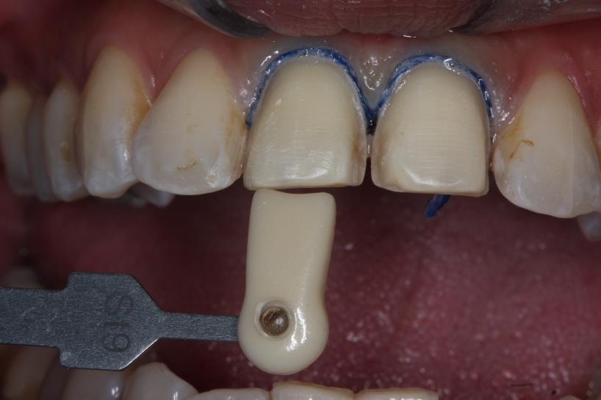
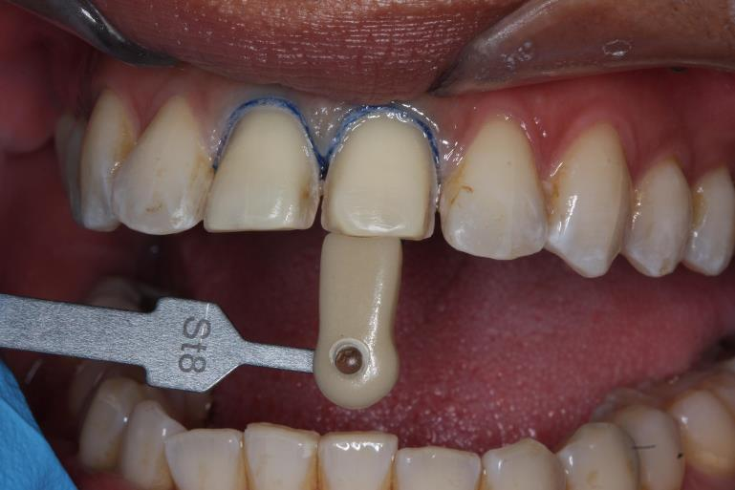
Stump Shade (die shade)
Enables the technician to fabricate a model die similar to the preparation of the patient, on the basis of which the correct shade and brightness values of the all-ceramic restoration may be selected.

Slide 13
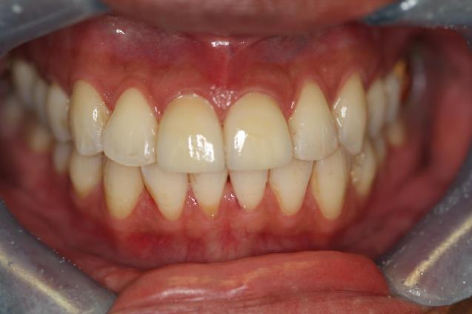
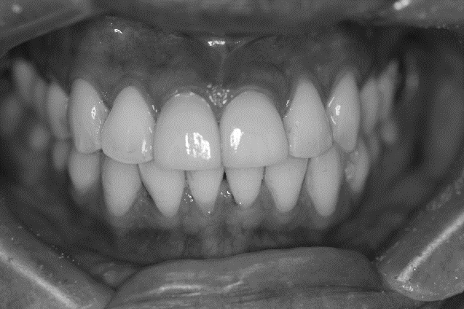
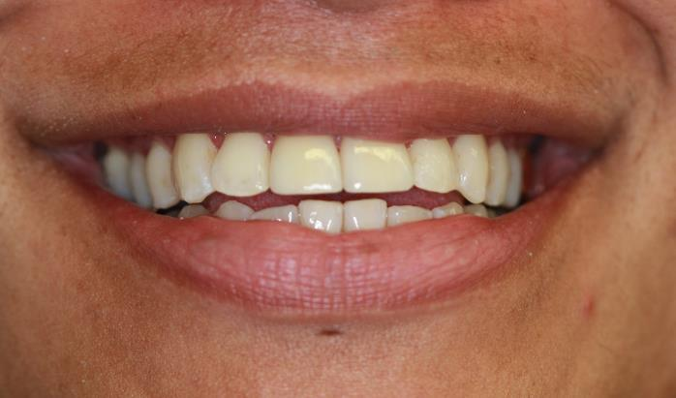
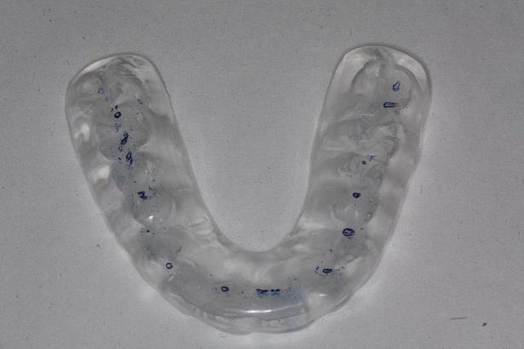
Post-operative
Notes:
The veneers were cemented using Variolink cement.
Trial paste was used to check the fit and the shade. Check occlusion and adjust if needed. Polish and finish and proceed with cementation once the patient is satisfied. Since the shade of the veneers matched perfectly, neutral shade of cement was used for final cementation.

Slide 14
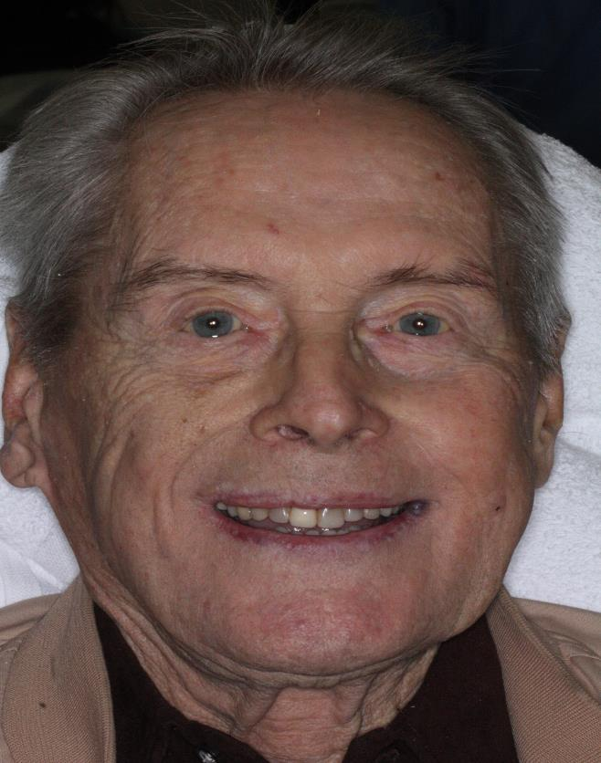
Case #2: Direct Composite Veneers
90 year old male presented to the clinic with chief complain of “ I want to do something for my teeth as they are grinding down”.
MH:
CHF, Prosthetic Heart Valves, HTN, Arthritis and Xerostomia.
DH:
Western Dental In SF.
Pt already taking Premedication per his PCP for his prosthetic heart valves .
Pt under care of OM for his Xerostomia, which linked to Polypharmacy.
1st appointment:
COE, FMX done and Diagnostic models taken, Med-Consult sent.
2nd appt: Pre op pictures taken and bite registration done for mounting the models.
Consults obtained.
3rd appt: 1 session was dedicated to discuss all available treatment options with all faculties and specialists to ensure pt understands all options and prognosis for each.
Show pt the wax-up and help understand the final result.
Treatment options:
No Treatment
Direct composite
Veneers
Crowns
Extractions followed by implant or removable.
Patient chose to do composite veneers after discussing all the RBAC.

Slide 15
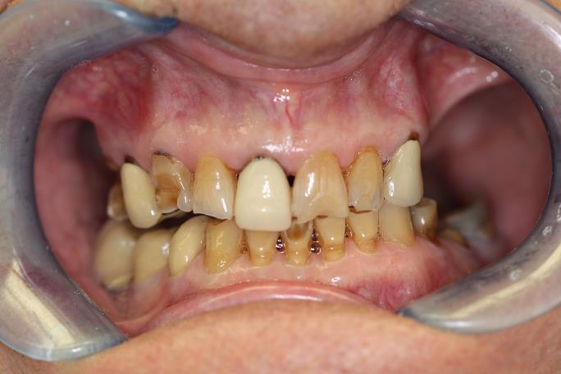
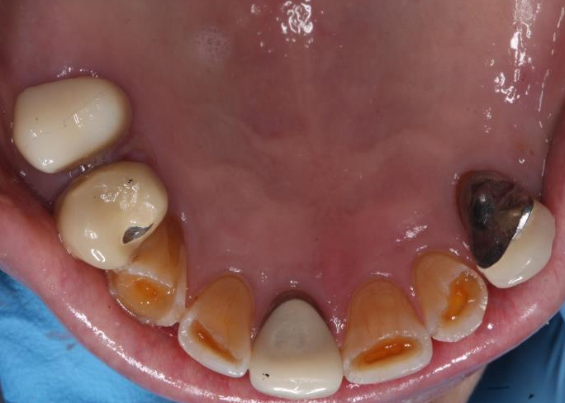
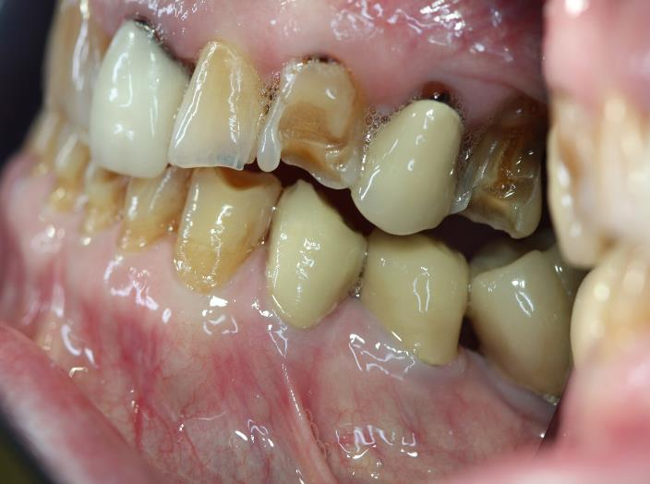
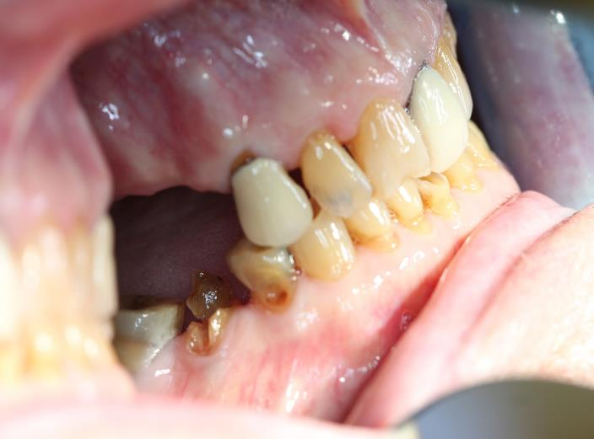
COMPOSITE

Slide 16
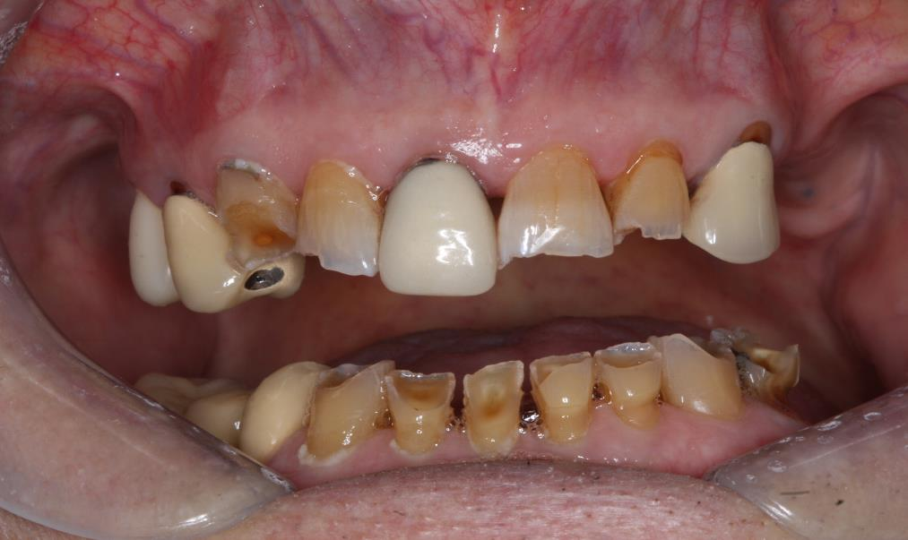
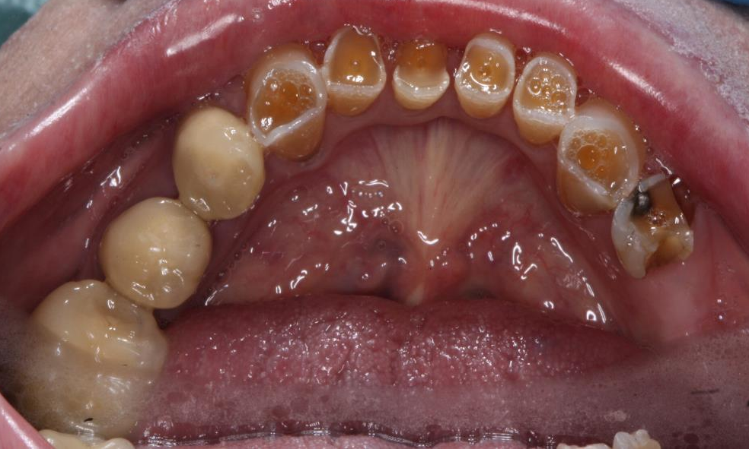

Slide 17
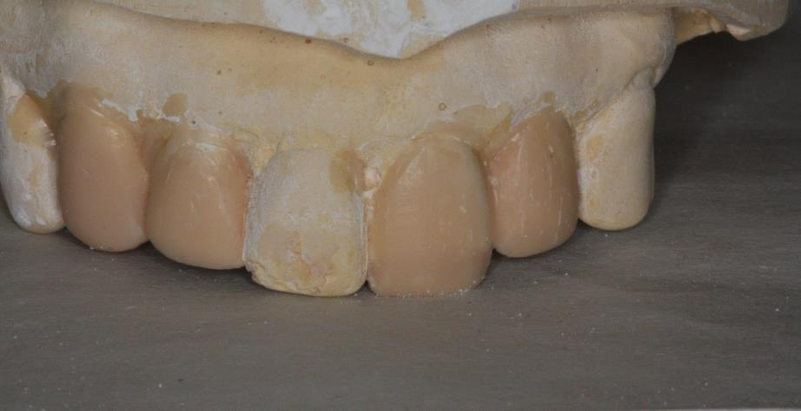
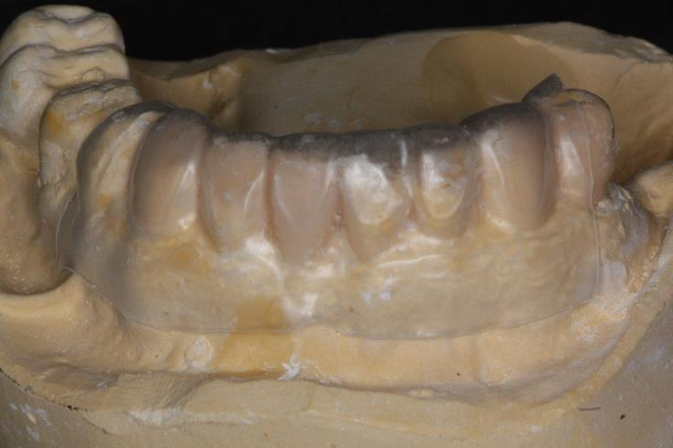
Wax - Up and Stent

Slide 18
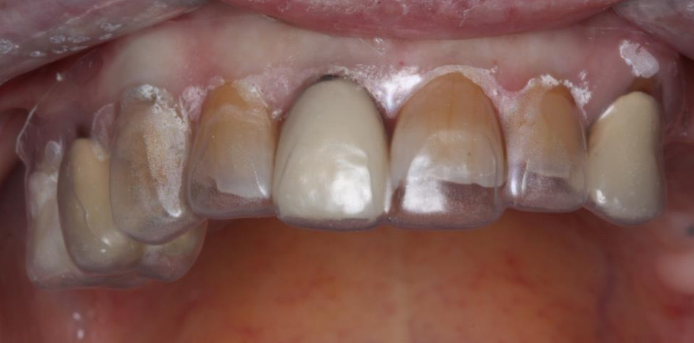
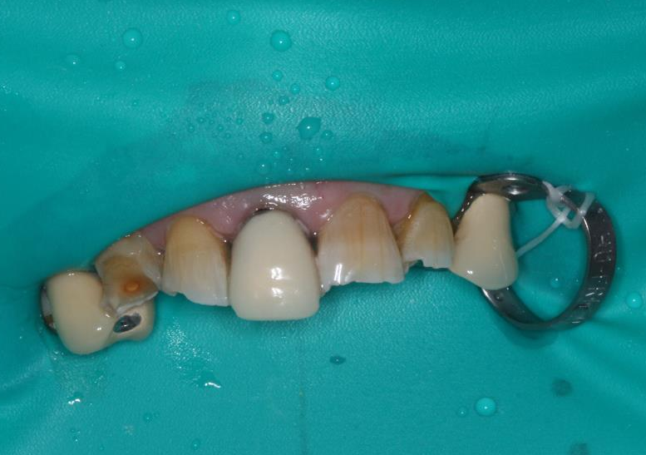
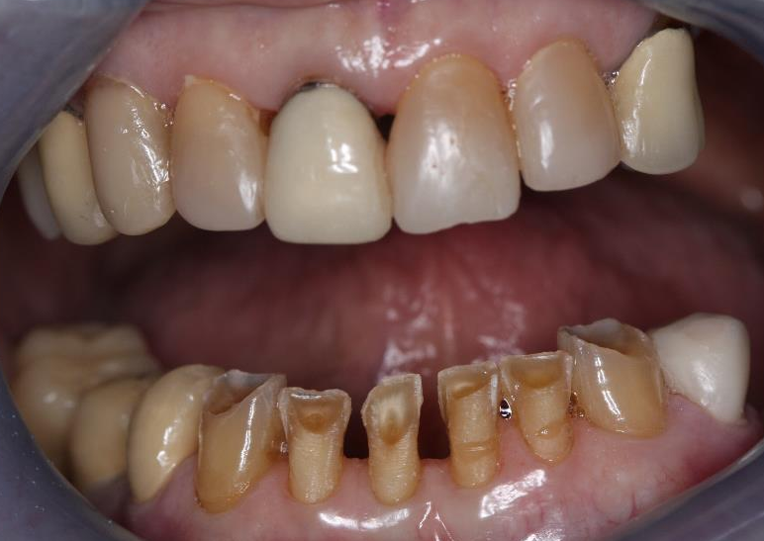
Counter Clockwise:
Stent Try-in, Rubber Dam isolation, prep design for lowers.

Slide 19
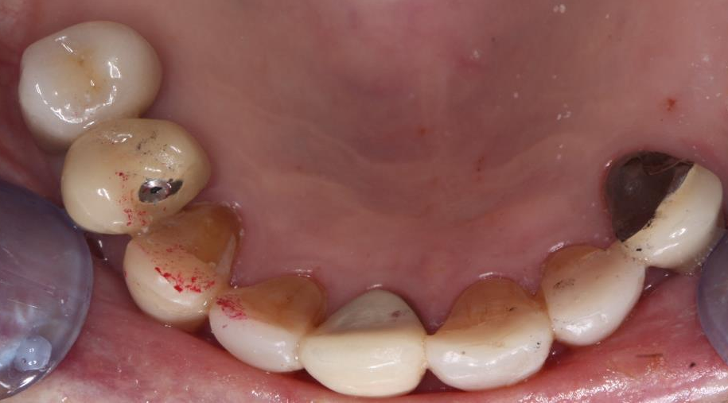
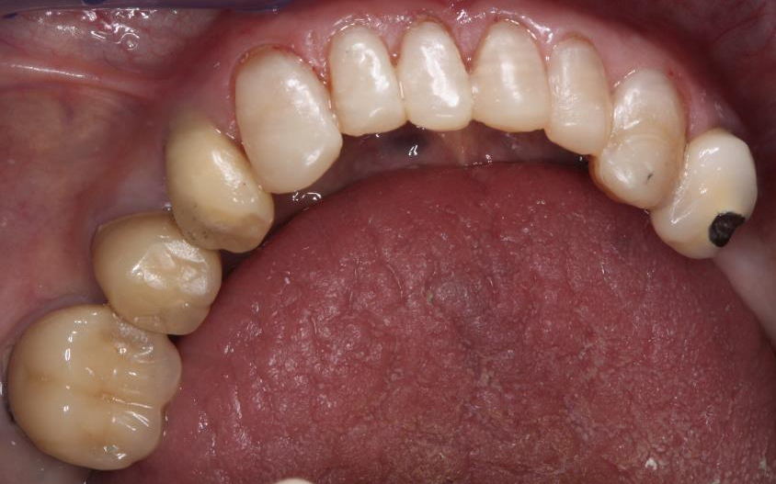
POST-OP OCCLUSAL VIEW

Slide 20
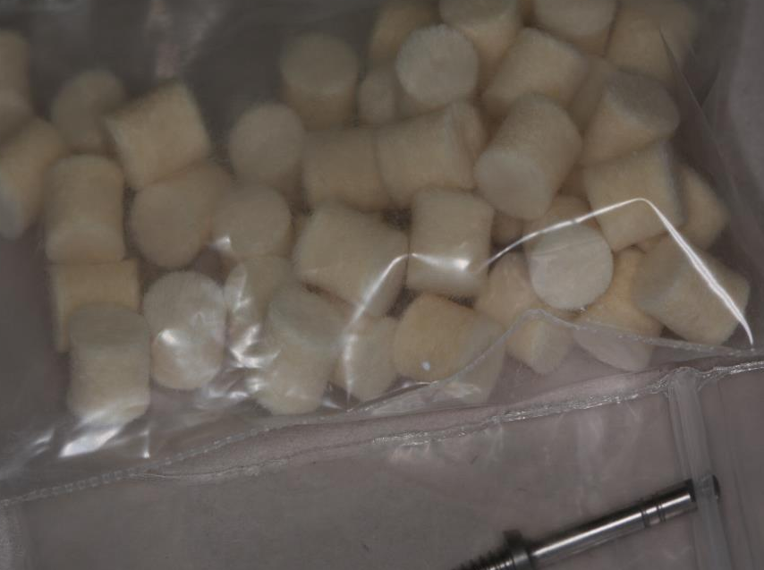
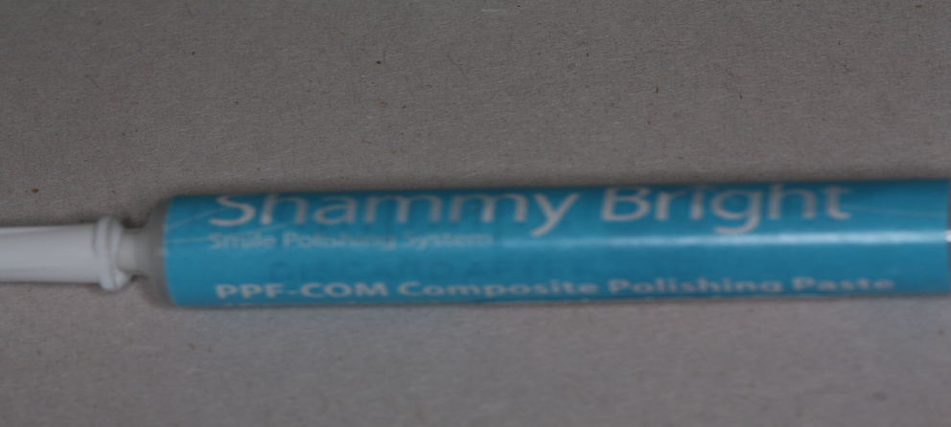
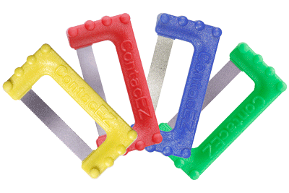
Some Polishing tools
EX Contact : Different grits for IPR, removing bonding or opening contact.

Slide 21
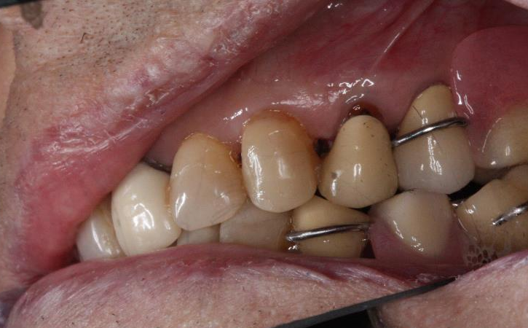
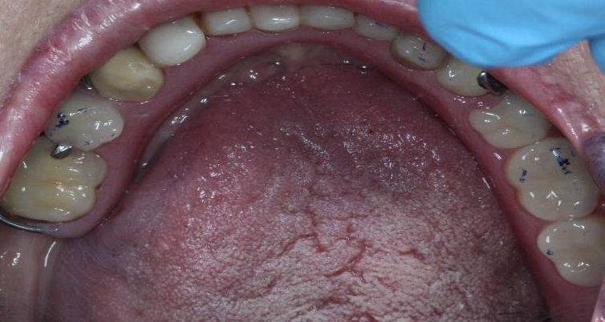
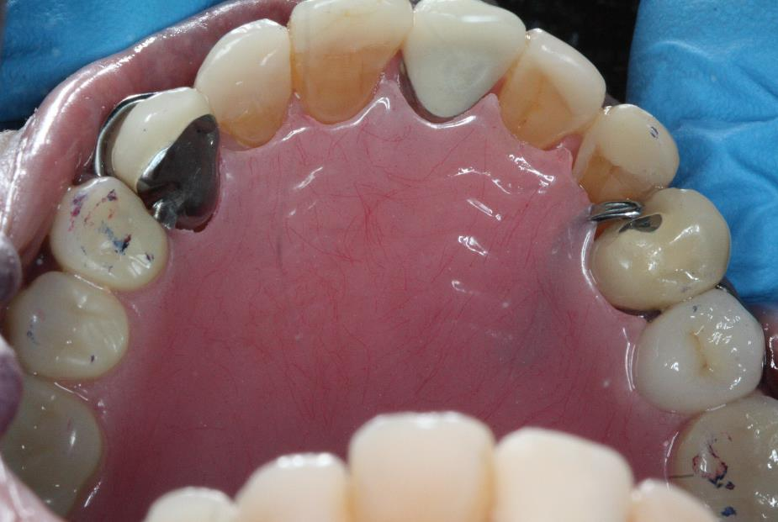
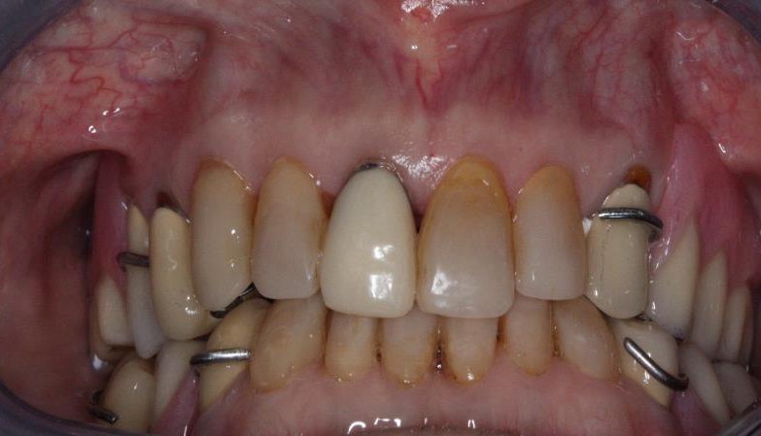
Notes:
Final Finishing done and Upper and lower stay-plates made as pt declined Partials (especially due to his arthritis in fingers and hand) wanted something temporary.
We Used his pre-existing Rest seats on previously done crowns as stops for his stay-plates.

Slide 22
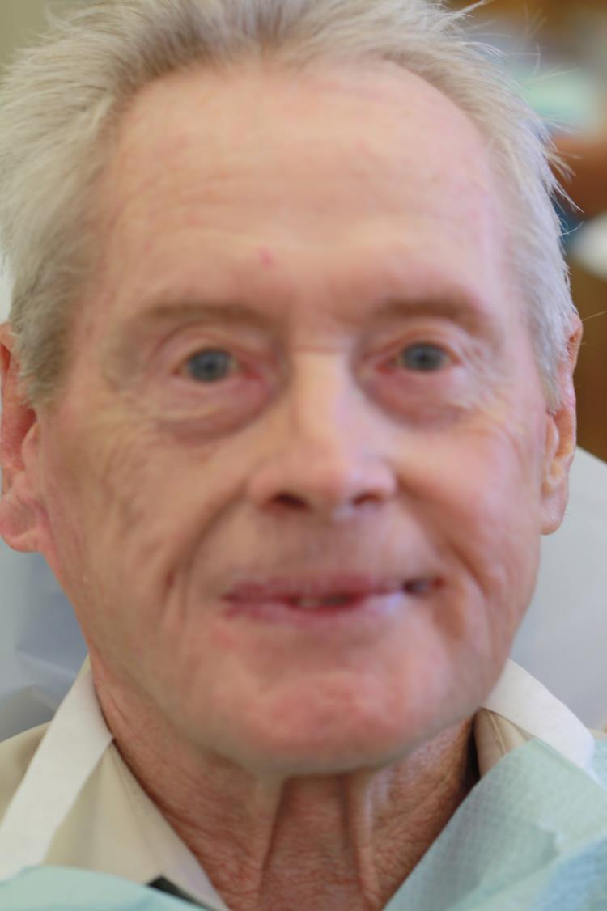
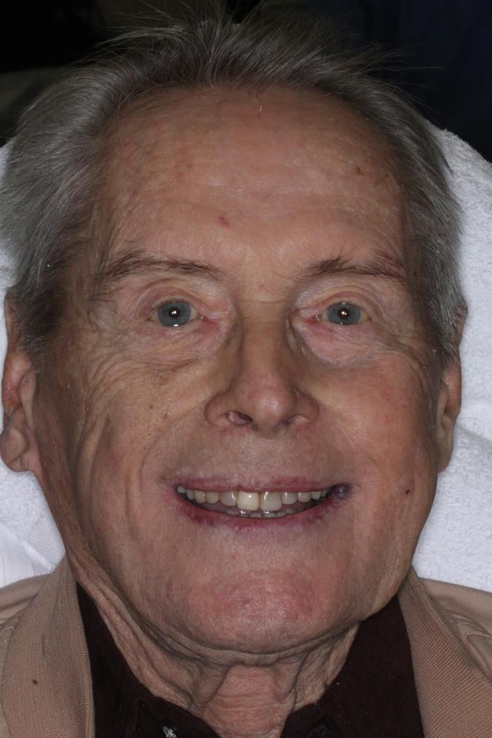
Pre-op Smile
Post-op Smile

Slide 23
Case 3. Veneers #7- #10
CC: 42 y.o/M presents to the clinic complaining of wide, open space between his two front teeth and would like it to be closed. He says he does not smile because he is embarrassed.
Med hx: Non-contributory, healthy.
Dental hx: Pt. has had #13 and #14 implants done previously in January 2017.
1st appointment:
Upper and lower alginate impressions taken.
Photographs taken.
Facebow record and Blu mousse bite registration completed for mounting casts.
2nd appointment:
Wax up completed and pt. shown the wax-up for approval.
Putty impression of the wax-up made and temporaries using the putty and Pro-temp was made for the pt.
Pt. agreed to do four veneers from #7 - #10.

Slide 24
3rd appointment:
Veneer preps completed.
Full upper and lower arch impressions taken using heavy and light body impression material.
New bite registration using Blu-mousse completed.
Stump shade and teeth shade selection completed.
4th appointment:
Veneers tried on for the fit, adjusted as necessary.
Veneers tried in using trying paste and shown to the pt. for approval before final cementation.
Veneers cemented using Varilink cement.
Occlusion and contacts checked.
5th appointment:
Follow up scheduled.

Slide 25
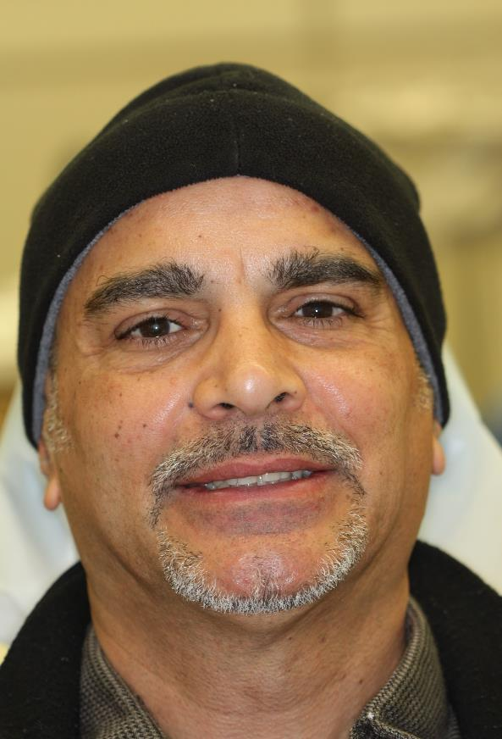
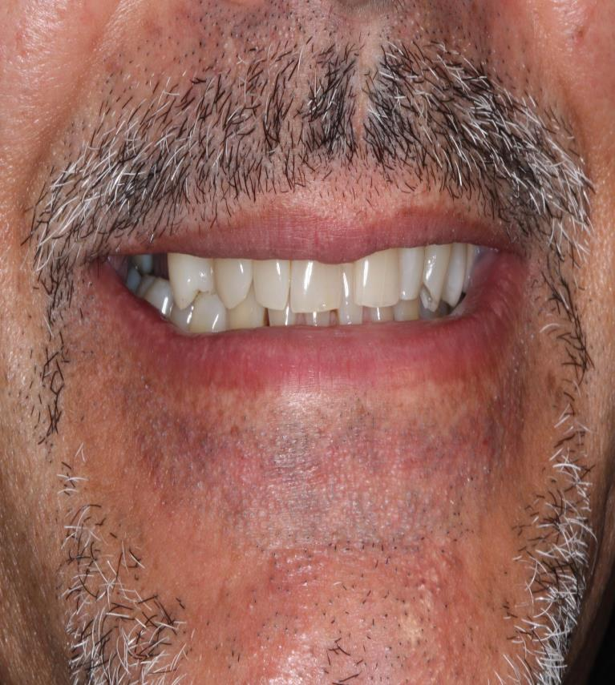
Pre-op

Slide 26
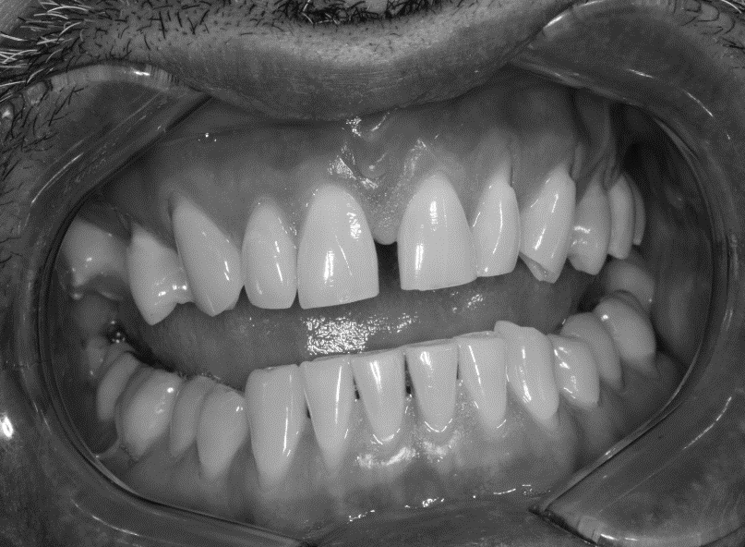
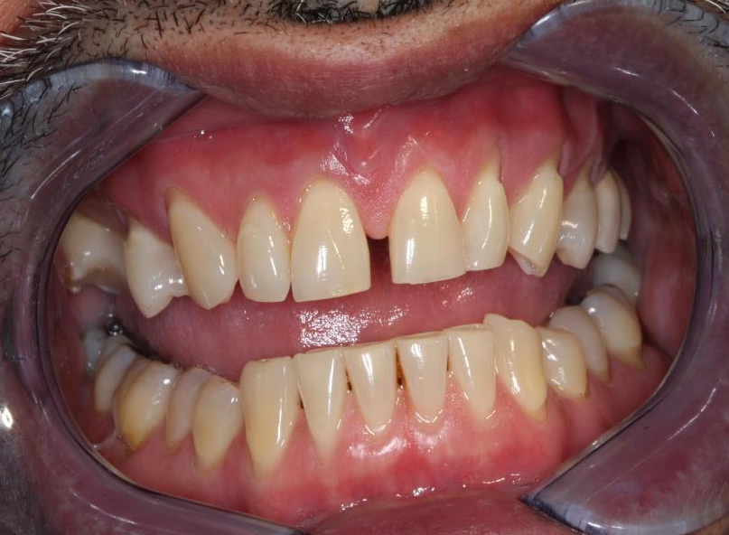
Pre-operative photographs

Slide 27
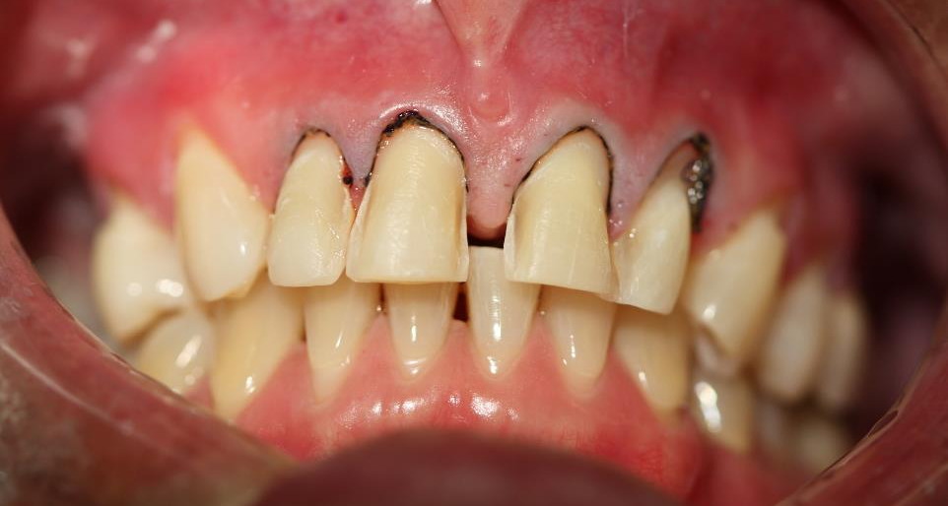
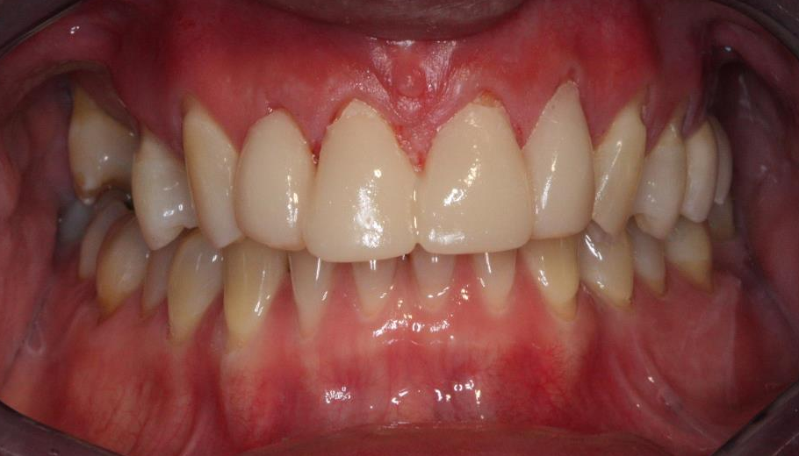
Completed teeth preparation for veneers
Temporary Veneers using Protemp
The temporaries were locked-in in place and therefore no luting agent was used

Slide 28
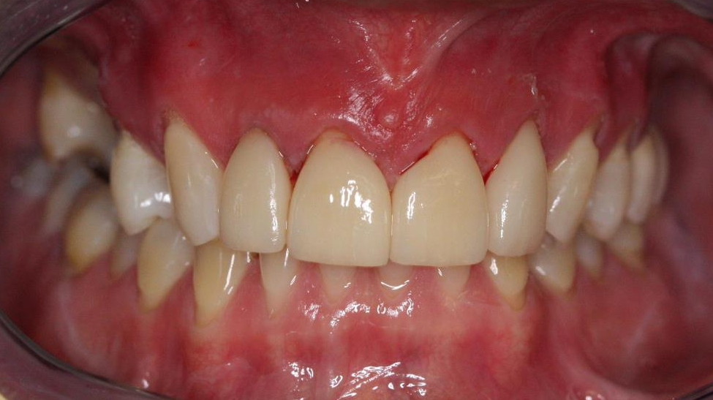
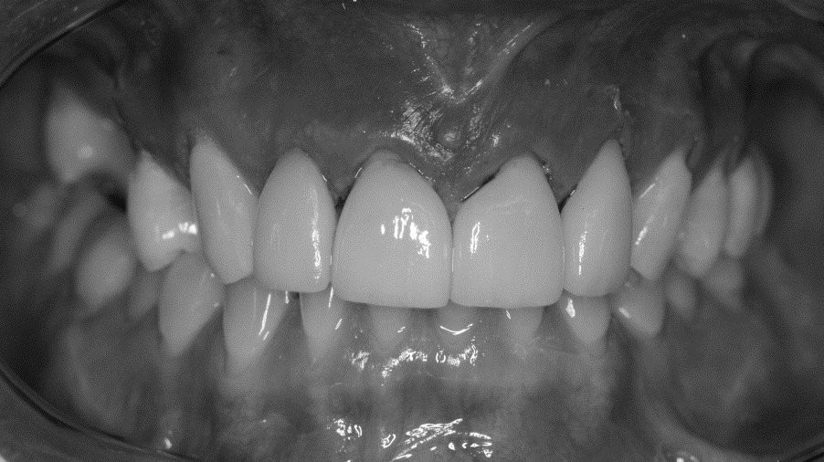
Post-op

Slide 29


Post-op

Slide 30
Case 4- Crowns
CC: 34 years old female presented with complain of “ I don’t like spaces in my upper and lower teeth and I want to get braces”
MHx: Healthy
A: Peg laterals #7, 10
Localized advanced chronic periodontitis involving mandibular anteriors
Tx Options given after consults:
No Treatment for U/L
Full coverage restorations for #7,10 and SRP & 1 month evaluation for lower anteriors
Veneers for all 4 U/L incisors (after SRP & 1 month evaluation for lower anteriors)
RBA discussed with pt, pt opted to have Full coverage restorations for #7,10 and decided to wait for the treatment of lower anteriors.
Study models taken for diagnostic wax up. Wax up completed using polycarbonate crowns instead of traditional lab wax up technique. Advantages: reduced laboratory cost, can be done chair side for pt approval. Disadvantages: can not alter anatomy.

Slide 31







CROWN

Slide 32





Slide 33

MOCK-UP
Tooth preparation was done on the diagnostic cast and denture teeth were used to aid in mock-up

Slide 34






Slide 35
Special Thanks to
Faculty and Mentors:
Dr Gurinder Atwal Dr Joel Boriskin Dr Barry Burstein
Dr Richard Mogensen Dr Sukhmani Singh
Dental Laboratories:
CA Dental Arts Dental Masters
References:
Terry, D. A., Leinfelder, K. F., & Geller, W. (2009). Aesthetic & restorative dentistry: material selection & technique. Stillwater, MN: Everest Pub. Media.
Manauta, J., & Salat, A. (2012). Layers: an atlas of composite resin stratification. Milan: Quintessence.

