Slide 1
Patient Case Study
Marie Kim, Lauren Leza, Dexter Nguyen, Jeffrey Proniloff, Dien Sun, Yat Tang, Lita Vo • Spring Quarter 2017

Slide 2
Patient Profile
June, 2016. 46 y/o female presents for
CC: “I need a lot of work, my tooth broke off, there are gaps between my teeth.”
Medical History: Non-contributory. Last physical January 2016
Medications: Takes Iron once in awhile
Allergies: NKDA
Surgical history: Non-contributory
Social history: Social drinker, no tobacco use, no recreational drug use
Dental history: Multiple restorations. Received regular dental care. Last prophy a month ago.
OHI: Brushes 2x/day with a hard toothbrush with colgate
fluoride toothpaste, listerine mouthrinse

Slide 3
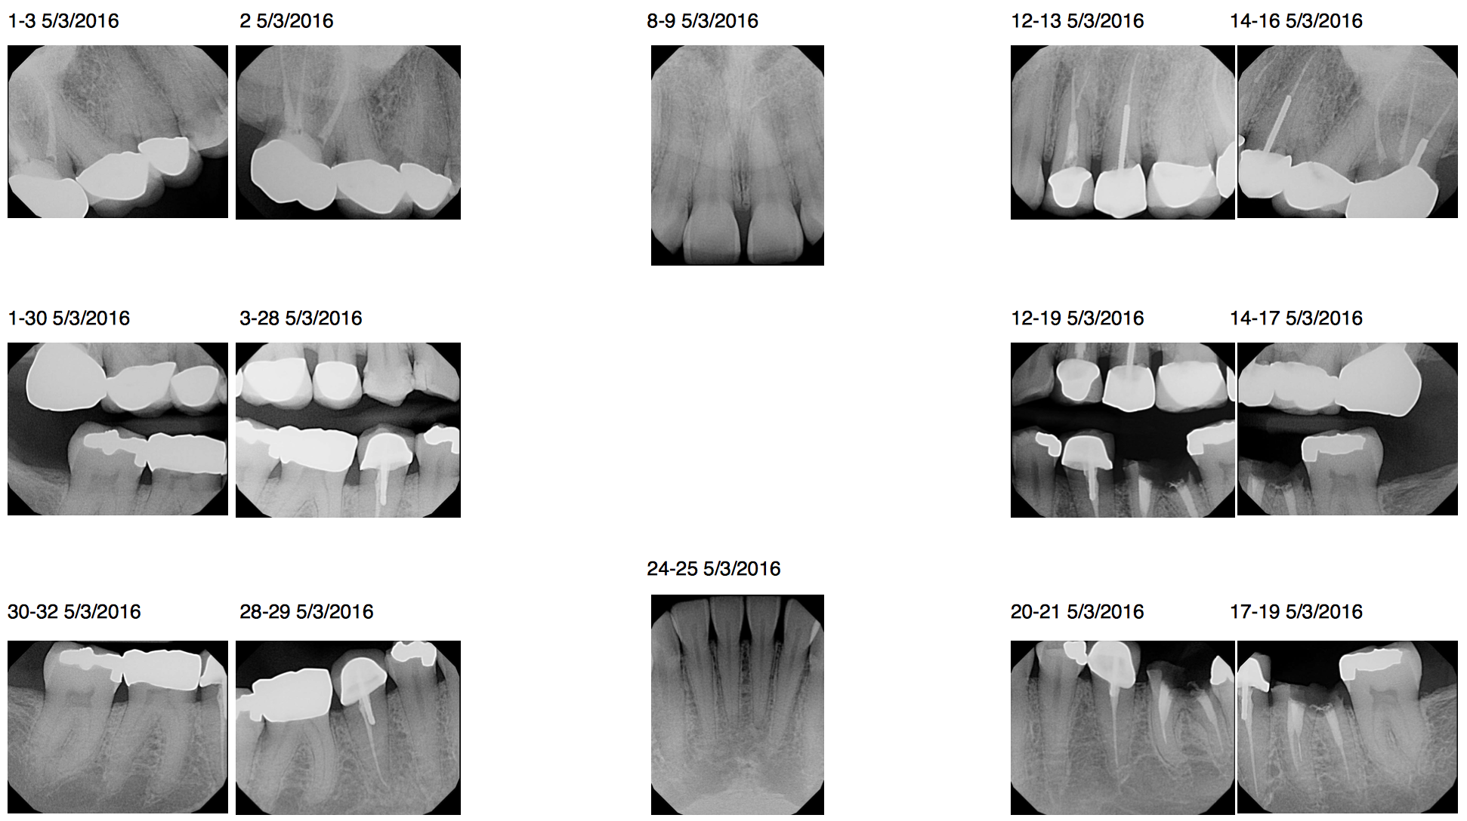
FMX

Slide 4
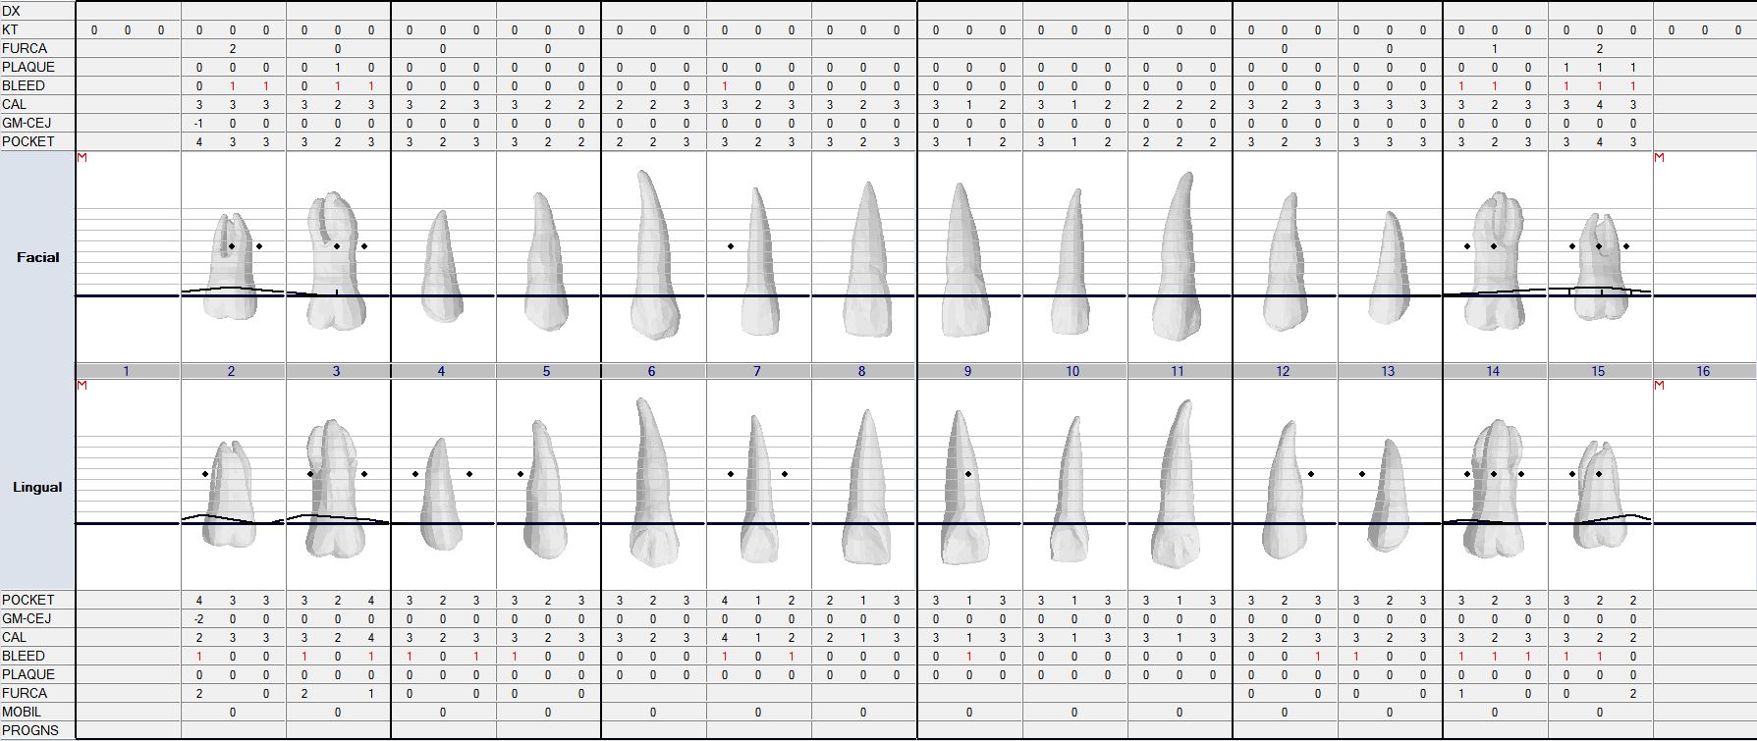
Perio (maxillary)
Dx : Gingivitis, Prophy 6 months recall

Slide 5
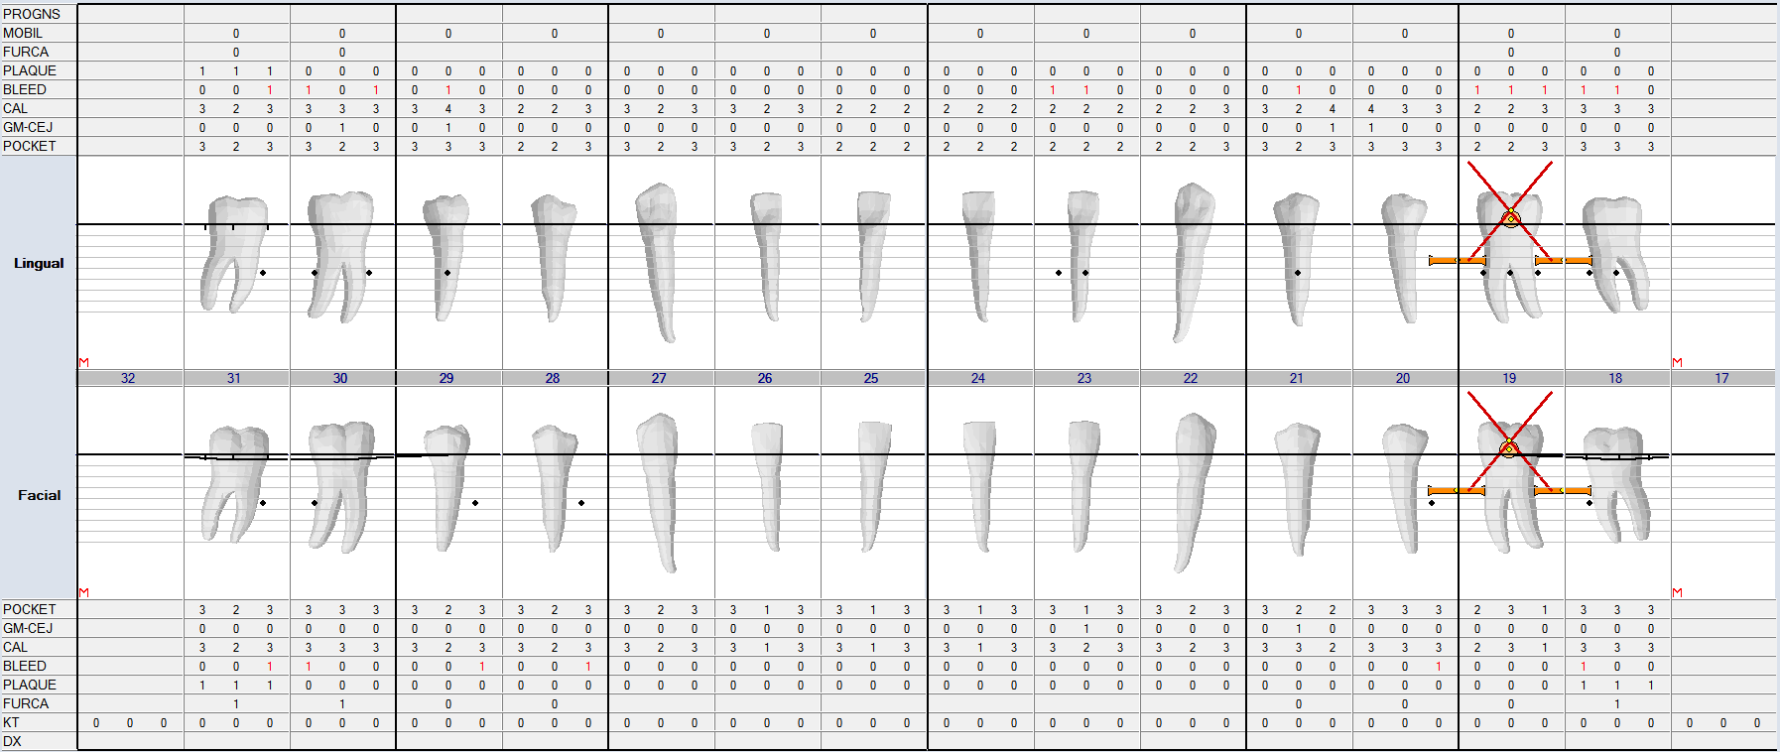
Perio (mandibular)
Dx : Gingivitis, Prophy 6 months recall

Slide 6
Clinical Findings

Slide 7
UR #2-8
#2 gold crown. RCT
#3 PFM
#4 PFM: (+) margin on distal
#5 MOD Cp: defective restoration / caries on D
#6 DI Cp: defective rest - open margin
#7 - 11: attrition / diastemas

Slide 8
UL #9-15
#12 PFM: fracture on M
#13 PFM: recurrent decay
(#12, 13 have post)
#14 PFM: (+) margin
#15 gold crown

Slide 9
LL #18-24
#18 MO Am: open margin
#19: crown root fracture
#20 PFM w/ RCT/post :recurrent caries
#21 DO Am: patient reports esthetic concern
#22 - 27: attrition and diastema between 23, 24

Slide 10
LR #25-31
#28 MO Am: Pt expressed esthetic concern
#29 PFM: (+) margin
#30 Gold: (+) margin
#31 MO Am: (+) margin

Slide 11
Initial Treatment Plan

Slide 12
PHASE I:
EXT #19 + post-op
OHI
Ortho referral regarding diastemas
Patient completed prophy at another dental office before coming to UCSF

Slide 13
PHASE II:
#5 MOD, #6 DI
#13 possible re-treat RCT
Closing anterior diastemas

Slide 14
PHASE III:
Replace defective crowns
Determine restorability of teeth
Bridge/implant to replace missing #19

Slide 15
PHASE IV:
RECALL
POE/Prophy/update BWX
CAMBRA
OHI

Slide 16
Treatment Highlights
…

Slide 17
Replacing #19
IMPLANT
  Risks: peri-implantitis
  Benefits: preserve adjacent teeth, predictable outcome, strength
  Cost: $$$$
  Time: 3-4 months, 4-6 appts.
FPD #18-X-20
  Risks - reduced adjacent teeth, last 8-10 years
  Benefits - use when there is lack of bone, adjacent teeth have large restorations or existing crowns
  Cost: $$$
  Time: 2-3 appts.
RPD
  Risks: accumulates plaque
  Benefits: function without invasive procedures
  Cost: $$
  Time: 5-6 appts.
NOTHING
  Risks: closure of space, hypereruption of opposing tooth, loss of bone
  Benefits: non-invasive
  Costs: 0
  Time: None
J Can Dent Assoc. 2000 Sep;66(8):435-8.
Notes:
J Can Dent Assoc. 2000 Sep;66(8):435-8.
Single-tooth replacement: bridge vs. implant-supported restoration.

Slide 18
#19: Implant vs. FPD
 | Advantages | Disadvantages
FPD | - Avoid implant surgical therapy restoration - Avoid vital structures - Eliminate the need for regenerative therapy - Slightly lesser cost of therapy than implant placement and grafting | - Involvement of adjacent teeth - Potential for endodontic therapy - Greater cost of treatment if endodontic therapy is required - More difficult to perform adequate home care
Implant | - No involvement of adjacent teeth - Greater ease of home care - Greater long-term predictability | - Need to avoid vital structures - Potential need for regenerative therapy - Possibility of second surgical visit
Dent Clin North Am. 2009 Jan;53(1):97-129,
Notes:
Dent Clin North Am. 2009 Jan;53(1):97-129, ix. doi: 10.1016/j.cden.2008.10.001.
Evidence-based decision making: replacement of the single missing tooth.

Slide 19
FPD #18-20
Endo consult regarding existing short post on #20
Plan:
remove existing crown
assess remaining tooth for necessity of longer post

Slide 20
SET BACKS
Temporary bridge: DL portion of #18 fractured numerous times
Patient was initially unaware of any bruxing habits
Recently discovered that she grinds and clenches her teeth throughout the day AND night
Updated treatment plan for occlusal guard.
Lab sent back wrong pontics

Slide 21
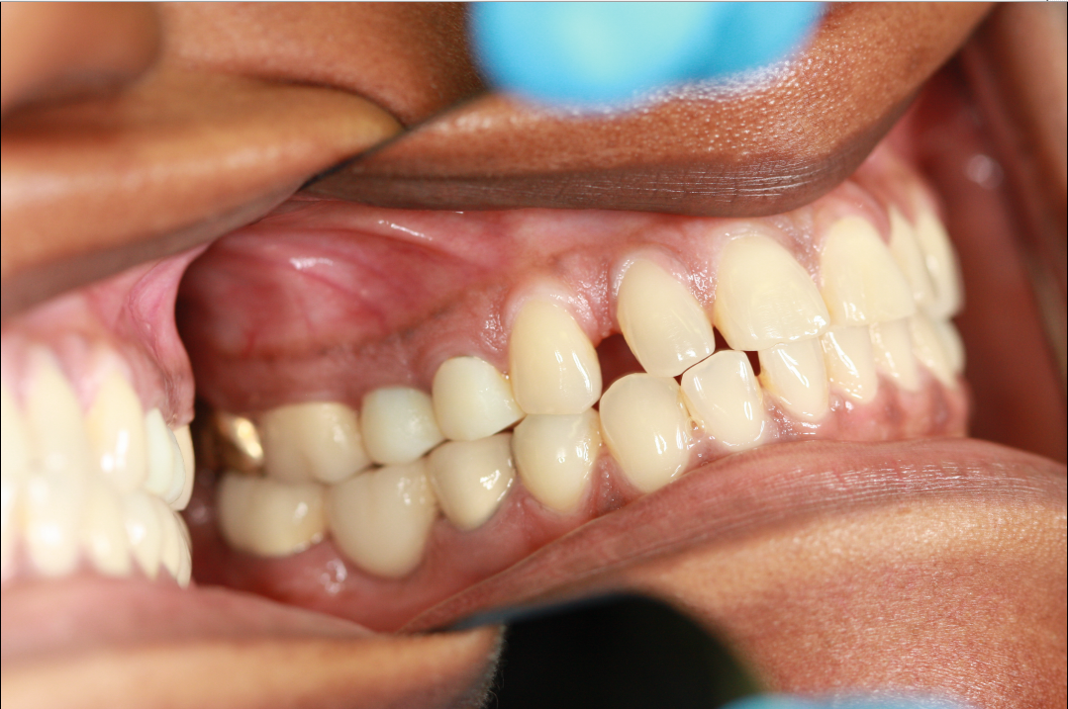
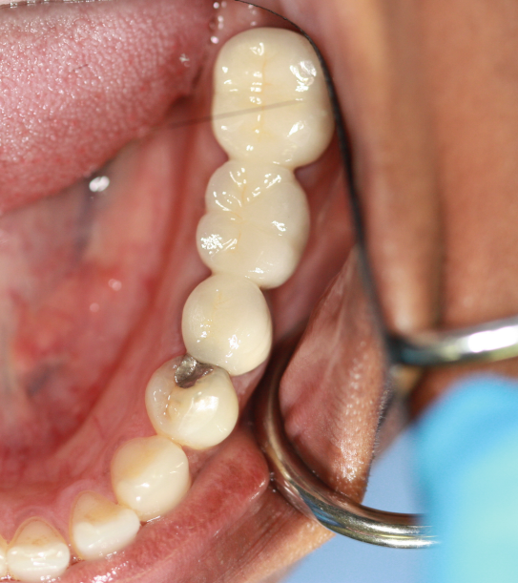
FPD #18-20 delivery

Slide 22
Replacing #12 and #13
SET BACKS
Gingivectomy completed because of gingival overgrowth into current defective restoration
While removing #13 temporary crown for final impression, existing post and core came out as well. Suspect recurrent decay.
Poor prognosis
Options for replacing #13:
  Implant #13
  FPD #12-14
  RPD
  Nothing
Patient decided on FPD #12-14
Updated treatment plan to extract #13, FPD #12-14

Slide 23
Laser gingivectomy vs Classical surgical removal with scalpel
Studies included (some studies are beyond the scope of this presentation, but studies have relatively the same findings)
  Clinical study 14 patients including males/females
    Aged 20-40 years
    Divided into two groups
      One crown lengthening with scalpel
      One crown lengthening with laser
    Statistical significance for pain scale
      On 3rd (P<0.002) and 7th day (P<0.044)
  Orthodontic soft tissue procedures
  Cosmetic smile lift gingivectomy in orthodontic patients - Controlled clinical trial
  Adjunct effectiveness of diode laser gingivectomy in maintaining periodontal health during orthodontic treatment
    Test group received diode laser gingivectomy as an adjunct to nonsurgical periodontal treatment
    Control group received nonsurgical periodontal treatment only
  Improved wound healing by low-level laser irradiation after gingivectomy operations
  Clinical study of gingiva healing after gingivectomy and low-level laser therapy
  Efficacy of three different surgical techniques in the management of drug-induced gingival overgrowth

Slide 24
Laser gingivectomy vs Classical surgical removal with scalpel
Advantages
      Better visibility during intervention
      Minimal/less postoperative discomfort
      Some procedures can actually forego local anaesthetic
      Better gingival recontouring
      No sutures necessary
      Less bleeding during and after surgery
      Rapid postoperative haemostasis
      Significant improvements in periodontal health over study period (P<0.05)
      Adjunctive use of lasers can produce an earlier and greater improvement in gingival health (P<0.05)
Negatives
High cost of laser equipment
Time consumption
Notes:
Types
Diode laser resection compared to classical surgical removal

Slide 25
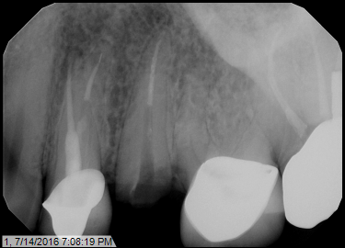
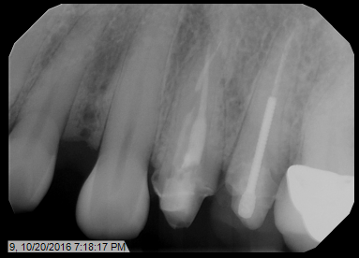
Replacing #12 and #13
SET BACKS
#12 : removed crown, updated PA, realized tooth did not have a post--B/U wasn’t connected to GP
NEW TREATMENT OPTIONS:
1) ext 12 + 13 + implant
2) ext 12, 13; FPD #11-14 (due to esthetics)
3) post + core on #12 for FPD #12-14 (guarded prognosis)
4) do nothing

Slide 26
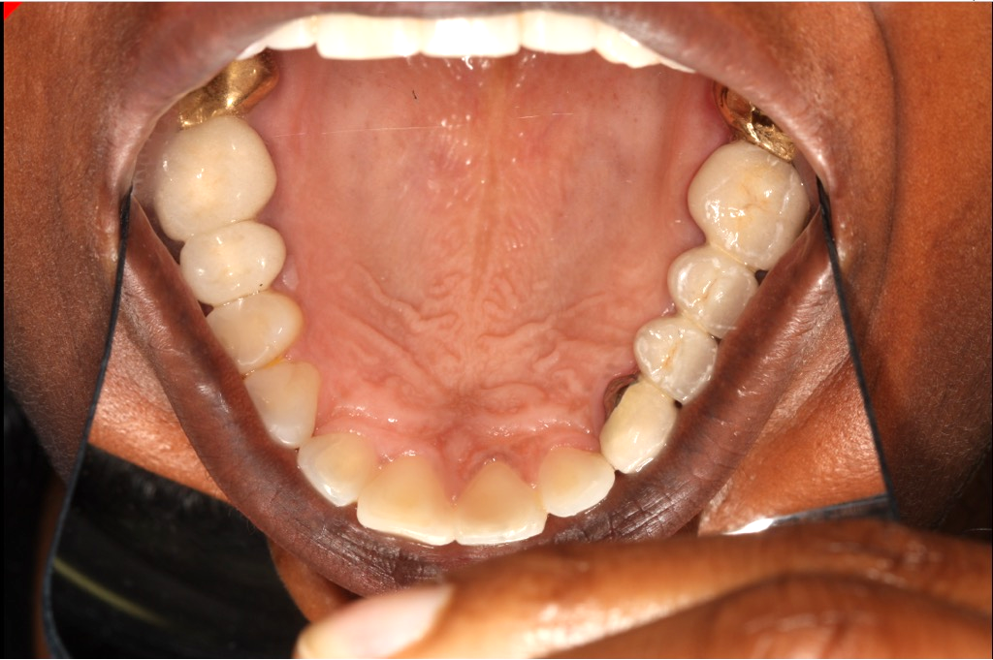
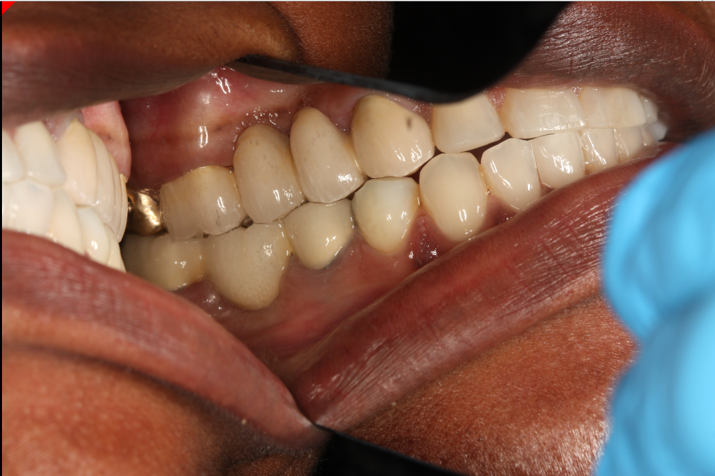
FPD #11-14 Delivery
Notes:
Matrix made before extracting #12 and #13. Prepared #11 and #14 for crowns. Crown lengthening completed on distal of #11 for more axial wall height. Extracted #12 and 13 and temporized FPD with ovate pontics for socket preservation.

Slide 27
Veneers #6-11
Ortho referral for max anterior diastemas and pt decided she did not want ortho
Porcelain veneers or direct composite veneers
INDIRECT VS. DIRECT

Slide 28
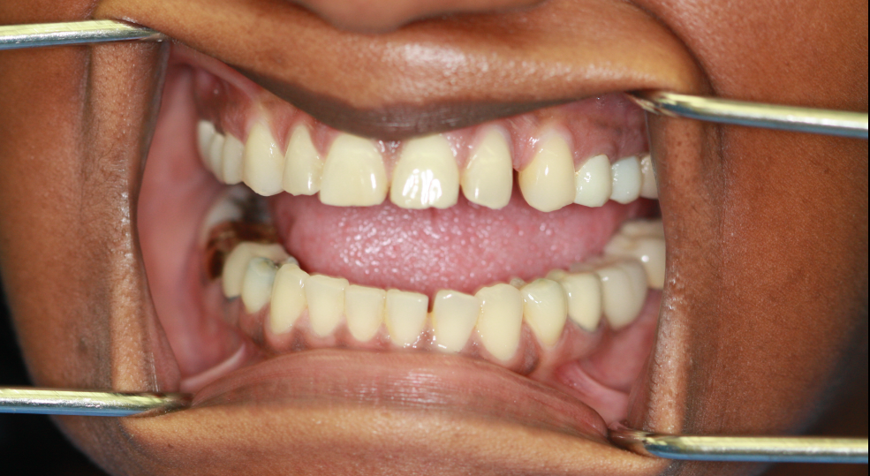
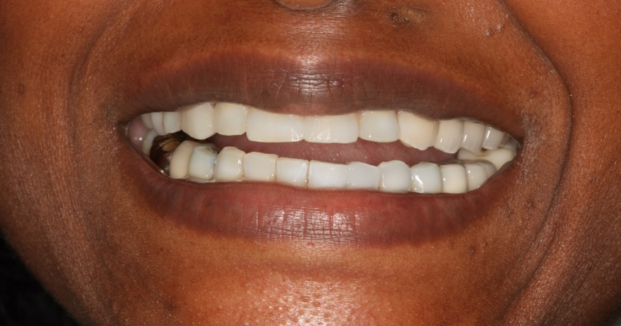
Veneers #6-11
BEFORE
AFTER
Pt decided direct b/c of cost and conservative procedure
Waxed up anteriors to determine size, shape, and midline
Completed procedure

Slide 29
Direct vs indirect veneers
Direct Veneers:
Advantages:
Tooth conservation, cost, time, reversibility of treatment, no need for additional adhesive cementing system, better marginal adaptation, cracks/fractures can be repaired intraorally, higher compressive strength¹
Disadvantages:
Lower resistance to wear, discoloration¹
Indirect Veneers:
Advantages:
High resistance against attrition/fractures/discoloration¹, better long term performance, less maintenance²
Disadvantages:
Long chair time, higher cost, need of an additional adhesive cementing system¹, can have irreparable failures²
Notes:
According to Second source; no significant difference in cosmetic improvement with porcelain veneers

Slide 30
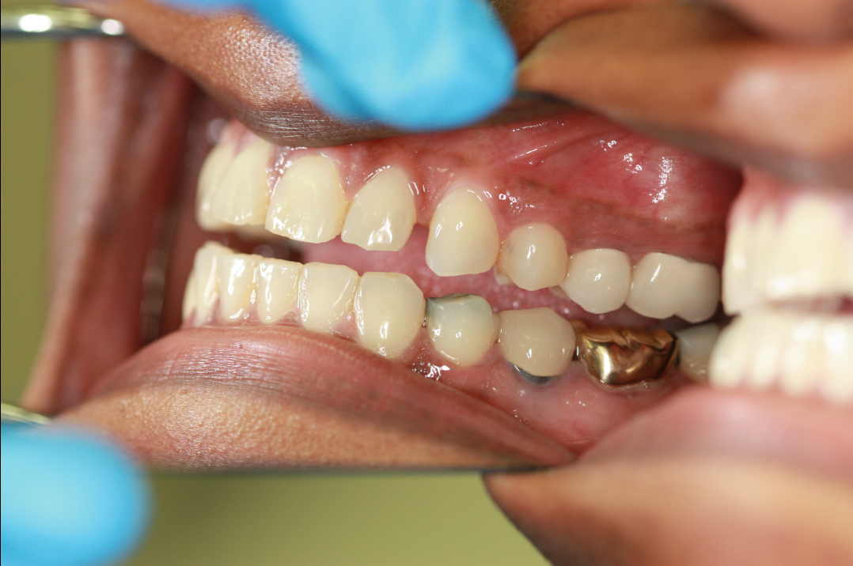
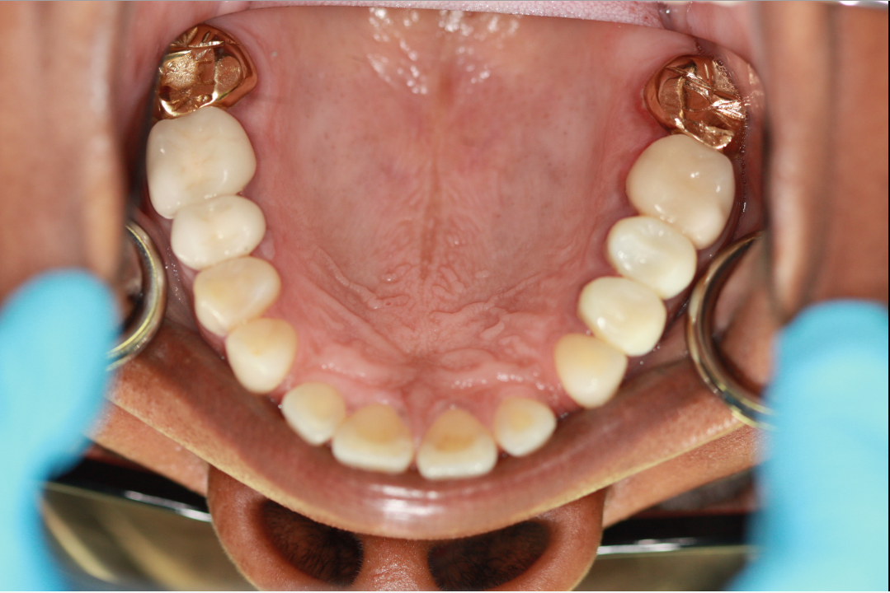
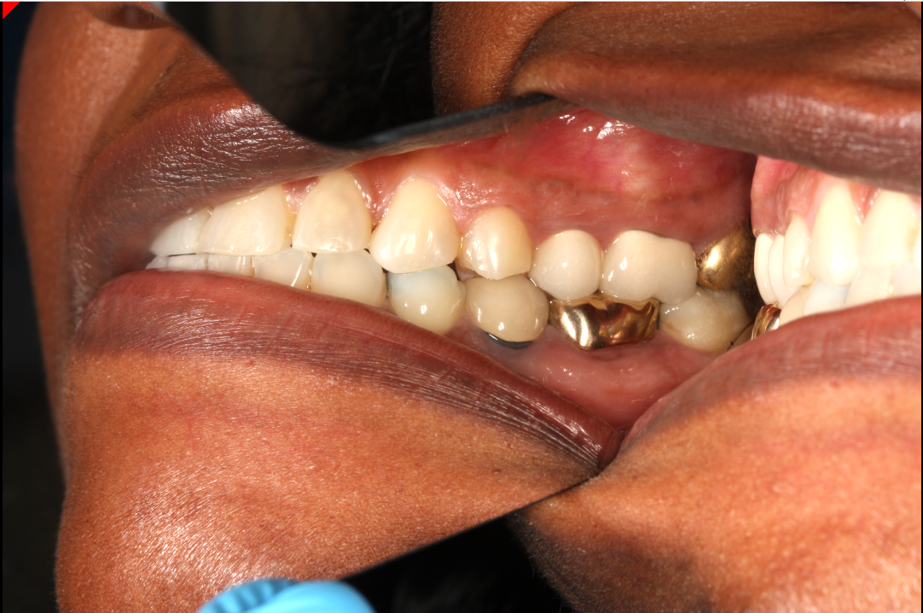

Slide 31
References:
Direct Composite Laminate Veneers: Three Case Reports. Bora Korkut, Funda Yanıkoğlu, Mahir Günday. J Dent Res Dent Clin Dent Prospects. 2013 Spring; 7(2): 105–111. Published online 2013 May 30. doi: 10.5681/joddd.2013.019
The Effect of Veneers on Cosmetic Improvement. S. Nalbandian, B. J. Millar Br Dent J. 2009 Jul 25; 207(2): E3–73. doi: 10.1038/sj.bdj.2009.609
Kulkarni, S., Bhat, P., & Thakur, S. (2015). Evaluation of soft tissue marginal stability achieved after excision with a conventional technique in comparison with laser excision: A pilot study. Indian Journal of Dental Research,26(2), 186. doi:10.4103/0970-9290.159159
Mavrogiannis, M., Ellis, J. S., Seymour, R. A., & Thomason, J. M. (2006). The efficacy of three different surgical techniques in the management of drug-induced gingival overgrowth. Journal of Clinical Periodontology,33(9), 677-682. doi:10.1111/j.1600-051x.2006.00968.x
Ozcelik, O., Haytac, M. C., Kunin, A., & Seydaoglu, G. (2008). Improved wound healing by low-level laser irradiation after gingivectomy operations: a controlled clinical pilot study. Journal of Clinical Periodontology,35(3), 250-254. doi:10.1111/j.1600-051x.2007.01194.x
Pandurić, D. G., Blašković, M., Brozović, J., & Sušić, M. (2014). Surgical Treatment of Excessive Gingival Display Using Lip Repositioning Technique and Laser Gingivectomy as an Alternative to Orthognathic Surgery. Journal of Oral and Maxillofacial Surgery,72(2). doi:10.1016/j.joms.2013.10.016
Sobouti, F., Rakhshan, V., Chiniforush, N., & Khatami, M. (2014). Effects of laser-assisted cosmetic smile lift gingivectomy on postoperative bleeding and pain in fixed orthodontic patients: a controlled clinical trial. Progress in Orthodontics,15(1). doi:10.1186/s40510-014-0066-5
Hebel, K. Gajjar, R., Hofstede, T. (2000). Single-tooth replacement: bridge vs. implant-supported restoration. J. Can. Dent. Assoc., Sep;66(8):435-8.
Fugzzzotto, P.A., (2009). Evidence-based decison making: replacement of the single missing tooth. Dent Clin North Am. Jan;53(1):97-129

Slide 32
Questions??
Email : jeff.Pron
Thank you!
ADIOSSSS

