Slide 1
Clinical Case Presentation
SPRING Quarter
PCC 146.04 2017

Slide 2
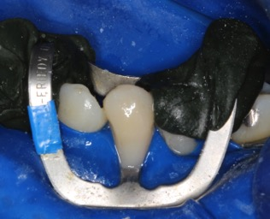
Case Presentation
Presented by:
Manbir Sandhu I1720
Kanika Attam I1701
Maria Valdez I1725

Slide 3
Case Presentation
Composite Class V Preparation and Restoration
Patient Name : Mendez Francisco
Age : 38 years
ASA I
NKDA
No relevant medical history
Chief Complaint “I want to get my teeth cleaned and have sensitivity on lower left side.”

Slide 4
Periodontal
Plaque induced generalized mild gingivitis
AAP classification I
Overall – Low risk

Slide 5
Clinical Findings
Current restoration: 14, 15, 18, 19 , 30, 31
NCCL’s: 20, 21
No wear seen
Overall – Moderate risk

Slide 6
Esthetics
Lip dynamics – Normal
Gingival architecture – Normal
Overall – Low risk

Slide 7




Armamentarium:
Local anesthesia : Inferior alveolar block (2%lidocaine) {Mental block should be given after IA if given before, IA wouldn't be effective}
Rubber dam punches
212 retractor
UCSF composite bur kit
H48L-012 bur from Gold bur kit
Slow speed hand piece

Slide 8
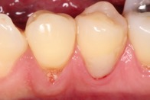
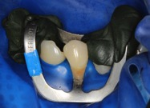
Pre-operative pictures
Without rubber dam
With rubber dam on

Slide 9
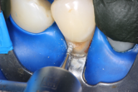
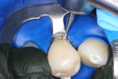
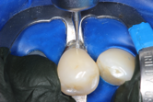
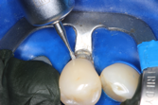
Procedure:
Slow speed hand piece used for preparation
While preparing the bur is kept perpendicular to the axial wall -
Mesial, Central & Distal

Slide 10
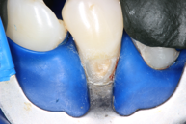
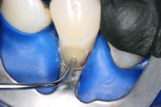
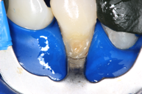
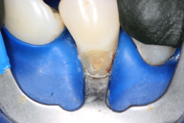
Final preparation
GC Fuji Lining LC applied and light cured
Etching and bonding done

Slide 11
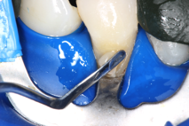
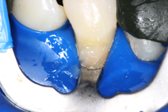
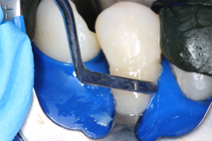
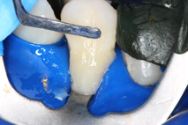
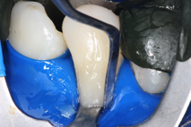
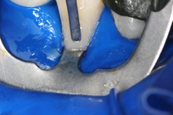
Placing composite in the preparation using layer technique

Slide 12
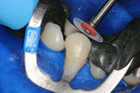
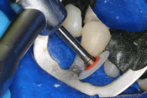
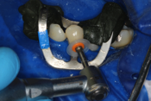
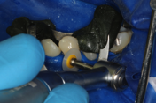
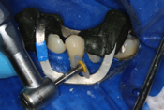
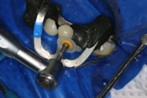
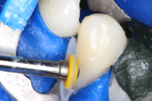
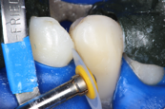
Composite was light cured for 40 seconds
Finishing & Polishing

Slide 13
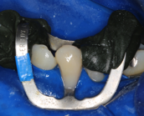
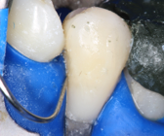
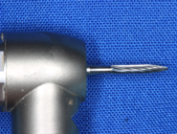
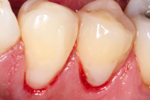
Final restoration with rubber dam on
Checking for gingival overhanging composite
Final composite Class V restoration

Slide 14
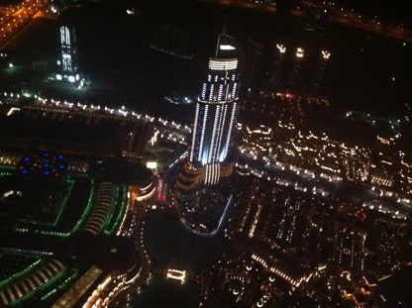
Thank You !

