Slide 1
“To Spee or Not to Spee?”
Homam Sebti
Shawn Chadha
Mugunth Nandagopal

Slide 2
This case presentation will cover the following concepts and challenges using both an evidence based and clinician approved approach.
Fixed Partial Dentures
Curve of Spee and influence on esthetics and function
Smile Design
Patient expectation and provider capacity

Slide 3
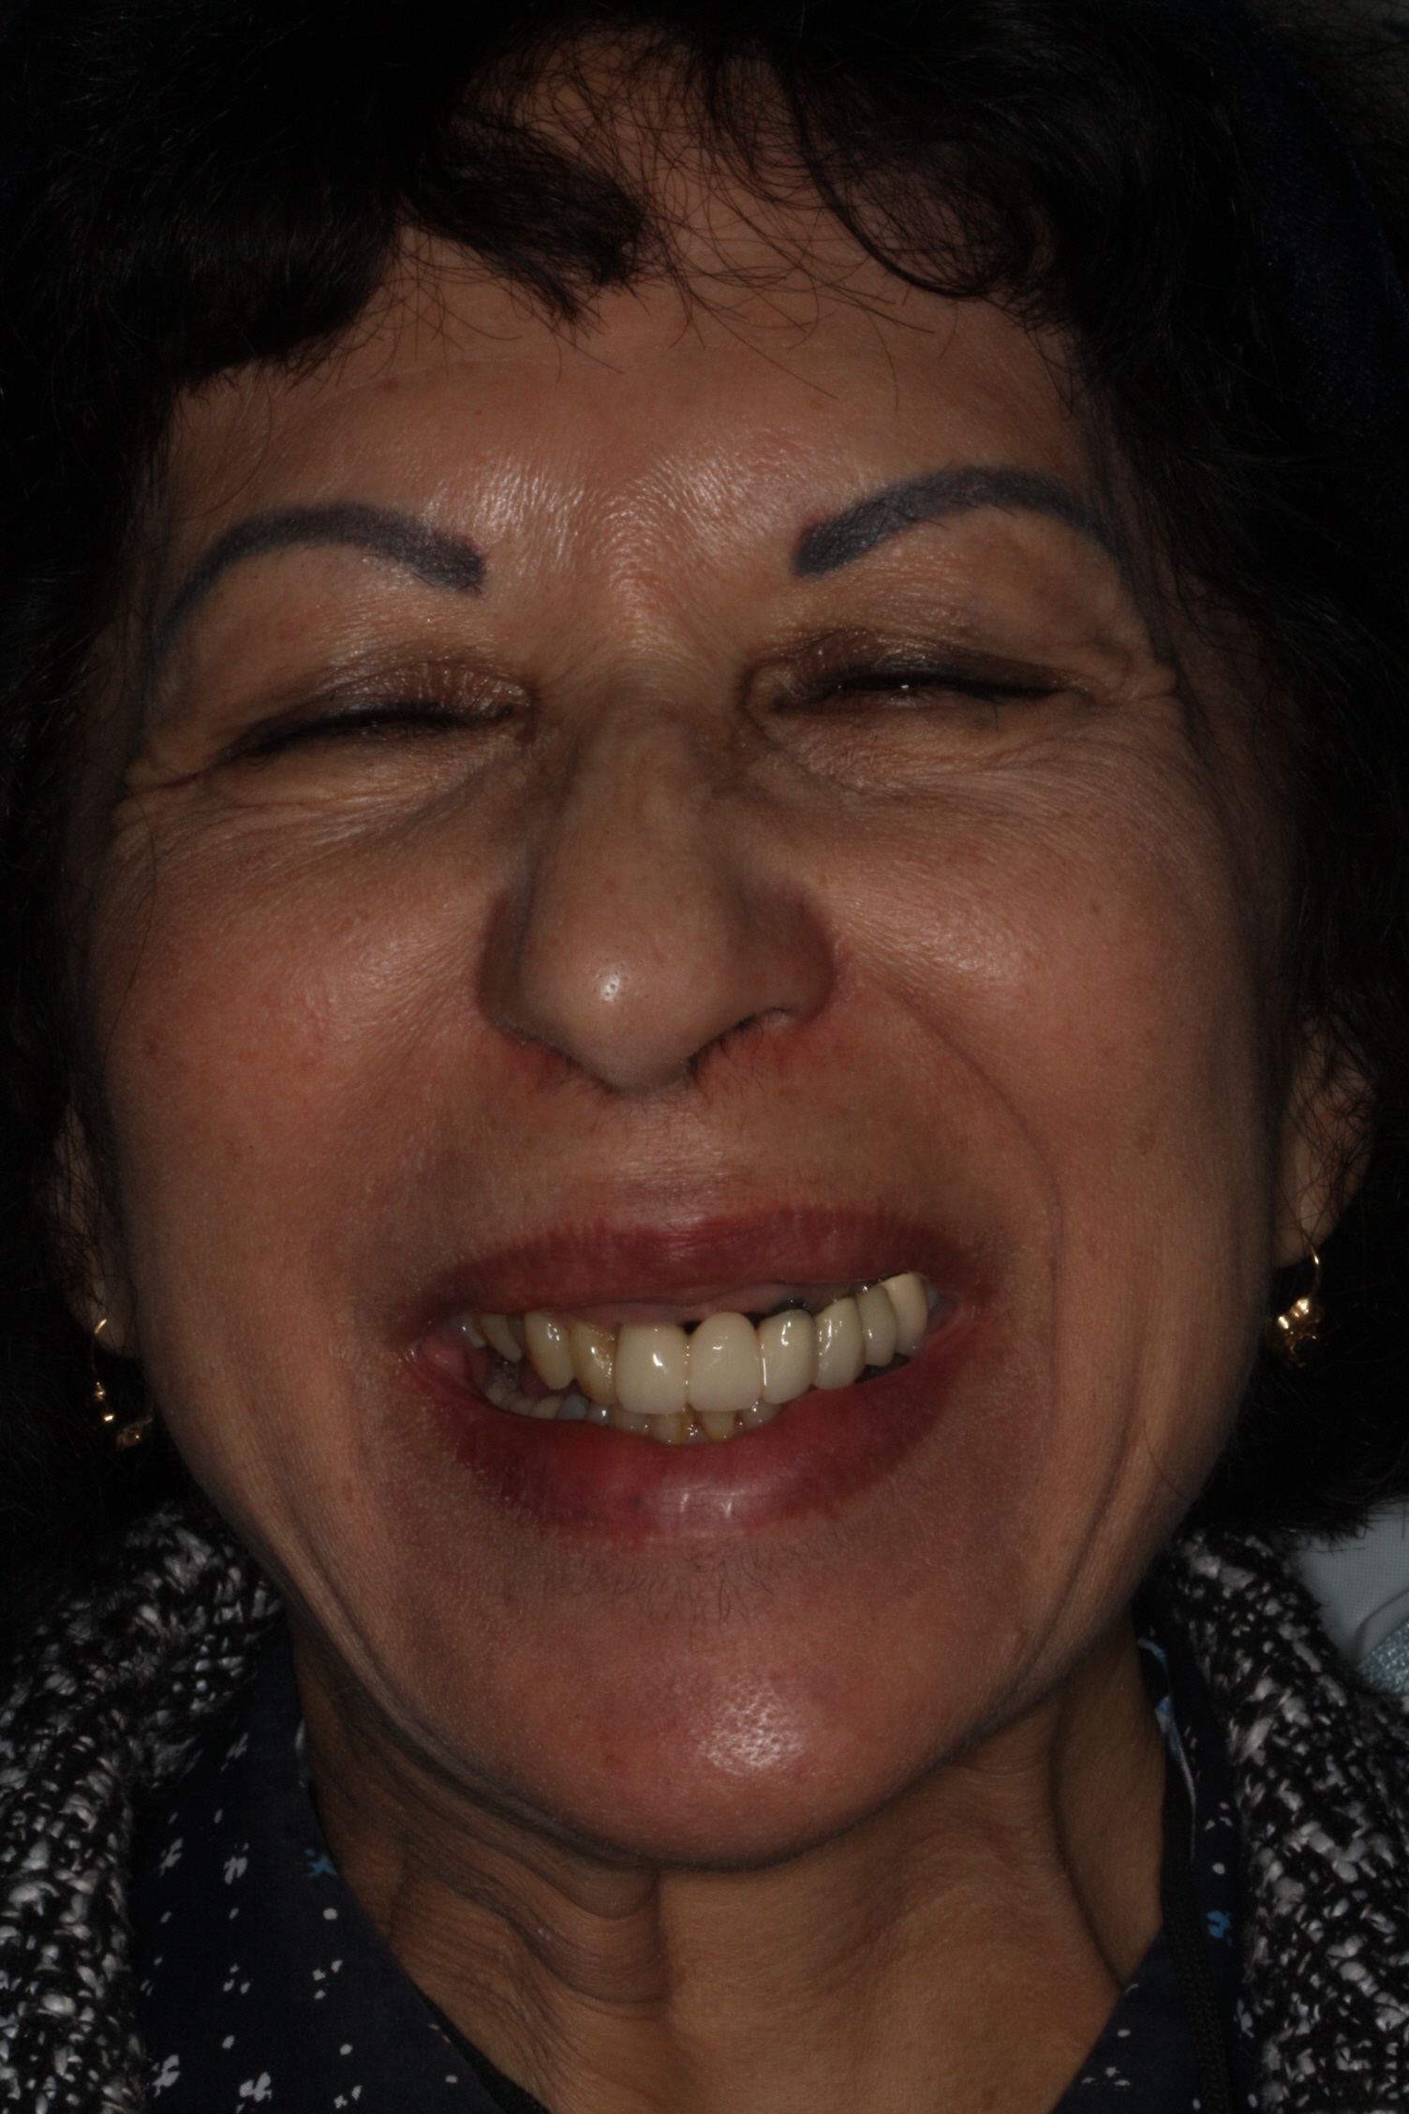
Patient Demographics
54 year old female presents to UCSF Buchanan Dental Center with a chief complaint of “I don’t like the way my bridges and smile looks.”
HOPI: No history of pain or sensitivity. Related to the CC; pt. Particularly comments on “black lines above crowns”, “mixed colors from tooth to tooth like a ‘checkerboard’”, and “slanted smile”.
MedHx: Non-contributory
NKDA

Slide 4
Patient Demographics
Dental Hx: Irregular dental care with last rehabilitative work performed at UCSF 10 years prior.
Social Hx: No Etoh, No smoking, No recreational drug use

Slide 5
Patient Demographics
Soft Tissue:WNL
Hard Tissue: No extraordinary findings
Occlusion: Stable occlusion with deep bite and signs of attrition. Pronounced Reverse curve of Spee on both L and R posterior bite.
Iatrogenic occlusal discrepancies induced by poor laboratory work and lack of review of wax-up prior to bridge delivery.
Periodontal Dx: Gen. moderate chronic periodontitis according to CAL.

Slide 6
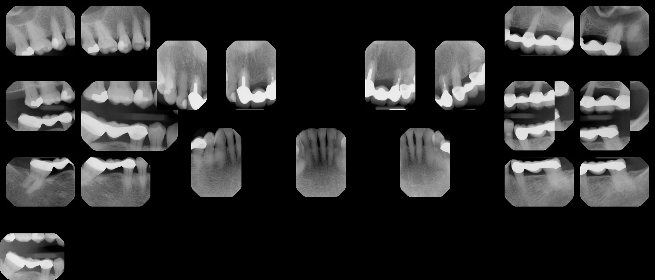
FMX

Slide 7
Phasing
Phase 1: Prophy, 1 mo. eval, 6 month maintenance
Phase 2: Sectioning of Bridge, restorability assessment and temporization.
Ultimately all abutments with old restorative material removed and replaced with B/U with Composite on #8,10, 13,15,18,20.
Phase 3:
Sequence 1: 4 UNIT FPD #8-11
Sequence 2: 3 UNIT FPD #18-20
Sequence 3: 4 UNIT FPD #12-15 (Cantelever #12)
Phase 4: Recall/Perio Maintenance
Alternatives presented to patient were no treatment or an RPD or Implants

Slide 8
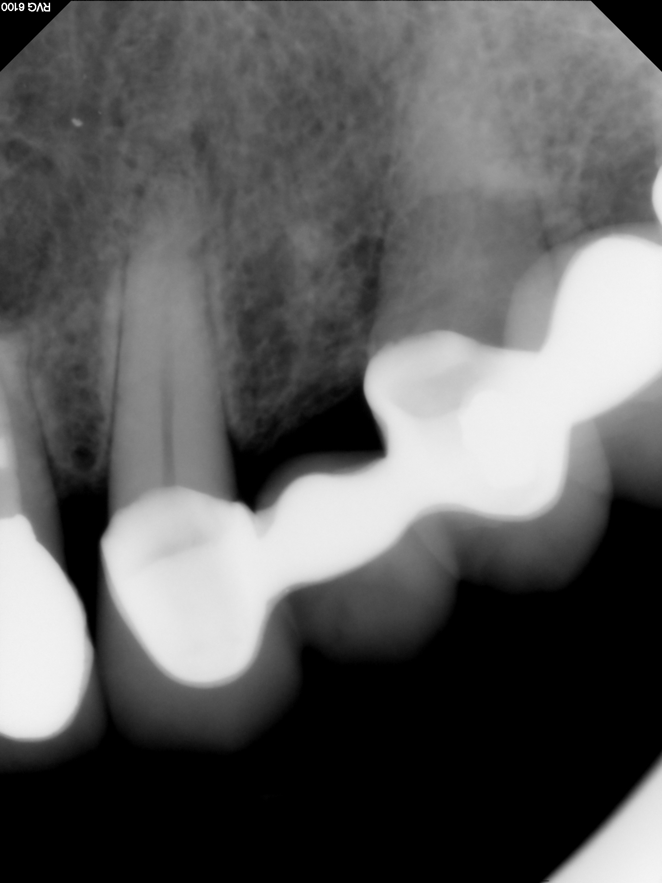
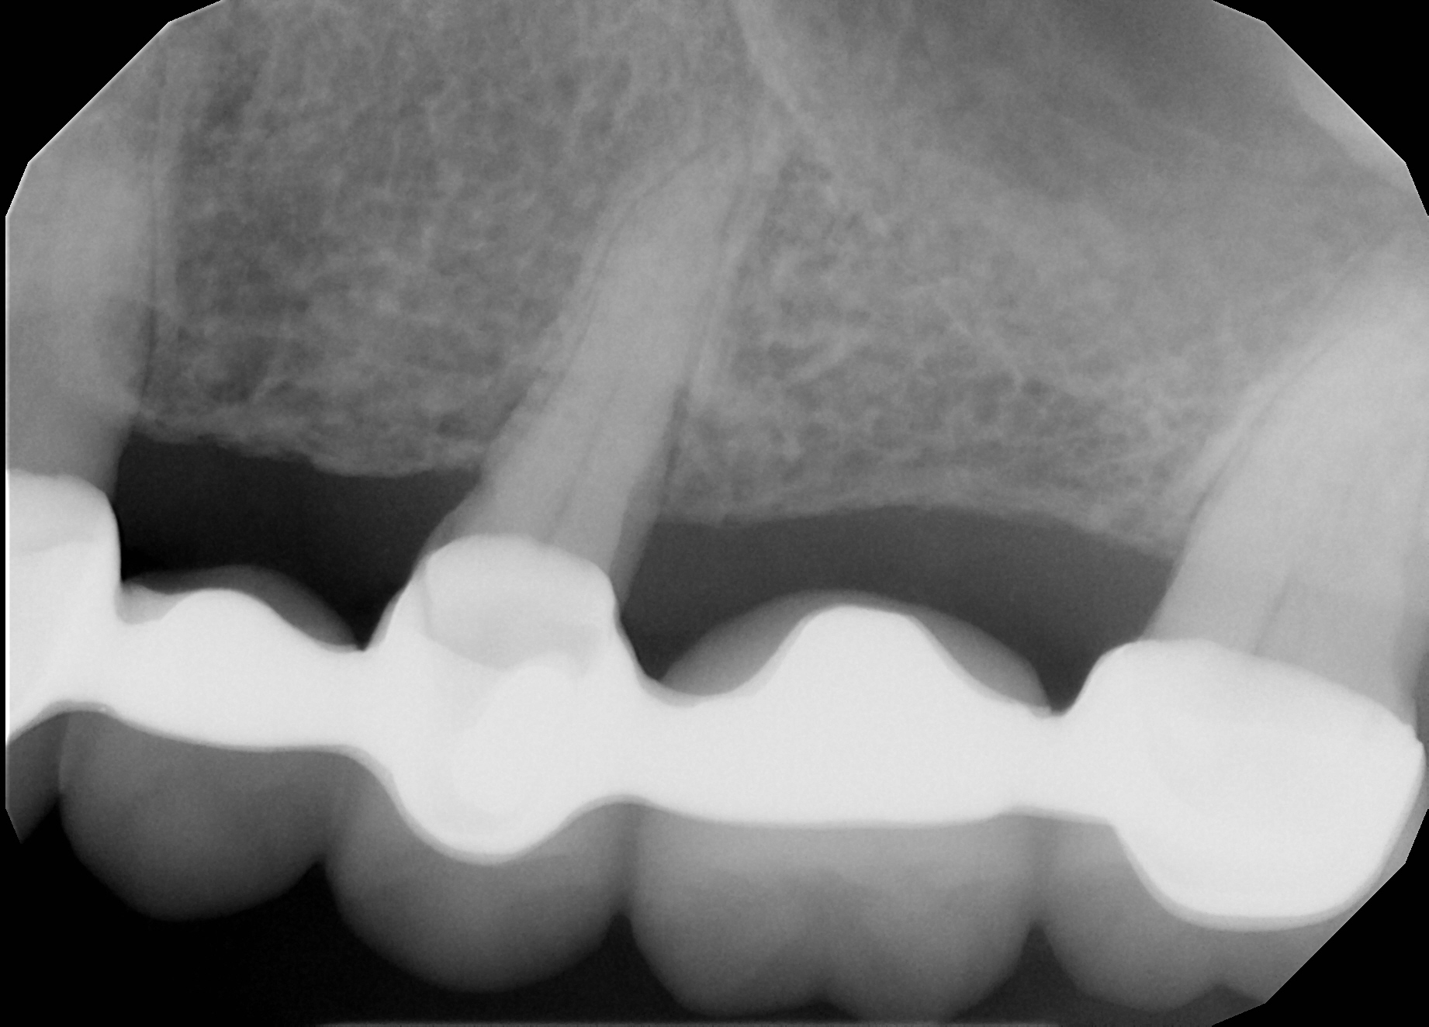
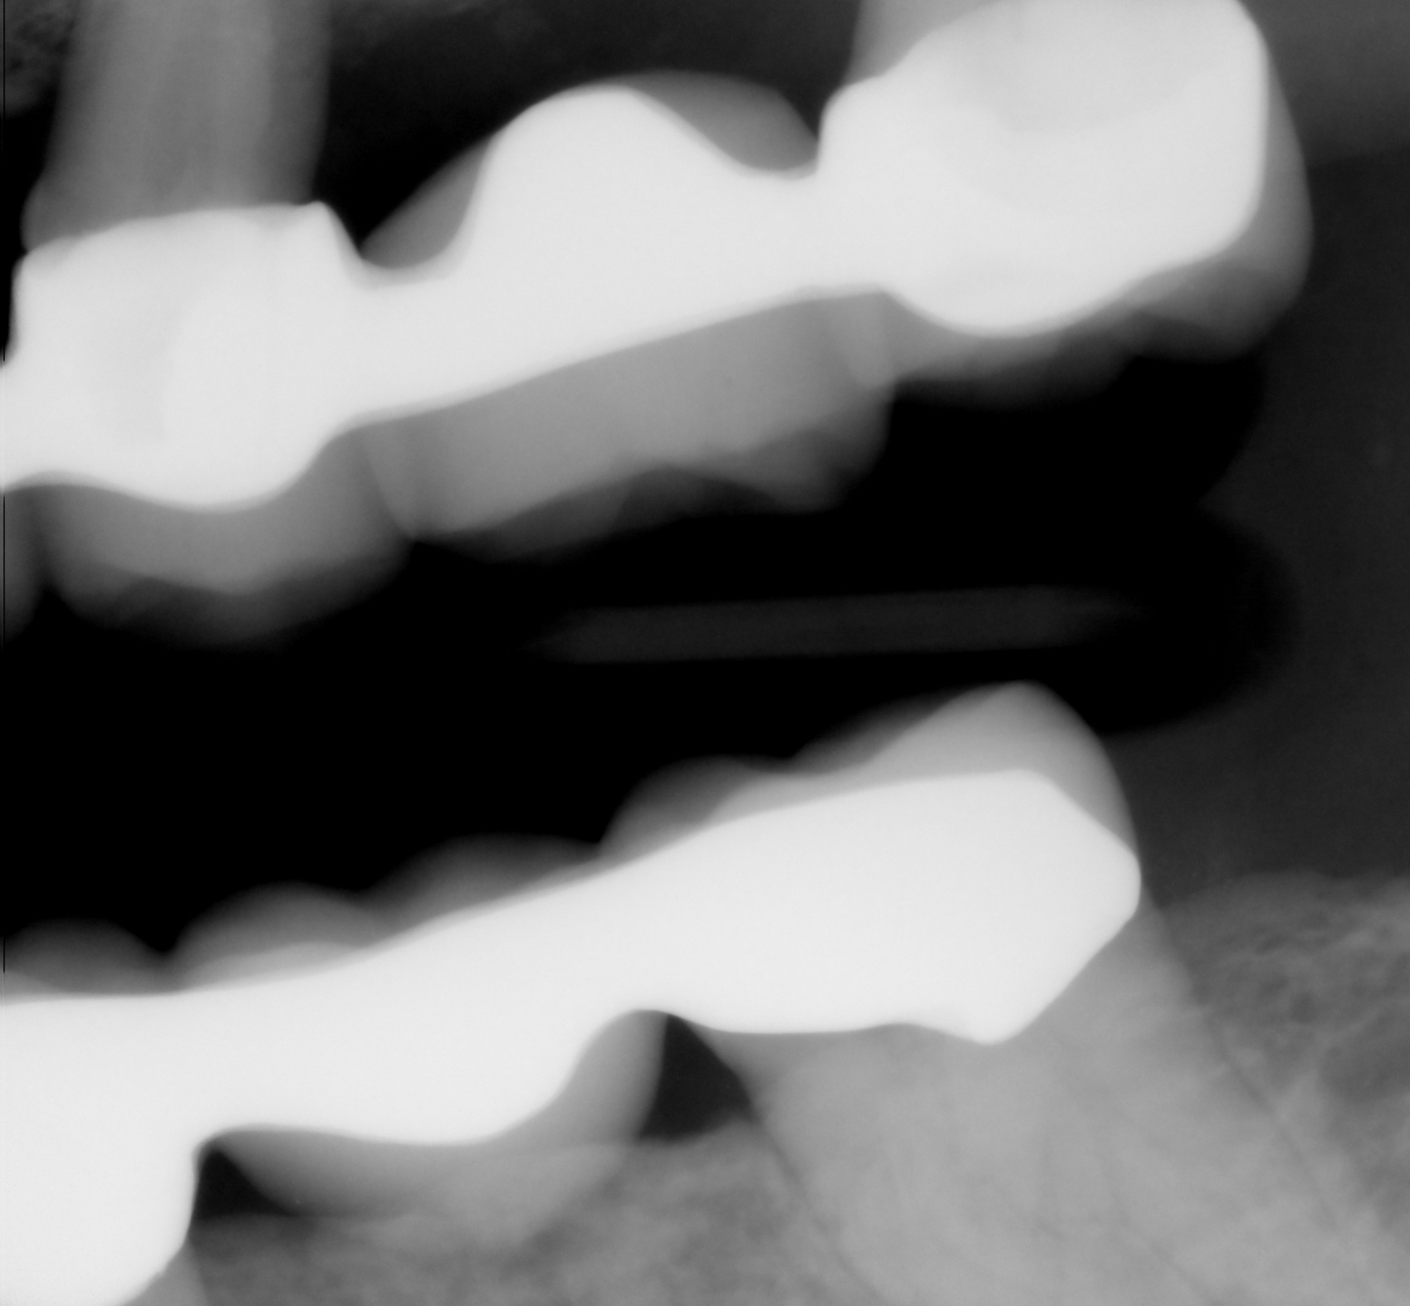
Radiographic Findings

Slide 9
Ascertained that patient wants only the prior bridges to be replaced.

Slide 10
Periodontal surgery was performed according to the patient. The description matched that of “Modified Widman Flap”.

Slide 11
Initial treatment plan included #12 to be planned as implant. She decided against it last minute.

Slide 12
#12 was placed as a cantelever to #13-15 FPD and all risks and benefits were explained thoroughly to patient.

Slide 13
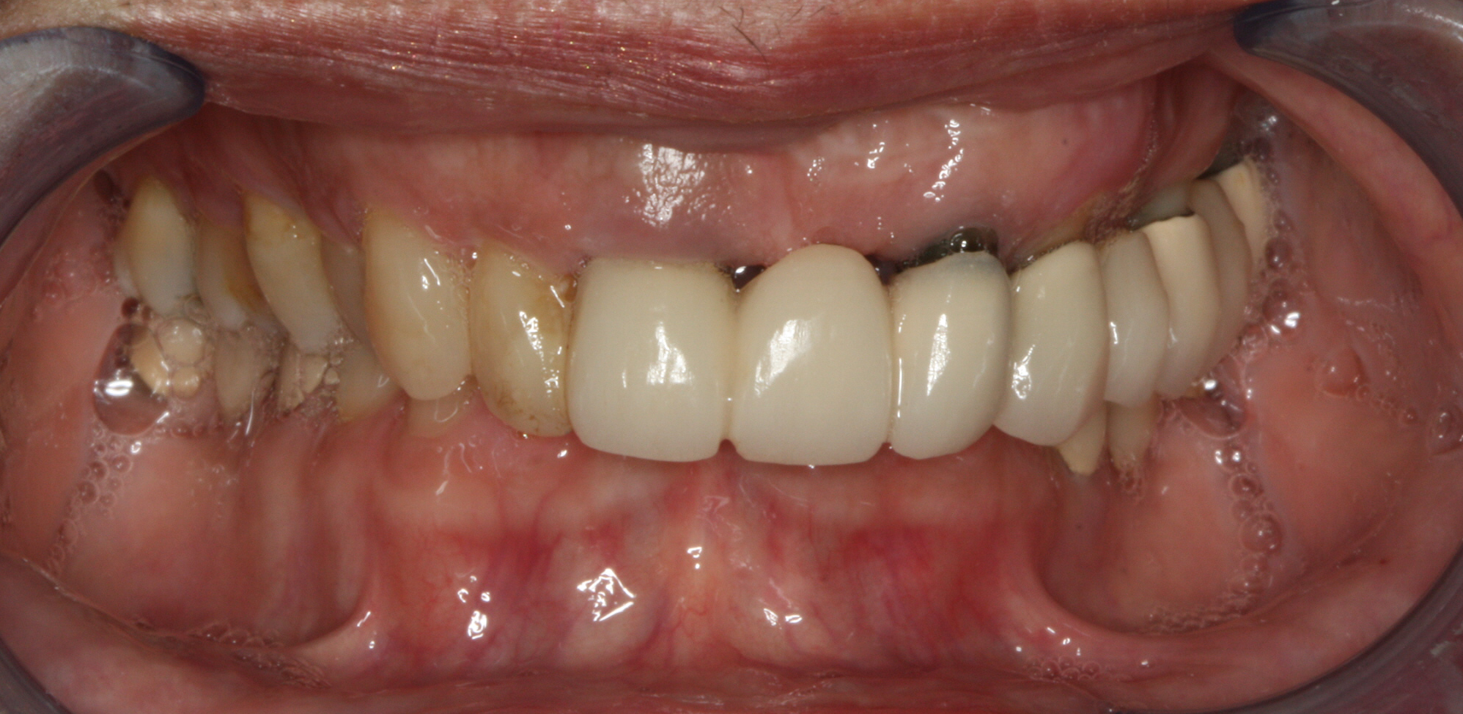
Palatoversion of right side
Deep bite
Buccal corridor obliteration

Slide 14
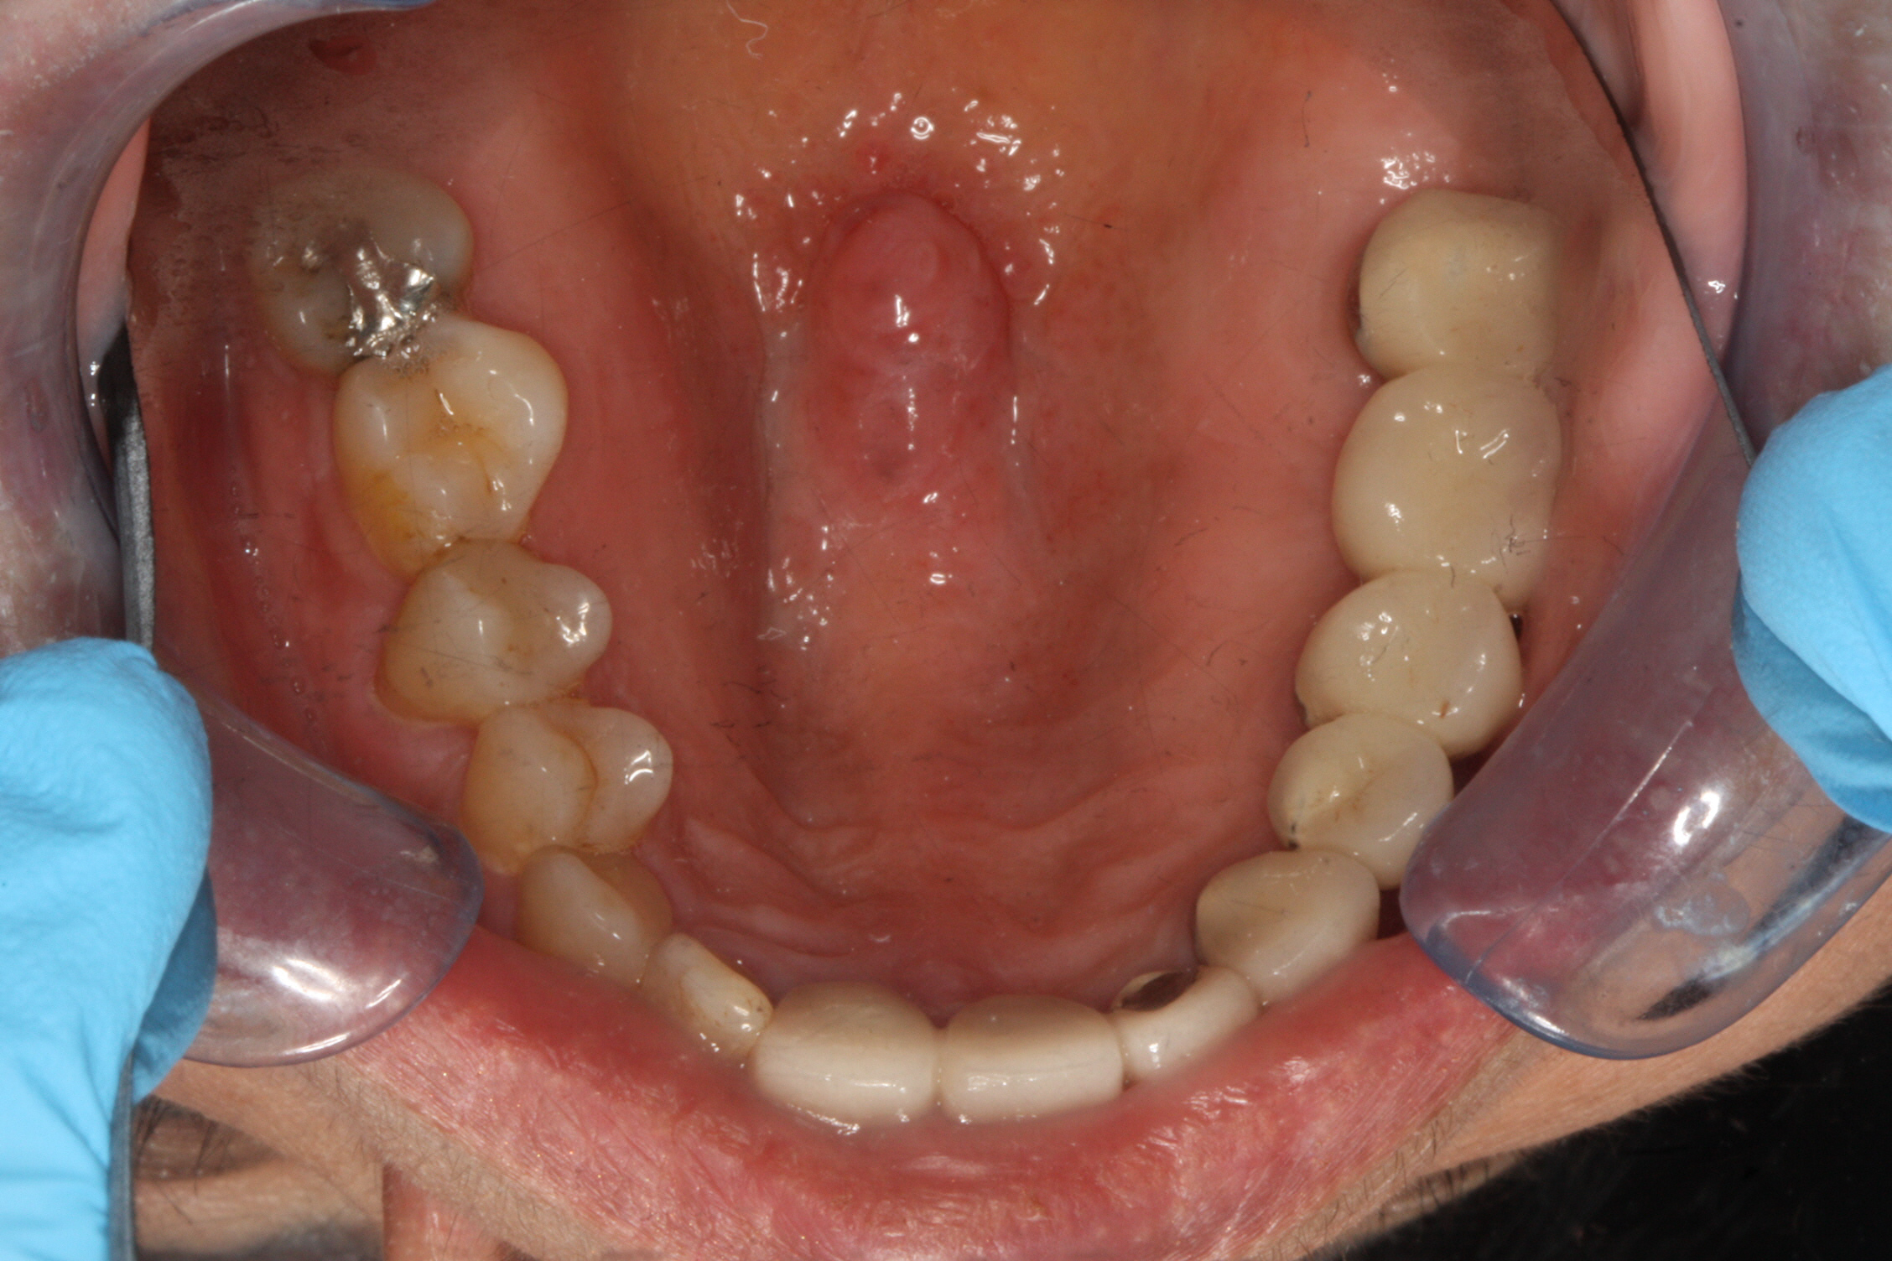
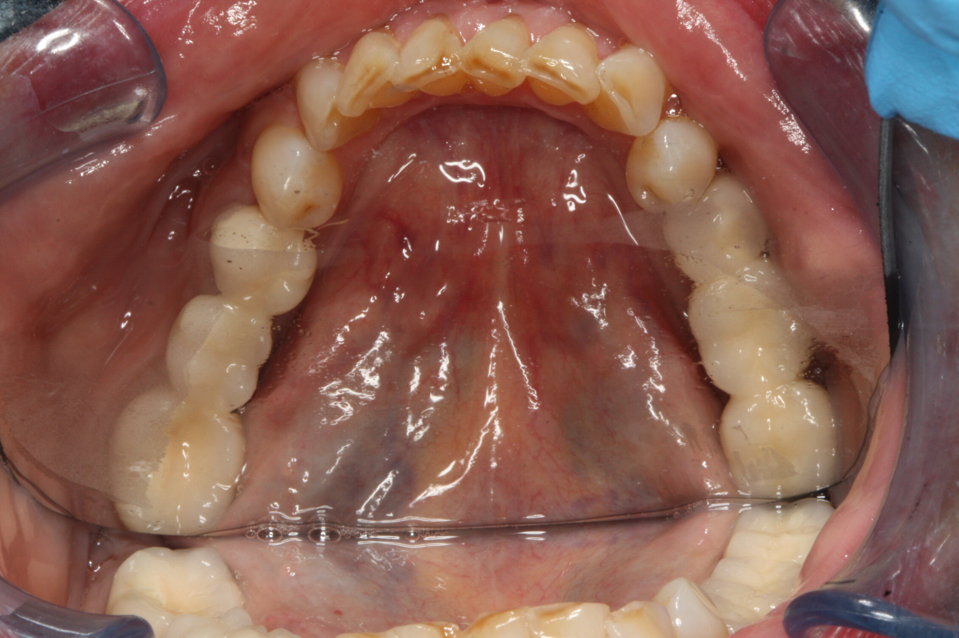

Slide 15
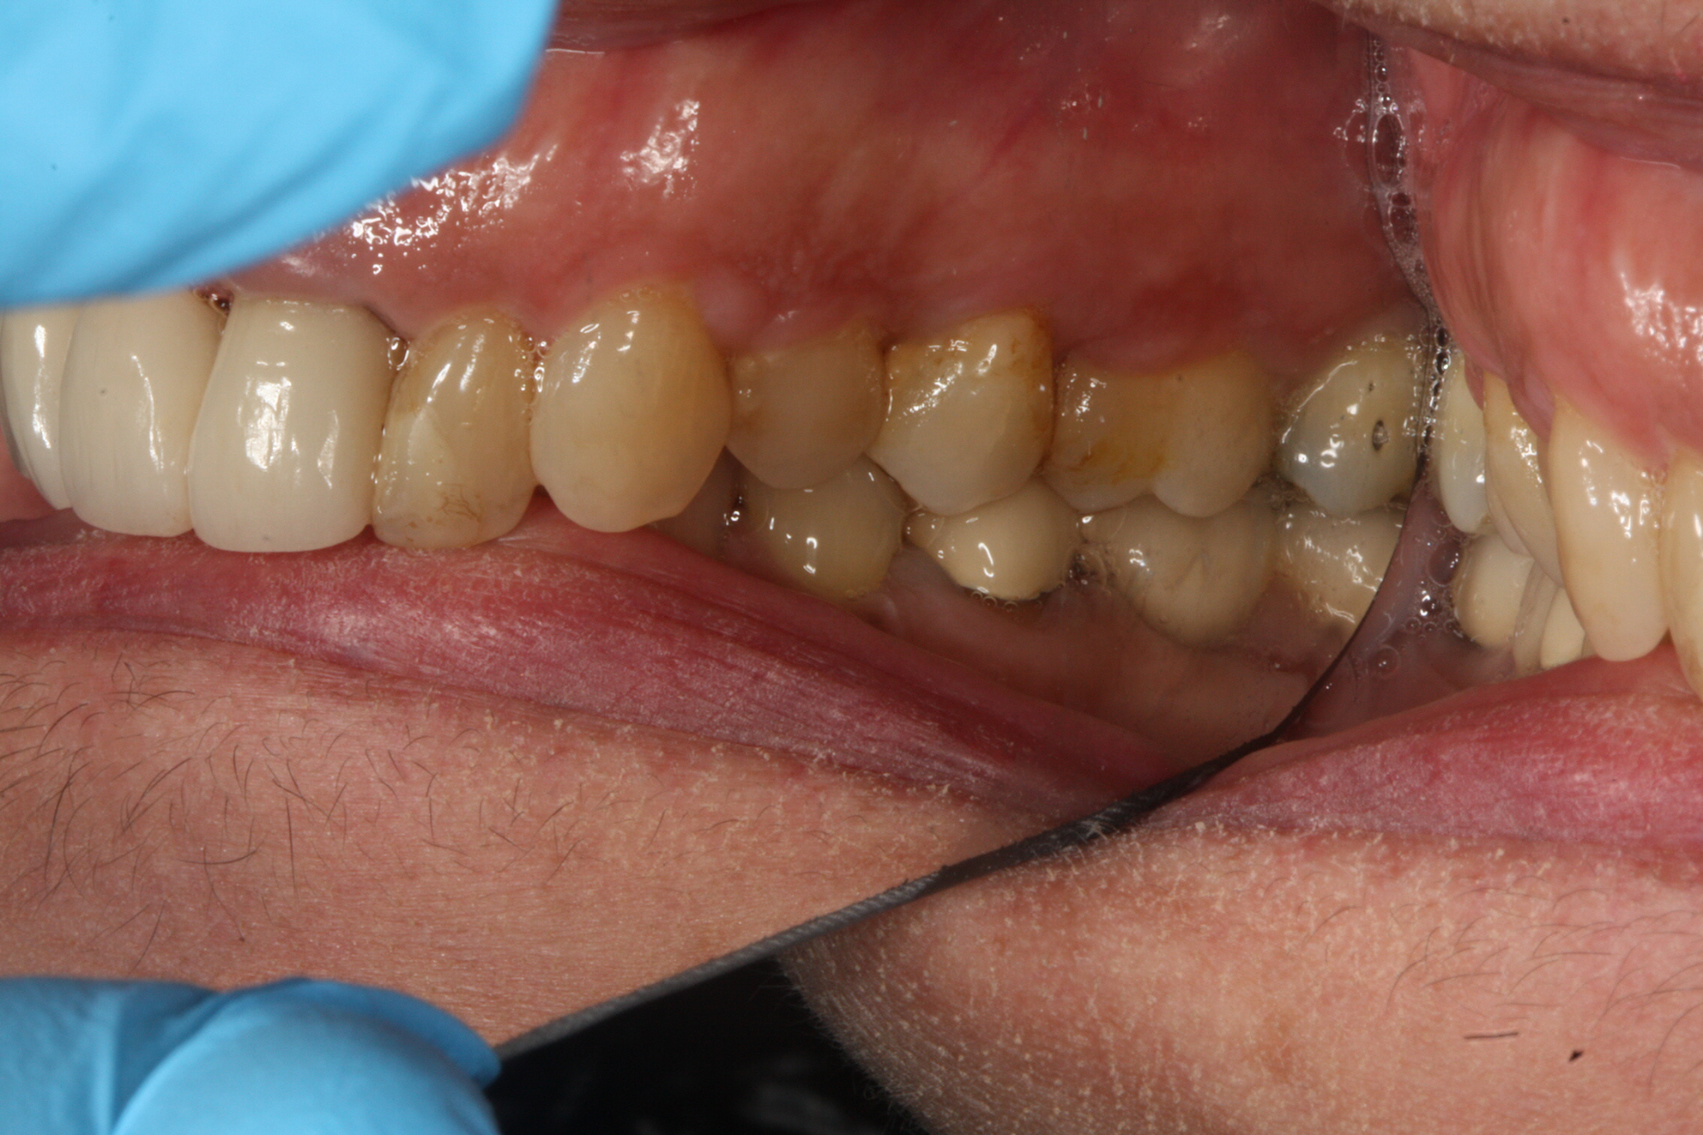
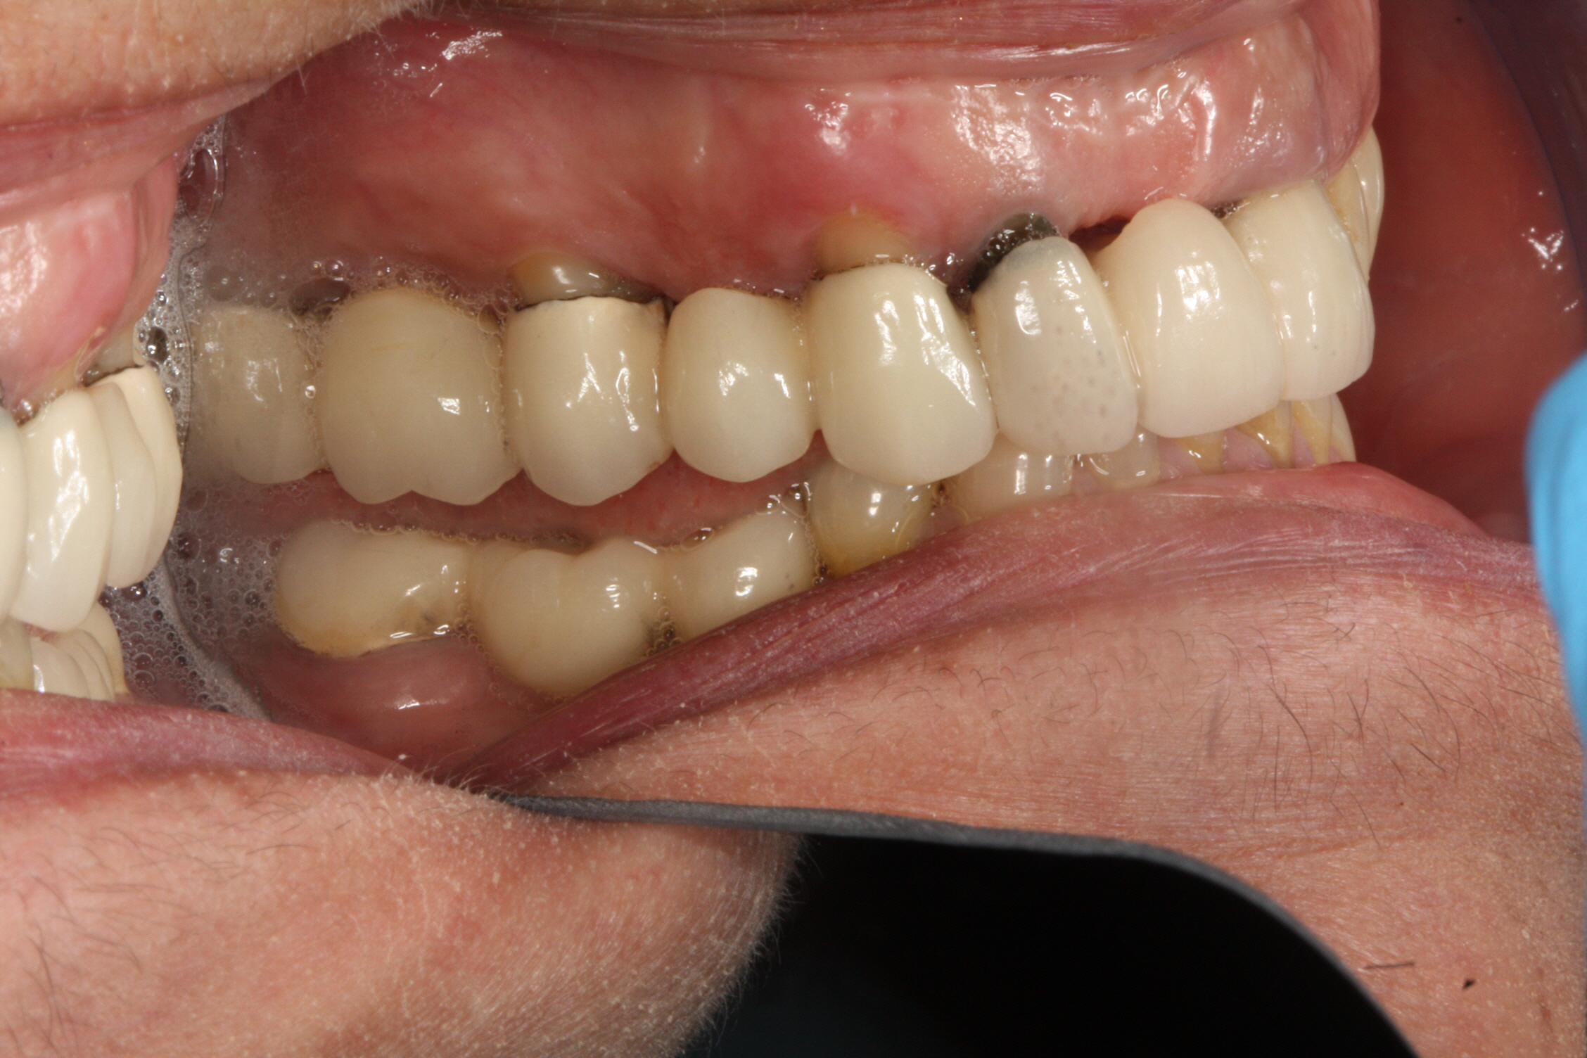

Slide 16
Caries restorability
Abfraction or gingival recession?
Pontic design change
Emergence profile
Exaggerated Curve of Spee

Slide 17
Between Phase III: Sequence 1 and 2
Reduction of #12-15 FPD to allow lab space to add porcelain to compensate for Curve of Spee

Slide 18
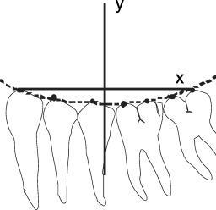
Sequencing of multiple FPDs necessitated that Upper plane of occlusion was adjusted to allow the dental laboratory enough room to equalize the lower plane of occlusion.

Slide 19
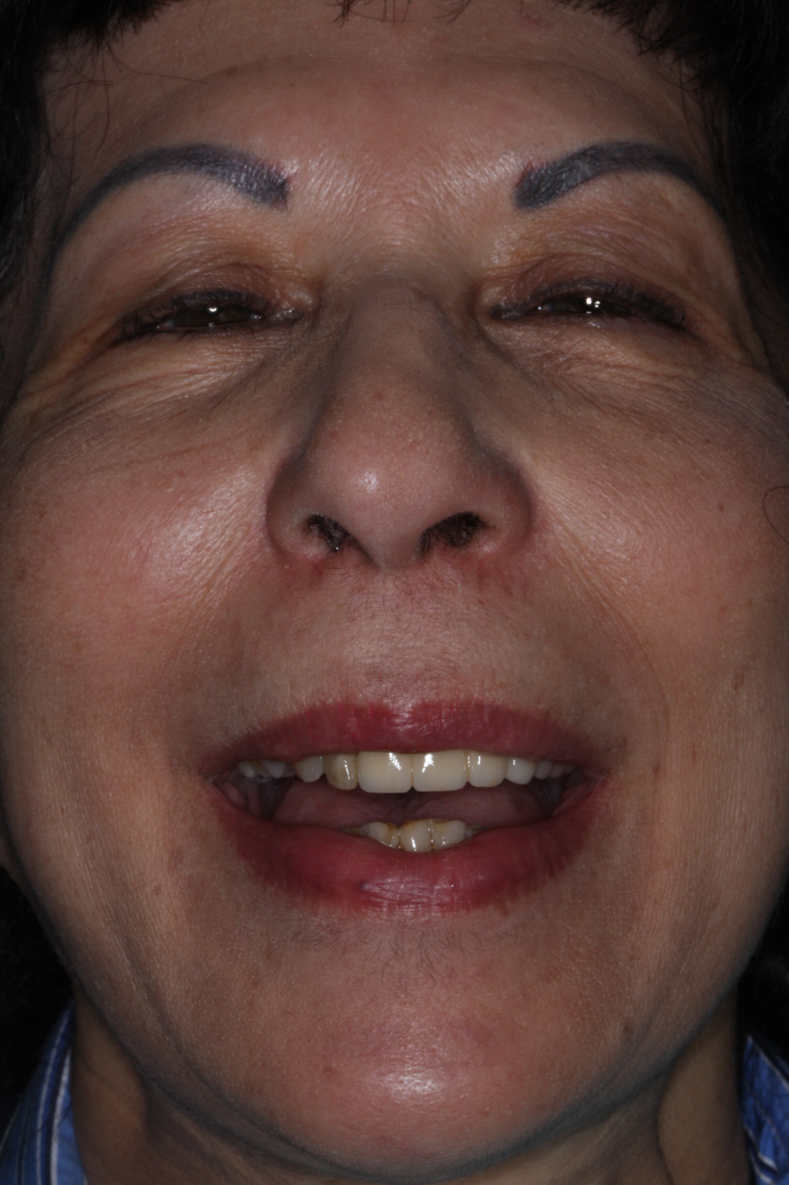
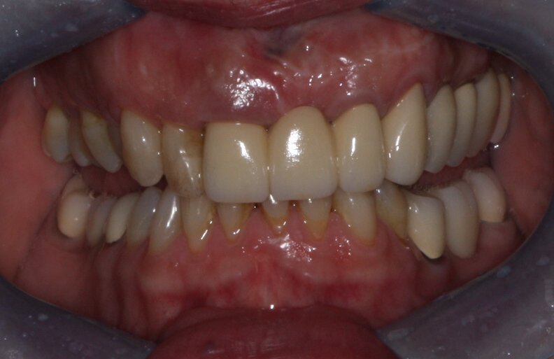

Slide 20
Post-operative correction of Plane of Occlusion.
Normalization of Curve of Spee, Monson and Wilson’s Sphere
(and Chadha’s Hexagon) resulted in more aesthetic outcome.

Slide 21
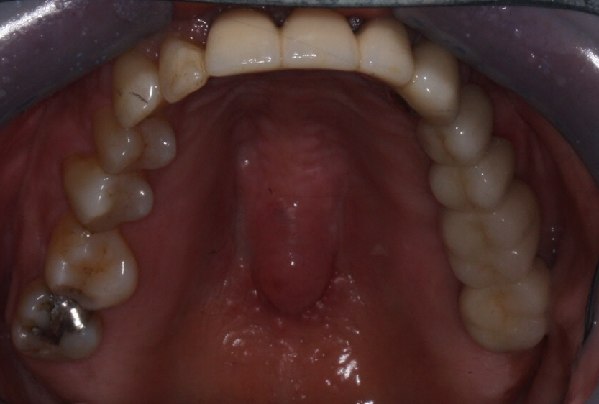
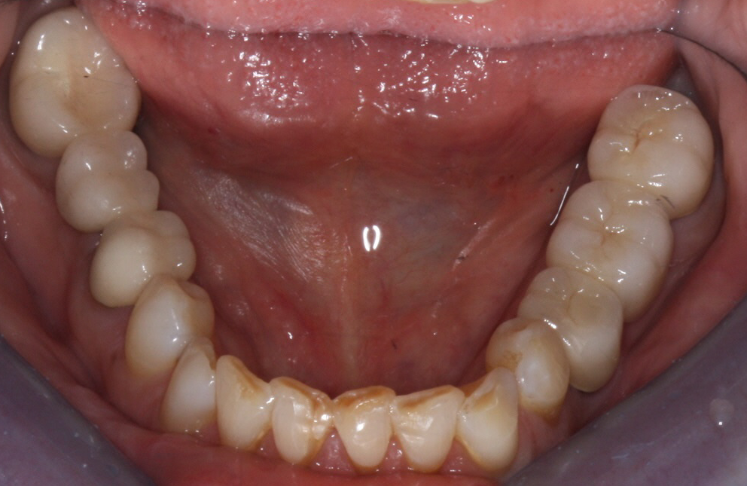

Slide 22
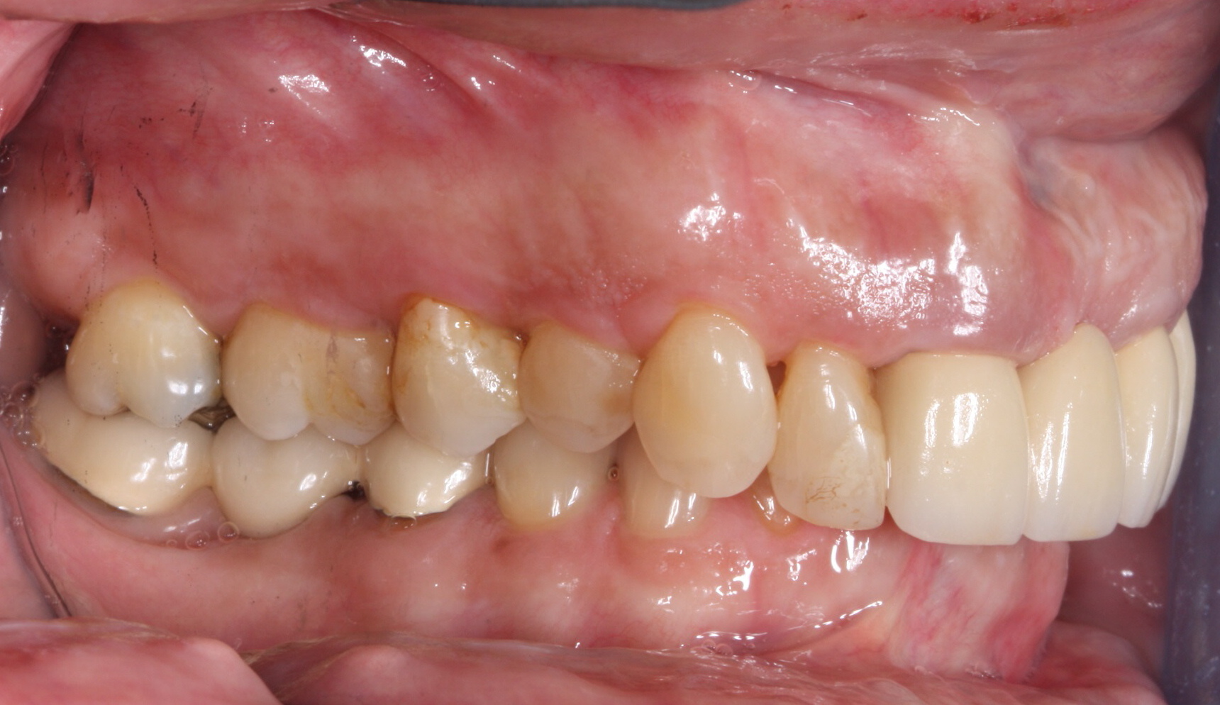
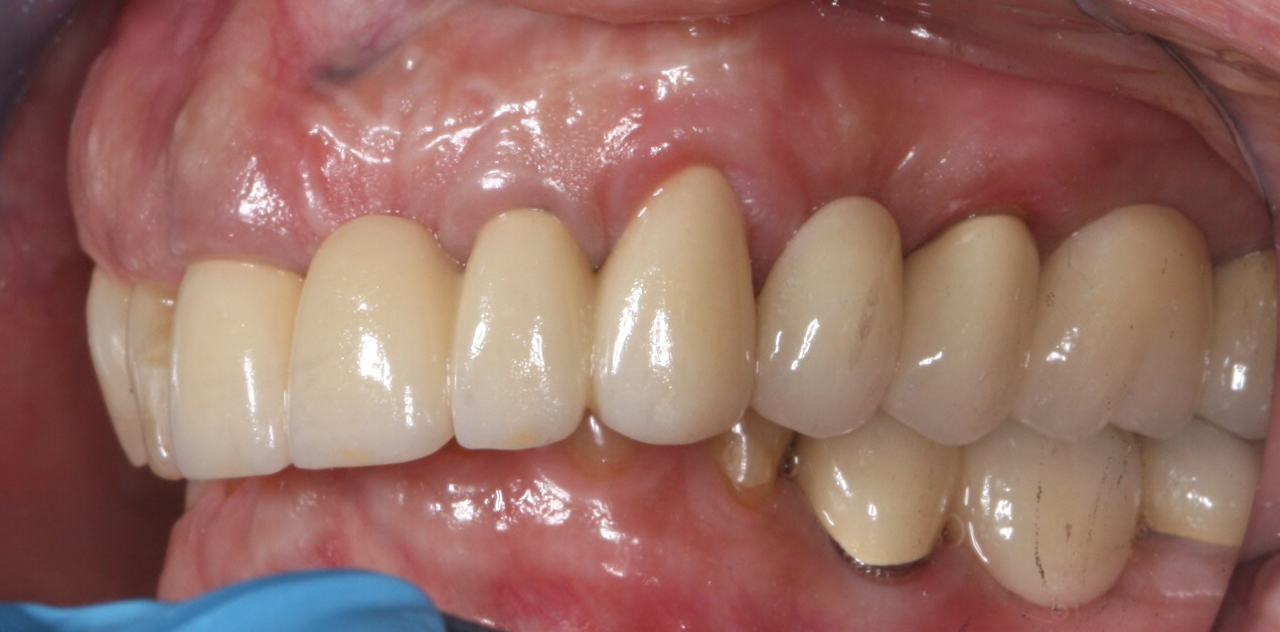

Slide 23
