Slide 1
Anterior Indirect Restorations
Elizabeth Chavez, Madhurima Ganguly, Aditi Garg , Enedzhan Khanamova and Yuvika RajKumar

Slide 2
Introduction
•Dentistry is an ever changing science. As new research and clinical experience broaden our knowledge, changes in treatment are required.
•This shift in the field of dentistry comes along just it time to meet the final needs and wants of patients who perceives an attractive smile no longer as a luxury but rather a necessary part of their life style. Aesthetic dentistry enables the dentist to change the appearance, size, color , shape, spacing and positioning of the teeth.
•An organized and systematic approach is required to evaluate, diagnose and resolve esthetic problems predictably.
•It is of prime importance that the final result is not dependant only on the looks alone. Our ultimate goal as clinicians is to achieve pleasing composition in the smile by creating an arrangement of various esthetic elements.

Slide 3
Introduction
•The goal of an esthetic makeover is to develop a peaceful and stable masticatory system, where the teeth, tissues, muscles, skeletal structures and joints all function in harmony.
•The preparation design for anterior restorations should encompass elimination of decay, function and longevity, and esthetic predictability.
•Metal ceramic restorations have excellent esthetic potential. The metal ceramic restorations owe their popularity to the simplicity, durability, strength, marginal adaptation and versatility of use.

Slide 4
CASE
81 years old female
C/C: “ I hesitate to smile as I do not like the metal show on my front teeth”
Med hx: Non-contributory
Social hx: Negative
Dental hx: Under regular dental care.
Patient was recommended a treatment plan that involved replacement of upper anterior crowns.
Patient was referred due to financial concerns

Slide 5
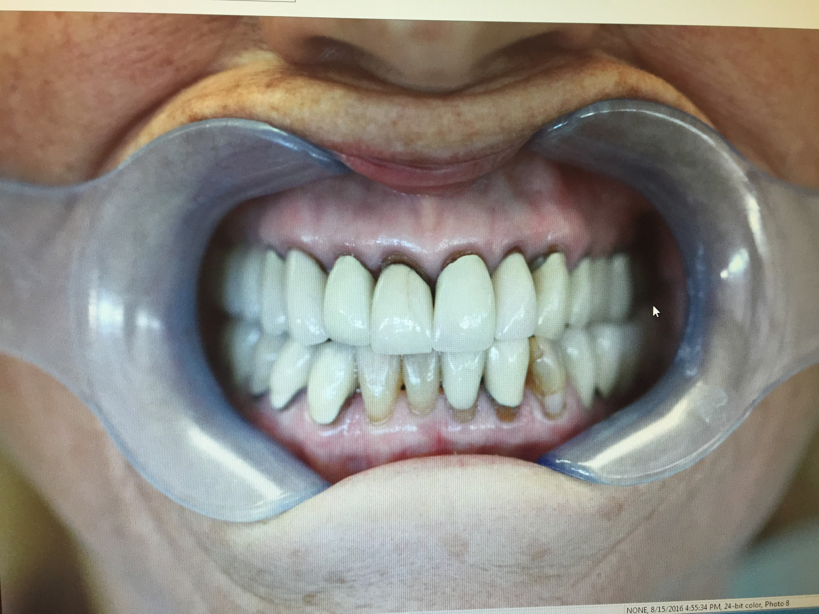
Pre-op

Slide 6
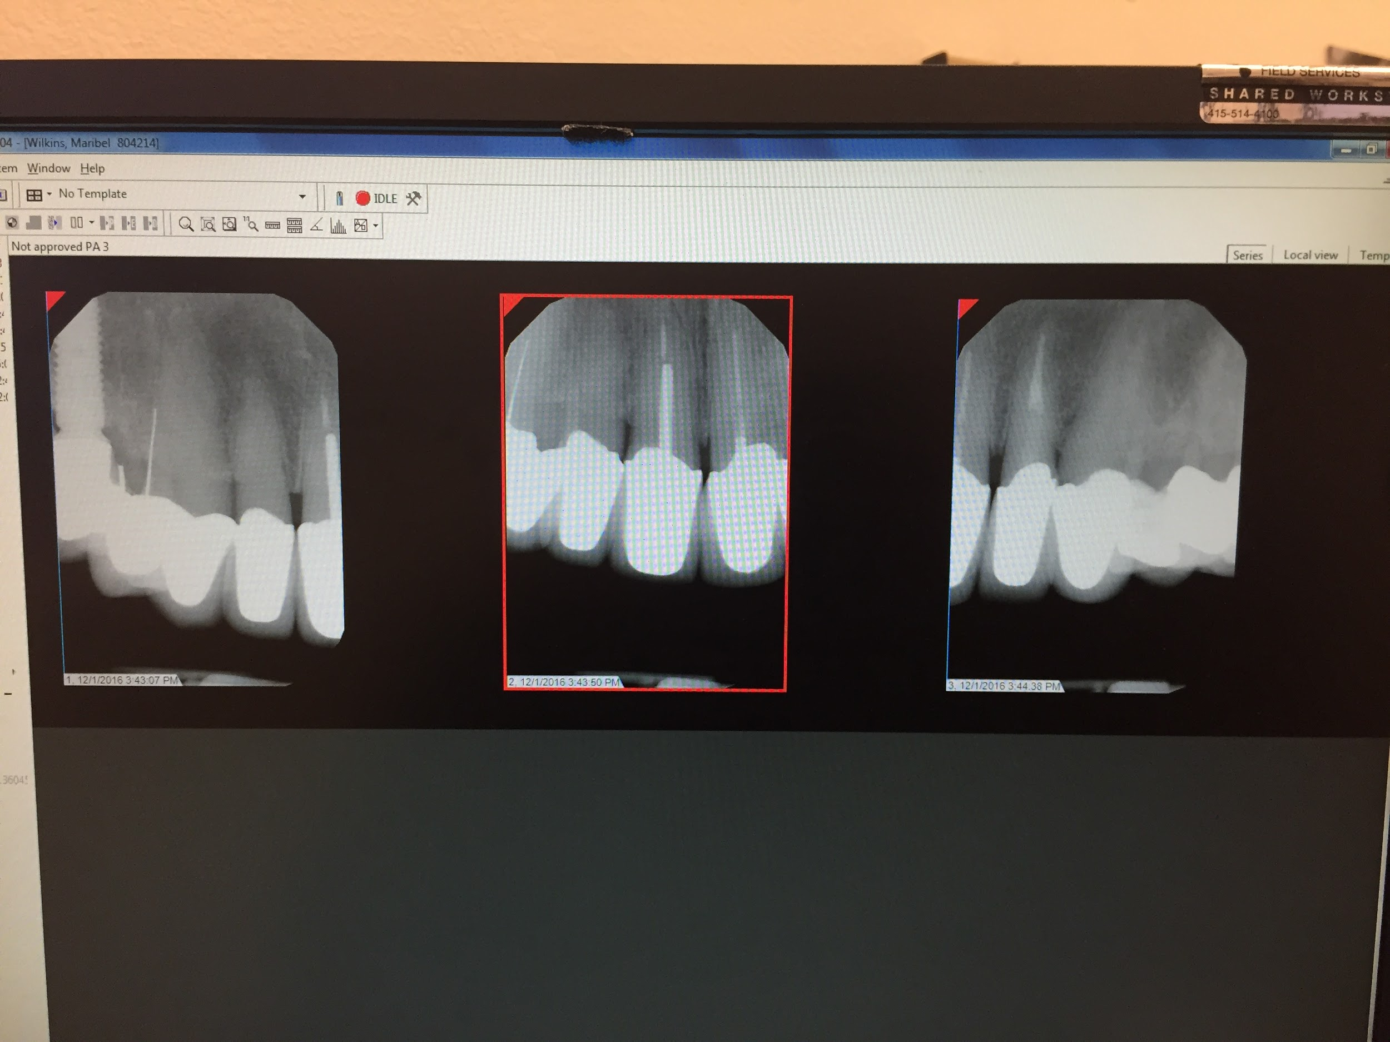

Slide 7
Clinical and Radiographic evaluation
Soft and hard tissue: WNL
Periodontal diagnosis: Periodontal Health
Multiple crowns (PFM) present since 30-40 years old.
Previous endodontic treatment: #6,8,9
Endo consult: No signs and symptoms of infection or possible developing infection.

Slide 8
Study models and face bow record established.
Treatment options presented:
No Treatment
Repair with composite
Replace crowns #6-11

Slide 9
Treatment Options
Treatment Options | Advantages | Disadvantages
E-MAX crown Press lithium di-silicate stained or multilayered porcelain overlay | Premium aesthetics Excellent fit Metal-free Biocompatible Low Cost | Durability - brittle Remaining tooth structure
Chameleon Zirconia ( Zirconia coping with multilayered porcelain overlay) Designed and milled using CAD/CAM technology and build up by hand. | Premium aesthetics Excellent fit Metal-free Biocompatible Durability Remaining tooth structure | Cost

Slide 10
Treatment Options
Treatment Options | Advantages | Disadvantages
PFM crown Non- precious, precious alloy with layered porcelain | Good aesthetics Good strength Traditional cementation or bonding technique Low cost Can be used as survey crown | Aesthetics Remaining tooth structure Non-allergic Opposing occlusion Porcelain Fracture Shade selection
Direct composites | One-visit procedure Cost effective Repair potential Chair side control of anatomy Minimal irreversible loss of tooth structure | Tend to discolor Wear off quickly Marginal Staining Shade selection difficulty Often requires repair and replacement

Slide 11
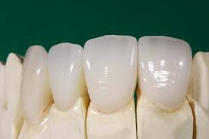
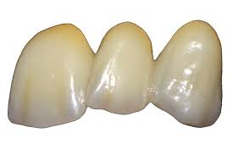
Photos of treatment options
Chameleon Zirconia
E-MAX crown

Slide 12
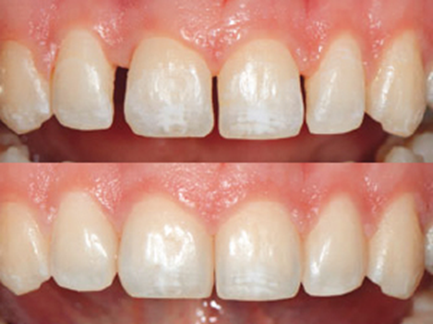
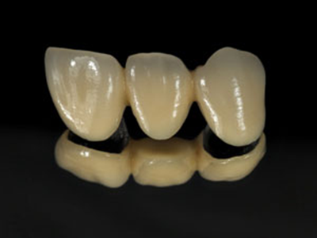
PFM crown
Direct composites

Slide 13
Patient was not willing to compromise with esthetic outcomes (possible with composite repair).
She was highly motivated to chose the option (crown replacement) that would give her the best esthetic results which would help her regain her social confidence.

Slide 14
Discussion was done about the number of crowns to be replaced.
She mentioned that #6 does not bother her esthetically.
A final decision was made to replace #7-11.
Patient was given an option to replace #6 in the future if need be.

Slide 15
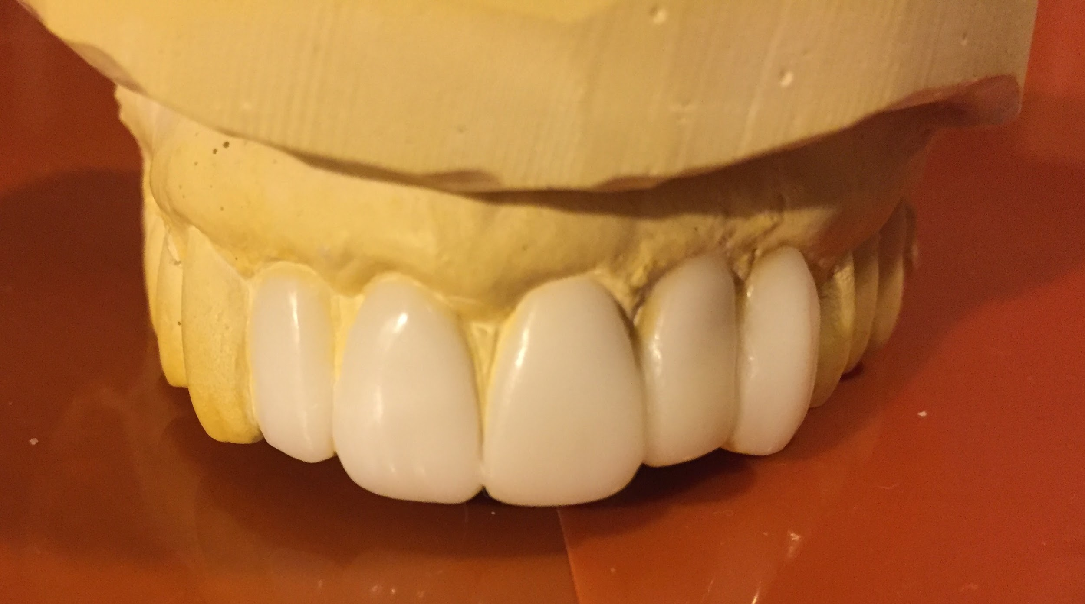
Wax-up

Slide 16
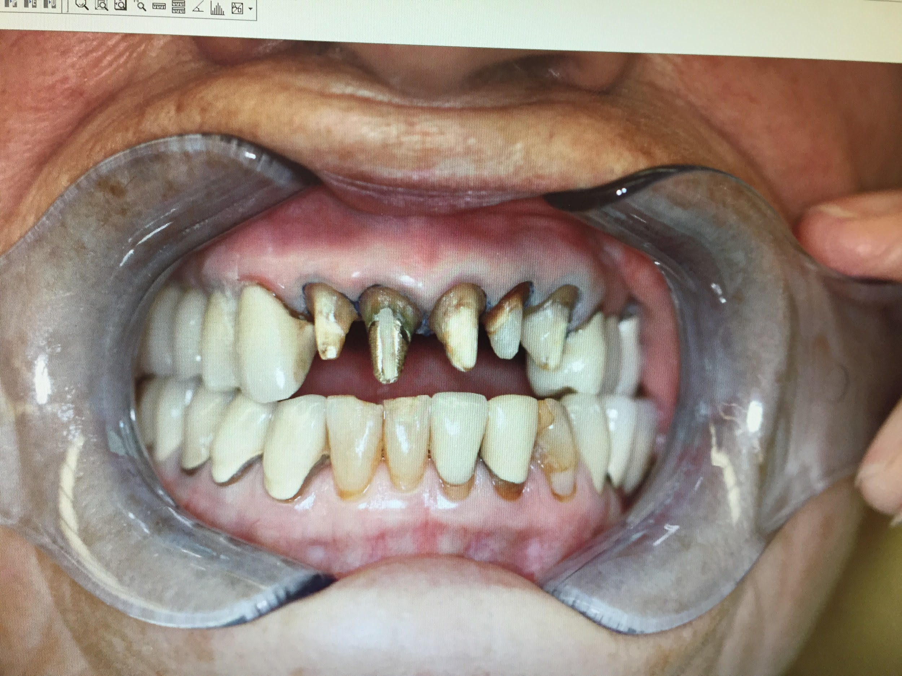
Teeth Preparation

Slide 17
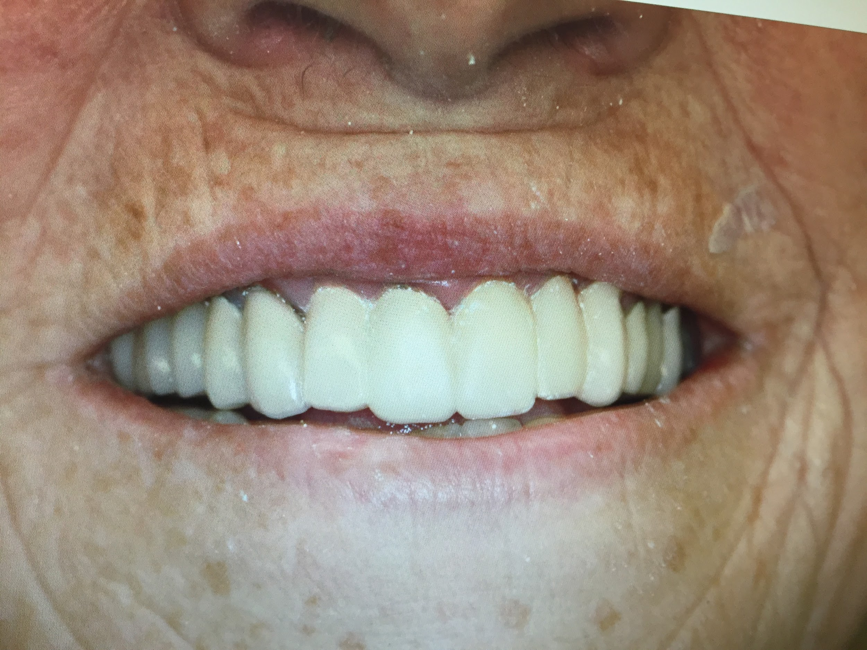
Provisional Restorations
Patient feed-back was
taken and appropriate
adjustment made to
temporaries.
It was also recommended
to take feed-back from
close family members.
Patient was a part of shade
selection.
Lab was requested to
maintain pre-existing anterior
occlusion.

Slide 18
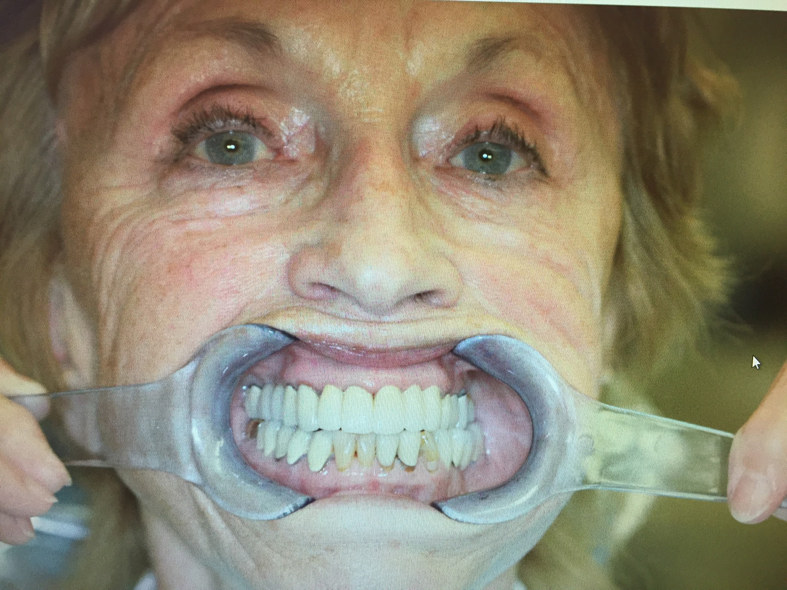
Final Result

Slide 19
Challenges of the treatment planning
Establishing realistic treatment objectives
Create a vision, using the desired result as the blue print
Determine the sequence of treatment
Ideal proportions
Interaction between the orthodontist/Periodontist/prosthodontist and General Dentist

Slide 20
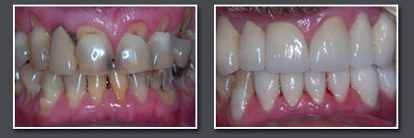
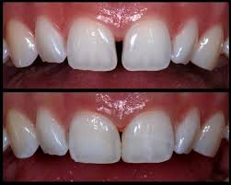
Challenges while restoring
Influence on shape of face
Making the effects of Aging
Restores appearance
Attention to both gums and teeth
Tooth form, contour and shade
Harmony with gingival biotype

Slide 21
Conclusion
Anterior esthetic restorations help build the patient’s confidence
Proper communication between the laboratory and the dentist is crucial for superior results. Send photos
Provisional restorations should mimic the final result as much as possible to set realistic expectations.

Slide 22
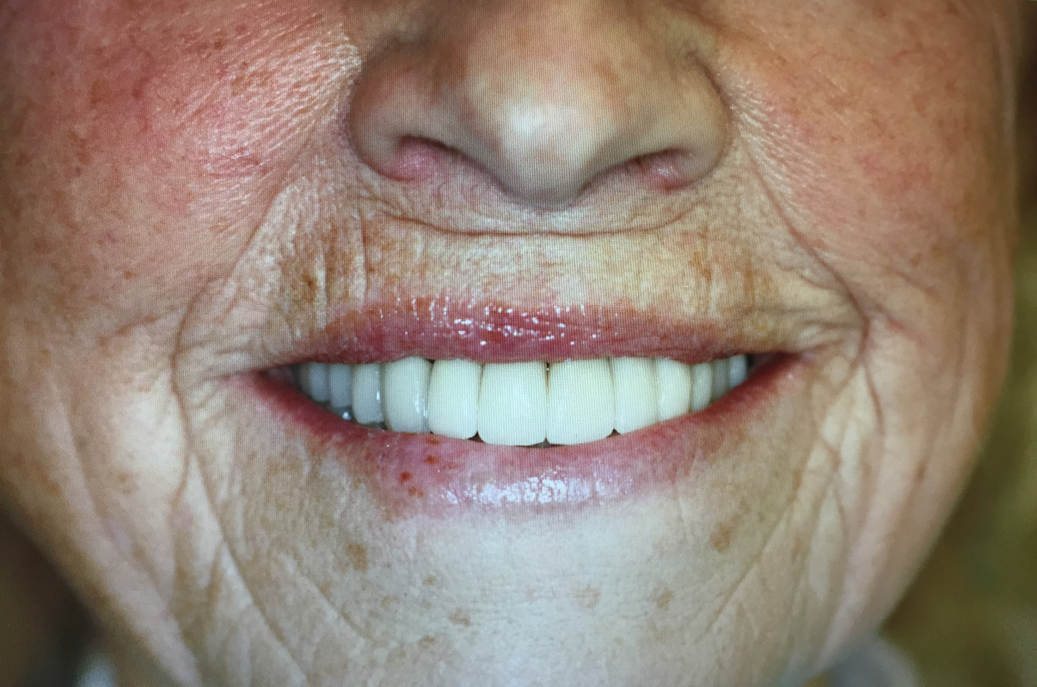
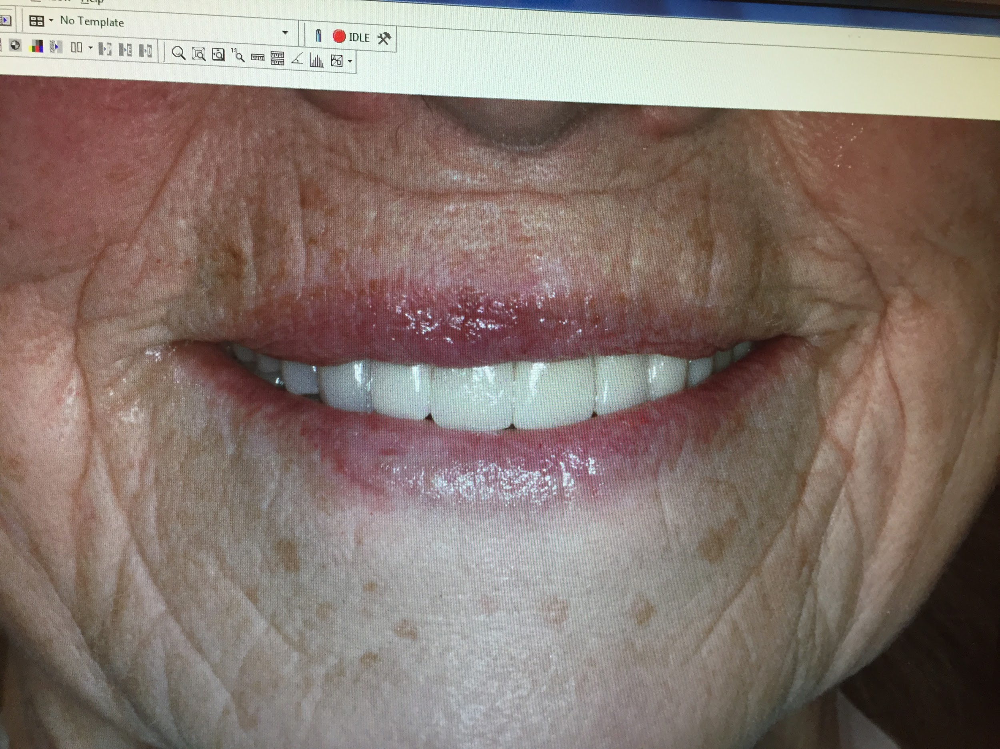
Everyone deserves a beautiful smile

Slide 23
Thank you

