Slide 1
PCC 146.01-.04
Advanced General Dentistry Assignment
Yadvinder Bhullar
I1705
Supervising Faculty: Dr. Richard Mogenson

Slide 2
Chief Complain
49 yr F came for ER visit with a chief complaint of Sharp pain & sensitivity in left lower posterior region.
Clinical Observations: Severe pericoronitis with and fractured DL cusp of #18 causing irritation and trauma to the distal free gingival mucosa.

Slide 3
TX Plan
After Perio consult, it was advised to have Gingivectomy of the distal free gingival tissue.
Pt was given RBA for Laser surgery and with Kirkland gingivectomy.
Pt opted for Laser surgery.
Patient was advised to her OHI maintained and cleaning the Peridex.

Slide 4
Tx Plan Options
Treatment Option #1
SRP 4 Full Quads
Gingivectomy
Full coverage for #18

Slide 5
Tx Plan Options
Treatment Option #2
SRP 4 Full Quads
Onlay/Inlay Prep to conserve tooth structure

Slide 6
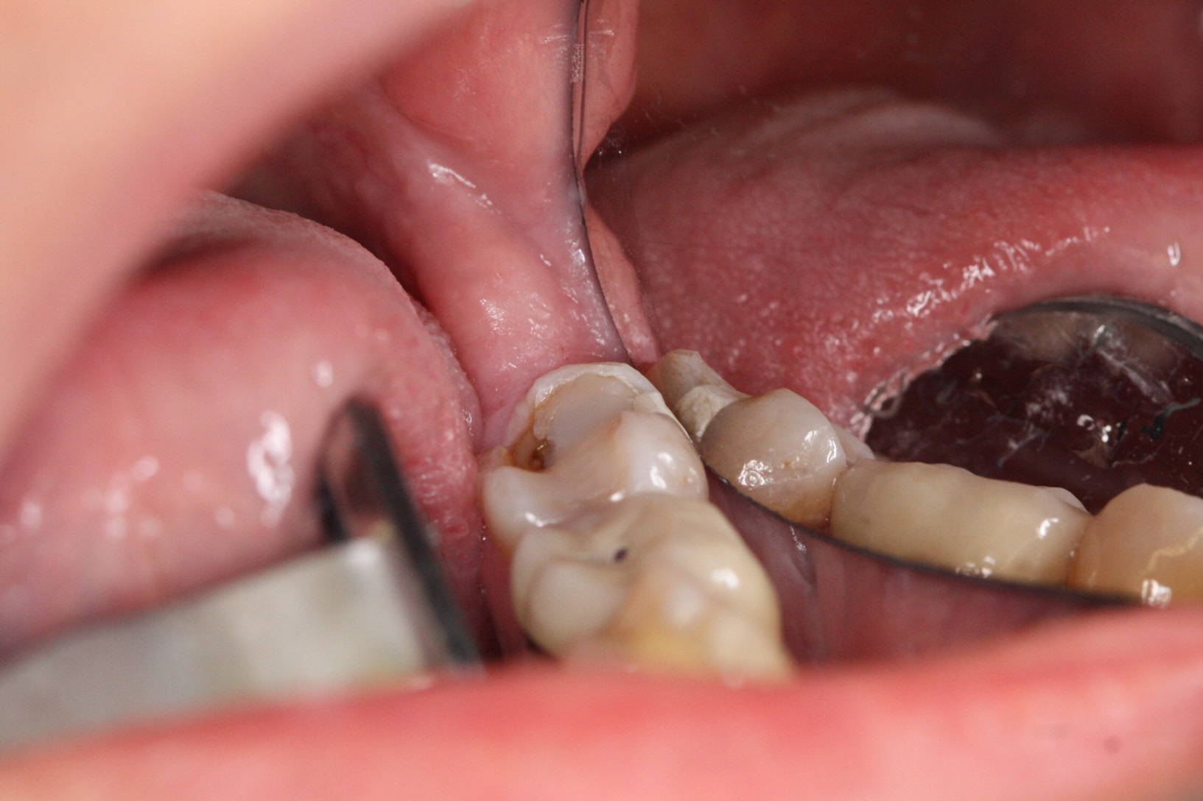
Pre-op picture

Slide 7
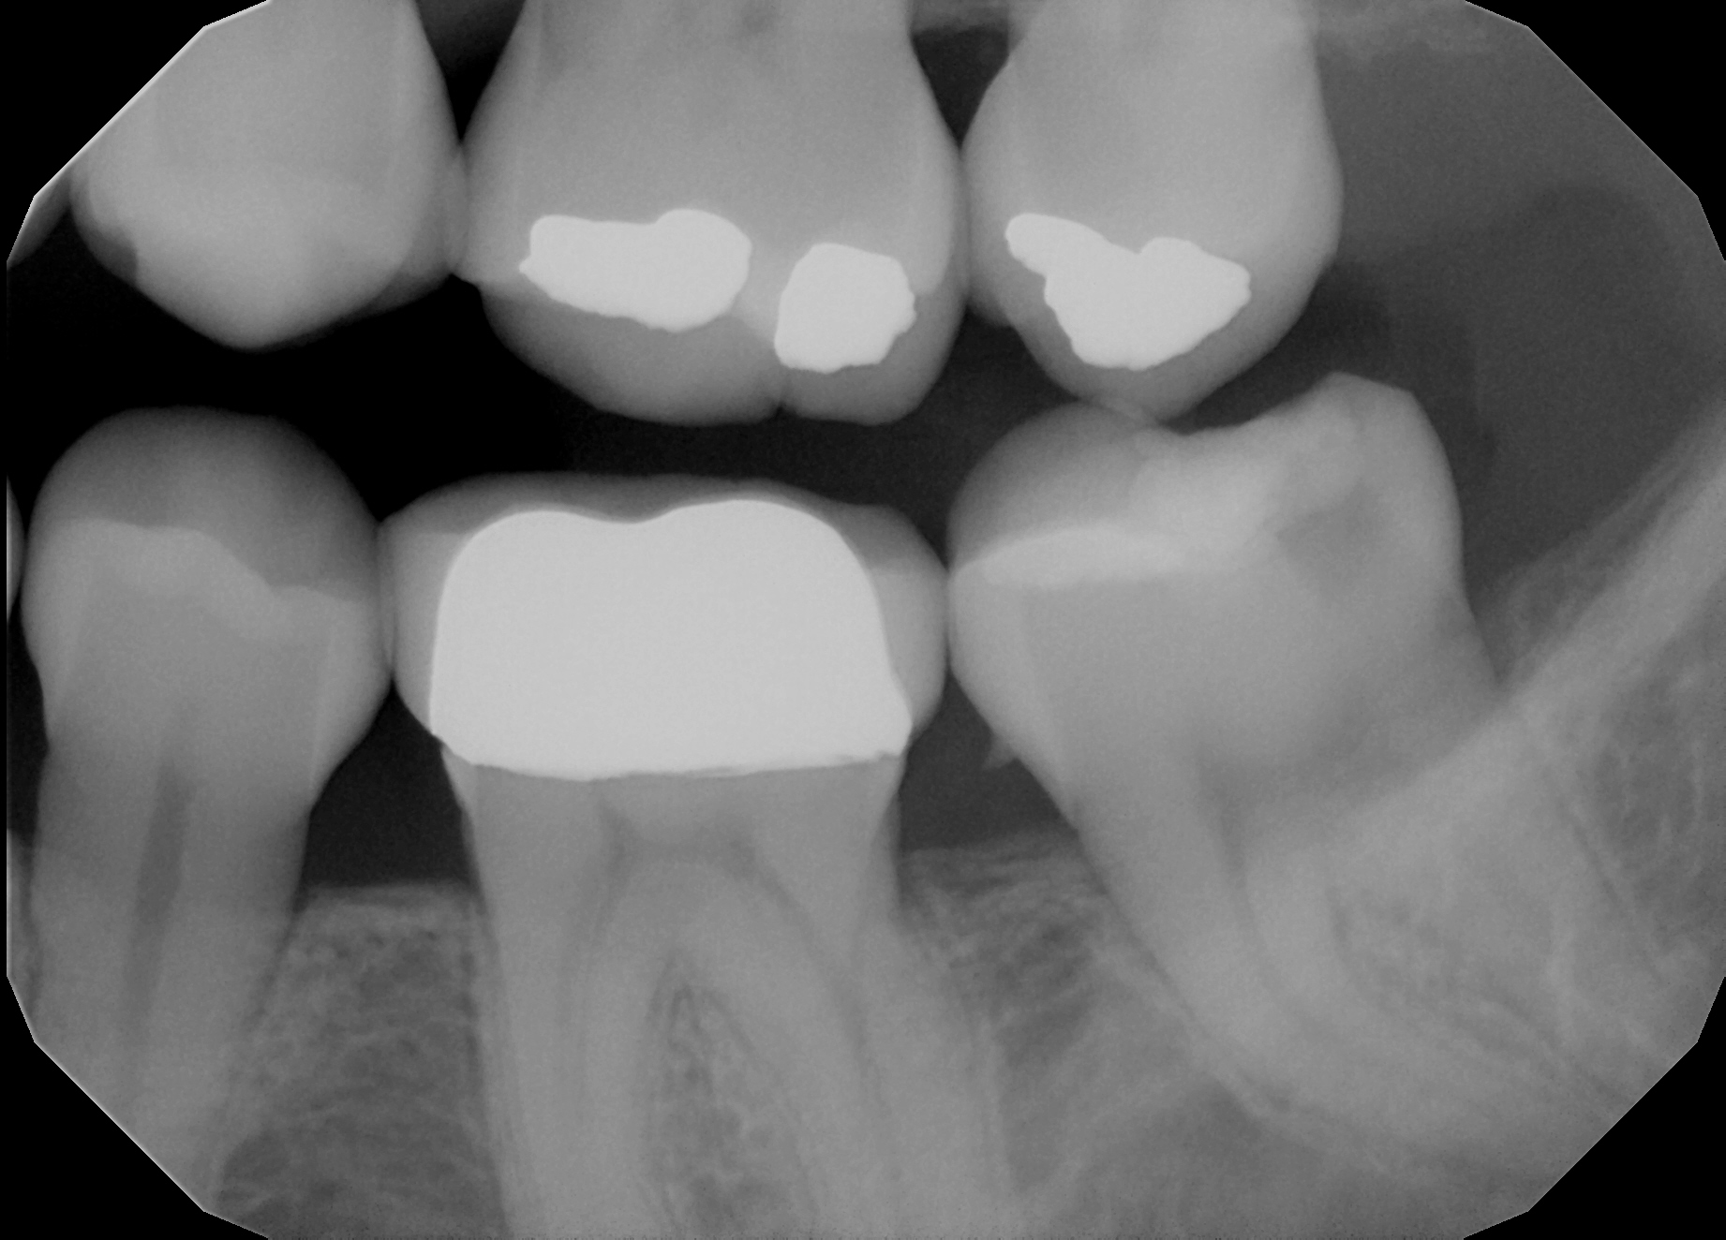
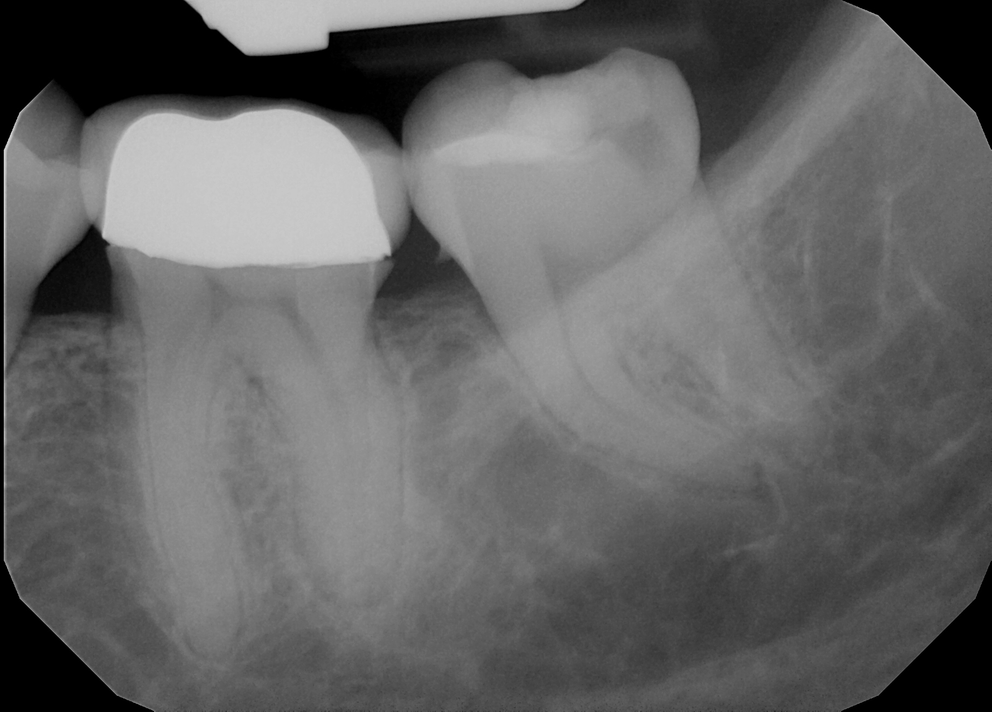
Pre-op X-rays

Slide 8
Tx Plan
Patient opted for maintenance of Oral Hygiene after 4 Quads of SRP.
Pt declined getting gingivectomy even after explaining RBA of Laser surgery.
Pt is maintaining good oral hygiene after 1 Month Eval. Pockets depths were significantly reduced in the pseudo pocket in the distal suclus of #18

Slide 9
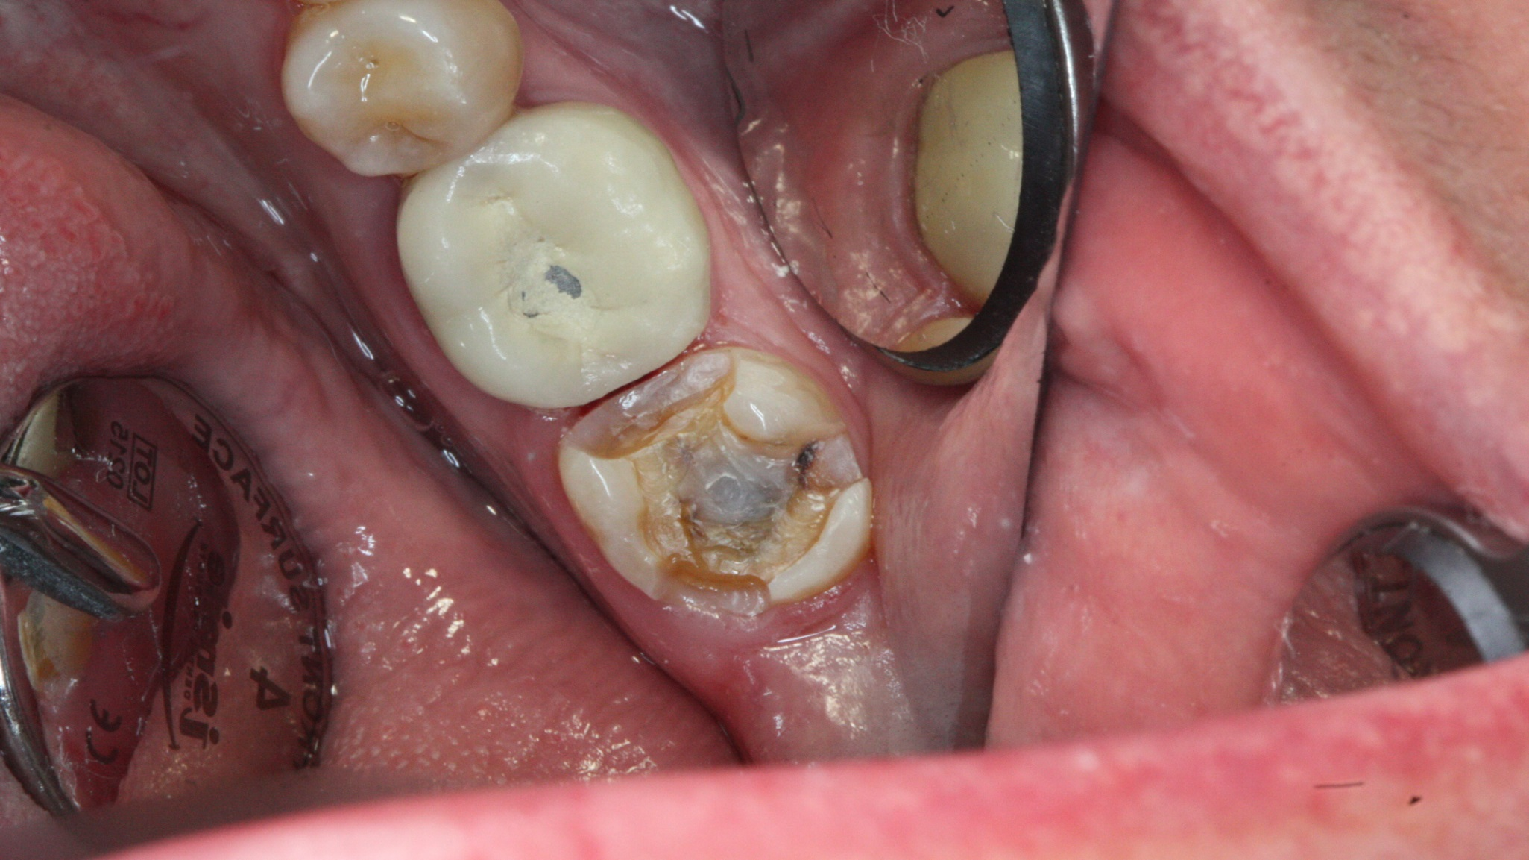

Post Op Picture

Slide 10
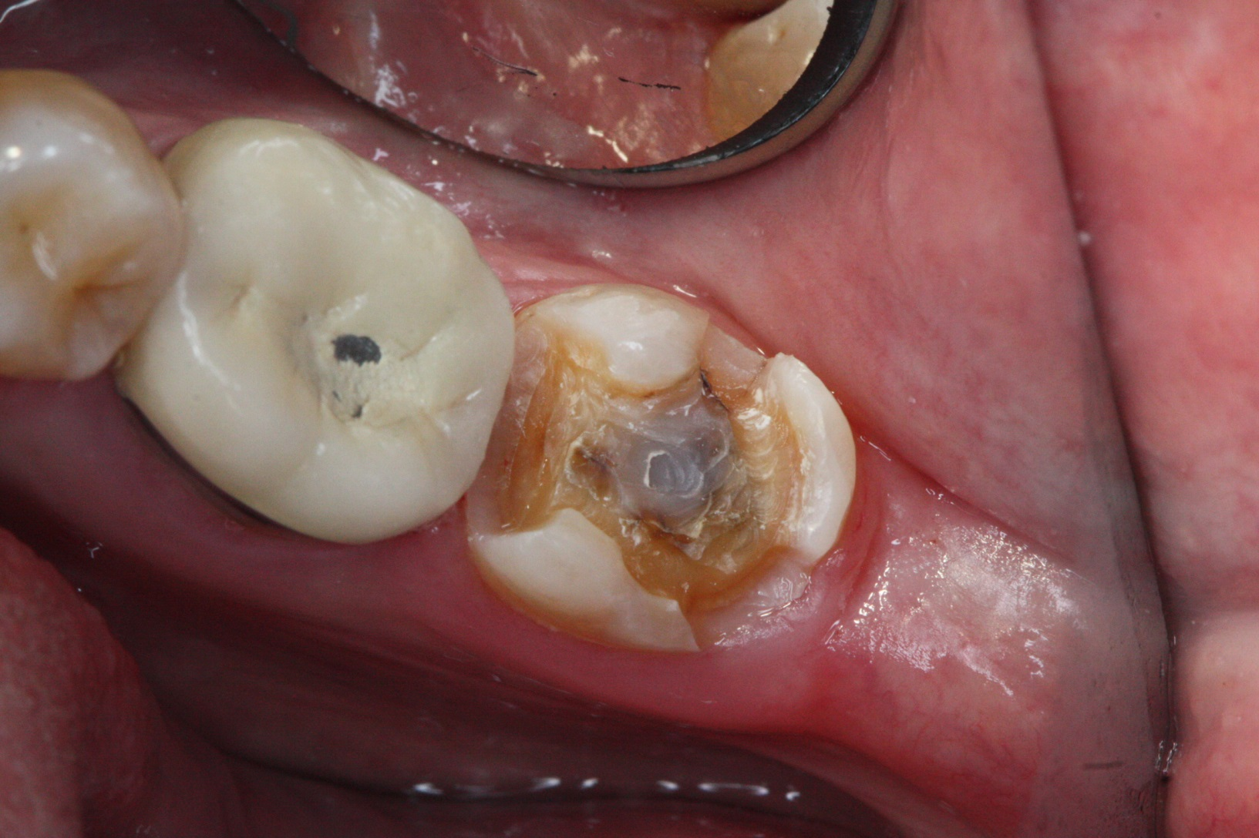
GOLD onlay Prep

Slide 11
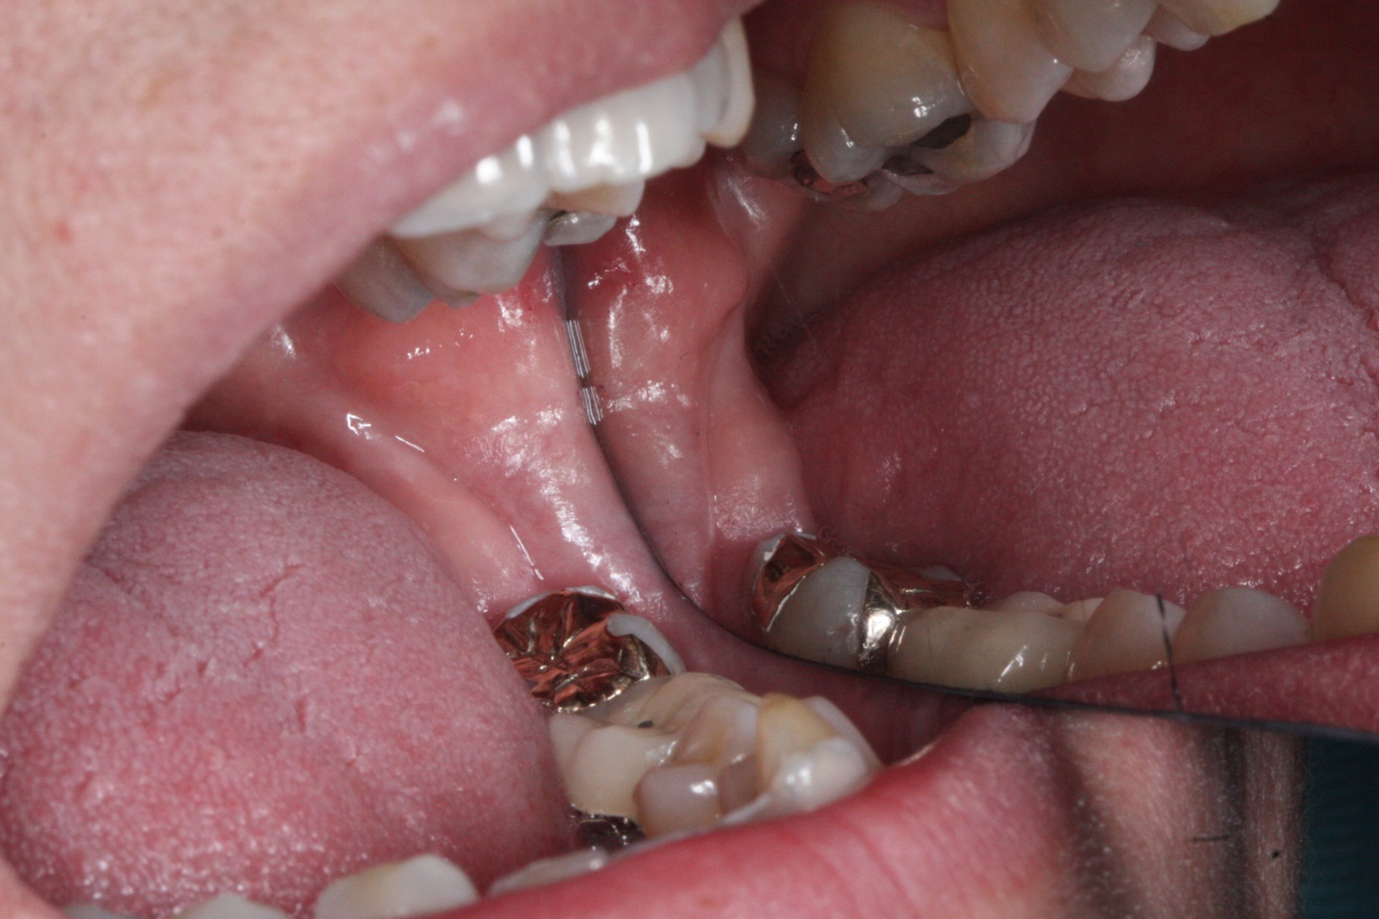
Post-op Pictures

Slide 12
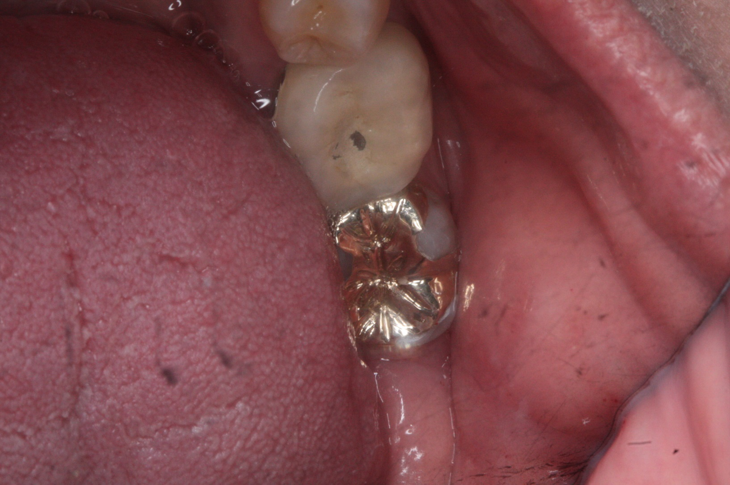
Post-op Pictures

Slide 13
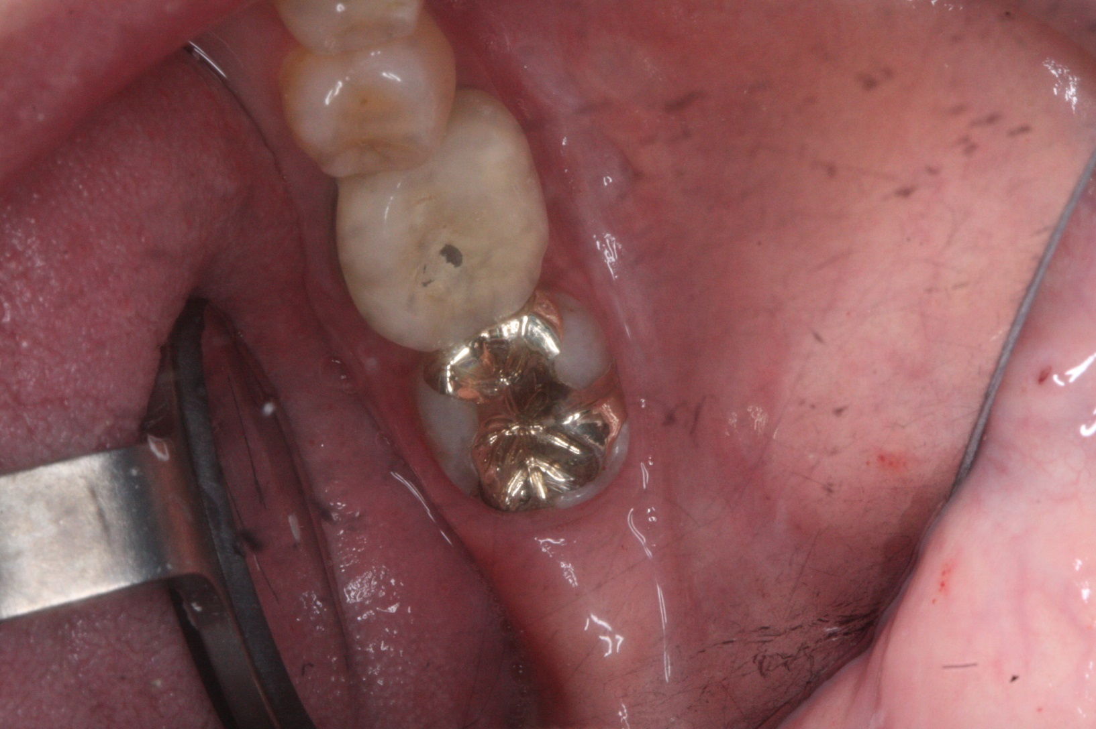
Post-op Pictures

Slide 14
Post-op
The onlay-inlay restoration was cemented withFuji plus cement and pt was given all the post-op instructions.
The Tooth was placed out of occlusion by reduction of the opposing occlusion after explaining the RBA and taking verbal consent from the patient.

