Slide 1
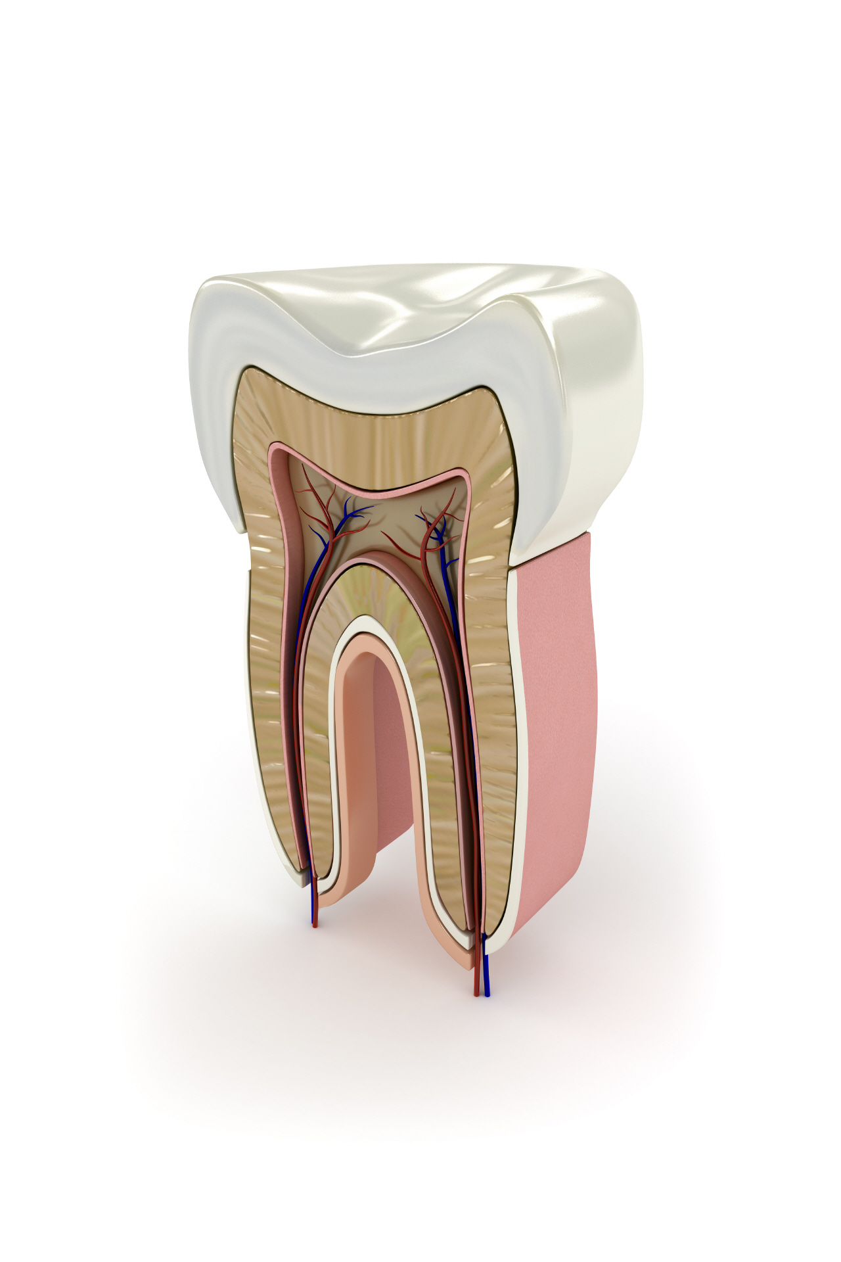
Molar Endo Case Presentation
Leon Chung
Sean Hsieh
Alex Wong

Slide 2
Patient Background
43 y/o female
MedHx: non-contributory
Meds: none
NKDA
SocialHx: No hx of smoking nor recreational drugs
DentHx: Last dental exam and cleaning 2 years ago

Slide 3
Patient Presentation
CC: pain on lower left, point to #19
S: Spontaneous pain started 10 days after preparation of #19 gold crown. 10/10 localized pain. Symptom does not improve with medication.
O: EPT: 47, Cold lingering > 1 min, PD: 3-4mm, Percussion: +, Palpation: -
A: #19 with large existing amalgam with fractured lingual wall. Full coverage is indicated to prevent further catastrophic damage. #19 with supragingival fracture margin is restorable.

Slide 4
Patient Presentation Continue.
Iatrogenic induced pulpitis due to crown preparation
#19 Pulpal Dx: Irreversible pulpitis
  Periapical Dx: Normal apical tissue
Post is not indicated due to sufficient walls
P: NSRCT, Core, Crown
  Alternative Tx: Option A: No tx
      Option B: Ext -> implant/ FPD/ RPD

Slide 5
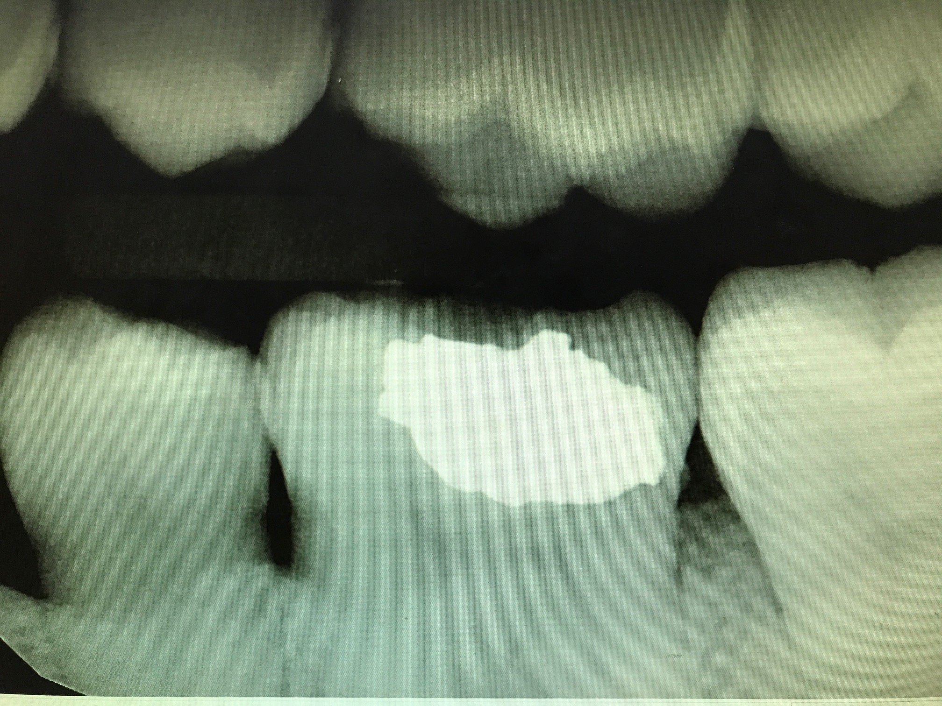
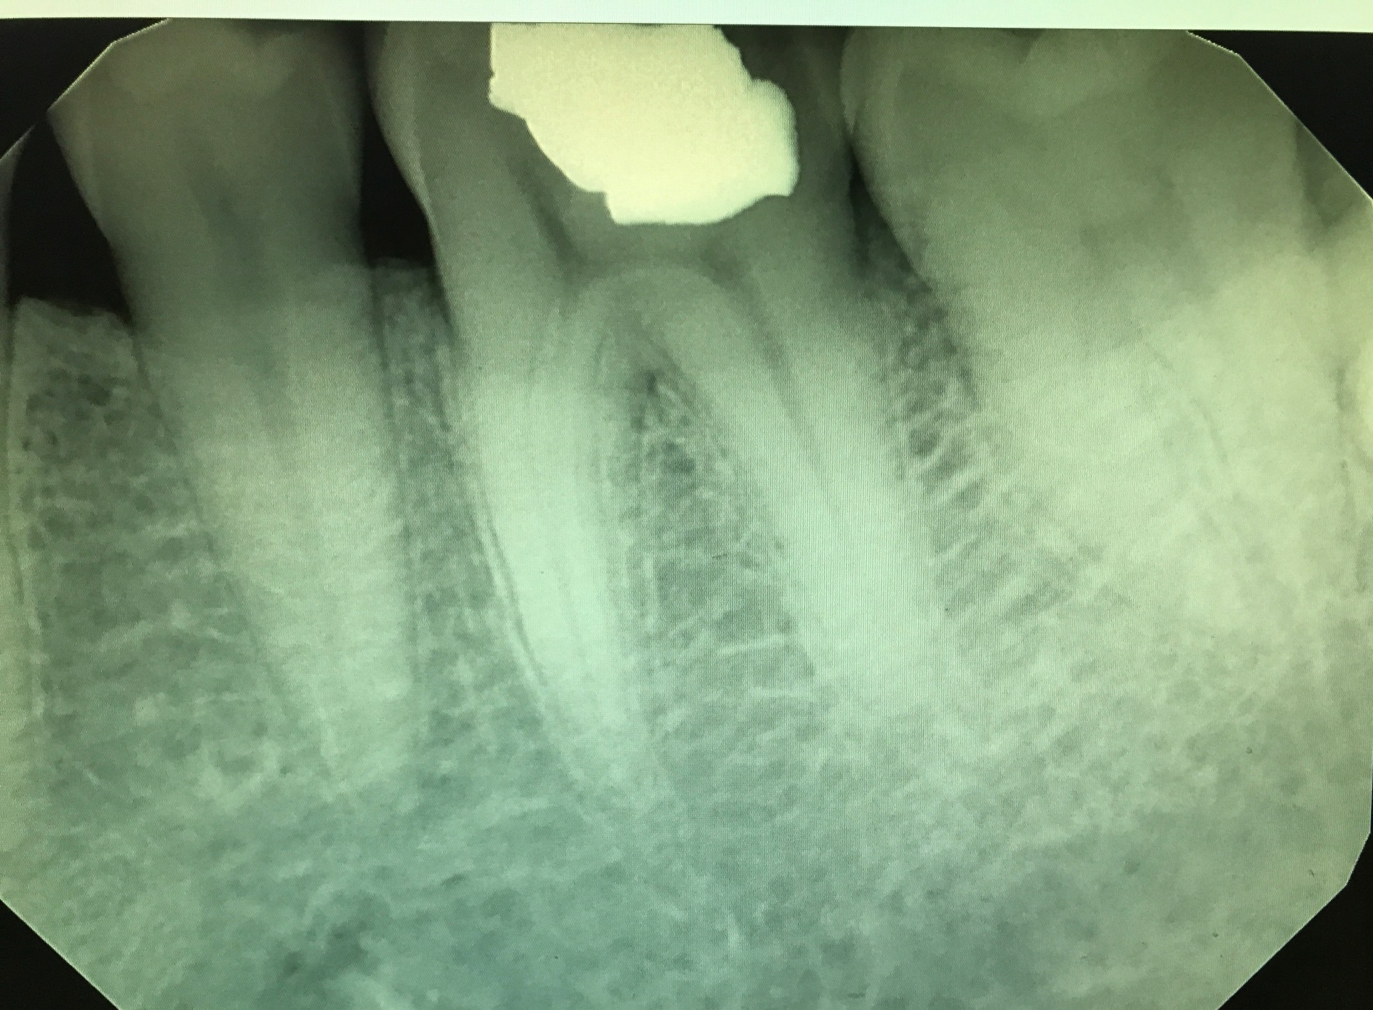
#19 Pre-op
Pros:
  Straight canals
  Short roots
  Minimal calcification
  Far away from IAN
Cons:
  Narrow pulp chamber

Slide 6
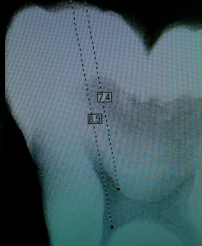
Principles of Access Preparation
Always have a BW and PAs of different angles to visualize the canal system
Use SLOB rule
Use radiographs to aid in depth determination of pulp chamber

Slide 7
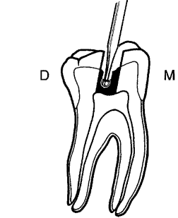
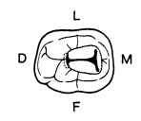
Goal is to achieve straight line access to canals
For mandibular molars, initiate access in mesial half of crown directed toward the distal canal
Outline form is completed in dentin before proceeding into pulp chamber
Form is roughly a trapezoidal shape with the mesial side wider buccal-lingually
Once pulp is entered, must unroof entire pulp chamber for proper visualization, access, and cleaning

Slide 8
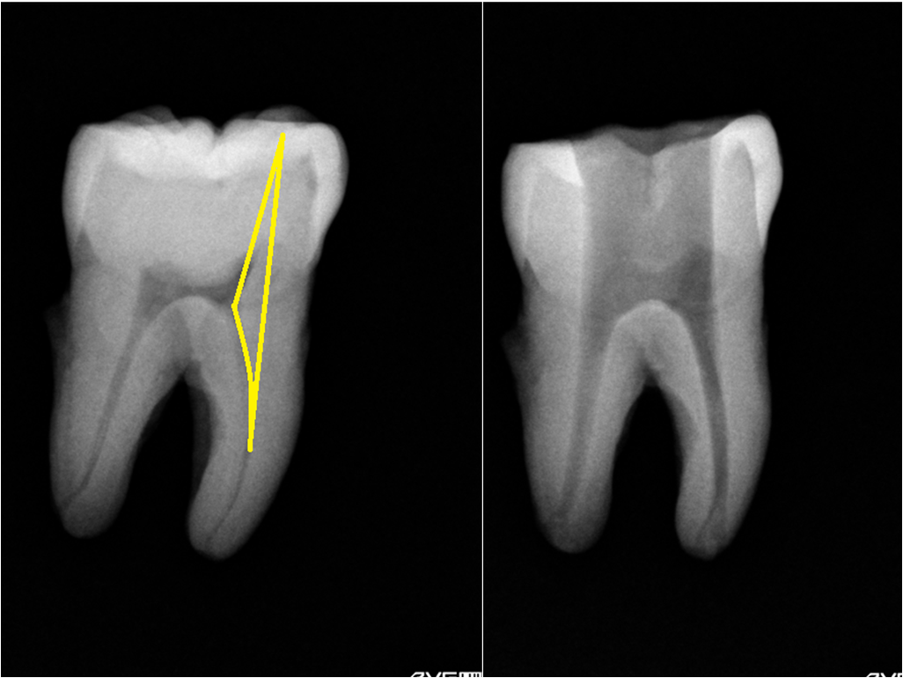
Mesial dentinal shelf (yellow triangle) must be removed
  allow straight line access of mesial canals
  reduce risk of ledging

Slide 9
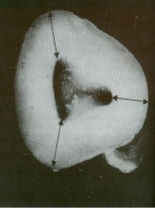
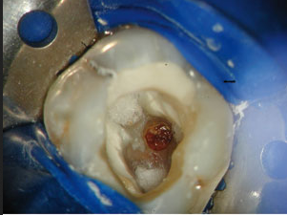
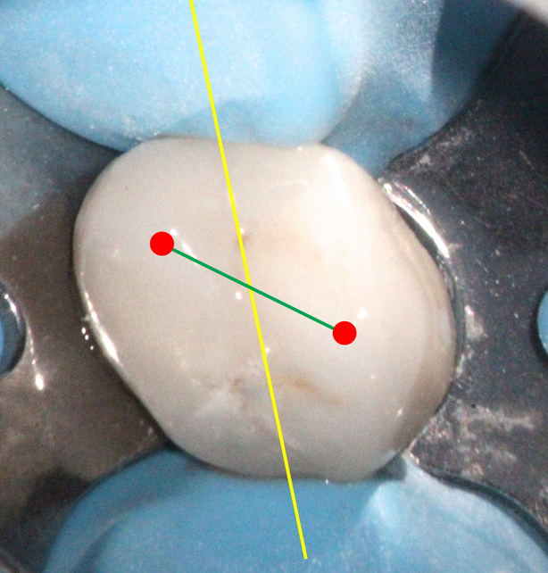
Laws
Law of Centricity: Pulp chamber wall is equi-distance from external surface of tooth at the level of CEJ
Law of Color Change: Color of pulpal floor is darker than pulpal walls
Law of Symmetry: Orifices of canals are equi-distance from an imaginary line drawn mesio-distally through the pulp chamber. This is true for all except maxillary molars.

Slide 10
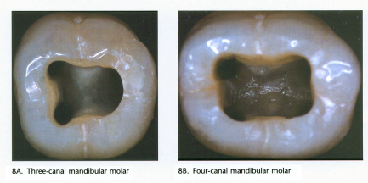
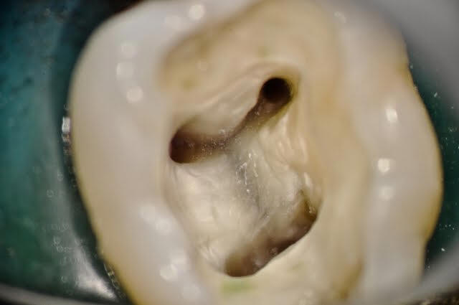
How many canals?
In a study of 209 permanent mandibular 1st molars*:
  Mesial root - 96% 2 canals
  Distal root - 65% 1 canal, 35% 2 canals
Look for symmetry of the pulp chamber floor
Often times a groove can be seen between the orifices
Access preparation is dictated by canal system
*Sahi S et al. Root canal morphology of human mandibular first permanent molars in an Iranian population. DDD 2008; 2(1)
Notes:
[http://onlinelibrary.wiley.com/doi/10.1111/iej.12256/full]

Slide 11
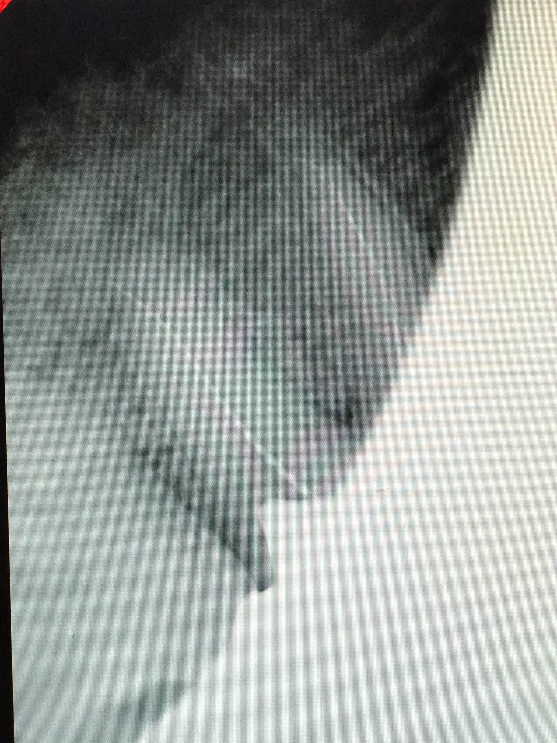
Access Preparation
Rubber dam used throughout entire procedure
3 canals were located: MB, ML, D
WL determined with #15 file and apex locator
  MB 17.5mm
  ML 17.5mm
  D 16.5mm

Slide 12
Cleaning and shaping
Objectives:
  1. Mechanically and chemically remove all diseased hard and soft tissue
  2. Create a continuously tapering conical form while preserve the apical foramen
Mechanical: hand files, NiTi rotary file
Chemical: 2.5% NaOCl, CaOH
Research shows that mechanical cleaning only reach 40% of canal wall, chemical solution does majority of cleaning because the canal systems may be much bigger than files and have various shapes.

Slide 13
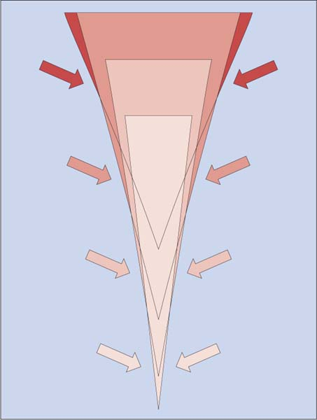
Crown down technique
This technique was used to clean and shape #19
Crown down = Using successively smaller taper NiTi rotary files to create coronal flare and remove diseased tissue from coronal to apical
Advantages:
Removes coronal interferences/increase access to apical segment
Removes coronal diseased tissue first before proceeding apically
Allows irrigant to more closely reach instrument depth
Disadvantage:
Higher potential to lose apical constriction

Slide 14
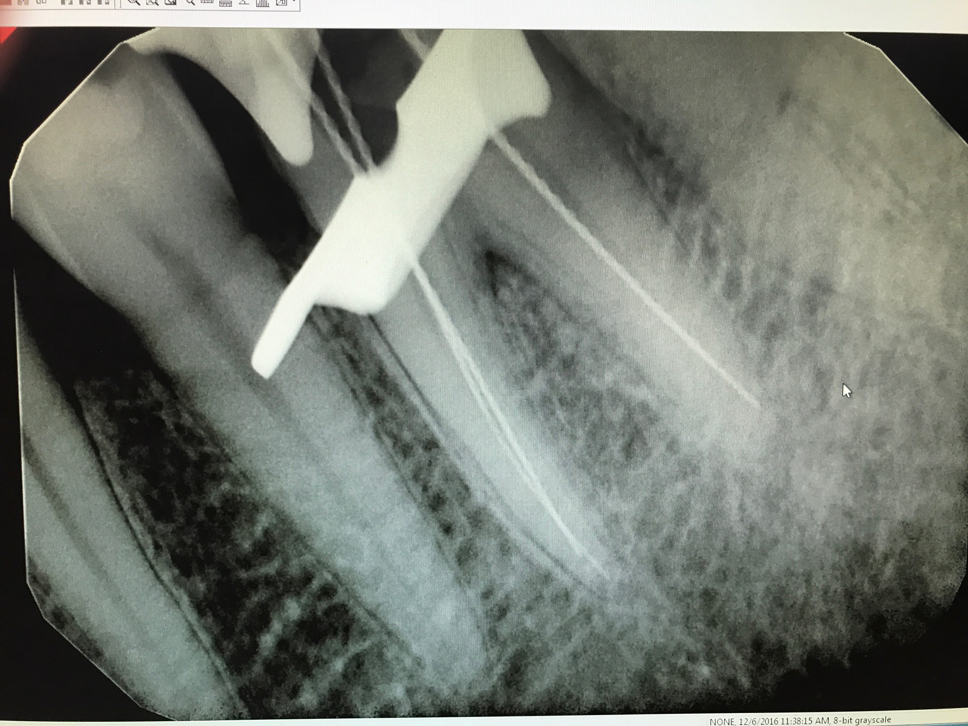
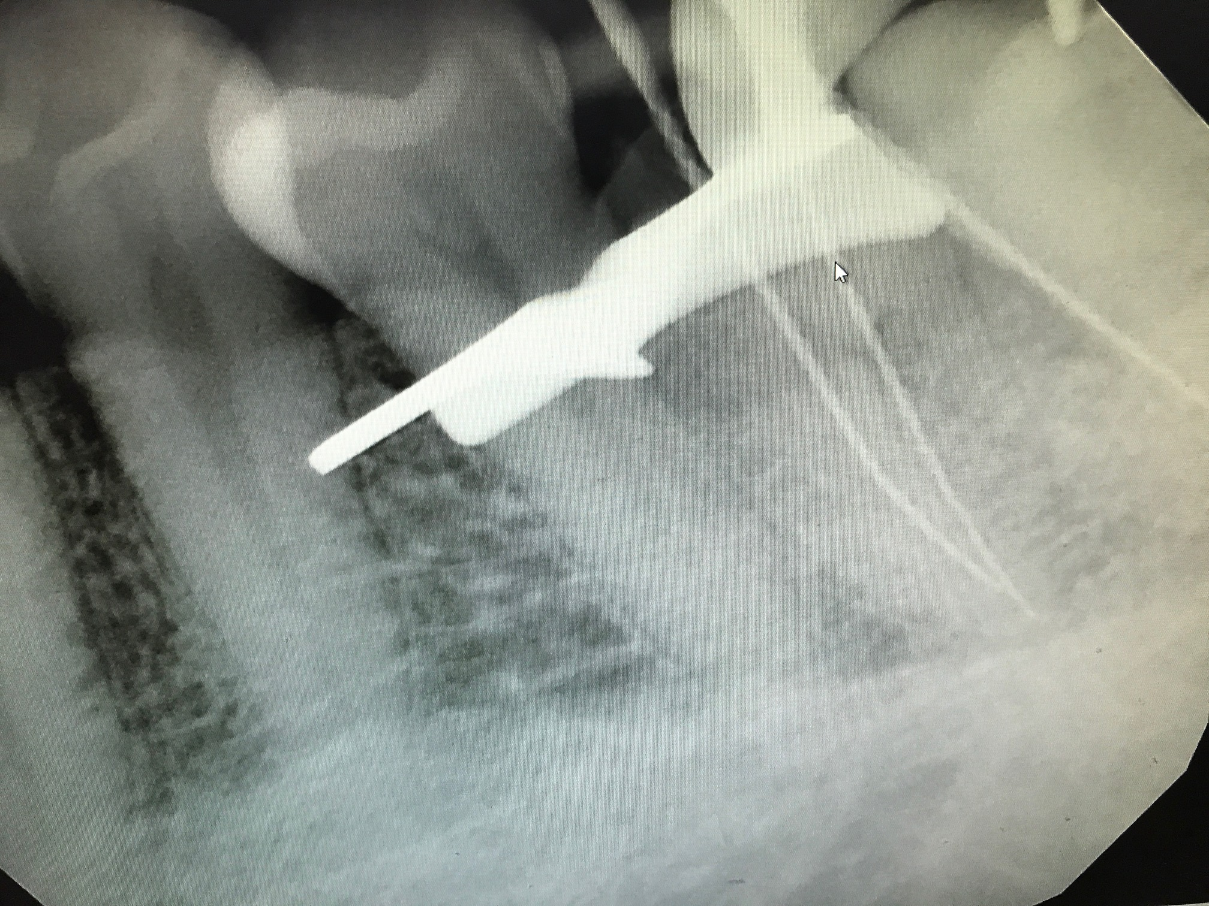
Clean and Shaping
Fig 1
Crown down technique used to clean and shape to a .06 taper for D canal and .04 taper for MB ML canals
MB and ML were joined in the apical ⅓ of the root.
Master apical file was determined:
  MB 25
  ML 25
  D 30
PA X-rays of:
  Fig 1. Straight View
  Fig 2. Mesially Angled View.
Fig 2

Slide 15
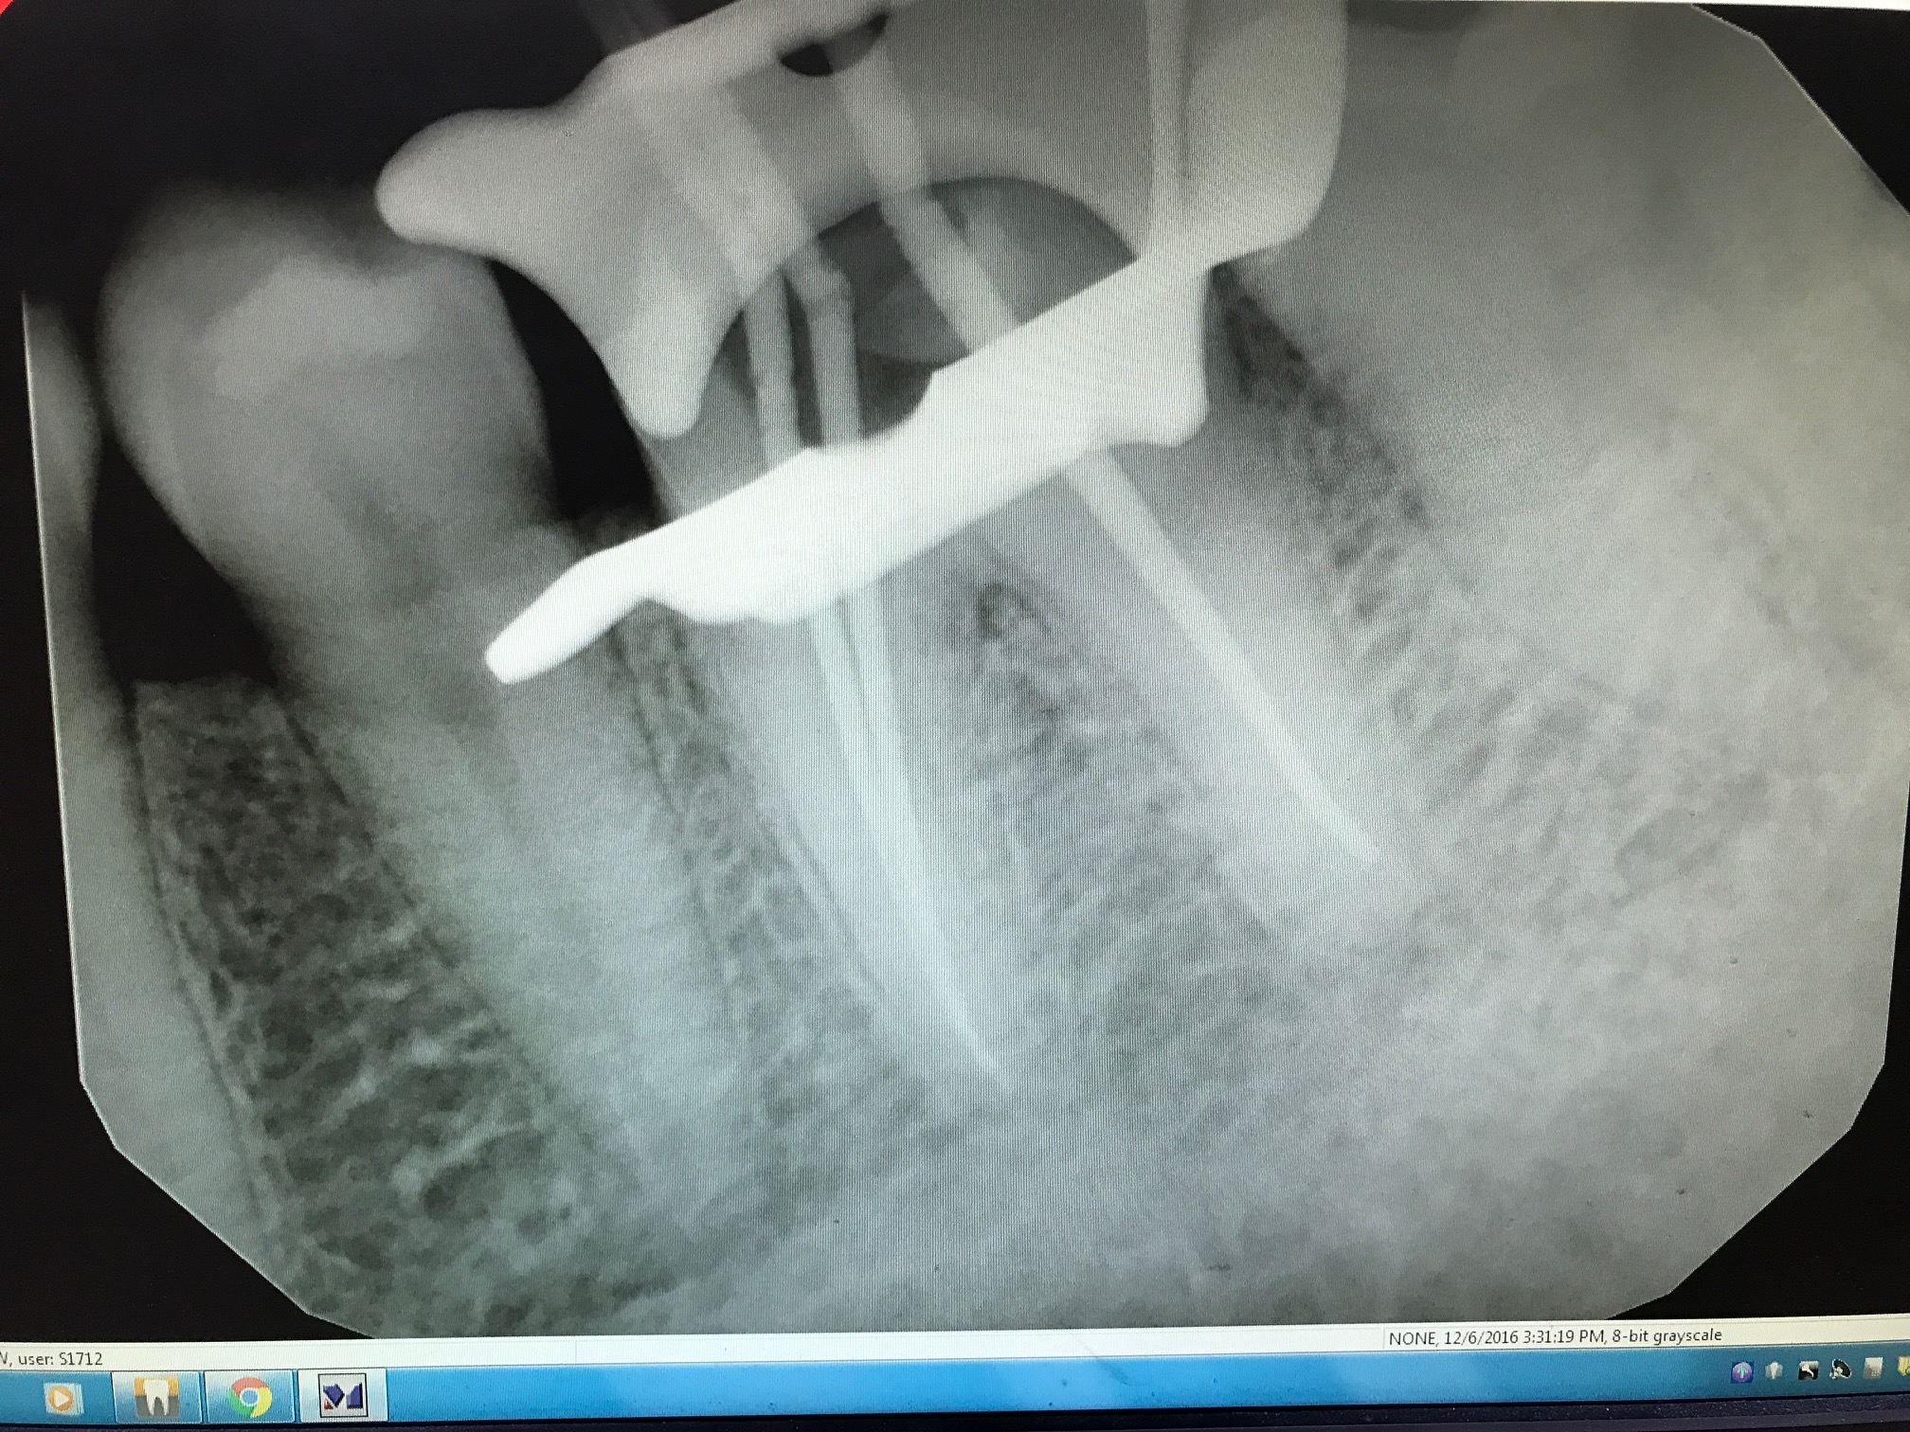
Obturation: Cone fit
Gutta percha cones were fitted to taper and MAF for each of the canals.
Cone Fit X-Ray was taken to verify the fit of cone prior to obturation.

Slide 16
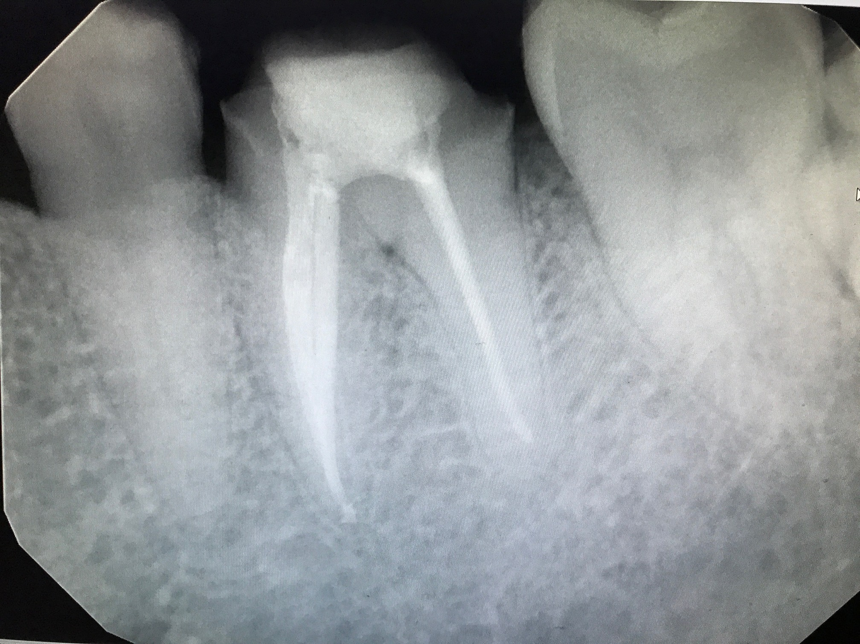
Obturation: Warm Vertical Condensation
Sealer was placed at the apical third of each of the cones.
Downpack was completed to 5mm from the apex for each of the canals
Backfill was completed for each of the canals.

Slide 17
Warm vertical vs lateral condensation - which is better?
Aminsobhani M, Ghorbanzadeh A, et al. Comparison of obturation quality in modified continuous wave compaction, continuous wave compaction, lateral compaction and warm vertical compaction techniques. J Dent (Tehran). 2015 Feb; 12(2): 99–108.
“the frequency of areas not adapted to the canal walls was significantly higher in LC technique compared to MCWC (P ≤ 0.02). The void areas were significantly more in the LC technique than in other techniques in teeth (P < 0.001)”
Sobhi MB, Rana MJ, et al. Comparison of vertical with lateral condensation technique in obturation of root canal system. J Coll Physicians Surg Pak. 2004 Aug;14(8):455-8.
“Warm vertical technique resulted in a uniform smooth surface and least observable space between gutta percha and canal wall, especially in middle and apical region.”
Peng L, Ye Ling, et al. Outcome of root canal obturation by warm gutta-percha versus cold lateral condensation: a meta-analysis. JOE. 2007 Feb; 33(2): 106-109.
“The results suggest that the two obturation techniques are not significantly different except in overextension... In conclusion, warm GP obturation demonstrated a higher rate of overextension that CLC. Postoperative pain prevalence, long-term outcomes, and obturation quality were similar between the two groups.”
Conclusion: Although the advantages of warm vertical condensation are well documented, the literature does not provide a clear distinction with regards to long-term outcome between different obturation methods

Slide 18
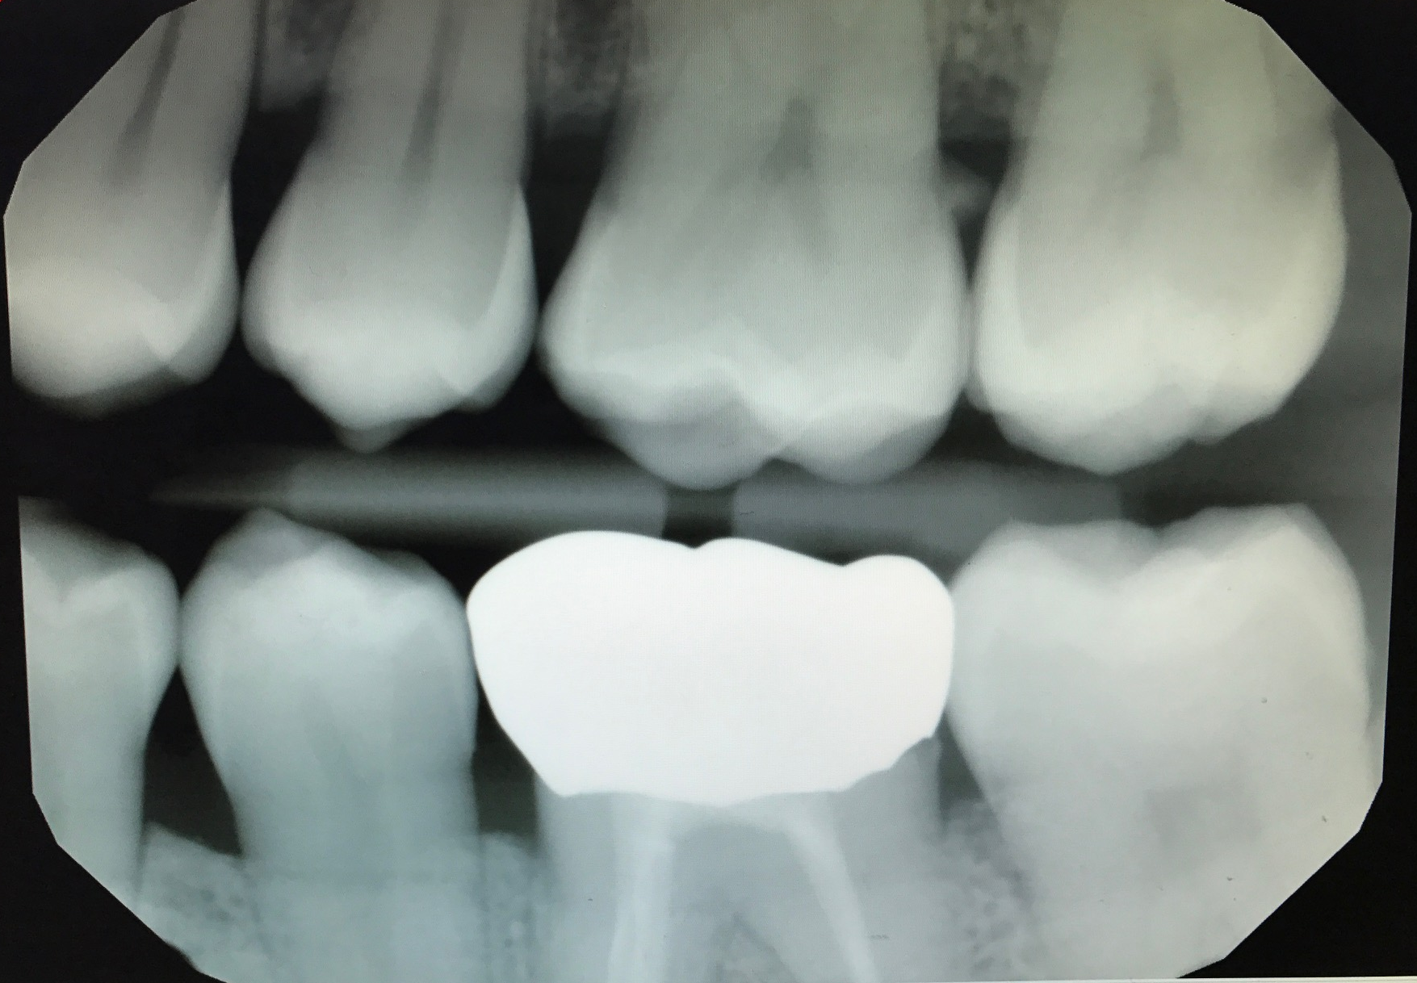
Outcome of the Case
#19 buildup completed. No post was necessary because there was enough tooth structure remaining with 3 solid walls.
#19 crown preparation was modified after RCT
#19 gold crown was delivered. Pt has been asymptomatic since.

Slide 19
Endo pearls
When in doubt take an x-ray
Pre-curve the files to create the glide path, especially mesial canals
Use the forceps to insert the file if access is difficult
Trust your apex locator
Importance of explaining risks before every procedure

Slide 20
References
Bahroloomi Z., Soleymani AA, Modaresi J, Imanian M, Lotfian M., Accruacy of an Electronic Apex Locator for Working Length Determination in Primary Anterior Teeth. J Dent (Tehran). 2015 Apr; 12(4): 243-248.
Sobhi MB, Rana MJ, Ibrahim M., Taslee-ul-Hudda., Comparison of veritcal with lateral condensation technique in obturation of root canal system. J Coll Physicians Surg Pak. 2004 Aug: 14(8):455-8
Rising D., Endodontic access in molar teeth, Presentation. Spring 2015
UCSF School of Dentistry, Endodontic Manual PRDS, 2014.

