Slide 1
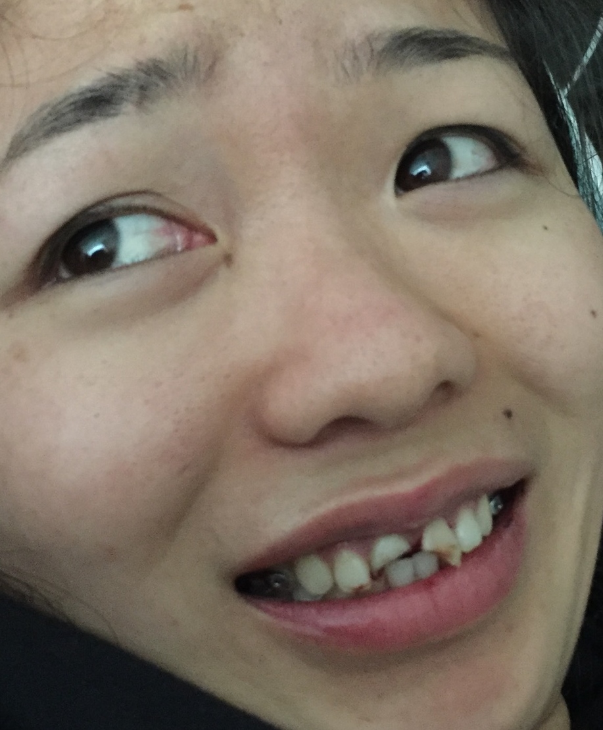
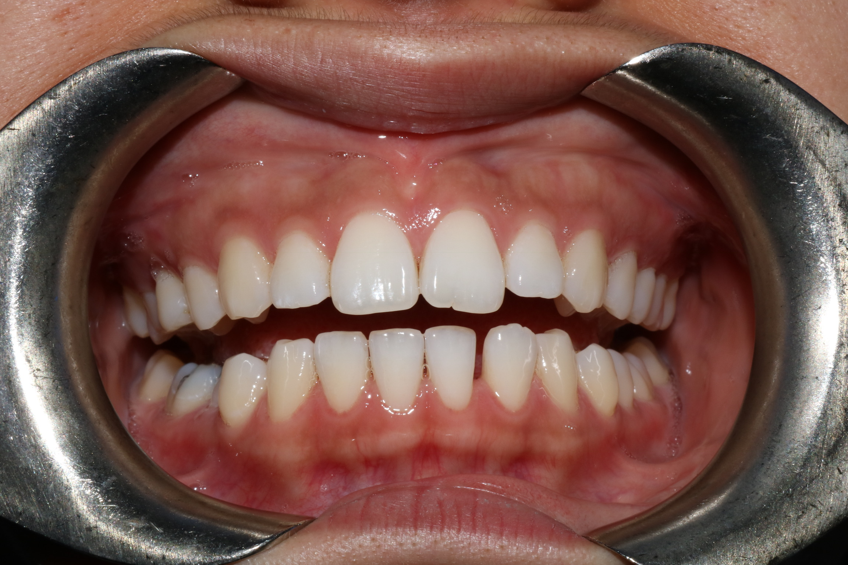
All I Want for Graduation is…
Yolanda Ho, Ruth Yan, Melissa Milder, Caitlyn McGue, Amy McFarling, Minerva Loi, Jasmine Manubay

Slide 2
Patient YH
26 YO Chinese female
Original CC: “I want to correct the gap between .”
  Diastema between 25, 26
Now: “I fell and broke my teeth.”
Pt was in pre-invisalign workup at time of crown fractures

Slide 3
Medical History
Asthma – triggered by pollen
Albuterol inhaler PRN (uses infrequently)
NKDA
No surgical hx

Slide 4
Dental History
Extensive intracoronal restorations
Pt has received irregular dental care until beginning dental school in 2013
High caries risk
Moderate fear/anxiety of dentists

Slide 5
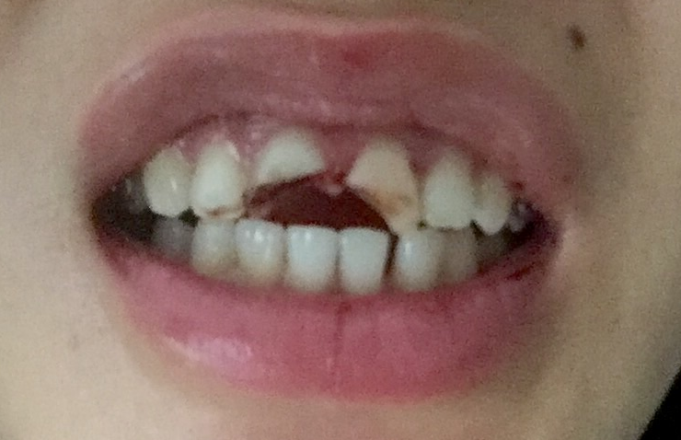
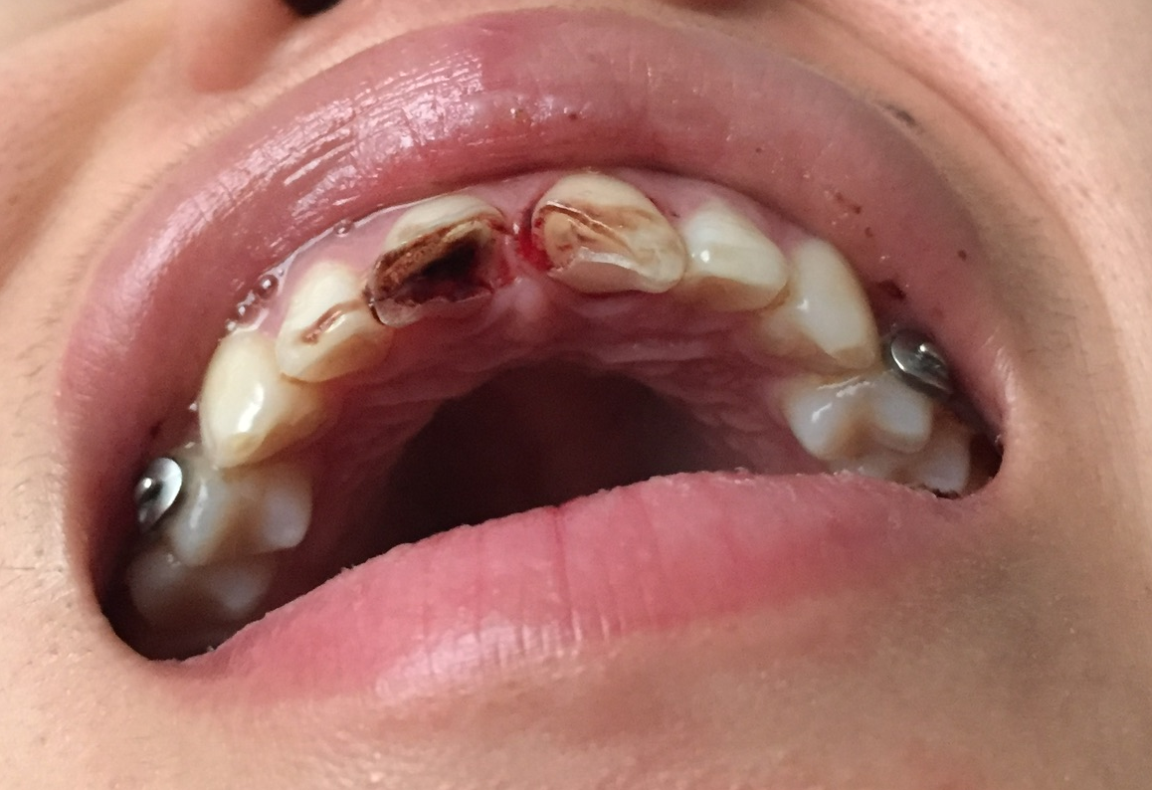
Wah wah…..
Notes:
Clinical Exam:
Pt presents for emergency services with fractured #8 and 9 due to trauma (falling)
#9 class III mobile
#8 appeared to be immobile but during treatment discovered lingual complicated oblique fracture to alveolar crest
Both were class III enamel-dentin fracture with pulpal involvement

Slide 6
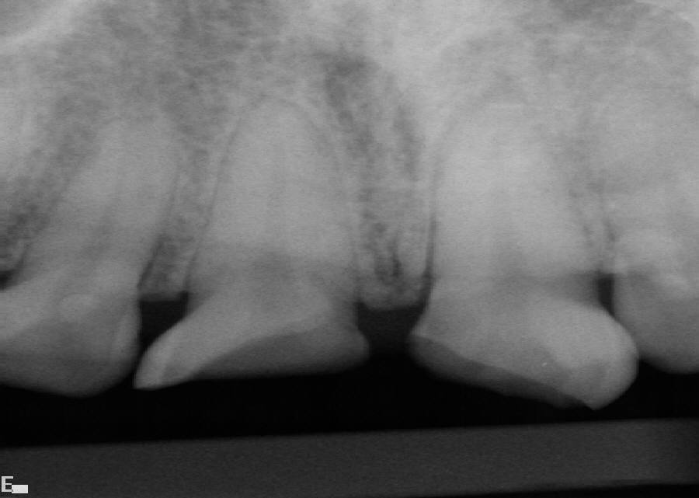

Slide 7
Treatment Planning Considerations
Non-restorable – Tsuji
  Extraction
  Stayplate
  Implant
Anterior Implant Prognosis in Young Adults¹
  Implant survival rate 95.5% but with high frequency of prosthetic complications (crown fracture, etc.)
  Mean bone loss: 1.53mm (12-15years)
  Patients generally satisfied with long-term treatment outcomes

Slide 8
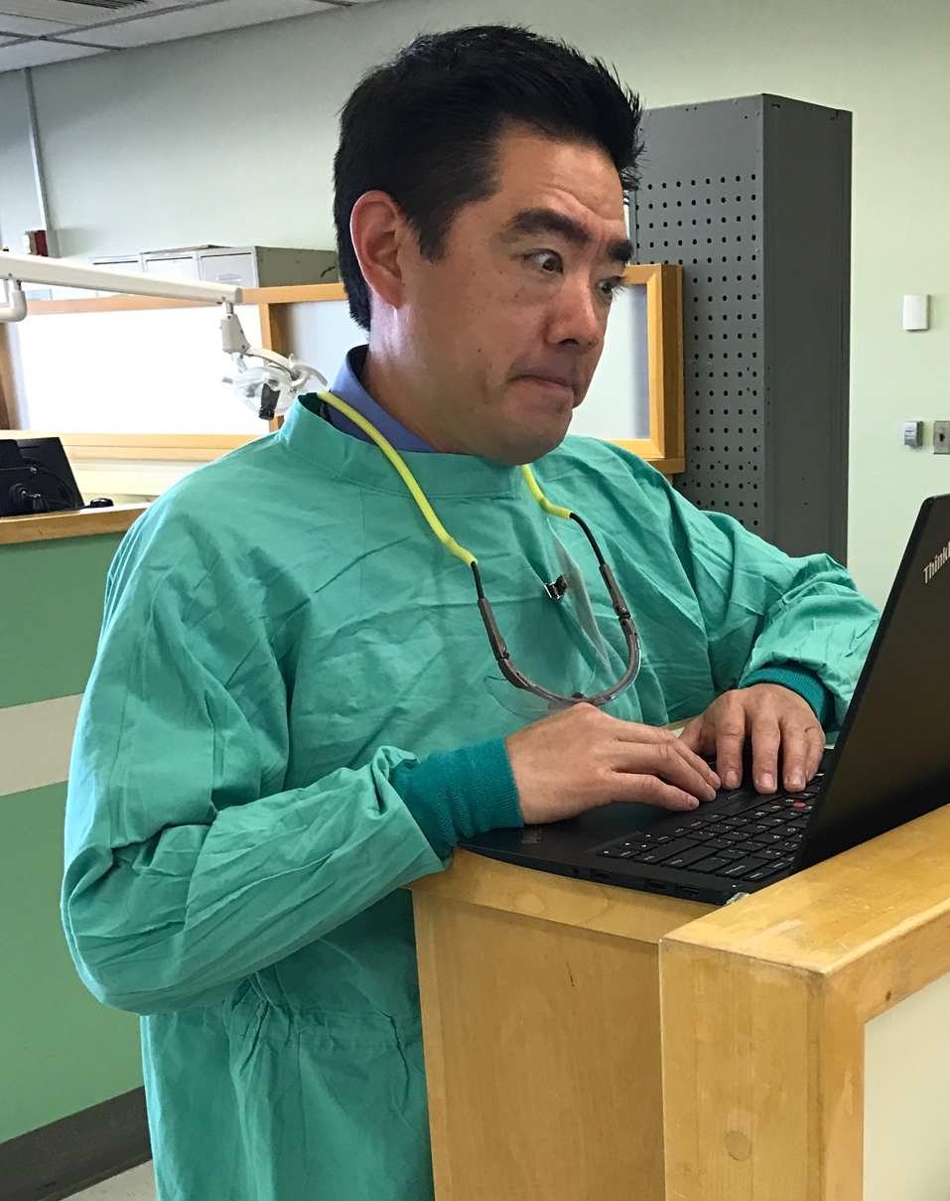
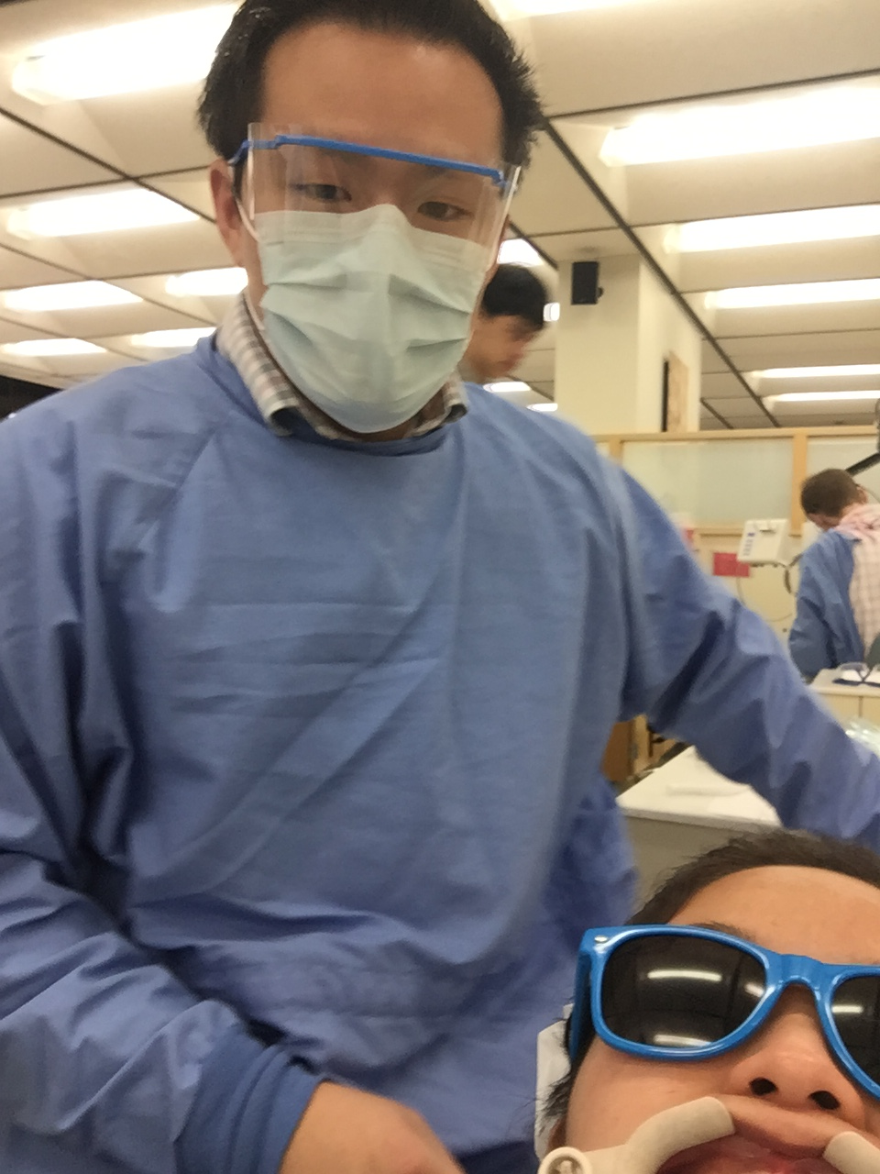
Treatment Planning Considerations
Restorable – Tsuji
  Emergent RCT #8 and 9
  Stabilize mobile teeth
  Pending stabilization, for #8 (fx to alveolus)
    Crown lengthening and/or Ortho extrusion
      To establish adequate ferrule and biologic width
    Post and b/u
      Cast post
      Pre-fab metal post
      Pre-fab carbon fiber post
  Crowns (#8 and #9)
    PFM
    Emax
    PBZ
    Facial Veneers

Slide 9
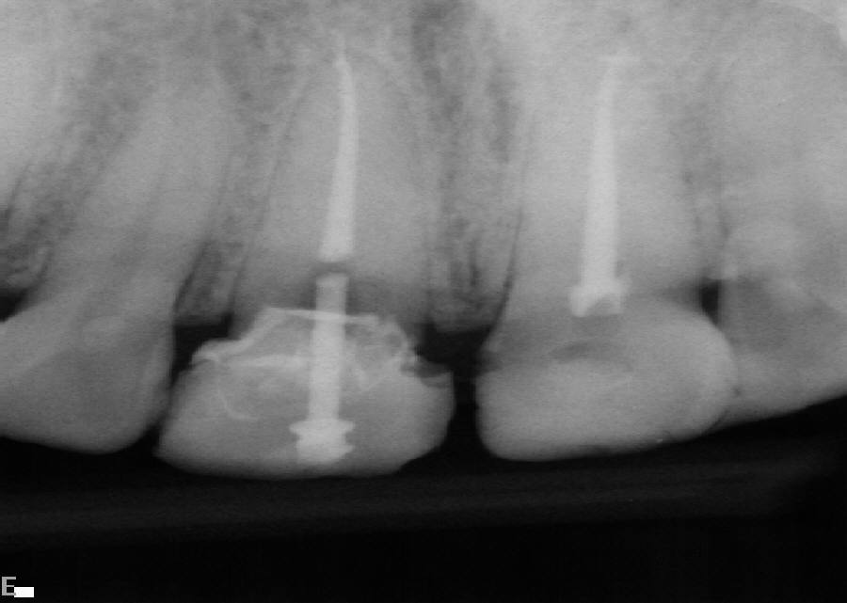
Emergency Endo

Slide 10
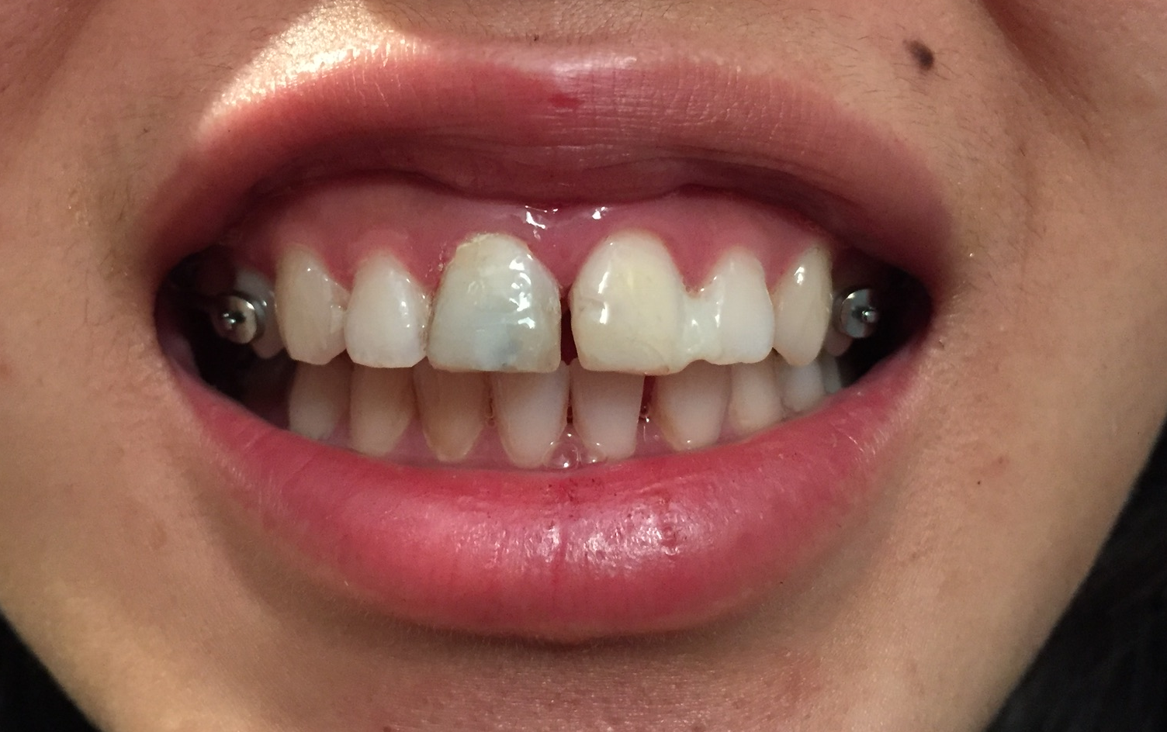
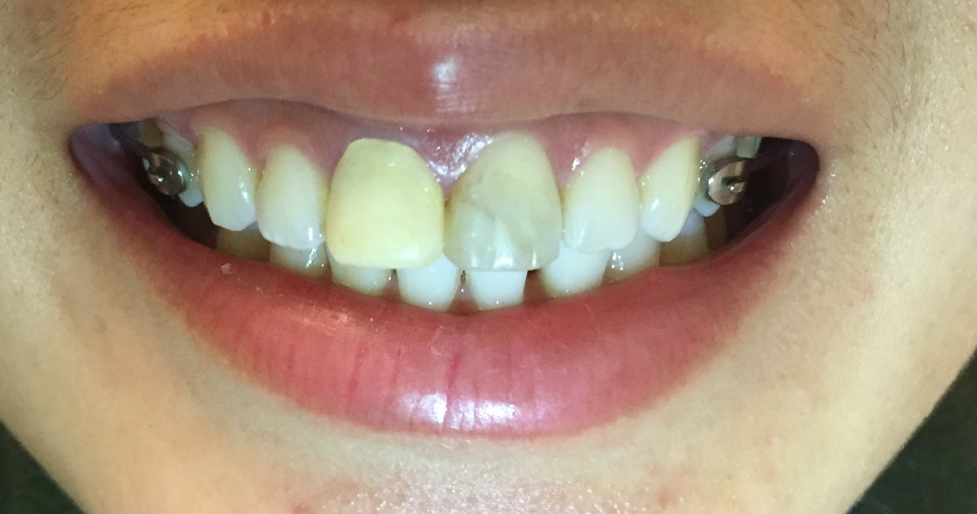
Getting Temps
Notes:
#9 class III mobile so splinted to #10 with composite
#8 not mobile but severe lingual oblique fracture to alveolar crest
#8 temp re-made to improve contour, #9 had color change over a couple of days
Splint removed at one week because if leave teeth splinted for too long will cause teeth to ankylose

Slide 11
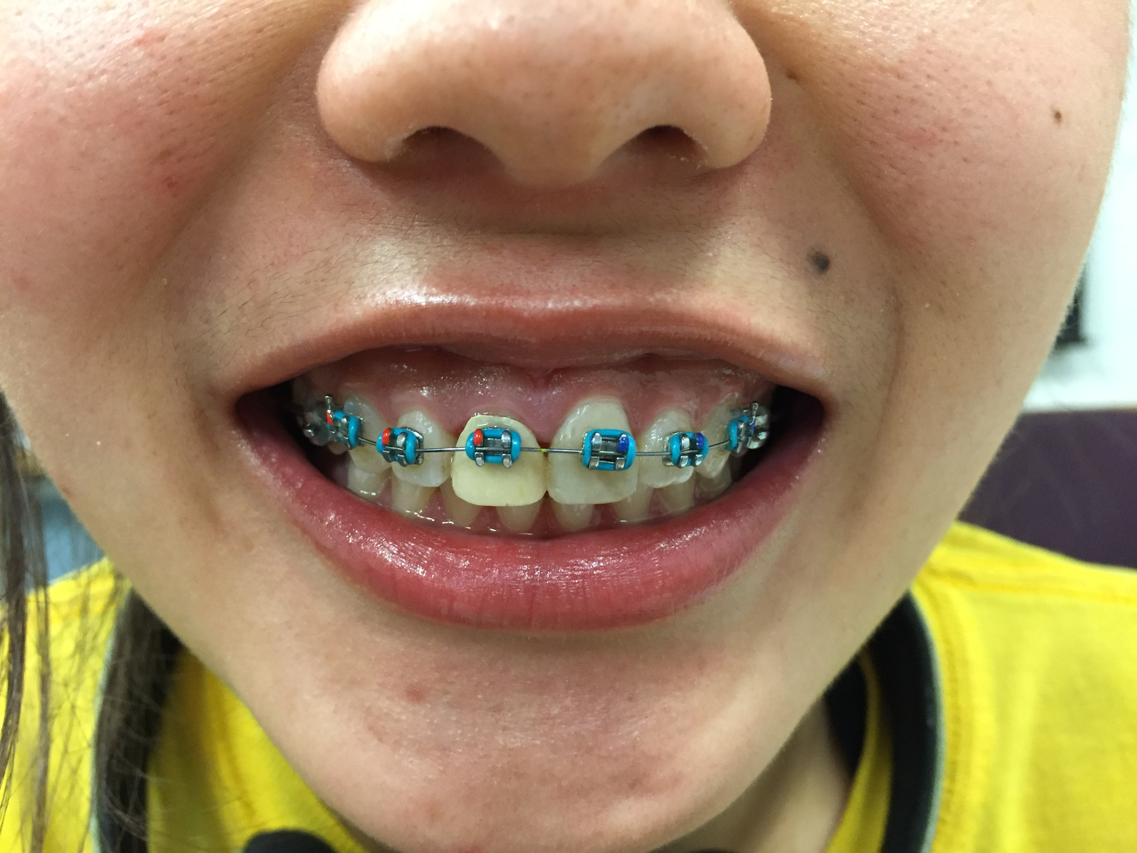
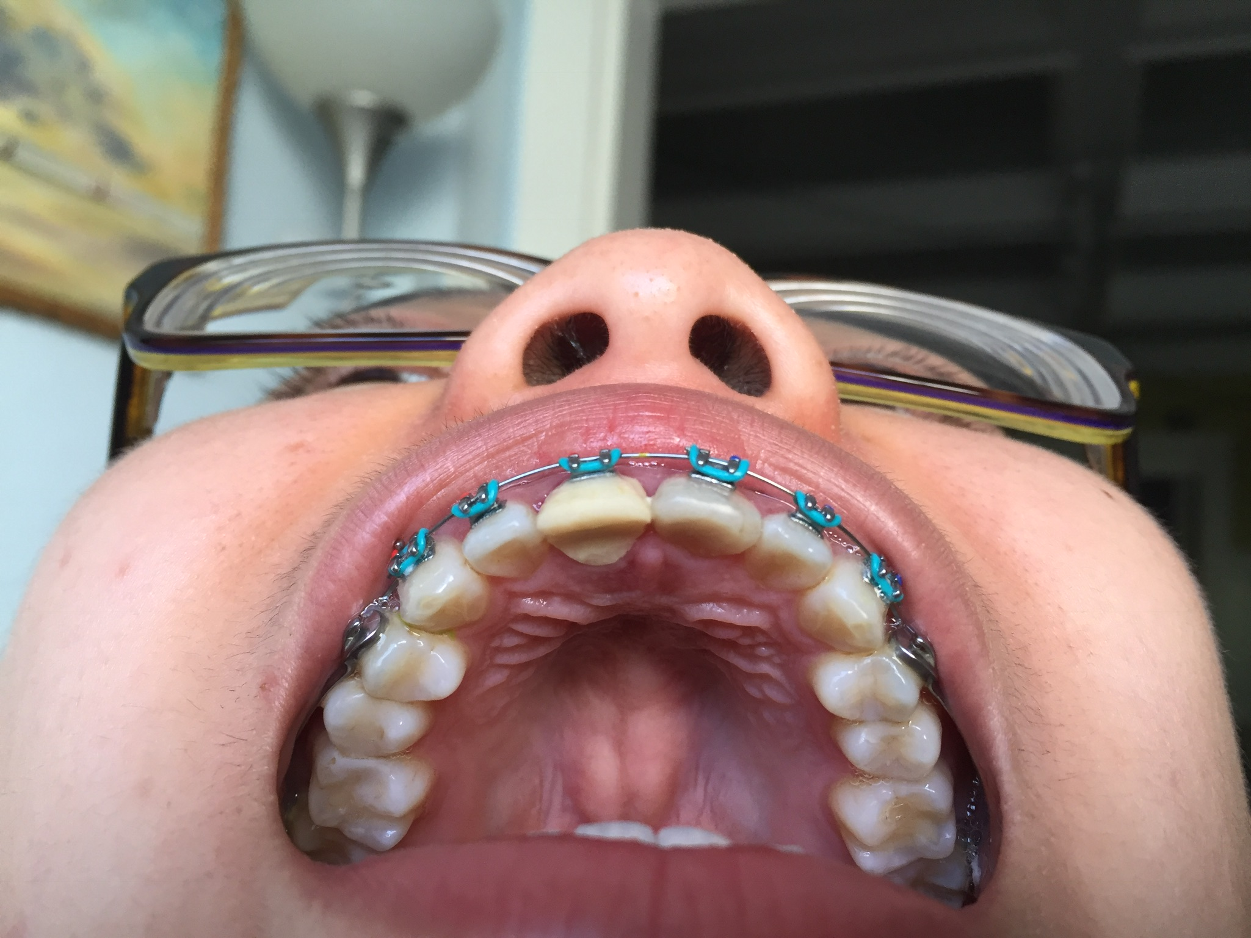
Starting the Long Orthodontics Process
Notes:
Because of oblique lingual alveolar fracture on #8 needed to do ortho extrusion to have adequate ferrule and biologic width
April 2 extrusion began with acrylic temp
April 8 temporary fell off

Slide 12
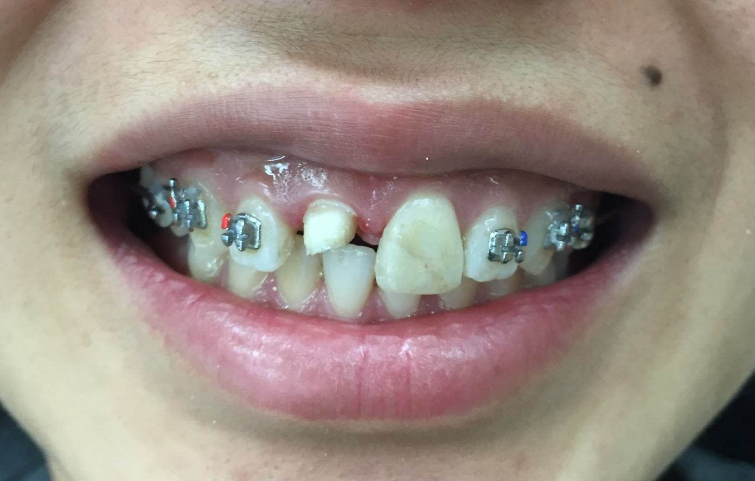
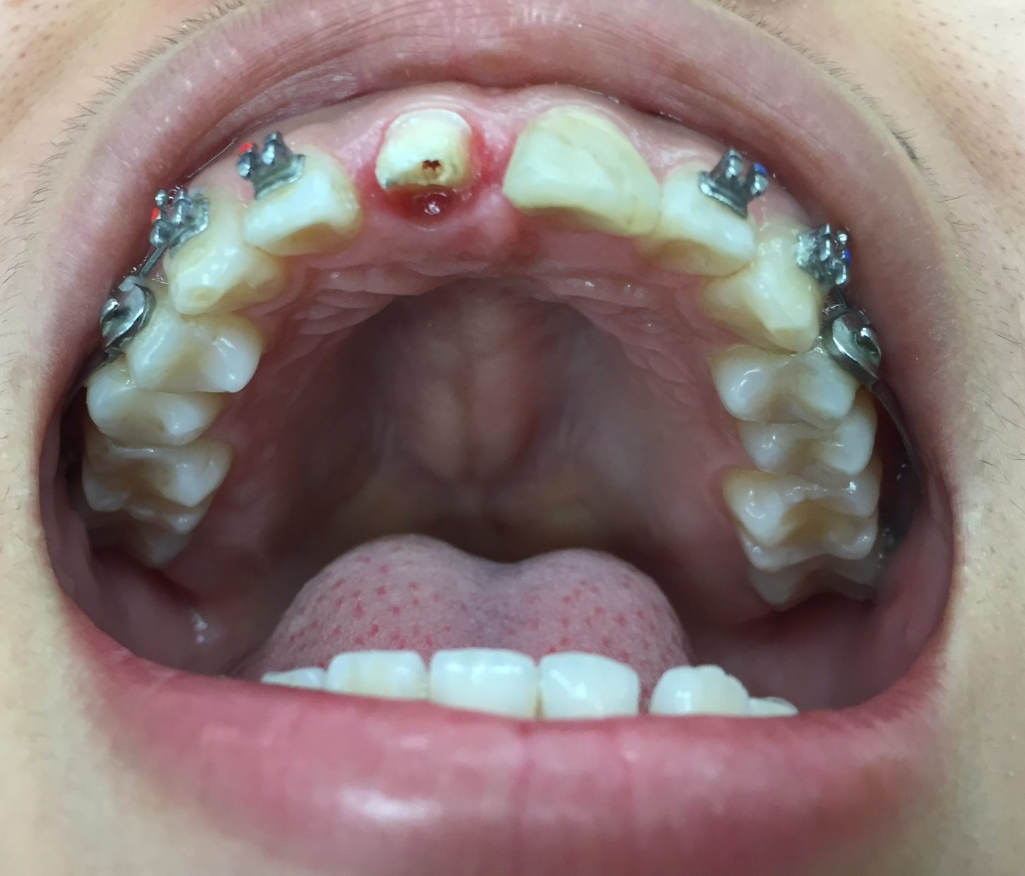
But…Problems with a Temporary
Notes:
Temp crown and temporary post fell out numerous times

Slide 13
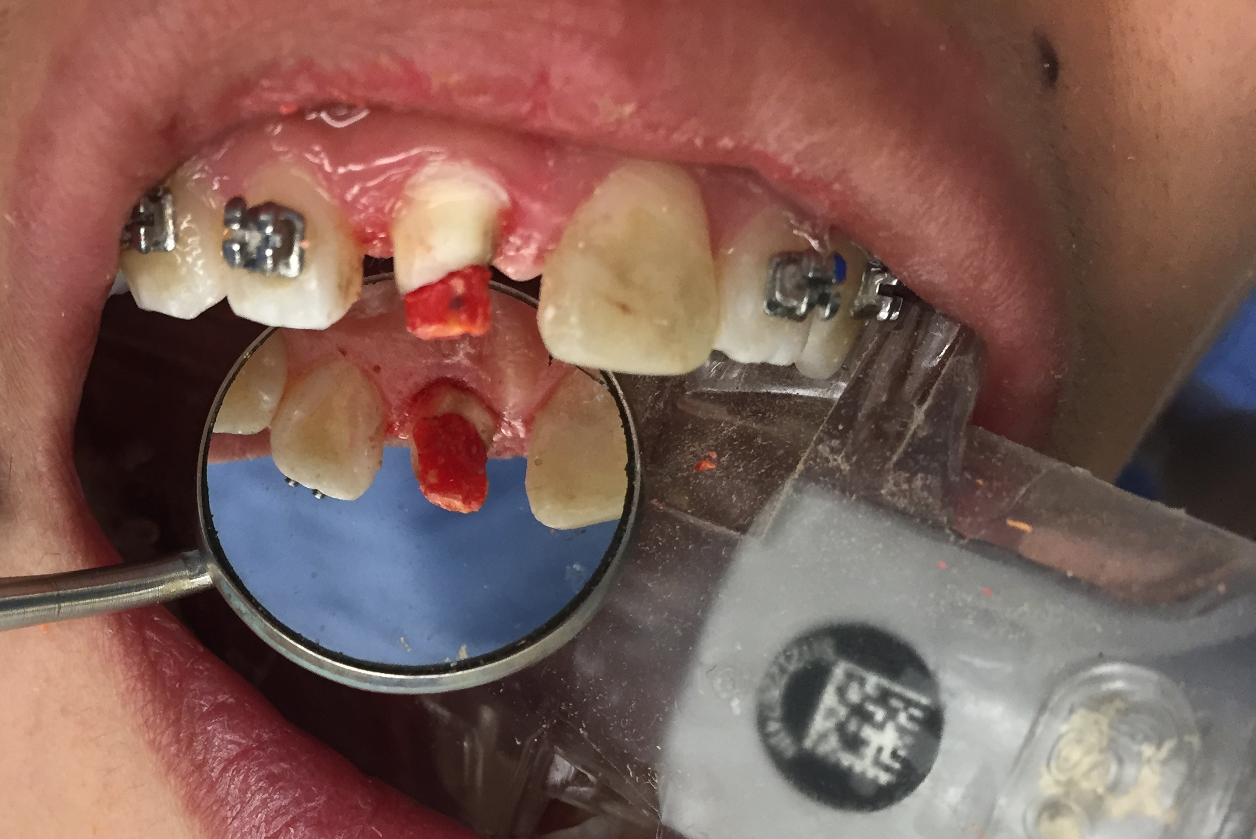
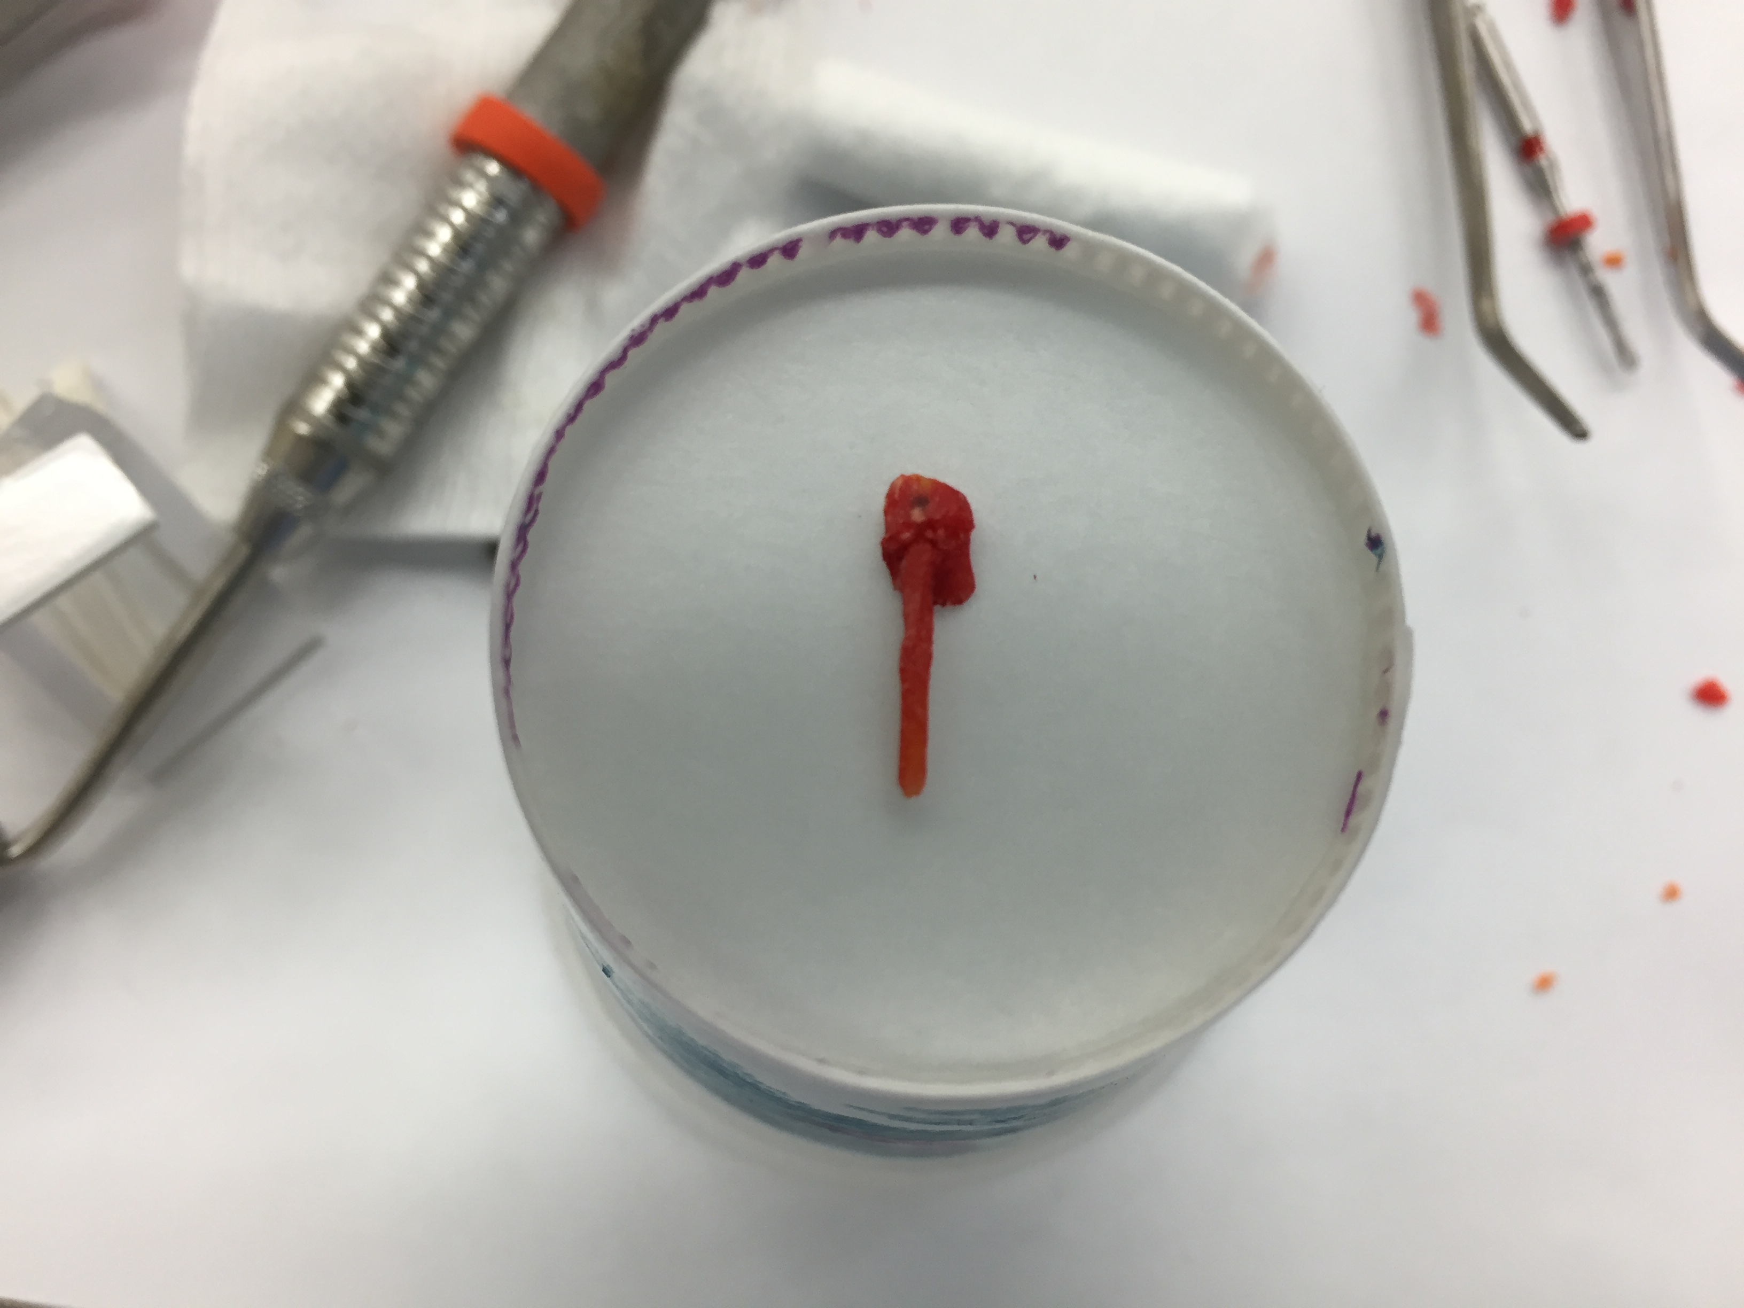
Cast Post and Core

Slide 14
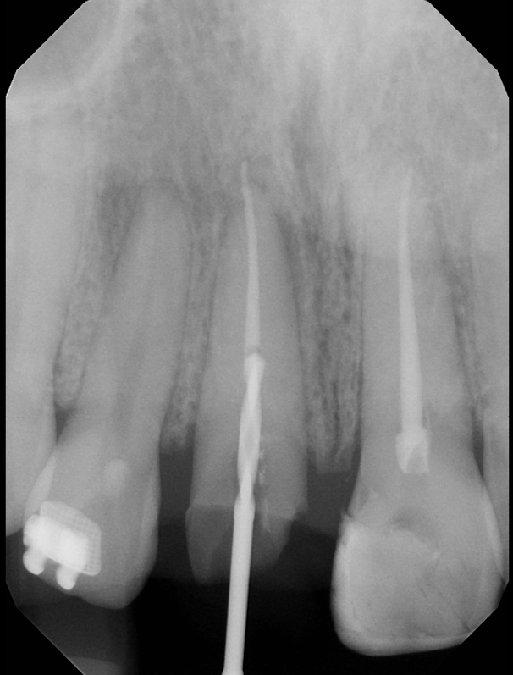
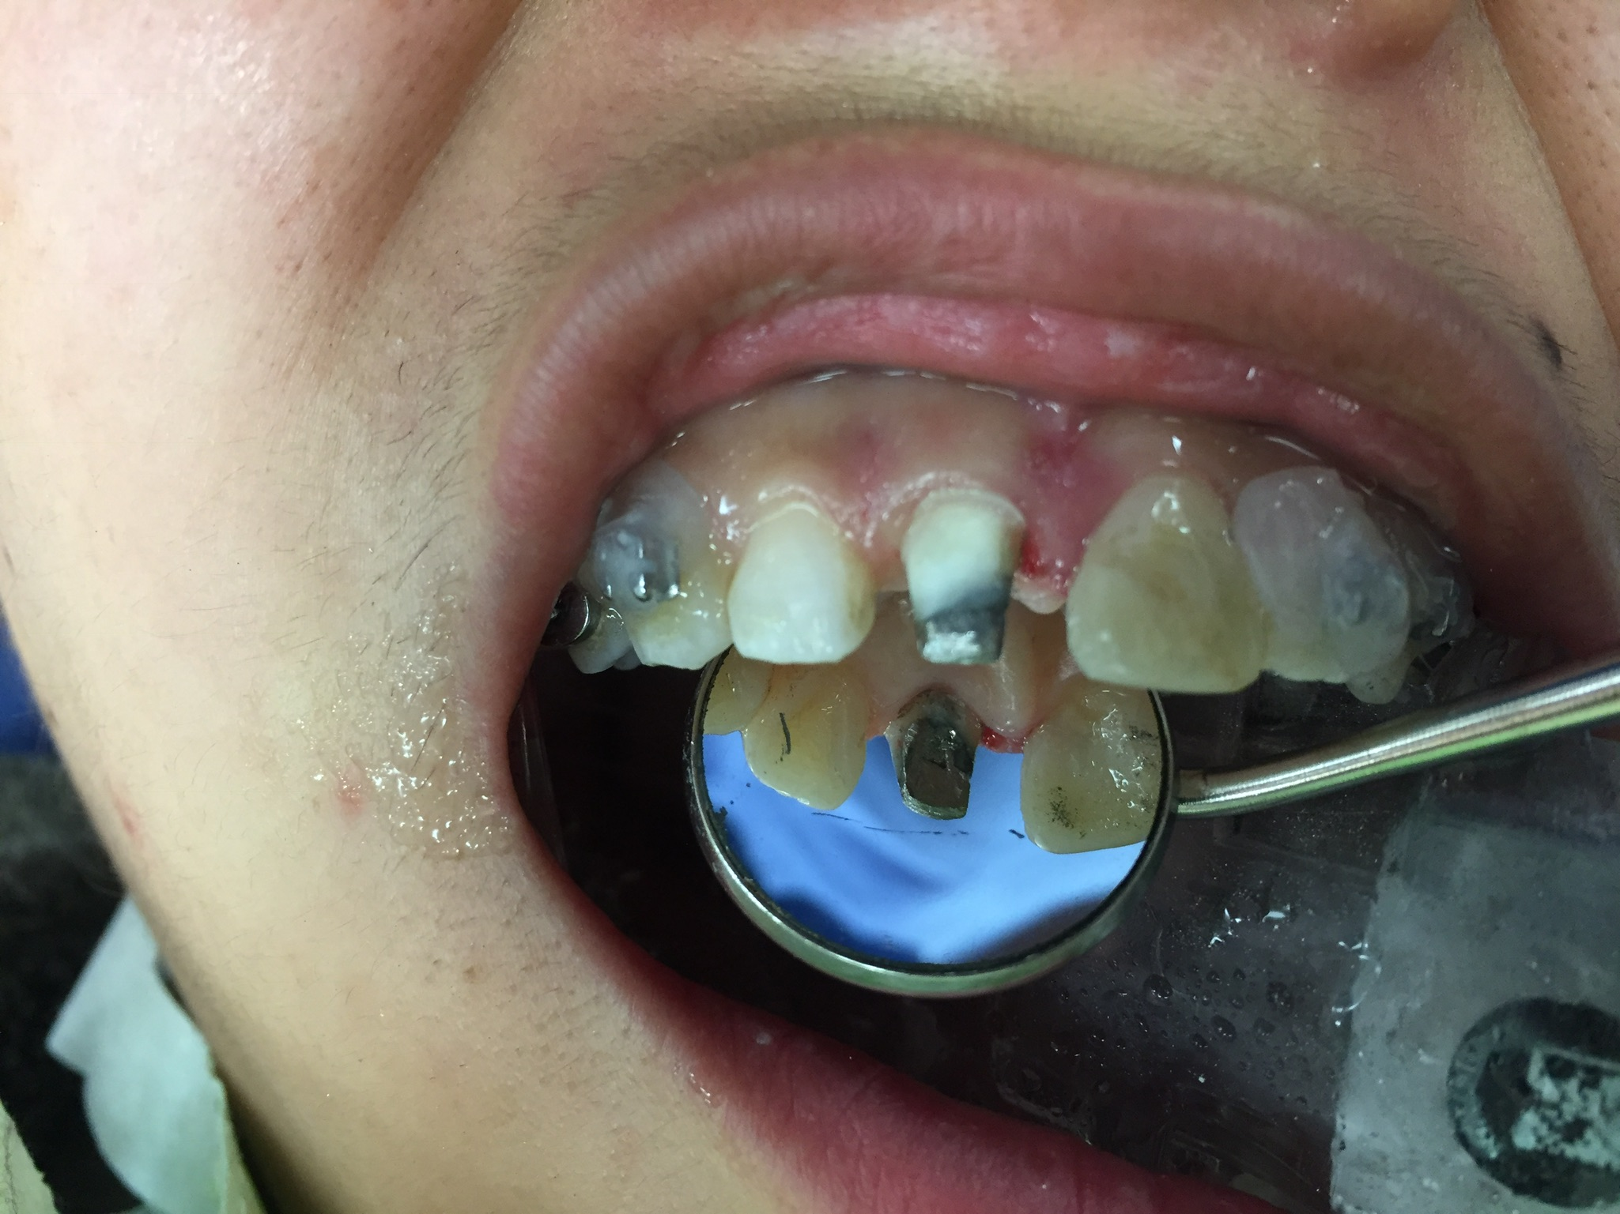
Cast Post and Core
Notes:
April 28 – hoped for more retention with cast post for temporary

Slide 15
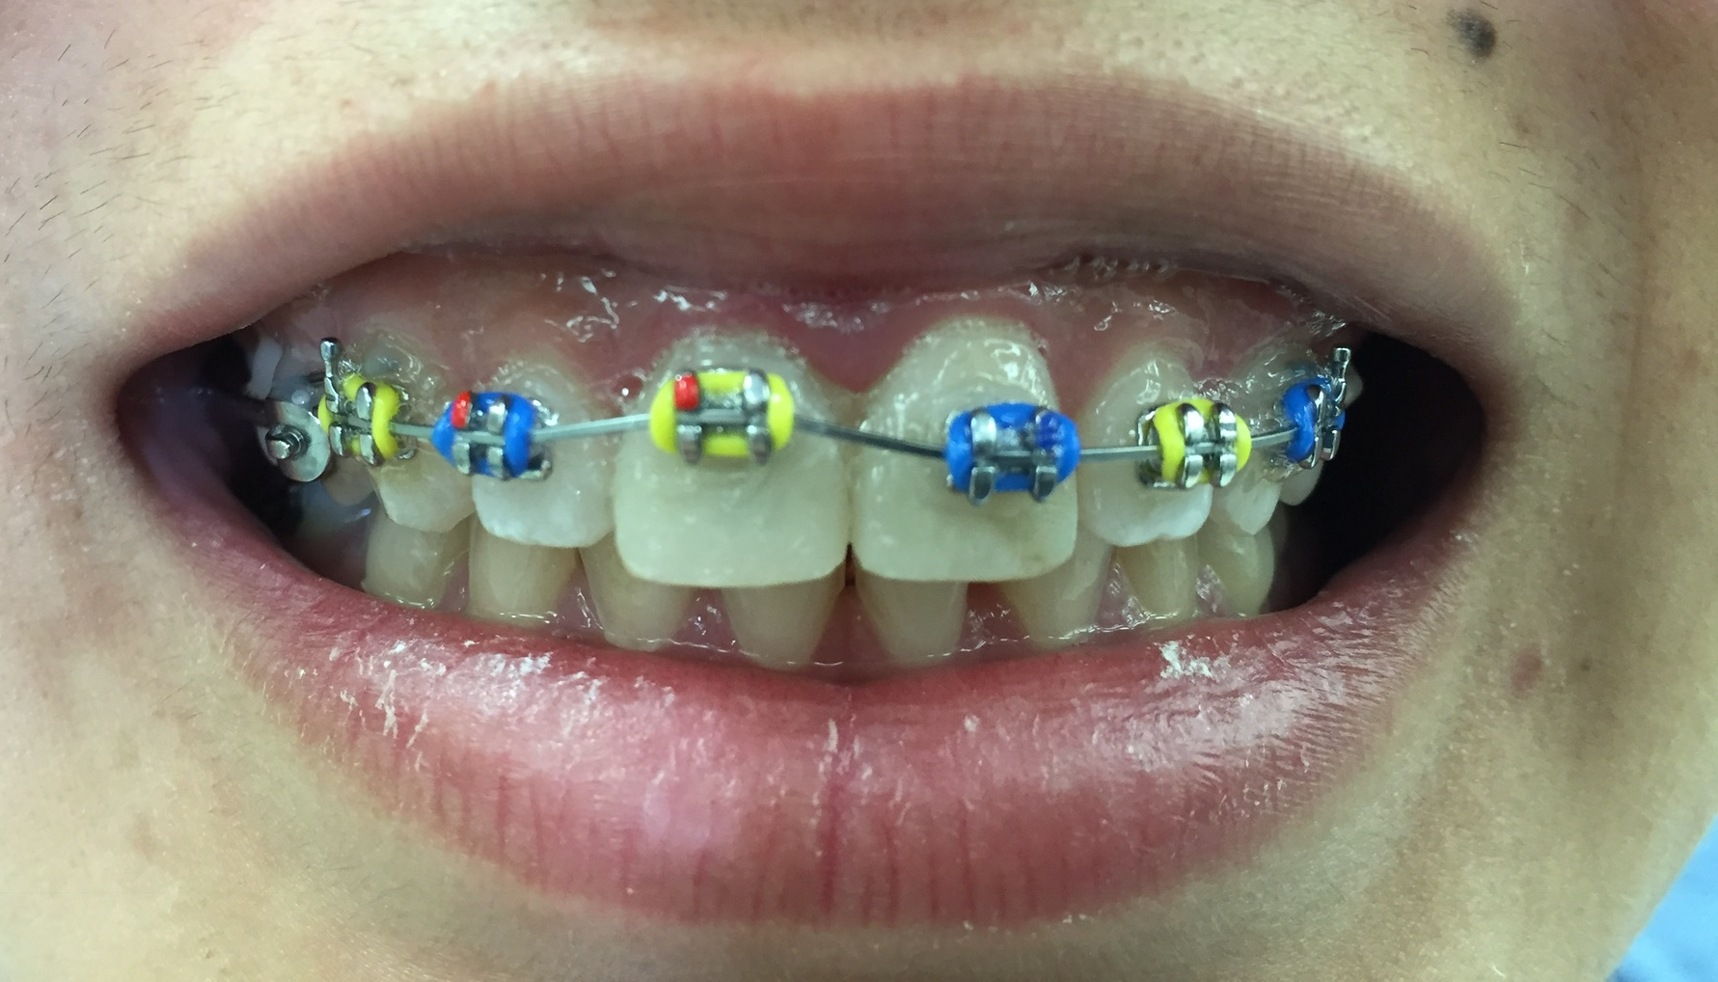
Orthodontic Extrusion³
Indications for ortho extrusion:
  Tooth fractured without enough ferrule for final restoration
  Must be enough tooth structure to bond bracket
  Ideal for oblique fractures
Timeline:
  In cases such as this – ortho is phase II following phase I emergency RCTs
  Usually lasts 8-12 weeks with re-adjustments every 2 weeks for extrusions of appx 2-4mm
  Followed by 4 month retention to prevent relapse
  Then to phase III periodontal crown lengthening (to be discussed later)
Notes:
Composite b/u then done over cast post and core to eliminate problem of temporary falling off

Slide 16
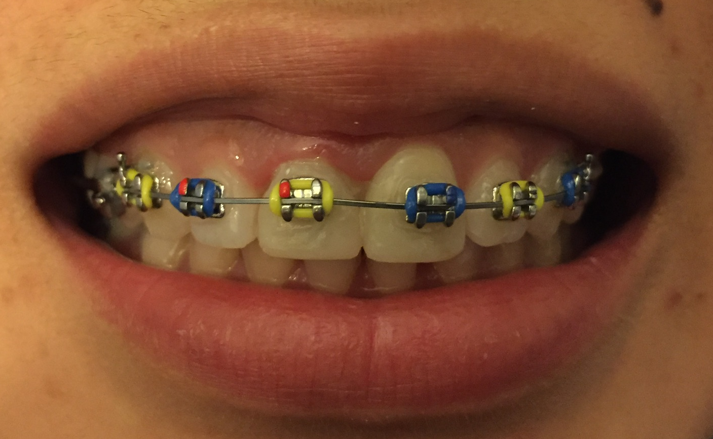
In Just THREE HOURS! WOOWWWWWW

Slide 17
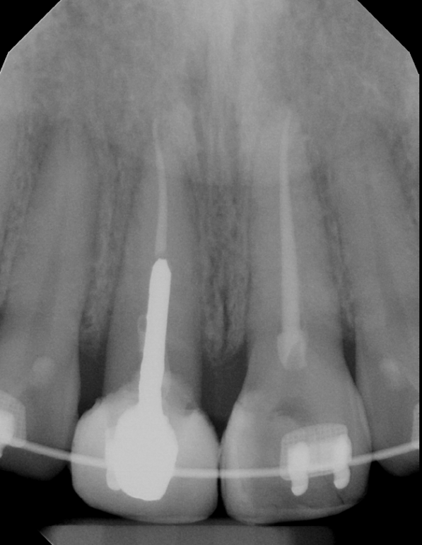
Completed Ortho Extrusion – 2 Months

Slide 18
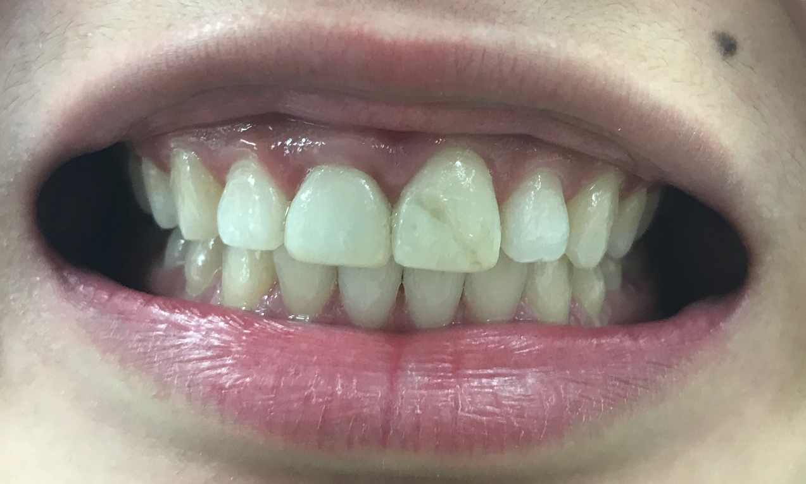
Completed Ortho – Feb 10, 2017
Notes:
Ortho extursion typically 6-8 wks with time for stabilization after
But in this case – finished ortho extrusion and continued with traditional braces to correct class II and pts original CC of diastema
June 2 traditional ortho started and finished Feb 10 – ortho treatment was not completed to ideal but rather to patient and provider timeline
But diastema was closed so original CC corrected within that timeframe

Slide 19
Crown Lengthening³
Phase III following ortho extrusion + 4 months of retention
Includes:
  Gingival flap
  Ostectomy
  Gingivoplasty
Indications:
  Esthetics
  Restorative Margin Placement
Allow 6-8 weeks for healing before final restoration

Slide 20
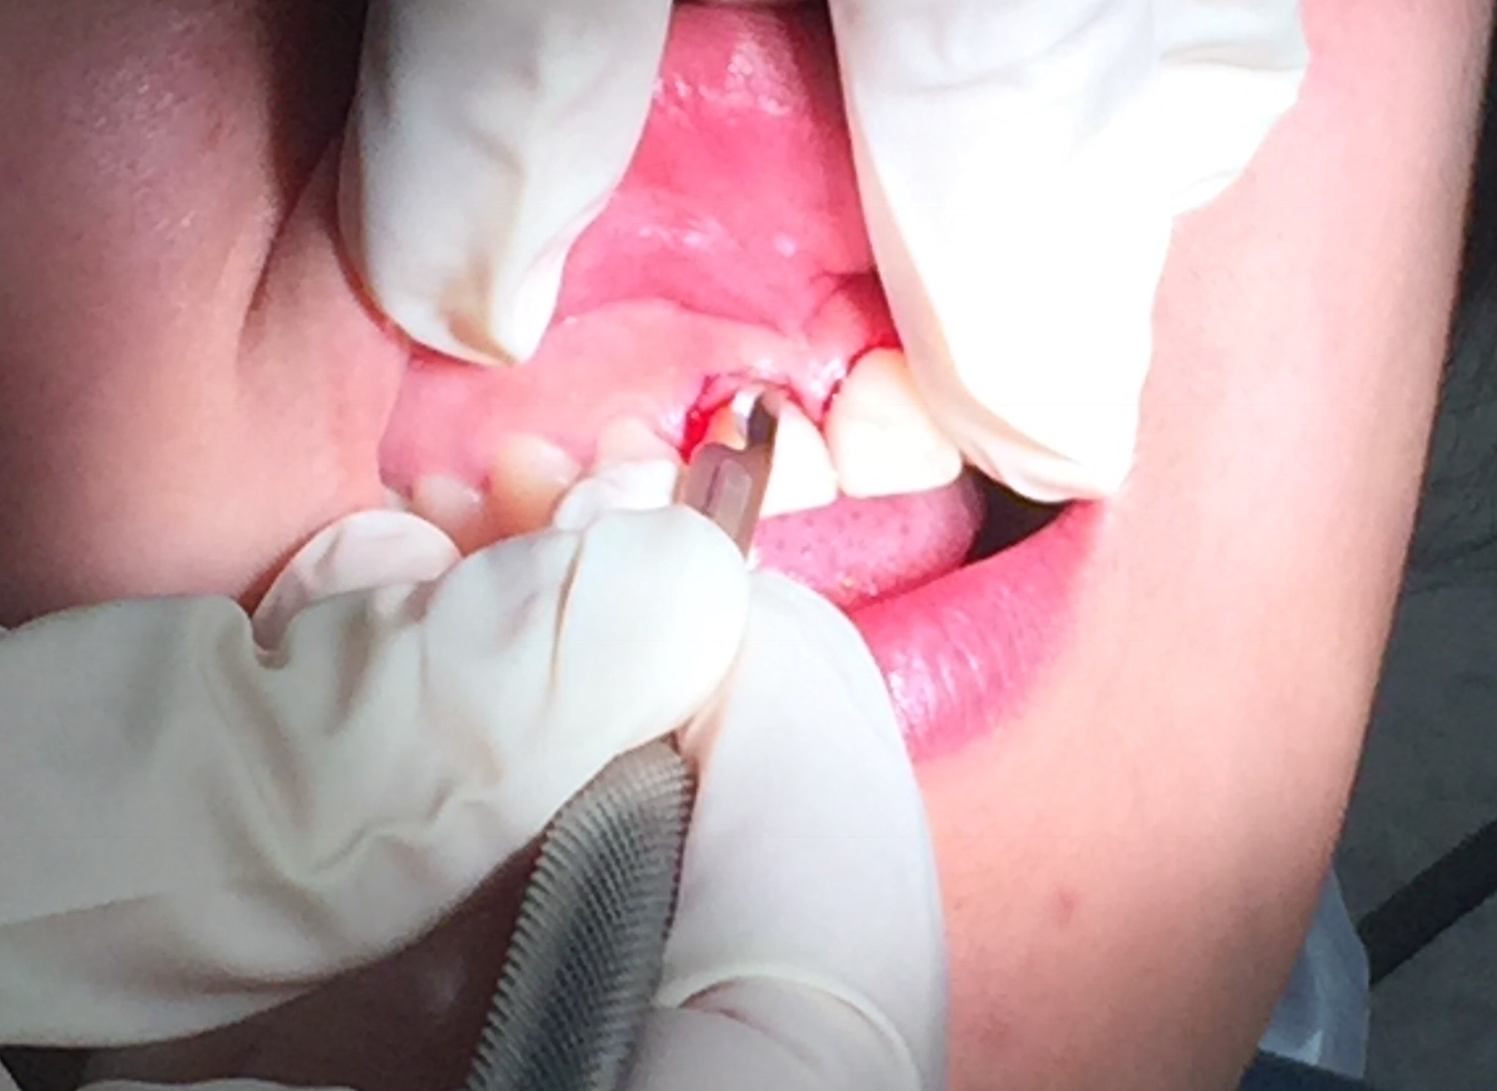
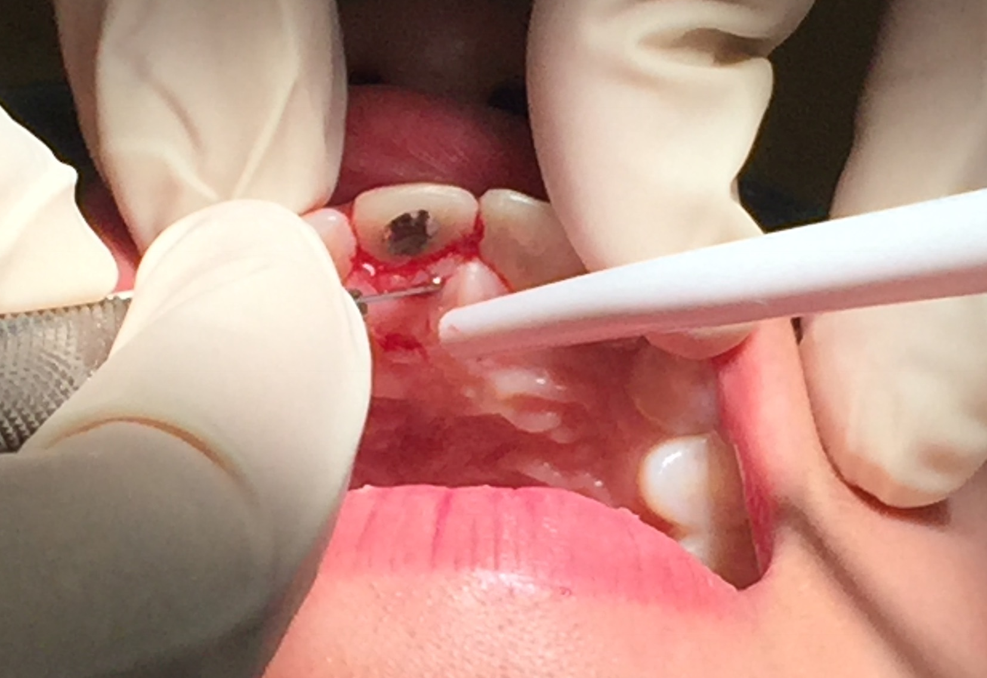
Gingivectomy
Notes:
March 10 – waited for Dr. Xenoudi
Gingivectomy + ostectomy on #8.

Slide 21
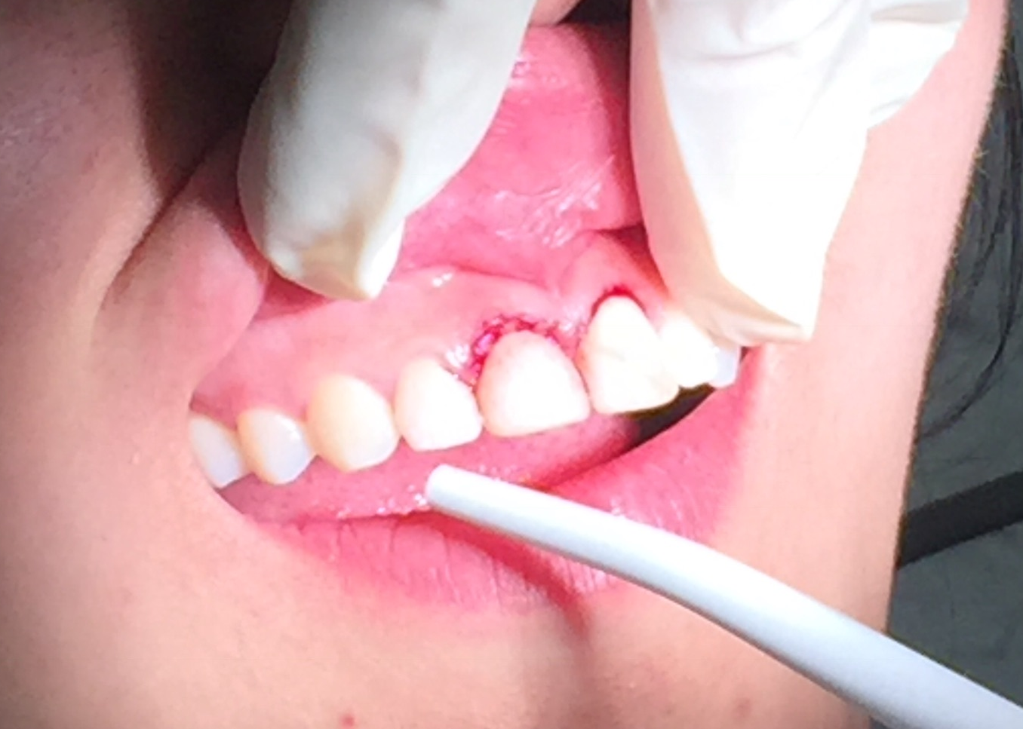
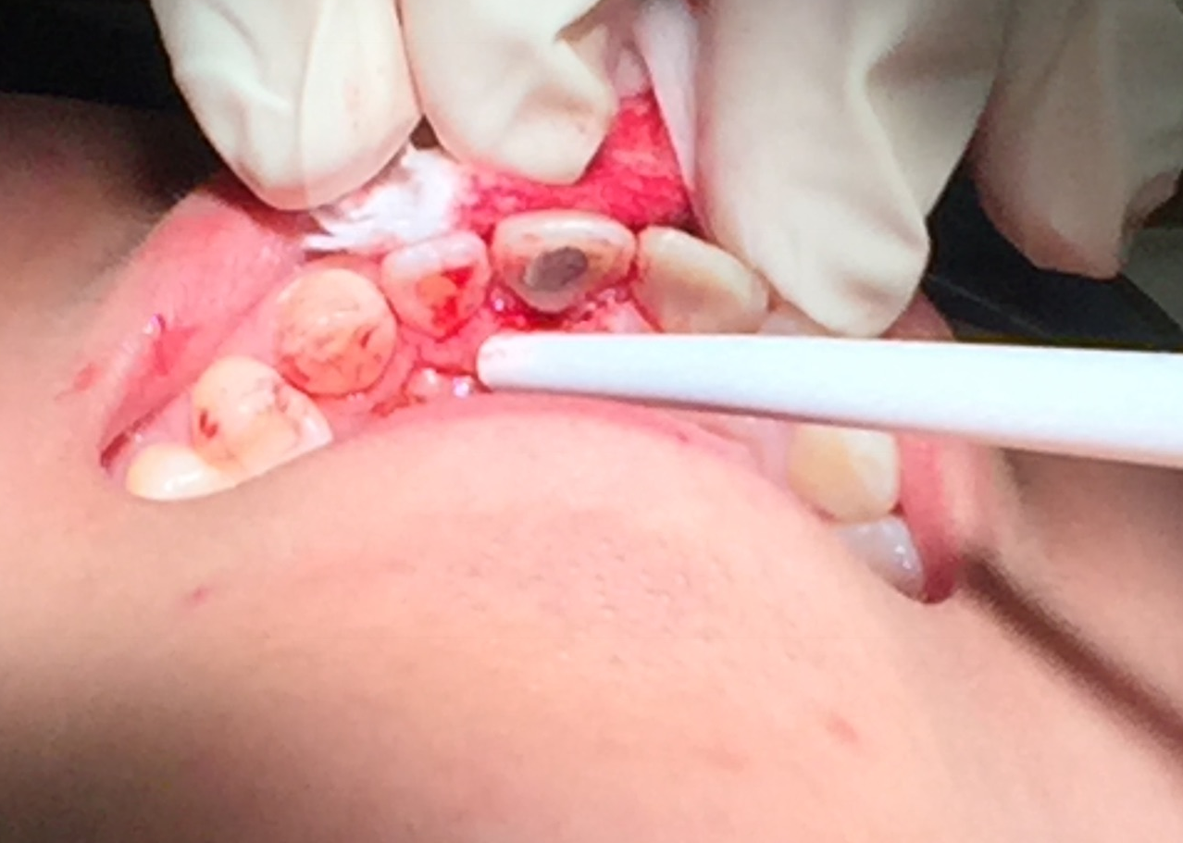

Slide 22
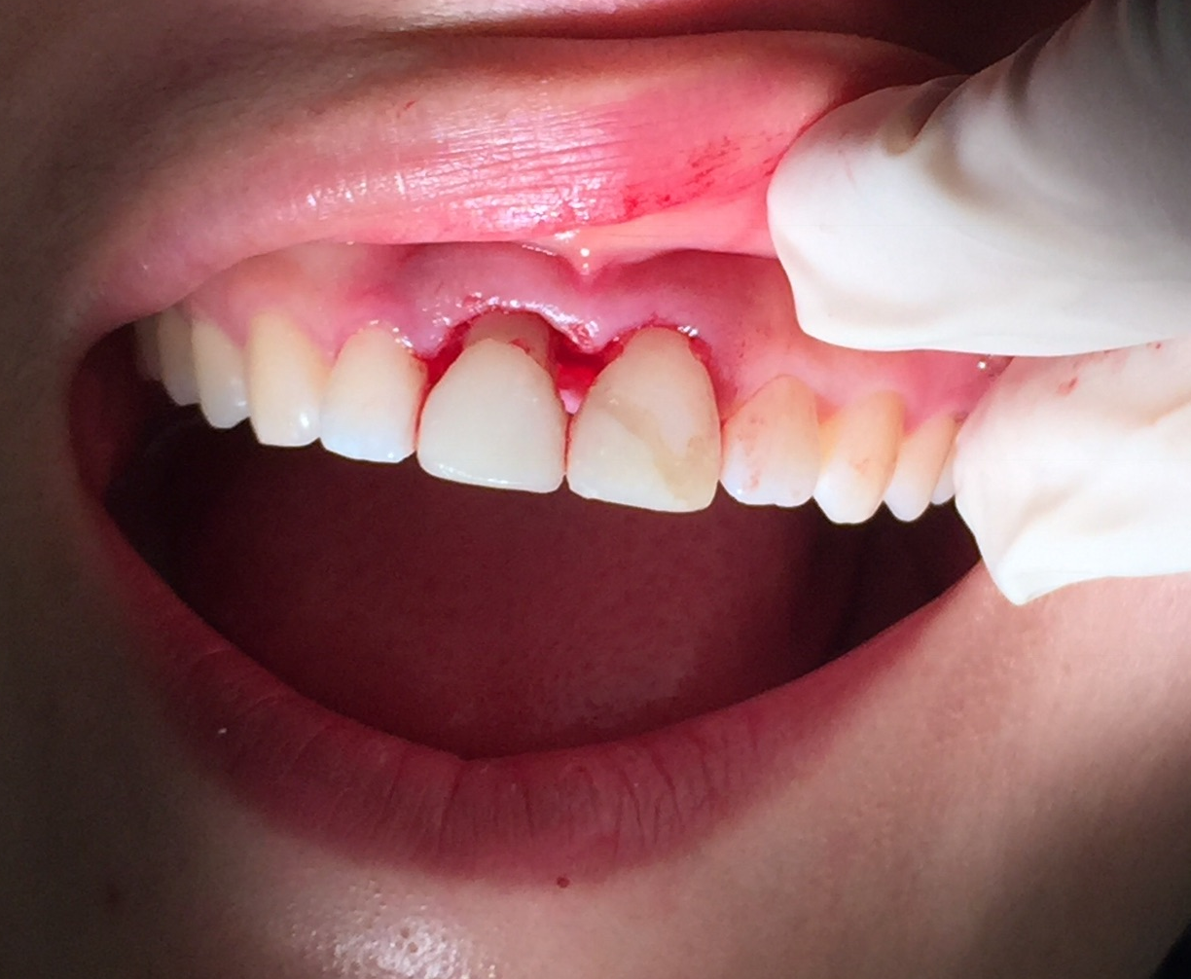
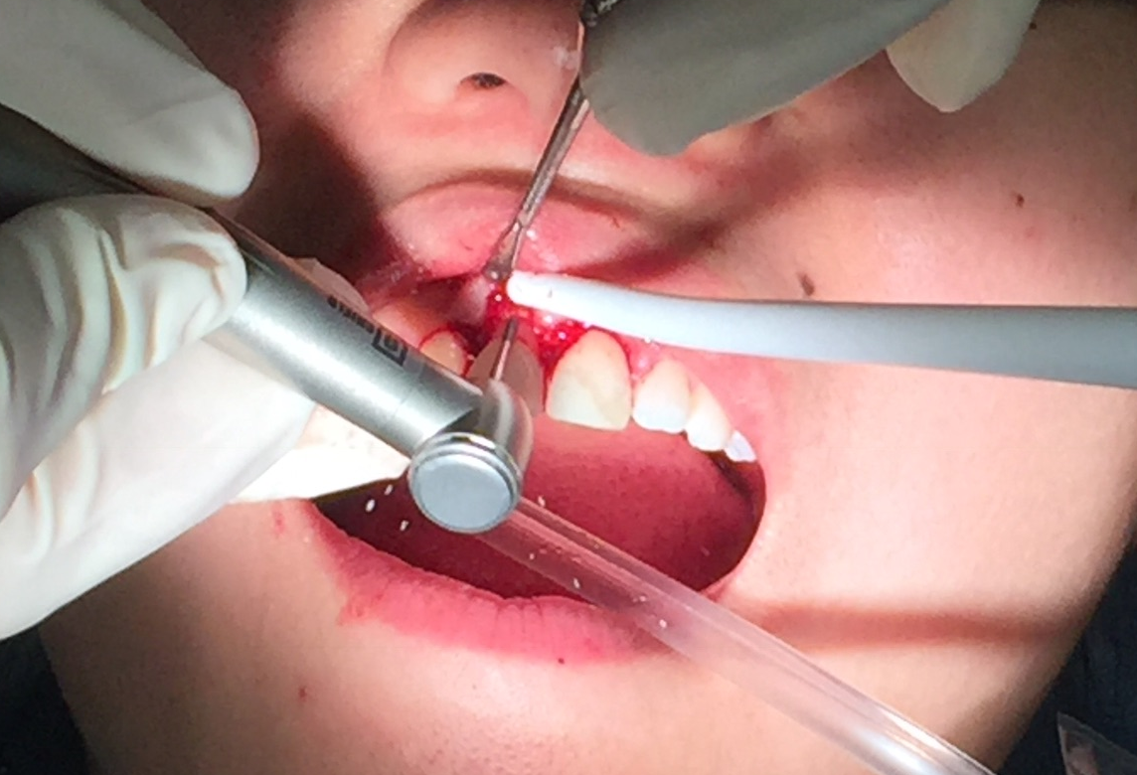
Ostectomy
Notes:
Large black triangles – big esthetics issue

Slide 23
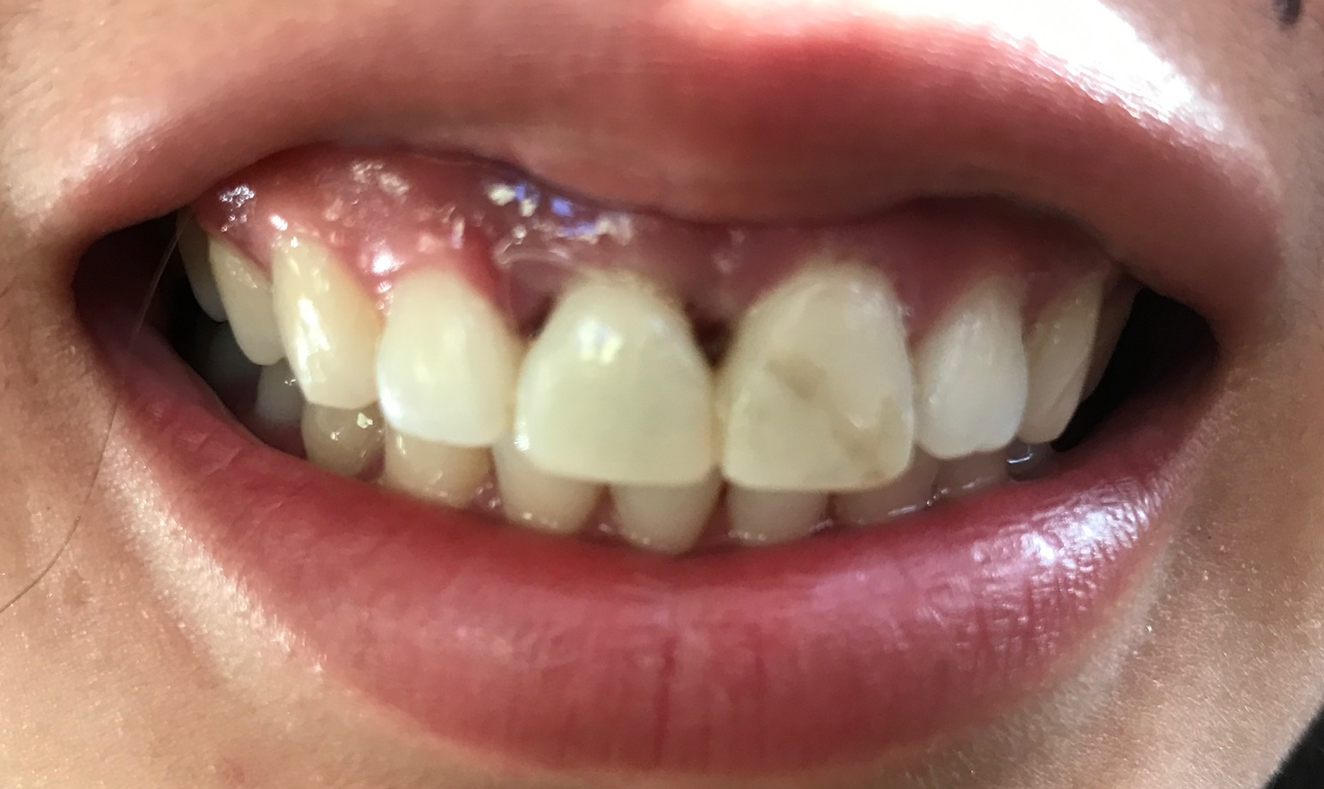
Black Triangles
Notes:
Gingiva came back down so thought needed to go back for gingivectomy but perio and general said to use temps to contour gingiva and encourage papilla regrowth
Contact should be 4mm from alveolar bone in order for papilla regrowth

Slide 24
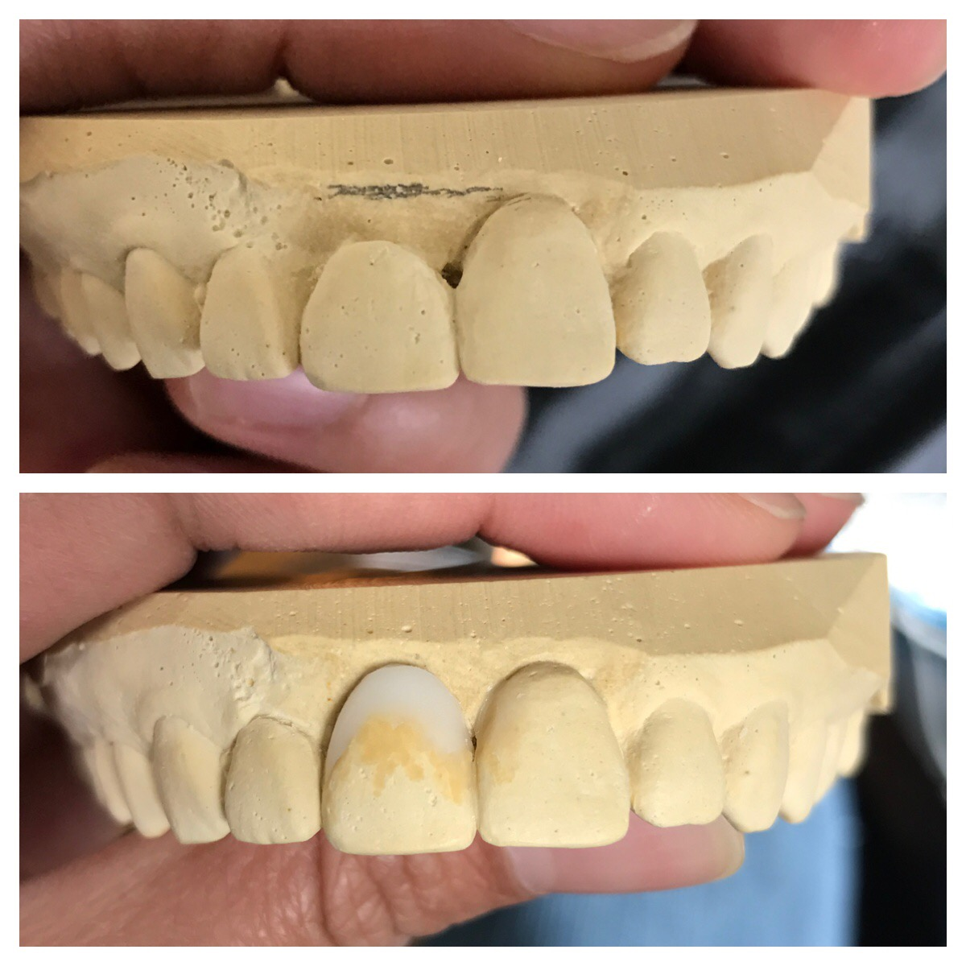
Waxing Up

Slide 25
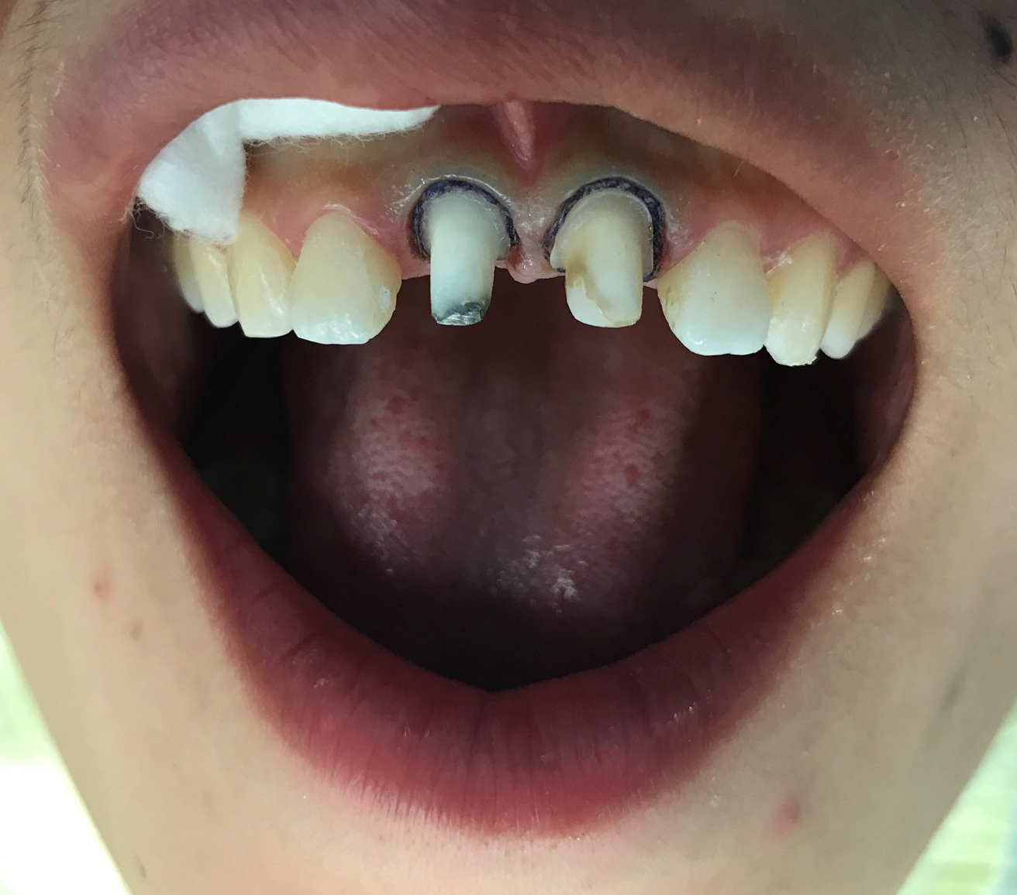
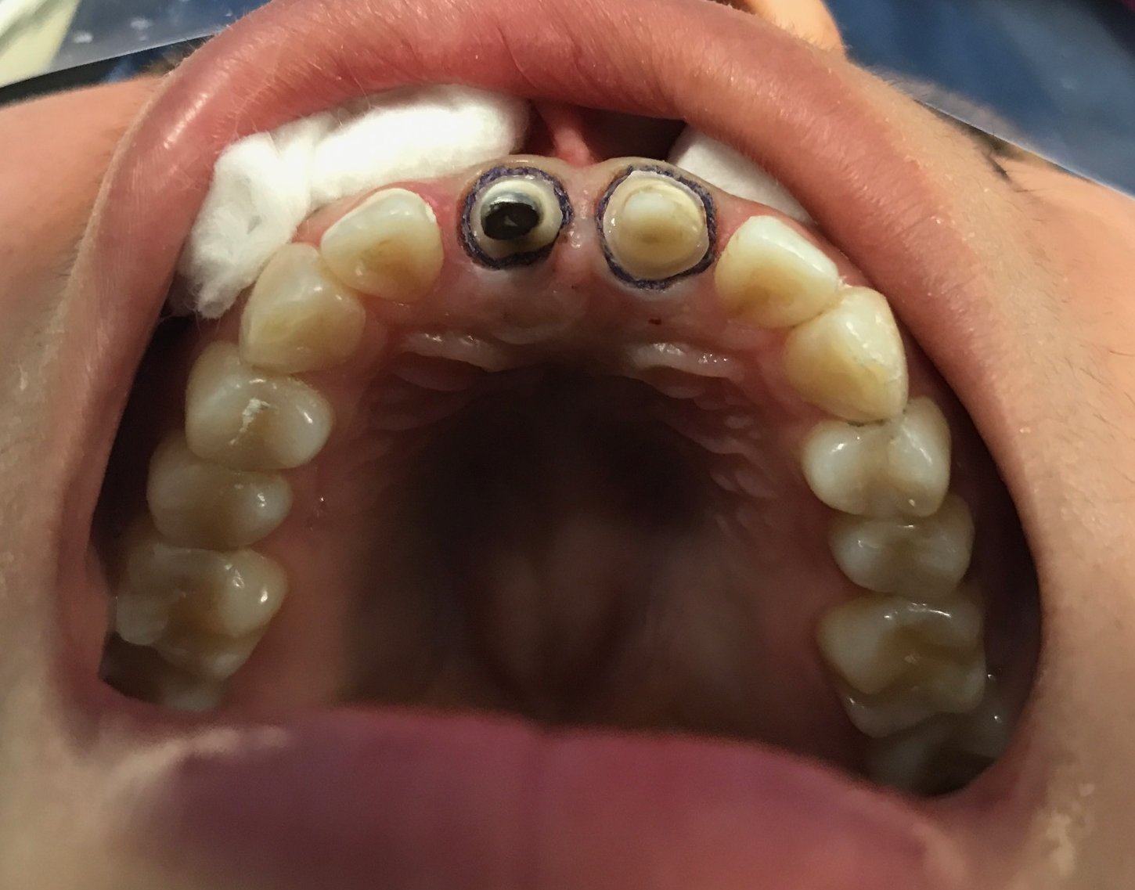
Getting Back to Normal
Notes:
Over one month later – about 5 weeks – April 17

Slide 26
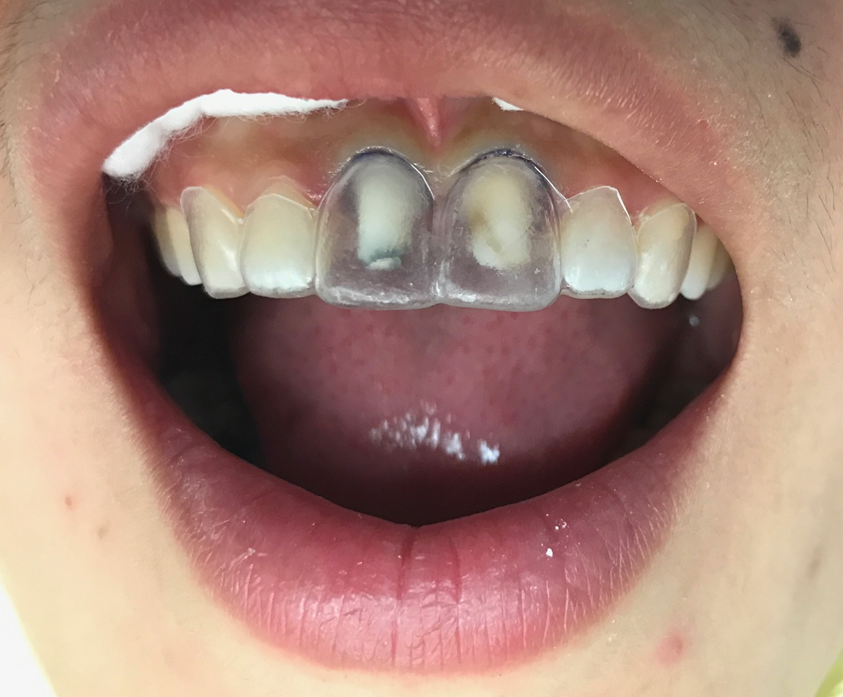
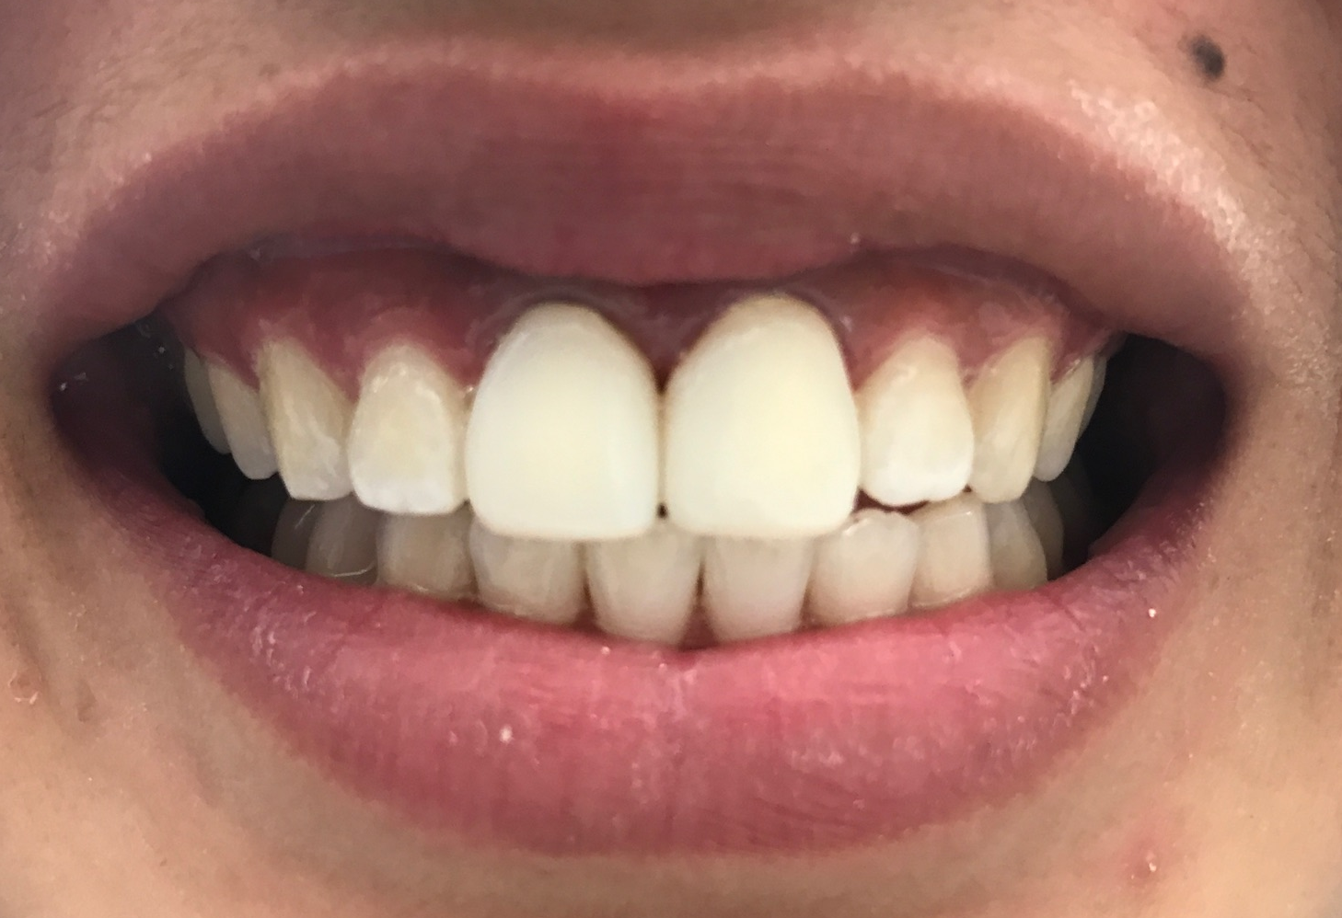
Notes:
Wax up and suck-down stent made to correct black triangles

Slide 27
Porcelain-Bonded to Zirconium Crowns
Why PBZ?²
Unfortunately, the crowns did NOT deliver on their first attempt… ☹
Complications included:
  Poor color match (despite custom shade matching at the lab)
  Poor fit of crowns
Emax was not an option due to cast-post and core decision (too translucent)
PFM and PBZ require similar clinical procedures
Zirconium-oxide substructure is comparable to metal substructure
PBZ is metal-based but without esthetic concerns of dark metal showing
However, more frequent chipping with zirconium based materials

Slide 28
References
1. Misje K, Bjørnland T, Saxegaard E, Jensen JL. Treatment outcome of dental implants in the esthetic zone: a 12- to 15-year retrospective study. Int J Prosthodont. 2013;26(4):365-9.
2. Christensen GJ. Porcelain-fused-to-metal versus zirconia-based ceramic restorations, 2009. J Am Dent Assoc. 2009;140(8):1036-9.
3. Sun YC, Li Y, Tong J, Gao P. An interdisciplinary approach to treat crown-root-fractured tooth. Niger Med J 2013;54:274-7.

