Slide 1
Application to Specific Research Questions
Interconnections and variables of interest depend on research question
Specifying relationships:
  Ensures that ecologic thinking is incorporated into research question and design
  Provides clarity into pathways being investigated and how they relate to other influences

Slide 2
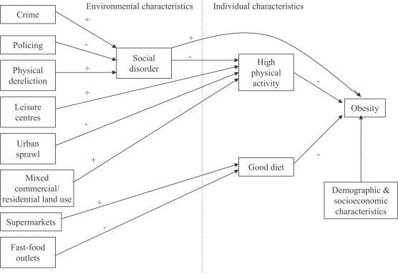
Theoretical model linking social and physical environmental characteristics to obesity
Pathways to obesity: Identifying local, modifiable determinants of physical activity and diet
Mai Stafford , Steven Cummins , Anne Ellaway , Amanda Sacker , Richard D. Wiggins , Sally Macintyre
Social Science &amp; Medicine, Volume 65, Issue 9, 2007, 1882 - 1897

Slide 3

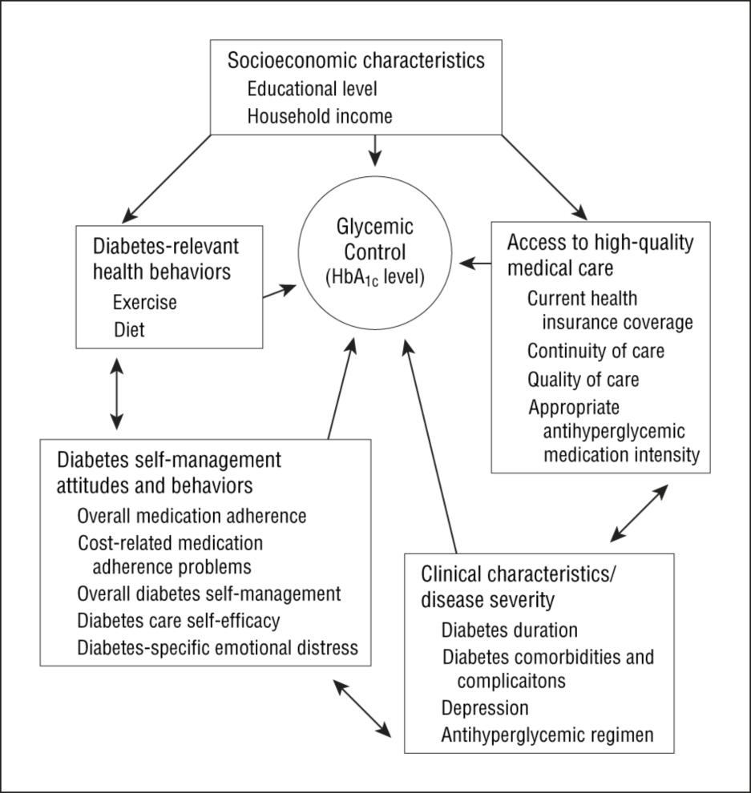
From: Mechanisms for Racial and Ethnic Disparities in Glycemic Control in Middle-aged and Older Americans in the Health and Retirement Study
Arch Intern Med. 2007;167(17):1853-1860. doi:10.1001/archinte.167.17.1853
Figure Legend:
Hypothesized mechanisms for racial/ethnic disparities in glycemic control. HbA_{1c} indicates hemoglobin A_{1c}.
Date of download: 2/9/2015
Copyright © 2015 American Medical Association. All rights reserved.

Slide 4
Map of Next Four Weeks
Week 2
Week 5
Economic & Social
Opportunities and Resources
Week 3
Living & Working Conditions
in Homes and Communities
Week 4
Behaviors
Medical Care
Interaction with genetic/other biological factors
HEALTH
Adapted from Braveman et al., for RWJ Foundation
Commission to Build a Healthier America | www.commissiononhealth.org

