Slide 1
Advanced Methods and Concepts in Research on Health Disparities and Social Determinants of Health:
CBPR
April 23, 2018

Slide 2
Minkler: CPBR Overview
“A collaborative process that equitably involves all partners in the research process and recognizes the unique strengths that each brings. CBPR begins with a research topic of importance to the community with the aim of combining knowledge and action for social change to improve community health and eliminate health disparities”.
Notes:
How much is cbpr about disparities?

Slide 3
Community-Based Participatory Research and Health Disparities?
Particularly relevant to health disparities research because:
  Can be used to address health outcomes for disenfranchised populations
  Provides opportunity to move beyond individual explanations to social determinants
  Focused on action
Pure CBPR is challenging; considering how to incorporate most relevant aspects of approach can be more tractable and still effective

Slide 4
What is a community?
Israel, Ann Rev Pub Health, 1998:
“Community is characterized by a sense of identification and emotional connection to other members, common symbol systems, shared values and norms, mutual— although not necessarily equal—influence, common interests, and commitment to meeting shared needs (83, 92, 150, 166). Communities of identity may be centered on a defined geographic neighborhood or a geographically dispersed ethnic group with a sense of common identity and shared fate.”

Slide 5
Minkler: Questions
What do you think of the claimed benefits of CBPR?
Which challenges do you think are most significant?
What do you think Minkler means by “systems development and local community capacity development”? How can this be accomplished?

Slide 6
Minkler: Benefits of CBPR
Support development of relevant research questions
Improve cultural sensitivity and reliability of measurements and methods
Uncover relevant lay knowledge necessary to understand problem and possible solutions
Enhance recruitment and retention
Improve interpretation of findings
Increase the relevance of intervention approaches
Notes:
How much about disparities?

Slide 7
Minkler: Challenges to CBPR
How to initiate the collaboration/identify the problem?
Insider-Outsider tension (including funding/benefits, trust)
Challenges in enabling and motivating community engagement
  Need to engage in meaningful capacity building, provide adequate compensation
Differences in paradigm about the process and outcomes of research
Disconnect in sharing findings, including different agendas (political vs. scientific)

Slide 8
Andrews: CBPR for Intervention Design
What do you think of the “origin story” of this collaboration?
What do you think of how CBPR principles were applied in this project?
How did the use of CBPR influence the intervention development? The study design?
How did they address sustainability?
What did you think of Table 1?

Slide 9
Andrews: Phases of Involvement
Problem identification
Needs assessment
Intervention development
Pilot studies
Randomized controlled trial

Slide 10
Andrews: Sustainability
Sustained effects of the intervention?
Capacity building of NAB and CHWs
Champions at multiple levels of partnering organizations to weather personnel changes
Balance between centralized and neighborhood-specific intervention development/input
Formalized processes
Sustained funding?

Slide 11
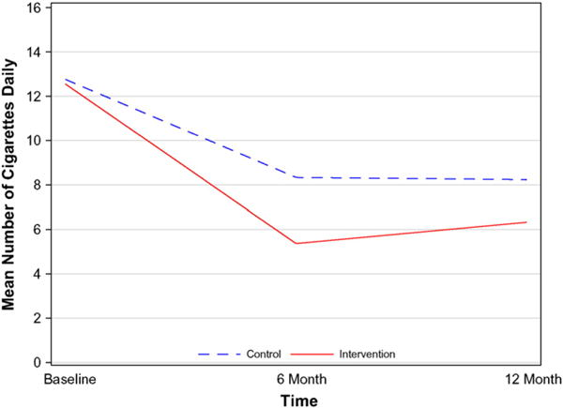
Andrews, 2016
Smoking abstinence rates at 12 months for intervention vs. control were 9% vs. 4.3%, p = 0.05.
Additional analyses accounting for passive smoke exposure demonstrated 12 month abstinence rates of 12% vs. 5.3%, p = 0.016.
In the multivariate regression analyses, there was no significant effect of the intervention on the odds of being a non-smoker (OR = 0.44, 95% CI: 0.18–1.07).
Intervention participants who kept coach visits, attended group sessions, and used patches were more likely to remain abstinent.

Slide 12
Vasquez: CPBR for Policy Change
Problem of pollution identified by community organization WE ACT, study design came from academic partners at Columbia
Trained 17 youth to monitor pollution and traffic
Academic researchers provided mentoring and oversight, analyzed data

Slide 13
Vasquez: CPBR for Policy Change
Policy mobilization was led by WE ACT: Results were used in public education campaigns, conferences, public testimony, briefing of officials
Academic partners participated in workshops, provided advice
Some conflict over timeline and focus
Ultimately contributed to conversion to “clean” diesel, implementation of more consistent airemonitoring, establishment of state wide environmental justice programs, contributed to discussions on a federal level

Slide 14
Vasquez: CBPR for Policy
What do you think of how CBPR principles were applied in this project?
What challenges did they face? How did they address them?
What aspects of this project could be generalized to other projects?
What do you think of the academic partner’s statement that “the motivation for involvement did not lie in identifying policy goals but rather in trying to fill scientific gaps”?
What role does research about the effectiveness of specific approaches to and aspects of CBPR have in health disparities research?
Notes:
Budget concerns, delay in publishing, retincence of partner – did a lot of transparent negotiation, got a grant for the community partner, strategically used the academic

Slide 15
Discussion Questions
Given the challenges and benefits of CBPR, how can disparities researchers move forward?
Minkler mentions importance of cultural humility in CBPR. What does this mean, and how can it be accomplished?
In doing CBPR, what is a community? How is this identified? (See Minkler page 8)
How could CBPR, or elements of CBPR, be incorporated into your work?

Slide 16
Cultural and Structural Humility
Cultural humility is the “ability to maintain an interpersonal stance that is other-oriented (or open to the other) in relation to aspects of cultural identity that are most important to the [person].^{[1]}” Cultural humility is different from other culturally-based training ideals because it focuses on self-humility rather than achieving a state of knowledge or awareness
We define structural competency as the trained ability to discern how a host of issues defined clinically as symptoms, attitudes, or diseases (e.g., depression, hypertension, obesity, smoking, medication “non-compliance,” trauma, psychosis) also represent the downstream implications of a number of upstream decisions about such matters as health care and food delivery systems, zoning laws, urban and rural infrastructures, medicalization, or even about the very definitions of illness and health

Slide 17
Different Approaches to Community Engagement
Start from scratch: develop community board, do needs assessment, network with organizations -> intervention development, etc.
Identify and partner with specific organization on specific issue - > intervention development etc.
Do community engaged research which takes into account community needs and involvement, without aspiring to “CBPR”

Slide 18
