Slide 1
Advanced Methods and Concepts in Research on Health Disparities and Social Determinants of Health:
Measurement
April 30, 2018
Kelsey Holt, ScD

Slide 2
Measurement
Measures are proxies for constructs you can’t directly observe
  E.g., socioeconomic position, as measured by education level
  E.g., interpersonal quality of care, as measured by interpersonal processes of care scale

Slide 3
Validity
Are you measuring what you think you’re measuring?
“To validate an interpretation or use of test scores is to evaluate the plausibility of the claims based on the scores. An argument-based approach to validation suggests that the claims based on the test scores be outlined as an argument that specifies the inferences and supporting assumptions needed to get from test responses to score-based interpretations and uses.”
Kane MT. Validating the interpretations and uses of test scores. Journal of Educational Measurement. 2013 Mar 1;50(1):1-73.
Notes:
Are you measuring what you think you are measuring?
Validation is about making the case that you are justified in drawing inferences about a latent construct based on your measure
To “validate a measure” is simple language that obscures the different forms of validity evidence, as well as the fact that a “valid” measure isn’t necessarily appropriate for us indiscriminately in all populations

Slide 4
Sources of validity evidence for score use (5 Cs)
Content
  Evidence based on content
    e.g., Focus group studies, literature reviews
Cognition
  Evidence based on response processes
    e.g., Think-aloud protocols
Coherence
  Evidence based on internal structure
    e.g., Reliability analysis, factor analysis
Correlation
  Evidence based on relations to other variables
    e.g., Convergent evidence
Consequence
  Evidence based on consequences of measurement
    e.g., Long-term evaluations of impact of testing on educational performance
Notes:
We won’t go into detail into the methods involved in each of these – just good to have an overview of the types of evidence that exist
Depending on your discipline, different categorizations/ divisions between types of validity evidence - sometimes, construct/criterion
Consequence – measure developers to assume responsibility for documenting the consequences of testing –particularly in high stakes environs- and the jutification for use of scores. Another example – impact of giving providers feedback on how they are treating patients. https://www.ncbi.nlm.nih.gov/pubmed/26839945

Slide 5
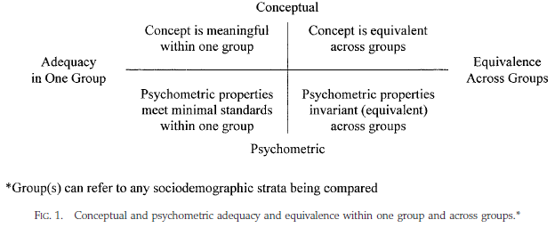
Conceptual versus psychometric considerations
Content and cognition validity evidence (qualitative)
Coherence validity evidence (quantitative)
Stewart & Napoles-Springer 2003
Notes:
Ramirez article talks about conceptual versus metric equivalence (factor loadings for latter). Structural equivalence would be whether relationsips with outside variables are same – but some say this isn’t necessary for validation because might have different real relationships.
For this Figure – it’s a guide to what quadrants might need further research if not enough evidence exists

Slide 6
Scale vs. index
Scale: responses to individual items share a common cause
  E.g., Sexual relationship power scale: “most of the time, we do what my partner wants to do” and “who usually has more say about what you do together” are both caused by the underlying level of relationship power of women
Index: responses to individual items share a common effect
    E.g., Stressful life events index: “losing a job” and “divorce” both cause stress
Can have single-item measures too (e.g., education level, race/ethnicity)
Note: Factor analysis and Cronbach’s alpha only appropriate for scales
Notes:
Coherence validity – alpha, factor analysis

Slide 7
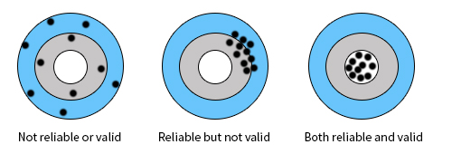
Reliability
Does the measure provide consistent scores?
  Over time (assuming latent construct is stable)
  By rater
Need reliability for validity, but don’t need validity for reliability
Image from: http://www.renaissance.com/2014/07/10/understanding-the-reliability-and-validity-of-test-scores/
Notes:
Precision
In other words, you can be consistently measuring the wrong thing!

Slide 8
Measurement and health disparities
We’ve already touched upon measurement in terms of a need to carefully consider race/ethnicity as a marker of complex, interrelated factors, and the need to improve our measures of discrimination to better understand why health disparities exist…
Today we will talk about how to make sure self-reported measures are not biased, due to conceptual or psychometric inequivalence
Imprecise measurement can lead to poorly targeted interventions
Notes:
Stewart & Napoles-Springer touch upon first bullet, we have already discussed need to carefully measure race, SES, discrimination. They also bring up measurement of QOC and acculturation. Then get into methods.

Slide 9
Discussion

Slide 10
McMahon article
How did the construction of the SRPS and IPC scales differ in the way that they have been evaluated for validity of score interpretation among different populations?
  IPC – initially developed with several diverse populations in mind
  SRPS – developed among one population and subsequently adapted
What evidence was initially used for the validity of use of the SRPS among a predominantly Latina population in the United States?
To what degree were conceptual versus psychometric equivalence assessed in the adaptations of the SRPS for different contexts?
Notes:
cross-cultural differences in interpretations of constructs and items used to measure construct
Qualitative methods, classical test theory, modern psychometric methods

Slide 11
Take Home Points
Measures are imperfect proxies for “true” nature of social phenomena
  Care must be taken to define the constructs measures are targeting (in particular for race/ethnicity)
  Bias can arise in self-reported measures when studying the same phenomena between diverse groups if concepts have different meanings or if items are not consistently interpreted between groups
There are various quantitative and qualitative approaches to assessing validity of measures and identifying bias
A focus on measurement is critical to advancing the agenda to decrease health disparities
  Need to better capture SES, discrimination, acculturation, quality of care, etc.
  Negative consequences of failing to consider differential functioning of a measurement tool among different groups

