Slide 1

2018 Interprofessional Standardized Patient Exercise Orientation

Slide 2
What is the ISPE?
During the ISPE you will work in a team of 4 students and a standardized patient (SP)
The ISPE is designed to give you:
  An opportunity to work with an interprofessional team and learn about their roles.
  Experience in developing an interprofessional team care plan
  Feedback on your communication and teamwork skills

Slide 3
Pre-work for the ISPE
Review this powerpoint.
Review intraoral examination findings folder on the CLE.
Notes:
Do we want to have them review any of the Module 5 Segments? Seg 5 – Team membership, Seg 6 Situational awareness Seg 7 Advocacy/Inquiry, Seg 8 FB

Slide 4
ISPE Team Members
During the ISPE your team may include the following members:
  3rd year medical student
  3rd year dental student
  3rd or 4th year pharmacy student
  1st year nurse practitioner student/clinical nurse specialist
  2nd year physical therapy student
  Interns from the dietician program
  2nd year social work student
  Chaplain intern

Slide 5
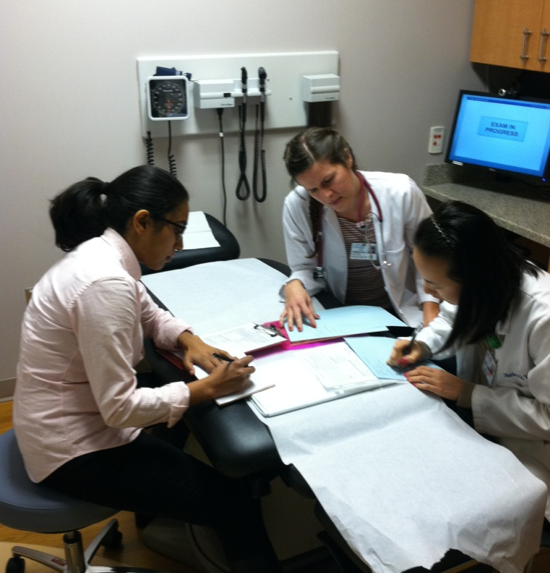
It’s all about the process…
It is about working in a team with the patient to come to a clinical understanding of what might be going on and formulating a team plan.
It is also an opportunity to teach your team members about your profession.

Slide 6
Overview of ISPE
Team Huddle to strategize (12 min)
Team Member Encounters (10 min each)
Team Huddle for Team Care Plan (12 min)
Debrief Session with Faculty (35 min)
Share Plan with Patient (14 min)
Peer Evaluation and Survey (14 min)

Slide 7
ISPE Format – Initial Huddle
You will have a 12 min “team huddle” to review the Patient Presenting Information.
During your Huddle, your team will:
  Review the case and have each team member talk about their role and how they would approach the case from their profession.
  Consider the unique skills that each team member brings to the encounter and areas of overlap
  Strategize and divide up tasks
  Decide the order for the team interviews
Notes:
The case is sufficiently complex that you should think about dividing up tasks during the visit so that you have adequate time to address all the issues in the case.

Slide 8
ISPE Format: Patient Encounter
For the patient encounter, each team member will have 10 minutes with the patient. In that time you may perform any combination of History, PE and sharing information/education.
Team members observe the encounter quietly in the room. ISPE faculty facilitators observe remotely.
Team huddles and all encounters are recorded.
The Standardized Patient (SP) will submit an evaluation for each team member based on the encounter.

Slide 9
No invasive procedures
For dental students, there will be no intraoral examination or periodontal probing. You can perform an external exam. The dental findings are available on the CLE and you should review them prior to the exercise. In addition, you will receive a folder with the dental findings at the beginning of the huddle.
Notes:
MOVE THIS SLIDE EARLIER

Slide 10
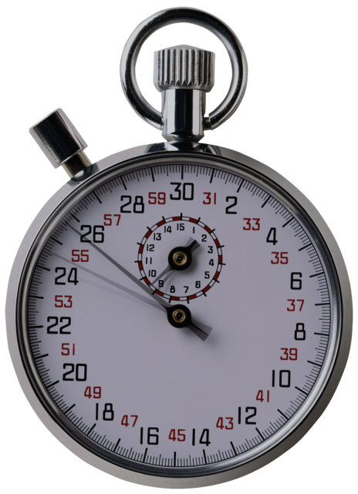
Encounter Timing
Listen to the intercom announcements about when to start your encounters.
You will hear a warning when there are 5 minutes remaining.
At 10 minutes, you will be notified that “time is up”; your team must promptly leave the room.
Your team will have ~5 minutes between each encounter to further discuss the case quietly in the hallway.
Notes:
When you are told to leave the room you must leave the room immediately.

Slide 11
Keep in mind….
The SP is aware that he is being seen by a team of providers.
You can refer to and build on information that other team members gathered.
Some teams may have more than 1 participant from a profession – divide up the tasks.
Notes:
The standardized patient is aware that s(he) is being seen by a team of providers. All patient encounters should be dealt with as if they were being seen in an outpatient clinic. We recognize that the encounter and room set-up may be different than how you would typically practice. The goal of this exercise isn’t to perfectly recreate how you see patients in your setting, but to provide you with as authentic experience as possible, working in an interprofessional team. Treat the standardized patient as a real patient and the encounter as real clinical encounter. You may use information gathered from watching previous students interact with this patient. You do not need to repeat portions of the history or physical exam performed by other team members unless you need additional information or if you believe your profession’s approach is unique.

Slide 12
Team Care Plan/Team Huddle
After your entire team completes your encounters, you will have a 12 min huddle to:
  Decide which issues that your team wants to address
  Construct a care plan
  Decide how you want to share with the patient
14 min to share your assessment and plan with the patient. You will need to prioritize!

Slide 13
Debrief Session
Two teams will join together for a 35 minute Debrief Session with a faculty member to discuss the interprofessional aspects of the experience.
Thereafter, please exit the Kanbar Center so the next session may begin on time.
Notes:
The hall proctor will guide you to the room for the debrief session.

Slide 14
Peer Evaluation and Survey
Proceed to the Library to immediately fill out the online Peer Evaluation and Survey. The link will be available on the ISPE 2018 CLE page.

Slide 15
To Recap…
Team Huddle to strategize (12 min)
Team Member Encounters (10 min each)
Team Huddle for Team Care Plan (12 min)
Debrief Session with Faculty (35 min)
Share Plan with Patient (14 min)
Peer Evaluation and Survey (14 min)

Slide 16
All you need is….
Your stethoscope (if you normally use one in your profession) and a pen or pencil.
Dress professionally for the exercise. Wear a white coat if you have one.
All equipment and supplies are provided in each exam room.
DO NOT use personal props in the rooms although you may use them outside of the room.
Notes:
During the hallway team discussions between each encounter, you may elect to use information databases on your smart phone. (Faculty, this has been a bit inconsistent during the encounters; we should reach consensus on this)

Slide 17
Peer-Peer Feedback
At the end of the debrief session, you will provide confidential written feedback to each team member on patient communication and teamwork skills
Specific areas to comment on around teamwork include:
  Contributions to the team
  Creating room for the input of others
  Active listening
  Flexibility in problem solving
  Focus and organization when communicating
  Respect for others’ opinions

Slide 18
Peer-to-Peer Feedback
Please keep in mind that the most helpful feedback is:
  Specific
  Directed at behaviors that can be changed
Consider using a Feedback framework:
  Keep – “I really liked the way you…”
  Start – “One suggestion for the future that you may want to incorporate…”
  Stop – “Avoid using medical jargon…”

Slide 19
Evaluation
The SP will evaluate your patient-provider communication skills.
You will complete a brief survey about the ISPE experience.
A link to your SP evaluation, Peer feedback, and the digitally recorded video of your patient encounter will be emailed to you within 1 month of the ISPE.
Notes:
Please access your UCSF EMAIL account directly. If you are forwarding your UCSF email account to another email service (including g-mail) the reporting system will not forward your scores.
We recommend that you review your video with a faculty member from your profession to get the maximum value from this experience. Any of the ISPE faculty present at your session would be happy to review your video with you at a later date.

Slide 20
After Your ISPE Experience
You will also be able to access a referenced sample team plan to review medical issues in the case.
We recommend that you review your SP encounter with a faculty member.

Slide 21

Final Words
We hope that this is a positive interprofessional learning experience for you!

