Slide 1
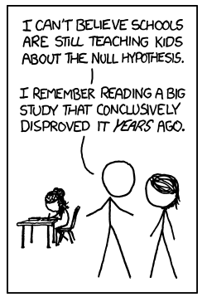
Statistical Inference:
Pitfalls of hypothesis testing

Slide 2
Pitfall 1: over-emphasis on p-values
Statistical significance does not guarantee clinical significance.
Example: a study of about 60,000 heart attack patients found that those admitted to the hospital on weekdays had a significantly longer hospital stay than those admitted to the hospital on weekends (p<.03), but the magnitude of the difference was too small to be important: 7.4 days (weekday admits) vs. 7.2 days (weekend admits).
Ref: Kostis et al. N Engl J Med 2007;356:1099-109.

Slide 3
Pitfall 1: over-emphasis on p-values
Clinically unimportant effects may be statistically significant if a study is large (and therefore, has a small standard error and extreme precision).
Pay attention to effect sizes and confidence intervals (see end of this lecture).

Slide 4
Pitfall 2: association does not equal causation
Statistical significance does not imply a cause-effect relationship.
Interpret results in the context of the study design.

Slide 5
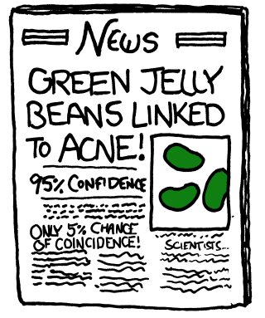

Slide 6
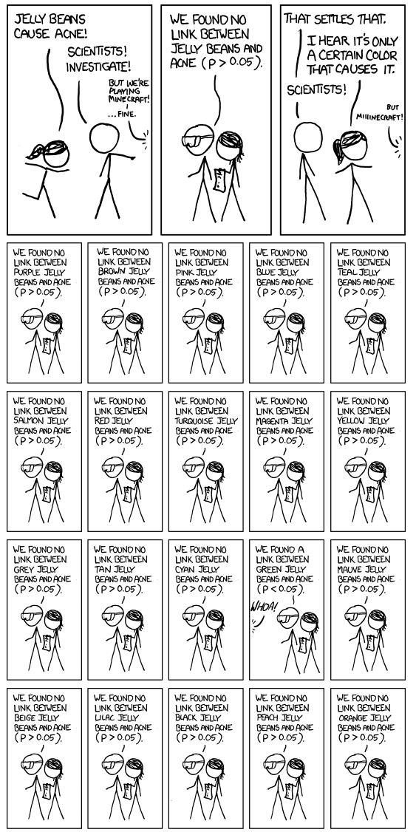

Slide 7
Pitfall 3: data dredging/multiple testing
In 1980, researchers at Duke randomized 1073 heart disease patients into two groups, but treated the groups equally.
Not surprisingly, there was no difference in survival.
Then they divided the patients into 18 subgroups based on prognostic factors.
In a subgroup of 397 patients (with three-vessel disease and an abnormal left ventricular contraction) survival of those in “group 1” was significantly different from survival of those in “group 2” (p<.025).
How could this be since there was no treatment?
(Lee et al. “Clinical judgment and statistics: lessons from a simulated randomized trial in coronary artery disease,” Circulation, 61: 508-515, 1980.)

Slide 8
Pitfall 3: multiple testing
The difference resulted from the combined effect of small imbalances in the subgroups
A significance level of 0.05 means that your false positive rate for one test is 5%.
If you run more than one test, your false positive rate will be higher than 5%.
If we compare survival of “treatment” and “control” within each of 18 subgroups, that’s 18 comparisons.
If these comparisons were independent, the chance of at least one false positive would be…

Slide 9
Sources of multiple testing
Pitfall 3: multiple testing
Source | Example
Multiple outcomes | a cohort study looking at the incidence of breast cancer, colon cancer, and lung cancer
Multiple predictors | an observational study with 40 dietary predictors or a trial with 4 randomization groups
Subgroup analyses | a randomized trial that tests the efficacy of an intervention in 20 subgroups based on prognostic factors
Multiple definitions for the exposures and outcomes | an observational study where the data analyst tests multiple different definitions for “moderate drinking” (e.g., 5 drinks per week, 1 drink per day, 1-2 drinks per day, etc.)
Multiple time points for the outcome (repeated measures) | a study where a walking test is administered at 1 months, 3 months, 6 months, and 1 year
Multiple looks at the data during sequential interim monitoring | a 2-year randomized trial where the efficacy of the treatment is evaluated by a Data Safety and Monitoring Board at 6 months, 1 year, and 18 months

Slide 10
Results from a previous Class survey…
Pitfall 3: multiple testing
The research question was to test whether or not being born on odd or even days predicted anything about your future.
I discovered that people who born on odd days wake up later and drink more alcohol than people born on even days; they also have a trend of doing more homework (p=.04, p<.01, p=.09).
Those born on odd days wake up 42 minutes later (7:48 vs. 7:06 am); drink 2.6 more drinks per week (1.1 vs. 3.7); and do 8 more hours of homework (22 hrs/week vs. 14).

Slide 11
Results from Class survey…
Pitfall 3: multiple testing
I can see the NEJM article title now…
“Being born on odd days predisposes you to alcoholism and laziness, but makes you a better med student.”
Assuming that this difference can’t be explained by astrology, it’s obviously an artifact!
What’s going on?…

Slide 12
Results from Class survey…
Pitfall 3: multiple testing
After the odd/even day question, I asked 25 other questions…
I ran 25 statistical tests (comparing the outcome variable between odd-day born people and even-day born people).
So, there was a high chance of finding at least one false positive!

Slide 13
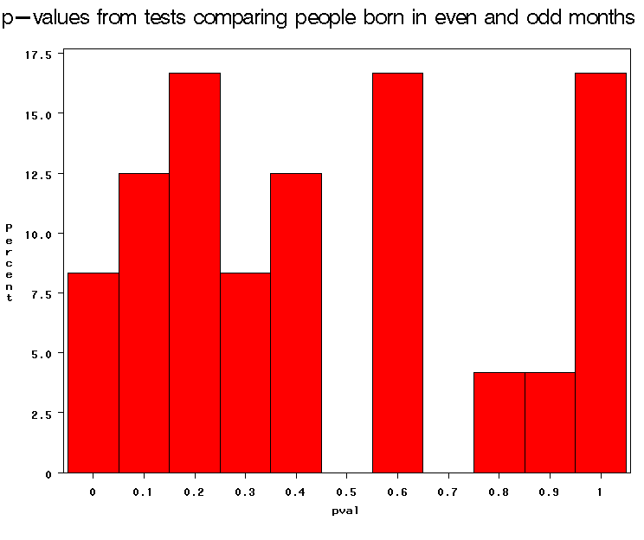
P-value distribution for the 25 tests…
Pitfall 3: multiple testing
Recall: Under the null hypothesis of no associations (which we’ll assume is true here!), p-values follow a uniform distribution…
Significant p-values!

Slide 14
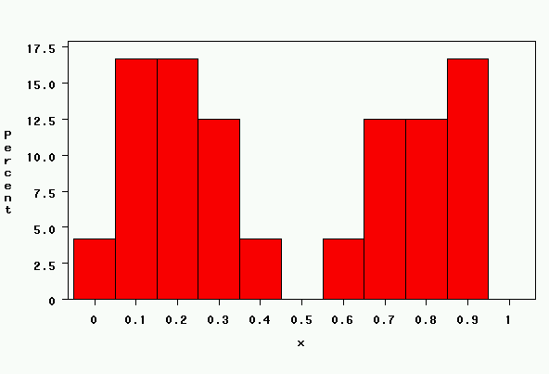
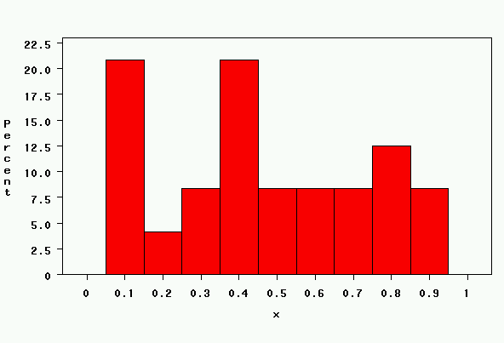
Compare with…
Pitfall 3: multiple testing
Next, I generated 25 “p-values” from a random number generator (uniform distribution). These were the results from two runs…

Slide 15
In the medical literature…
Pitfall 3: multiple testing
Hypothetical example:
  Researchers wanted to compare nutrient intakes between women who had fractured and women who had not fractured.
  They used a food-frequency questionnaire and a food diary to capture food intake.
  From these two instruments, they calculated daily intakes of all the vitamins, minerals, macronutrients, antioxidants, etc.
  Then they compared fracturers to non-fracturers on all nutrients from both questionnaires.
  They found a statistically significant difference in vitamin K between the two groups (p<.05) on the FFQ only.
  They had a lovely explanation of the role of vitamin K in injury repair, bone, clotting, etc.

Slide 16
Factors indicative of chance findings
Pitfall 3: multiple testing
1. Analyses are exploratory. | The authors have mined the data for associations rather than testing a limited number of a priori hypotheses.
2. Many tests have been performed, but only a few p-values are “significant”. | If there are no associations present, .05*k significant p-values (p<.05) are expected to arise just by chance, where k is the number of tests run.
3. The “significant” p-values are modest in size. | The closer a p-value is to .05, the more likely it is a chance finding. According to one estimate*, about 1 in 2 p-values <.05 is a false positive, 1 in 6 p-values <.01 is a false positive, and 1 in 56 p-values <.0001 is a false positive.
4. The pattern of effect sizes is inconsistent. | If the same association has been evaluated in multiple ways, an inconsistent pattern of effect sizes (e.g., risk ratios both above and below 1) is indicative of chance.
5. The p-values are not adjusted for multiple comparisons | Adjustment for multiple comparisons can help control the study-wide false positive rate.
*Sterne JA and Smith GD. Sifting through the evidence—what’s wrong with significance tests? BMJ 2001; 322: 226-31.

Slide 17
Pitfall 4: high type II error (low power)
Lack of statistical significance is not proof of the absence of an effect.
Example: A study of 36 postmenopausal women failed to find a significant relationship between hormone replacement therapy and prevention of vertebral fracture. The odds ratio and 95% CI were: 0.38 (0.12, 1.19), indicating a potentially meaningful clinical effect. Failure to find an effect may have been due to insufficient statistical power for this endpoint.
…the absence of evidence is not evidence of absence
Ref: Wimalawansa et al. Am J Med 1998, 104:219-226.

Slide 18
Pitfall 4: high type II error (low power)
Results that are not statistically significant should not be interpreted as "evidence of no effect,” but as “no evidence of effect”
Studies may miss effects if they are insufficiently powered (lack precision).
Design adequately powered studies and report approximate study power if results are null.

Slide 19
Pitfall 5: the fallacy of comparing statistical significance
Presence of statistical significance in one group and lack of statistical significance in another group ≠ a significant difference between the groups.
Example: In a placebo-controlled randomized trial of DHA oil for eczema, researchers found a statistically significant improvement in the DHA group but not the placebo group. The abstract reports: “DHA, but not the control treatment, resulted in a significant clinical improvement of atopic eczema.” However, the improvement in the treatment group was not significantly better than the improvement in the placebo group, so this is actually a null result.

Slide 20
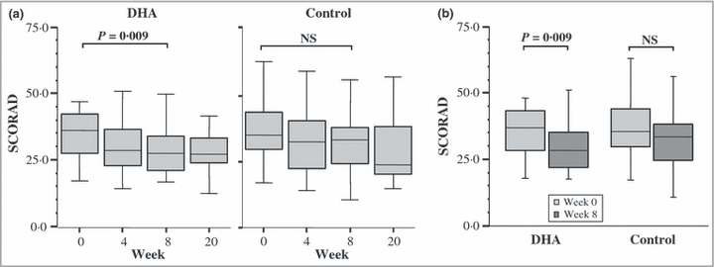
Misleading significance comparisons
Pitfall 5: the fallacy of comparing statistical significance
Figure 3 from: Koch C, Dölle S, Metzger M, Rasche C, Jungclas H, Rühl R, Renz H, Worm M. Docosahexaenoic acid (DHA) supplementation in atopic eczema: a randomized, double-blind, controlled trial. Br J Dermatol. 2008 Apr;158(4):786-92. Epub 2008 Jan 30.

Slide 21
How about Confidence Intervals
A plausible range of values for a population parameter.
The precision of an estimate.(When sampling variability is high, the confidence interval will be wide to reflect the uncertainty of the observation.)
Statistical significance (if the 95% CI does not cross the null value, it is significant at .05)
Notes:
It turns out that if you were to go out and sample many, many times, most sample statistics that you could calculate would follow a normal distribution.
What are the 2 parameters (from last time) that define any normal distribution?
Remember that a normal curve is characterized by two parameters, a mean and a variability (SD)
What do you think the mean value of a sample statistic would be? The standard deviation?
Remember standard deviation is natural variability of the population
Standard error can be standard error of the mean or standard error of the odds ratio or standard error of the difference of 2 means, etc. The standard error of any sample statistic.

Slide 22
The true meaning of a confidence interval
Suppose we do a computer simulation:
Imagine that the true population value is 10.
Have the computer take 50 samples of the same size from the same population and calculate the 95% confidence interval for each sample.
Here are the results…

Slide 23
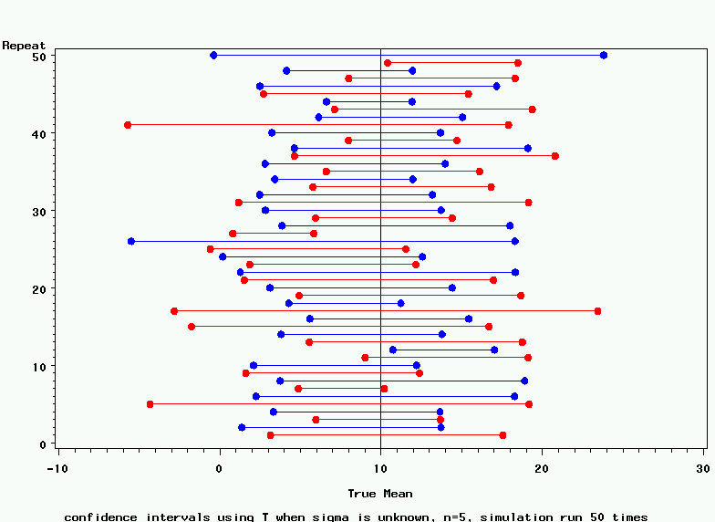
95% Confidence Intervals

Slide 24
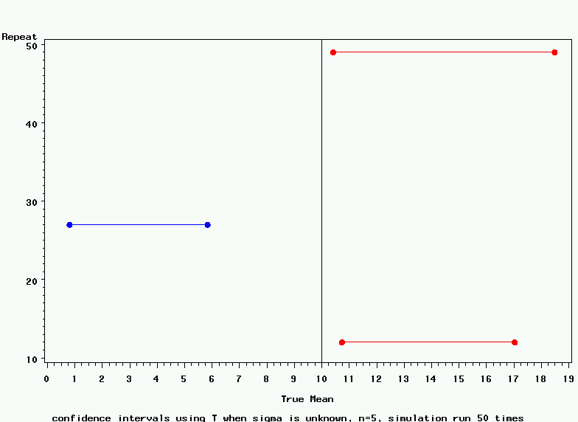
95% Confidence Intervals
3 misses=6% error rate
For a 95% confidence interval, you can be 95% confident that you captured the true population value.

Slide 25
Odds Ratio example: Antidepressant use & Heart Disease
Heart disease case
Control
antidepressants
217
871
No exposure
716
4645
1.62 (1.41 to 1.99)
“Antidepressants as risk factor for ischaemic heart disease: case-control study in primary care”; Hippisley-Cox et al. BMJ 2001; 323; 666-669

Slide 26
IS this a statistically significant association? YES
Null value of the odds ratio(no difference between cases and controls)
95% confidence interval
0.80 1.0 1.20 1.40 1.60 1.80 2.0 2.20
Null hypothesis: Proportions of cases who used antidepressants equals proportion of controls who used antidepressants.
Alternative hypothesis: Proportions are not equal.
P-value < .05

Slide 27
Multiple Comparisons: How do we control the family-wise error rate
Least Significant Differences (LSD)
Tukey (or Tukey-Kramer)
Bonferroni
Scheffe
False Discovery Rate

Slide 28
Multiple Comparisons: controlling the family-wise error rate
Least Significant Differences (LSD)
Has high power but less control of the family-wise error rate
Least conservative when doing many (>6) comparisons

Slide 29
Multiple Comparisons: controlling the family-wise error rate
Tukey (or Tukey-Kramer)
Specifies the exact significance level for your comparisons
Controls the α level but less power

Slide 30

Multiple Comparisons: controlling the family-wise error rate
Bonferroni
Divide your level of α by the number of tests.
Very conservative EXCEPT if you have the exact number of comparisons you are going to do.
Assumes all null hypotheses are true

Slide 31
Multiple Comparisons: controlling the family-wise error rate
Scheffe
Most conservative
Always controls for all possible comparisons
OK if you are ‘data snooping’

Slide 32
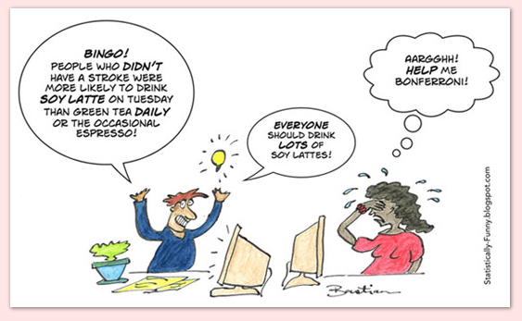
Multiple Comparisons: controlling the family-wise error rate
False Discovery Rate
A new (and rational) approach
Gives the expected proportion of Type 1 errors among the rejected hypotheses
Basic idea is ranking the p-values and only choosing the top X comparisons

Slide 33
Using ANOVA instead of t-tests
The extension of the t-test to several independent groups is called analysis of variance or ANOVA
Why is it called analysis of variance?
  Even though your hypothesis is about the means, the test actually compares the variability between groups to the variability within groups
The null hypothesis is:
  H₀: all equal means μ₁=μ₂=μ₃=…
  The alternative H_{A} is that at least one of the means differs from the others

Slide 34
ANOVA assumptions
The underlying data came from normally distributed populations
The observations are independent
The variance within each group over all groups (homoscedasticity)

Slide 35
ANOVA example
Does CD4 count at time of testing differ by drinking category?
*Using vct_baseline_biostat200_v1.dta **
hist cd4count, by(lastalc_3) percent fcolor(blue)

Slide 36
graph box cd4count, over(lastalc_3)

Slide 37
ANOVA example
tabstat cd4count, by(lastalc_3) s(n mean sd min median max)
Summary for variables: cd4count
by categories of: lastalc_3 (RECODE of lastalc (E1. Last time took alcohol))
lastalc_3 | N mean sd min p50 max
-----------------+------------------------------------------------------------
Never | 373 317.1475 253.4013 1 283 1601
>1 year ago | 180 305.3778 266.9453 2 248.5 1461
Within the past | 441 349.8662 273.9364 3 308 1932
year |
-----------------+------------------------------------------------------------
Total | 994 329.5322 265.5157 1 285 1932
------------------------------------------------------------------------------

Slide 38
ANOVA example
CD4 count, by alcohol consumption category
oneway var groupvar
. oneway cd4count lastalc_3
Analysis of Variance
Source SS df MS F Prob > F
------------------------------------------------------------------------
Between groups 344571.162 2 172285.581 2.45 0.0867
Within groups 69660550.3 991 70293.189
------------------------------------------------------------------------
Total 70005121.5 993 70498.6118
Bartlett's test for equal variances: chi2(2) = 2.4514 Prob>chi2 = 0.294
k=3 groups, n=994 total observations. n-k=991
. di Ftail(2,991,2.45)
.08681613
Notes:
SS stands for sum of squares
MS stands for mean squares
Bartlett’s test tests for non-equal variances and also departure from normality

Slide 39
ANOVA (t-test vs. F test)
Note that if you only have two groups, you will reach the same conclusion running an ANOVA as you would with a t-test
The test statistic F_{stat} will equal (t_{stat})²
. oneway cd4count sex
Analysis of Variance
Source SS df MS F Prob > F
------------------------------------------------------------------------
Between groups 521674.035 1 521674.035 7.41 0.0066
Within groups 70155332.6 997 70366.4319
------------------------------------------------------------------------
Total 70677006.7 998 70818.6439
Bartlett's test for equal variances: chi2(1) = 0.0472 Prob>chi2 = 0.828

Slide 40
ANOVA (t-test vs. F test)
. ttest cd4count, by(sex)
Two-sample t test with equal variances
------------------------------------------------------------------------------
Group | Obs Mean Std. Err. Std. Dev. [95% Conf. Interval]
---------+--------------------------------------------------------------------
1 | 374 299.6925 13.6301 263.5935 272.891 326.494
2 | 625 346.9104 10.65047 266.2618 325.9953 367.8255
---------+--------------------------------------------------------------------
combined | 999 329.2332 8.419592 266.1177 312.7111 345.7554
---------+--------------------------------------------------------------------
diff | -47.21789 17.34162 -81.24815 -13.18762
------------------------------------------------------------------------------
diff = mean(1) - mean(2) t = -2.7228
Ho: diff = 0 degrees of freedom = 997
Ha: diff < 0 Ha: diff != 0 Ha: diff > 0
Pr(T < t) = 0.0033 Pr(|T| > |t|) = 0.0066 Pr(T > t) = 0.9967

Slide 41
Statistical hypothesis tests
Data and comparison type | Alternative hypotheses | Test and Stata command
Numerical; One mean | H_{a}: μ≠ μ_{a} (two-sided) H_{a}: μ>μ_{a} or μ<μ_{a} (one-sided) | Z or t-test ttest var1=hypoth val.*
Numerical; Two means, paired data | H_{a}: μ₁ ≠ μ₂ (two-sided) H_{a}: μ₁ >μ₂ or μ<μ_{a} (one-sided) | Paired t-test ttest var1=var2*
Numerical; Two means, independent data | H_{a}: μ₁ ≠ μ₂ (two-sided) H_{a}: μ₁ >μ₂ or μ<μ_{a} (one-sided) | T-test (equal or unequal variance) ttest var1, by(byvar) unequal
Numerical, Two or more means, independent data | H_{a}: μ₁ ≠ μ₂ or μ₁ ≠ μ₃ or μ₂ ≠ μ₃ etc. | ANOVA oneway var1 byvar
Dichotomous; One proportion | H_{a}: p≠ p_{a} (two-sided) H_{a}: p>p_{a} or p<p_{a} (one-sided) | Proportion test prtest var1=hypoth value* bitest var1=hypoth value
Dichotomous; two proportions | H_{a}: p₁≠ p₂ (two-sided) H_{a}: p₁ >p₂ (one-sided) | Proportion test (z-test) prtest var1, by(byvar)
Categorical by categorical (nxk)
Notes:
*Can be written ==

