Slide 1
NonParametric Methods
Introduction
Ranks & Median
Paired Wilcoxon Signed Rank
Mann-Whitney test (or Wilcoxon Rank Sum test)
Others….

Slide 2
Parametric vs. non-parametric (distribution free) tests
Non parametric tests:
  No normality requirement
  Do require that the underlying distributions being compared have the same basic shape
  Ranks are less sensitive to outliers and to measurement error
If the underlying distributions are approximately normal, then the parametric tests are more powerful

Slide 3
What are nonparametric tests?
‘Parametric’ tests involve estimating parameters such as the mean, and assume that distribution of sample means are ‘normally’ distributed
Often data does not follow a Normal distribution e.g.; number of cigarettes smoked, health costs, etc.
Positively skewed distributions

Slide 4
A positively skewed distribution
What are nonparametric tests?

Slide 5
What are nonparametric tests?
‘Non-parametric’ tests were developed for these situations where fewer assumptions have to be made
Sometimes called Distribution-free tests
NP tests STILL have assumptions but are less stringent and less powerful
NP tests can be applied to Normal data but parametric tests have greater power IF the assumptions are met

Slide 6
Ranks
Practical differences between parametric and NP are that NP methods use the ranks of values rather than the actual values
e.g.
1,2,3,4,5,7,13,22,38,45 - actual
1,2,3,4,5,6, 7, 8, 9,10 - rank

Slide 7
Median
The median is the value above and below which 50% of the data lie.
If the data is ranked in order, it is the middle value
In symmetric distributions the mean and median are the same
In skewed distributions, median more appropriate

Slide 8
T-test
T-test used to test whether the mean of a sample is sig different from a hypothesised sample mean
T-test relies on the sample being drawn from a normally distributed population
If sample not Normal then use the Wilcoxon Signed Rank Test as an alternative

Slide 9

Wilcoxon tests
Frank Wilcoxon was Chemist at American Cyanamid who wanted to develop a test similar to t-test but without requirement of Normal distribution
Presented paper in 1945
Wilcoxon Signed Rank Ξ nonparametric paired t-test
Wilcoxon Rank Sum Ξ nonparametric independent t-test

Slide 10
Wilcoxon Signed Rank Test
NP test relating to the median as measure of central tendency
The ranks of the absolute differences between the data and the hypothesised median calculated
The ranks for the negative and the positive differences are then summed separately (W₋ and W₊ resp.)
The minimum of these is the test statistic, W

Slide 11
Wilcoxon Signed Rank Test Normal Approximation
As the number of ranks (n) becomes larger, the distribution of W becomes approximately Normal
Generally, if n>20
Mean W=n(n+1)/4
Variance W=n(n+1)(2n+1)/24
Z=(W-mean W)/SD(W)

Slide 12
Wilcoxon Signed Rank Test Assumptions
Population should be approximately symmetrical but need not be Normal
Results must be classified as either being greater than or less than the median ie exclude results=median
Can be used for small or large samples
Similar to the paired t-test
In Stata signrank x₁₌x₂

Slide 13
Paired samples t-test
Disadvantage: Assumes data are a random sample from a population which is Normally distributed
Advantage: Uses all detail of the available data, and if the data are normally distributed it is the most powerful test

Slide 14
The Wilcoxon Signed Rank Test for Paired Comparisons
Disadvantage: Throws away the real values and only the sign (+ or -) of any change is analysed
Advantage: Easy to carry out and data can be analysed from any distribution or population

Slide 15
Paired And Unpaired Comparisons
If you have the same sample measured on two separate occasions then this is a paired comparison
Two independent samples is not a paired comparison
Different samples which are ‘matched’ by age and gender are paired

Slide 16
The Wilcoxon Signed Rank Test for Paired Comparisons
Similar calculation to the Wilcoxon Signed Rank test, only the differences in the paired results are ranked
A group of 10 patients with chronic anxiety receive sessions of cognitive therapy. Quality of Life scores are measured before and after therapy.

Slide 17
Wilcoxon Signed Rank Test example
QoL Score
x1 | x2 | Diff | Rank | -/+
6 | 9 | 3 | 5.5 | +
5 | 12 | 7 | 10 | +
3 | 9 | 6 | 9 | +
4 | 9 | 5 | 8 | +
2 | 3 | 1 | 4 | +
1 | 1 | 0 | 3 | tied
3 | 2 | -1 | 2 | -
8 | 12 | 4 | 7 | +
6 | 9 | 3 | 5.5 | +
12 | 10 | -2 | 1 | -
W₋ = 2
W₊ = 7
1 tied

Slide 18
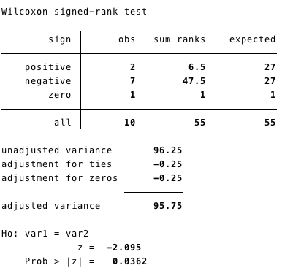
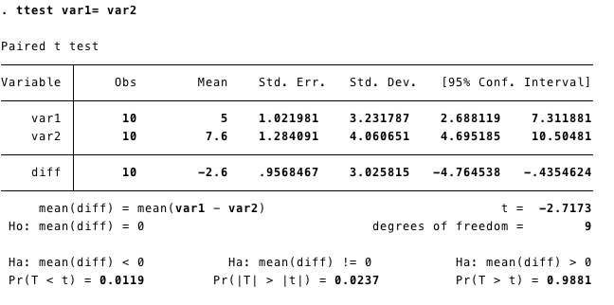
Stata output: Wilcoxon vs. t-test

Slide 19
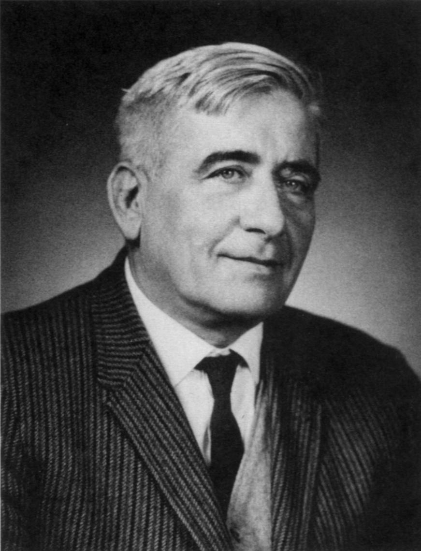
Mann-Whitney test Ξ Wilcoxon Rank Sum
Henry Mann, professor of mathematics @ Ohio State & Don Whitney was his student
Used when we want to compare two unrelated or INDEPENDENT groups
For parametric data you would use the unpaired (independent) samples t-test
The assumptions of the t-test were:
    The distribution of the measure in each group is approx Normally distributed
    The variances are similar
HB Mann

Slide 20
Wilcoxon (Mann-Whitney) Rank Sum Example
The following data shows the number of alcohol units per week collected in a survey:
Men (n=13): 0,0,1,5,10,30,45,5,5,1,0,0,0
Women (n=14): 0,0,0,0,1,5,4,1,0,0,3,20,0,0
Is the amount greater in men compared to women?
STATA: ranksum Alcohol, by(Gender)

Slide 21
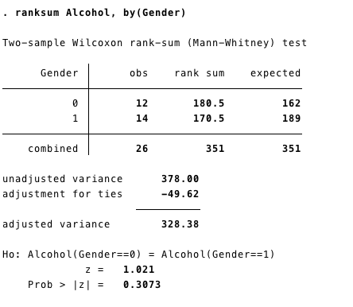
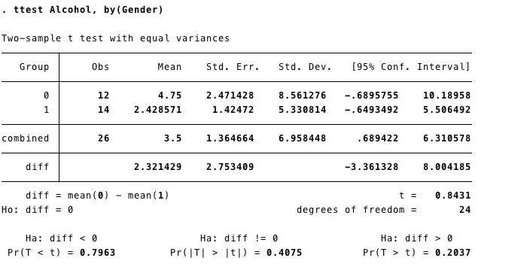
Stata output: Wilcoxon vs. t-test

Slide 22
Other NonParametric Methods
Sign Test
Median Test
Chi-squared test – next week!!
Spearman’s Rank Correlation Coefficient – in 2 weeks when we tackle regression!

