Slide 1
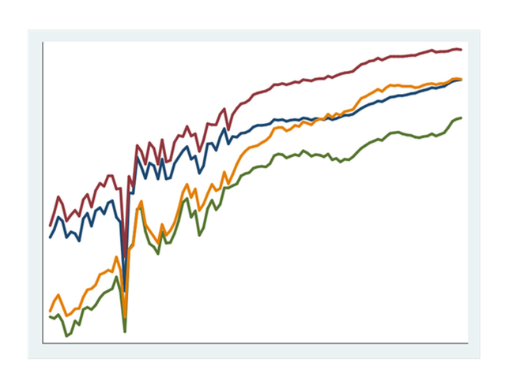
Stata Graphics

Slide 2
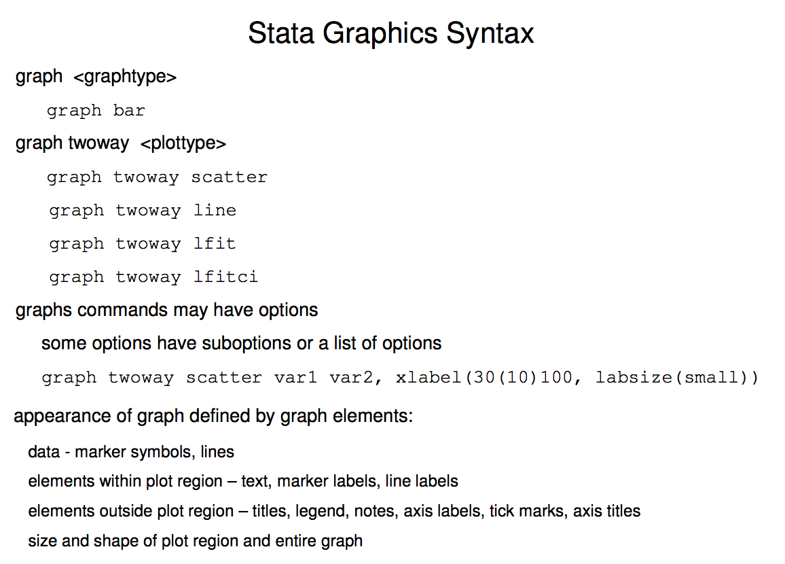

Slide 3
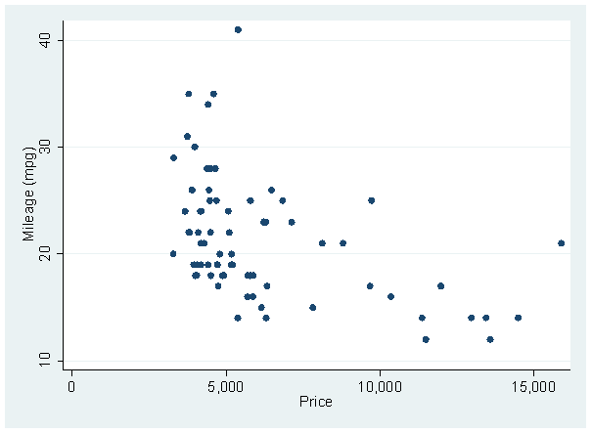
Intro To Graphing In Stata
“graph” is often optional. So is “twoway” in this case.
Note: Nearly all graphing commands start with “graph”, and “twoway” is a large family of graphs.

Slide 4
Creating Multiple Graphs with “by():”
Note that the value label is displayed above the graphs, and the variable label is displayed in the bottom right hand corner.

Slide 5
Overlaying “twoway” graphs
The || tells Stata to put the second graph on top of the first one – order matters! You don’t need to type “twoway” twice; it applies to both.
This is another way of writing the command – it doesn’t matter which one you use.

Slide 6
Twoway density
Syntax
  graph twoway (plot1, opts) (plot2, opts), opts
One plot
  kdensity Duration
Two plots overlaid
  twoway ( kdensity Duration if Group ==0, lcolor(blue) )
  ( kdensity Duration if Group ==1, lcolor(red) )
Side by side
  twoway ( kdensity Duration), by(Group)
Notes:
Show distributions, density best
Area scales to 1, can compare groups of different size.

Slide 7
kdensity Duration
  twoway ( kdensity Duration if Group ==0, lcolor(blue) ) ( kdensity Duration if Group ==1, lcolor(red) )

Slide 8
  twoway ( kdensity Duration), by(Group)

Slide 9
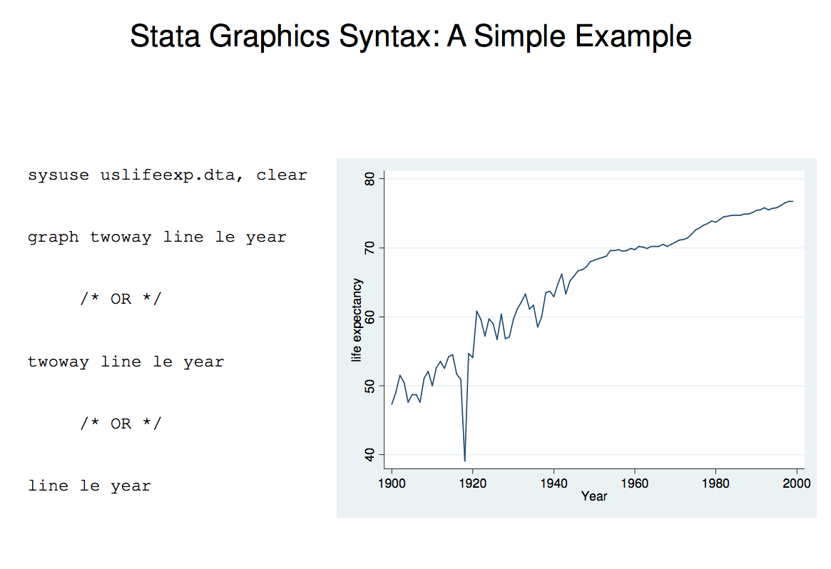

Slide 10
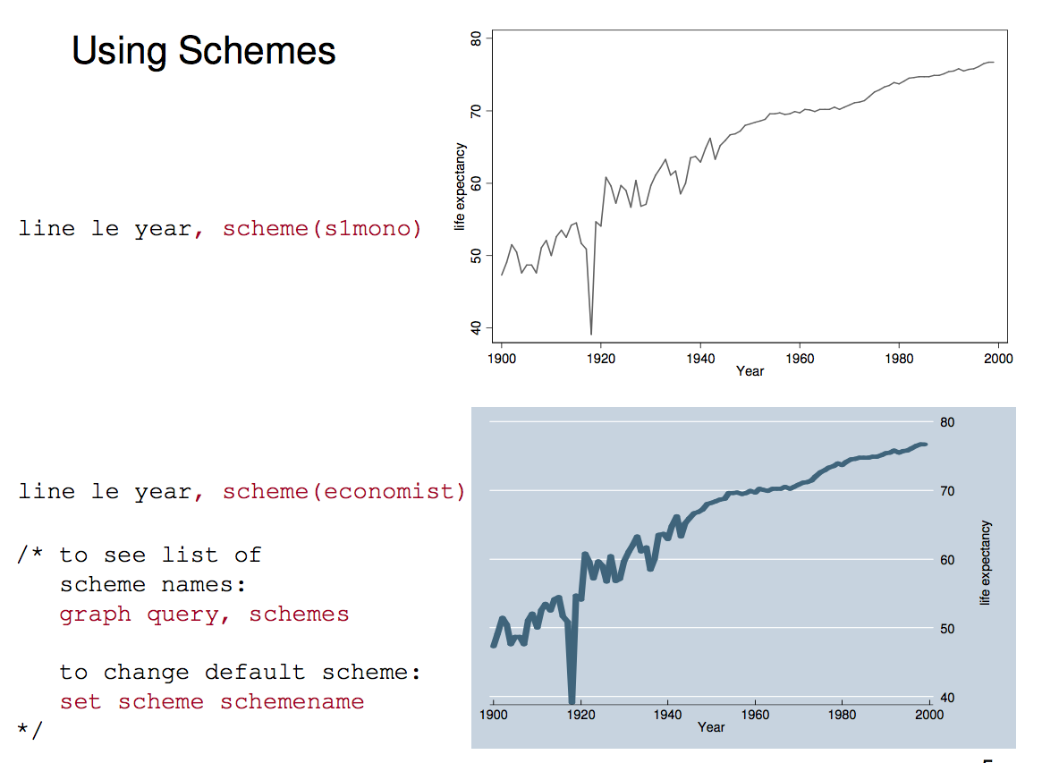

Slide 11
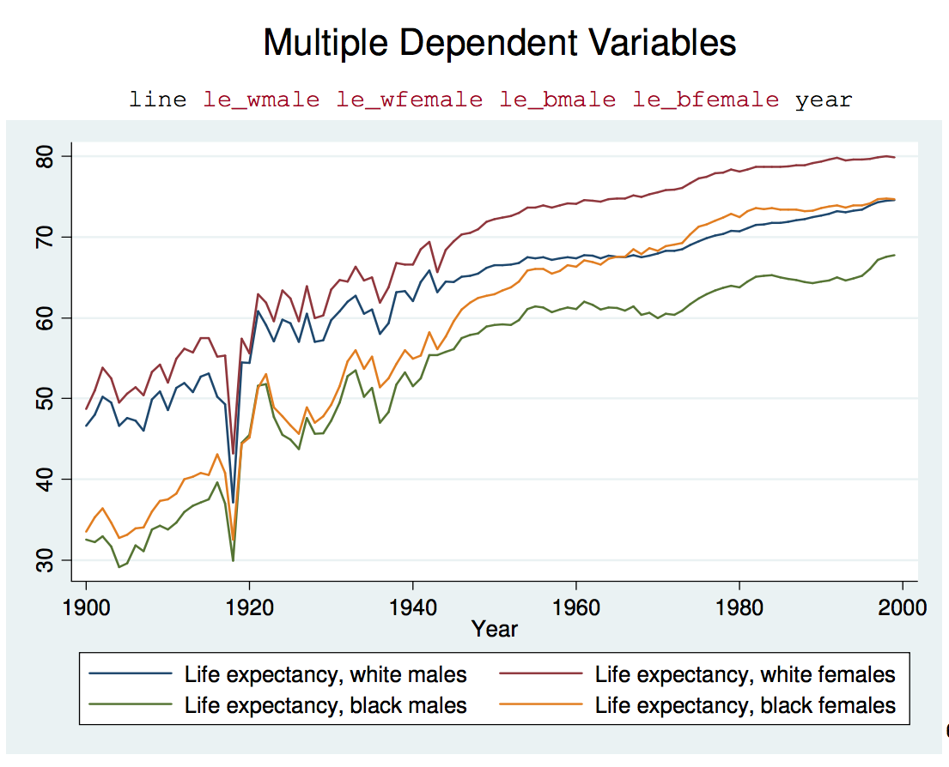

Slide 12
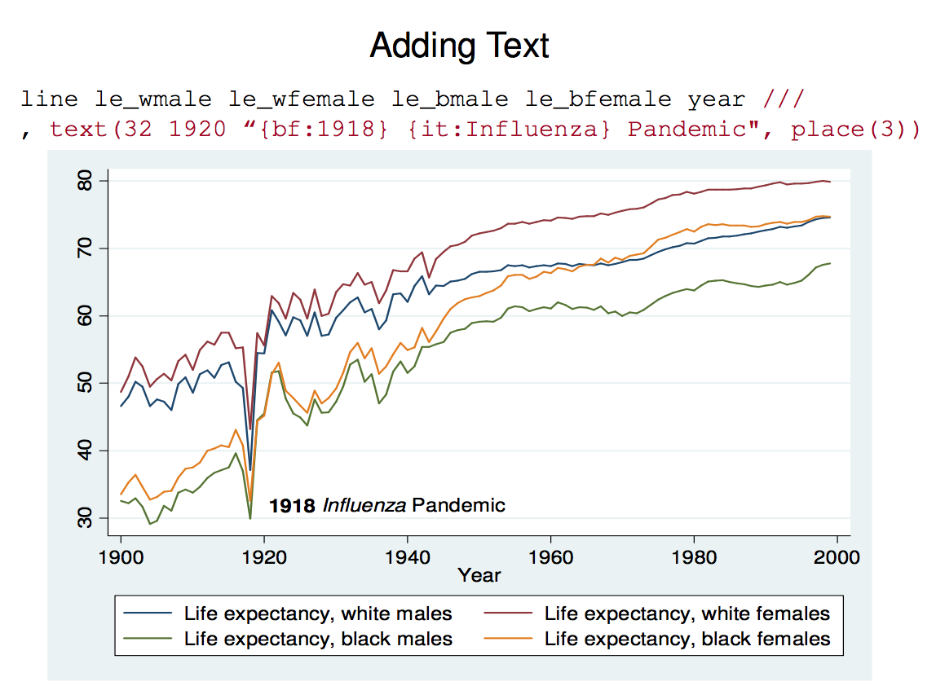

Slide 13
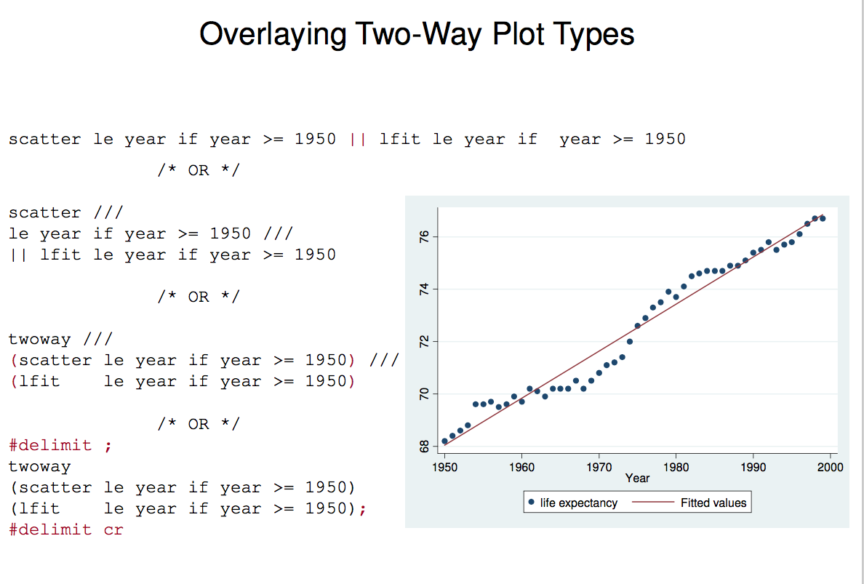

Slide 14
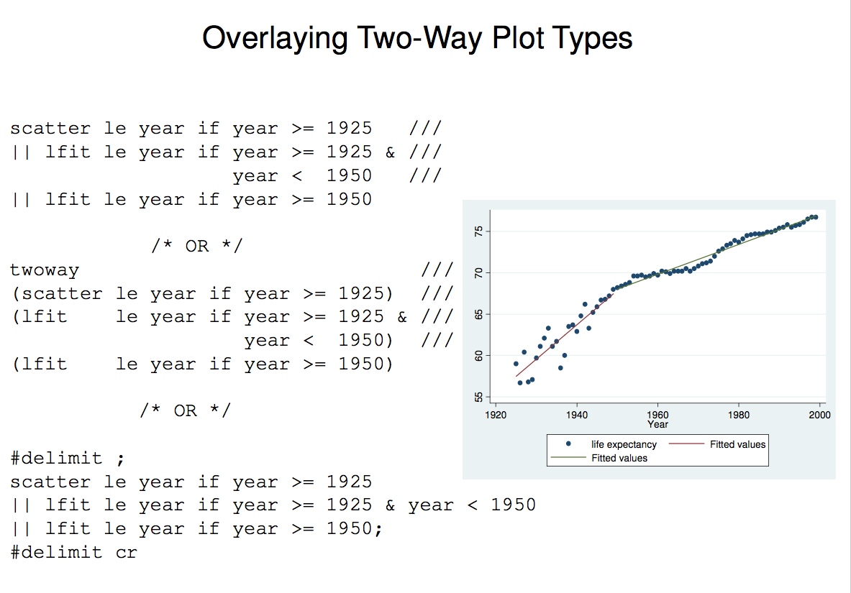

Slide 15
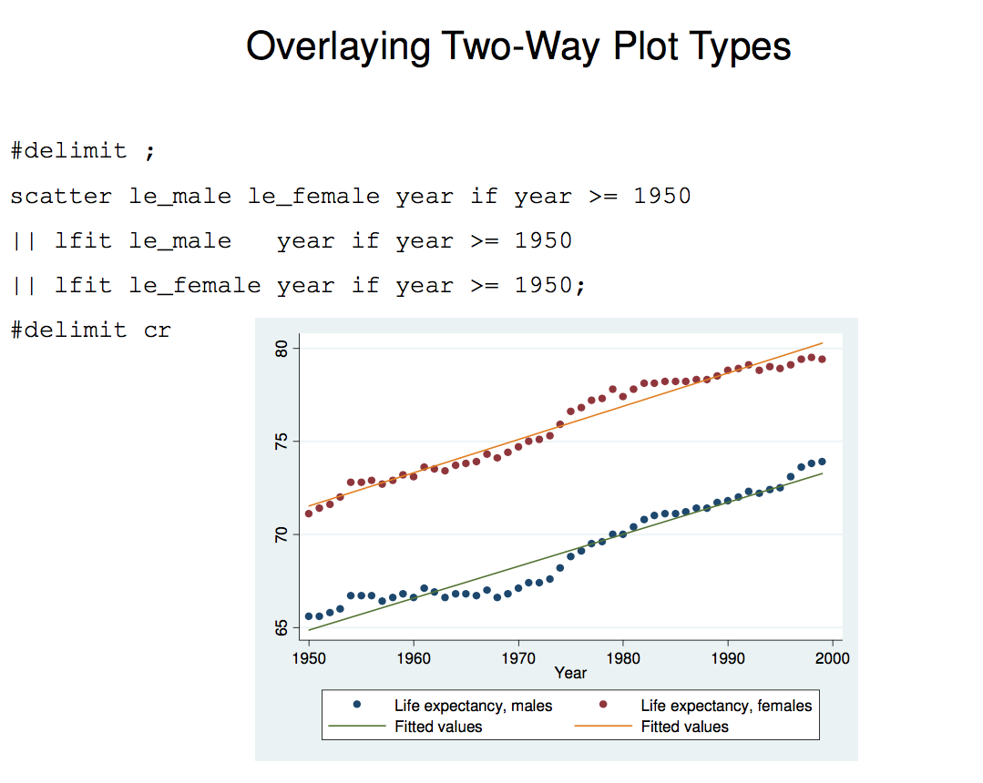

Slide 16
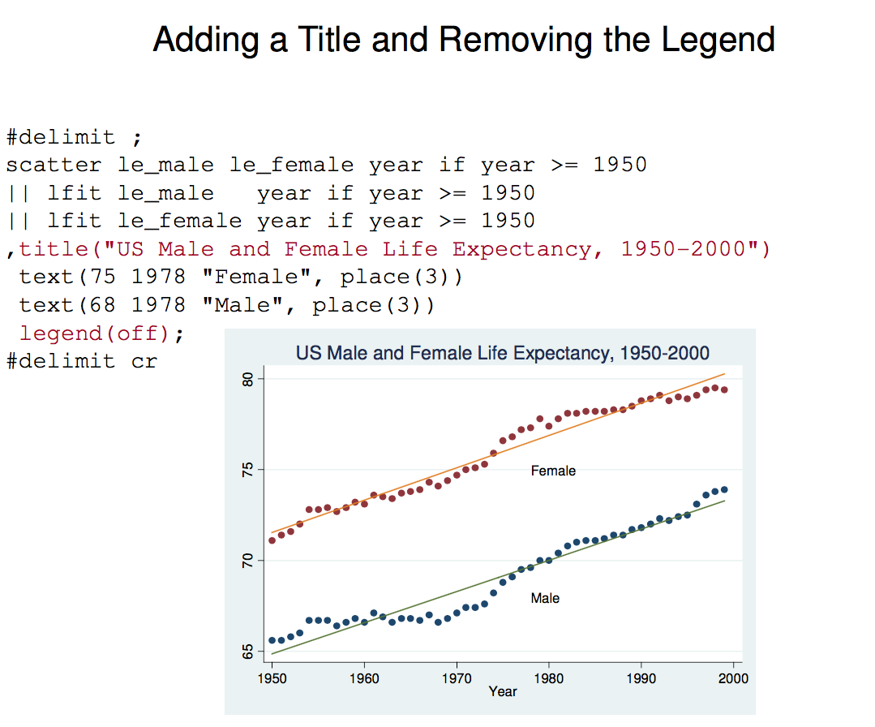

Slide 17
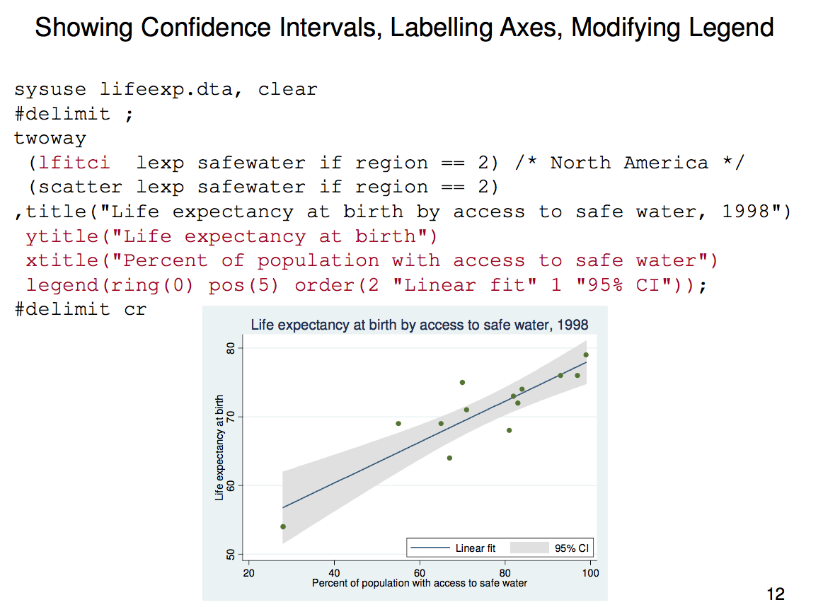

Slide 18
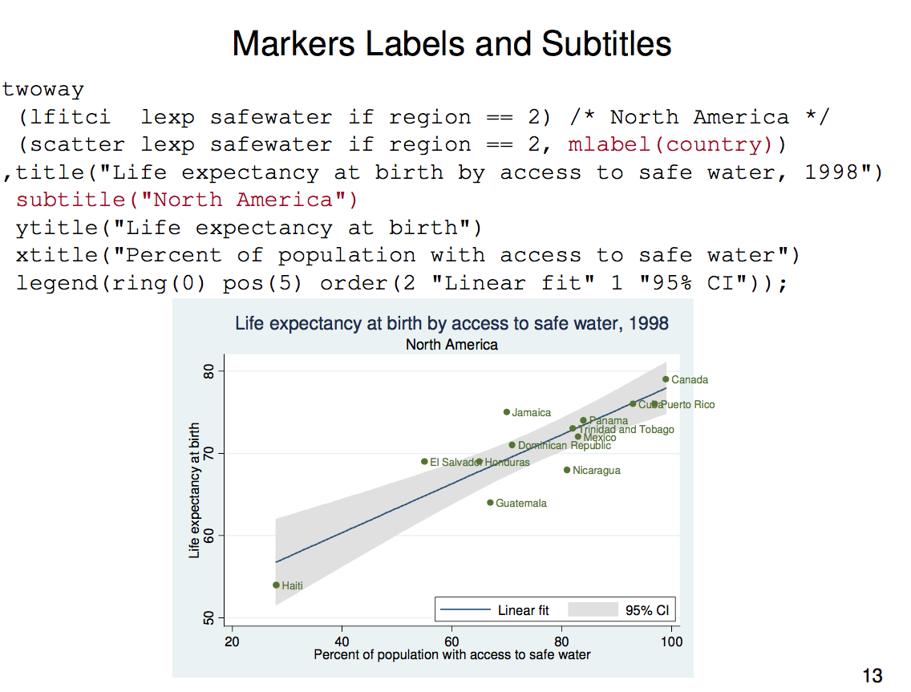

Slide 19
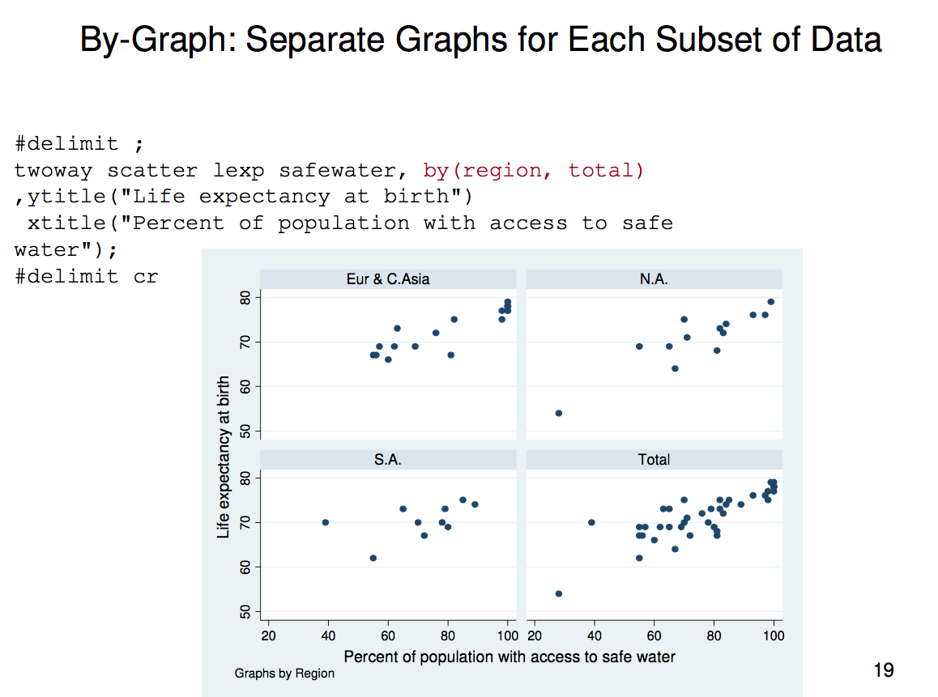

Slide 20
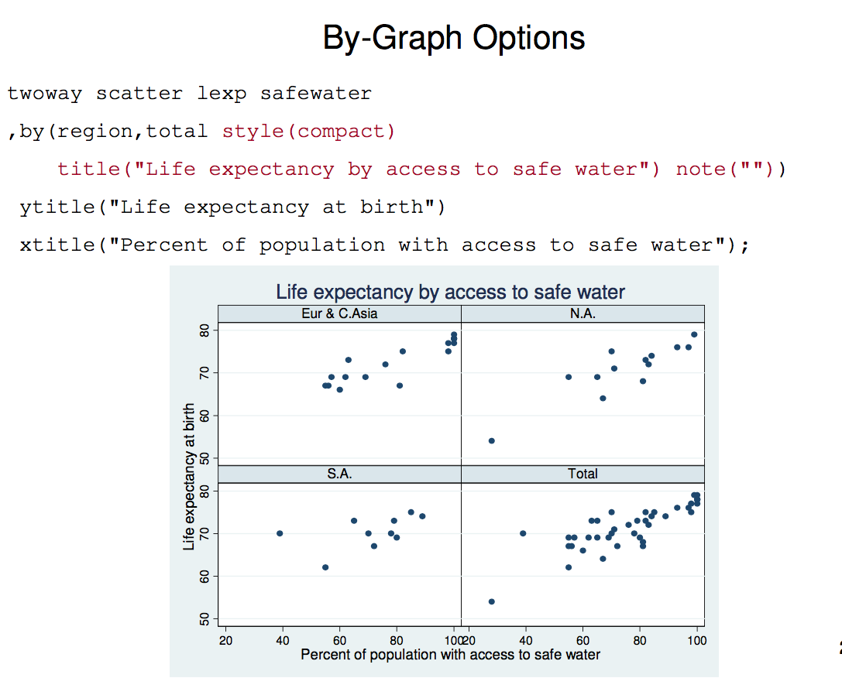

Slide 21
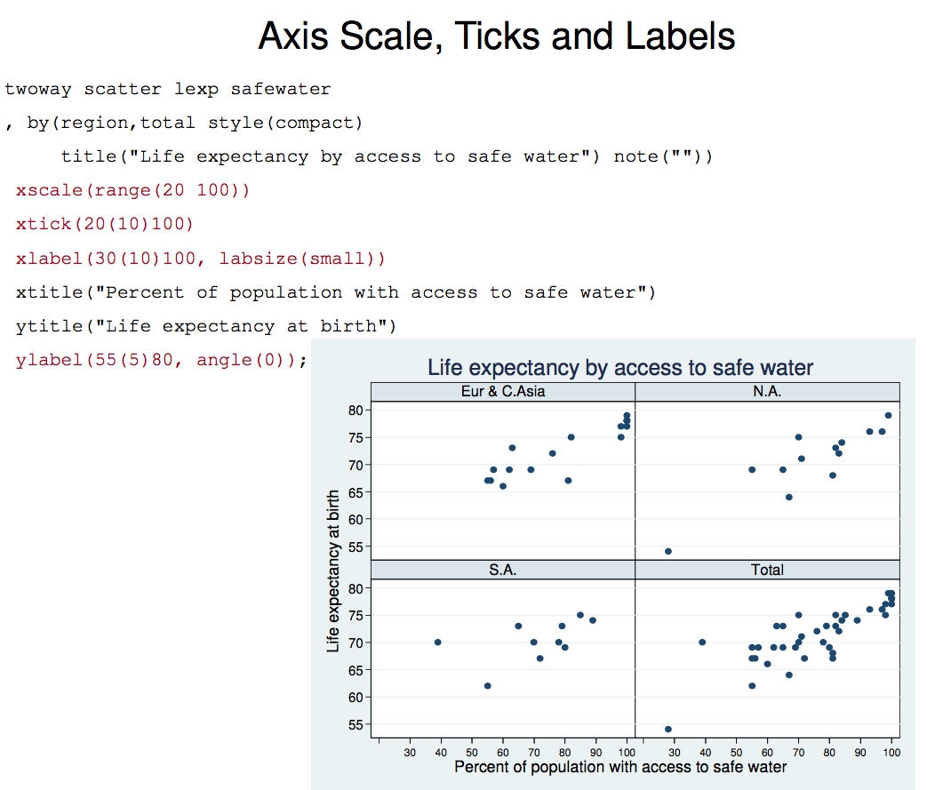

Slide 22
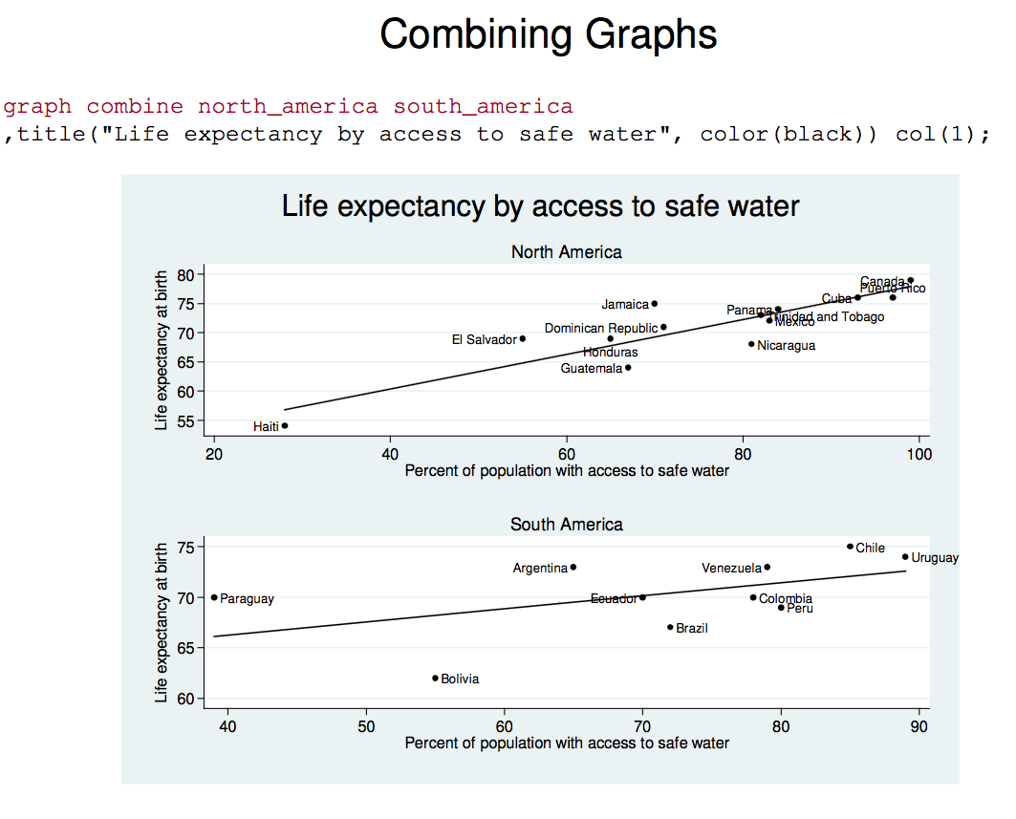

Slide 23
More Graphs
Graph matrix is a great alternative to a correlation matrix to investigate relationships between variables

Slide 24
Example using gestational data
Univariate
Density
  kdensity weight
Boxplot
  graph hbox weight

Slide 25
Bivariate
Scatter
  scatter weight gest
Notes:
Use scatter and density for
Cont Y and cat x
Cont Y and cont x
Binary Y and cont x

Slide 26
Scatter and density plots for many types of data

Slide 27
Continuous by 3 categories
Is birth weight the same over parity?
Scatterplot
Density plot
Equal means? Linear effect?
Outliers?
Equal variances?
Notes:
Scatter to see linear/no-linear effect, look for outliers
Density to see equal variance

Slide 28
Continuous by 3 categories
Scatterplot
twoway (scatter weight parity3) (fpfitci weight parity3) (lfit weight parity3), legend(off)
Look for:
  Outliers (all analyses)
  Non-linear effects (regression)
Notes:
Scatter to see linear/no-linear effect, look for outliers
Density to see equal variance

Slide 29
Continuous by continuous
twoway (scatter weight gest) (fpfitci weight gest) (lfit weight gest)
Look for:
  Main effect (line)
  Non-linearity (smooth)
  outliers
Notes:
Fpfitci plus lfit gives a graphic test of linearity

Slide 30
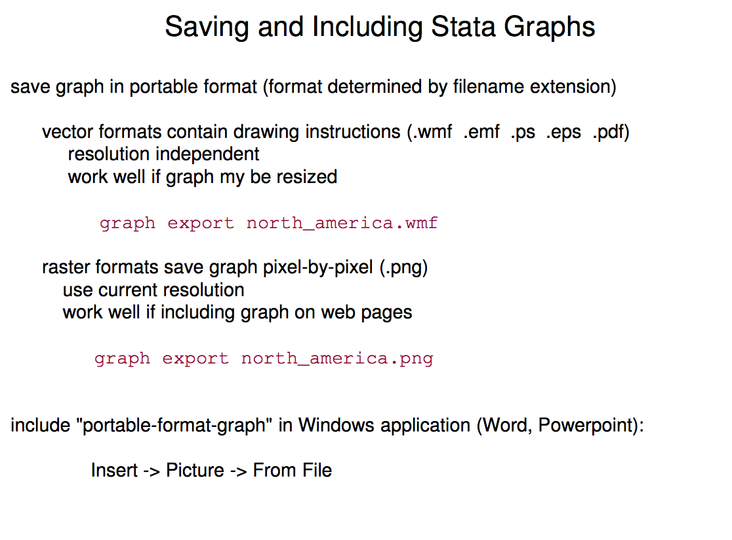
Useful Stata graph websites: https://www.ssc.wisc.edu/sscc/pubs/4-24.htm https://www.stata.com/support/faqs/graphics/gph/stata-graphs/

