Slide 1

Biostatistics 200
Basically, cleaning your data & then Basic Probability

Slide 2
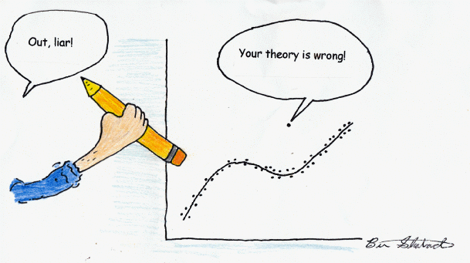
Data Cleaning
Always necessary with a new dataset
Assume your data has errors
Tables & summary statistics & graphs can help
Outliers – extreme values
Always keep a copy of the original data

Slide 3
Data Cleaning
Data cleaning tasks
  Examine your data
  Fill in missing values (many ways)
  Identify outliers and smooth out noisy data
  Correct inconsistent data
    Noisy
    Redundant
    Biased
*2005 Leff, Allen et al, Inside Employment Interventions: Effects of Job Development and Job Support on Competitive Employment of Persons with Severe Mental Illness, Psychiatric Services, 56(10): 1237-1245.

Slide 4
Outliers – what do we do?
Is the value physically possible?
Yes, keep them but…
Do sensitivity analyses (what’s that?)
Which summary measures are they likely to affect?
Trimmed means, robust statistics, transformations

Slide 5
And now for something almost completely different…quantifying your data very simply
You want to start looking at your data…
But first, remember that being a statistician means you never have to be certain…
Probability! Playing Rock Paper Scissors
http://www.essentially.net/rsp/

Slide 6
Probability:
It’s all about uncertainty
Probability is the numerical measure of the likelihood that an event will occur
Value is between 0 and 1
Sum of the probabilities of all mutually exclusive and collectively exhaustive events is 1

Slide 7
Events & Sample Spaces
Simple event
  Outcome from a sample space with one characteristic
  e.g.: Probability of a baby’s delivery @ 36 weeks
Joint event
  Involves two outcomes simultaneously
  e.g.: Probability of delivery @ 36 weeks AND the baby is female
The collection of all possible outcomes is the Sample space

Slide 8
Defining an Event
The result of an experiment or observation
The event occurs or does not occur
We all apply probability to events and we want to estimate the relative frequency that an event occurs over a large number of identical trials
An event can be a disease occurrence or an abnormal lab value

Slide 9
Definition of Probability
If an experiment is repeated n times under essentially identical conditions, and if the event A occurs m times, then as n increases,
  The ratio m/n approaches a fixed number which is the probability of A occurring
  P(A) = m/n

Slide 10
Probability of an event
Probability of an event is the relative frequency of its occurrence in a large number of trials repeated under the same conditions
  Always lies between 0 and 1 (inclusive)
  Denoted P(A) or P(X) etc…
  Examples?
    Efficacy trials?
    Vaccine trials?

Slide 11
Complement & Universe
The Complement of an event, A^{c} (A complement or ‘Not A’ )
  e.g. if A is the event that a person has a disease, A^{c} is the event that a person does not have a disease
  P(A) = 1 – P(A^{c})
  The universe of all possible events is P(A) + P(A^{c}) and this = 1

Slide 12
Union & Intersection
The Union of 2 events is written A U B
The Union is if either A or B or both occur
The Intersection is when both occur at the same time
P(
P(A U B) is the Union
= P(A) + P(B) – P(A ∩ B)
A ∩ B) is the Intersection
A U B
A
A ∩ B
B
Notes:
Think of union as ‘or’ and intersection as ‘and’ so a union is when either of the outcomes occurs and an intersection is when they both occur together.

Slide 13
Mutually Exclusive
Two events are mutually exclusive if they cannot occur together
  There is no overlap area because both can’t happen together
  The intersection is empty = 0
  e.g. being pregnant & not pregnant
A
B
Notes:
Two events are mutually exclusive when they cannot occur together so the intersection has probability = 0.0

Slide 14
Additive rule
The additive rule of probability can be applied to mutually exclusive events
For 3 events: If none of the events can occur together, then
P(A₁ U A₂ U A₃ ) = P(A₁) + P(A₂) + P(A₃)
For n events:
P(A₁ U A₂ U … U A_{n} ) = P(A₁) + P(A₂) + … P(A_{n})
Notes:
So for a group of families the union of having 1 child OR 2 children OR 3 children = P(1 child) + P(2 children) + P(3 children) because no family can have more than one of these events.

Slide 15
Probability summary
Complement: P(A)= 1-P(A^{c})
Intersection: P( A and B )= P(A ∩ B)
Union: P( A or B or both ) = P(A U B)
  P(A U B) =P(A) + P(B) – P(A ∩ B)
Mutually exclusive events:
P(A ∩ B) = 0
  If A and B are mutually exclusive: then
  P(A U B) = P(A) + P(B) additive rule
Notes:
Note that you need to subtract the intersection of A and B when computing their union because this overlap would be counted twice otherwise.

Slide 16
Simple Probability Example
A is the event that you are exposed to high levels of carbon monoxide (CO)
B is the event that you are exposed to high levels of nitrogen dioxide (NO₂)
In words:
  What is the intersection of A and B
  What is the union of A and B
  Are these events mutually exclusive?
Notes:
Can you be exposed to A and B at the same time? If yes, then there intersection has a probability > 0.0 and they are not mutually exclusive.

Slide 17
Conditional Probability & Rev. Bayes
The probability that an event B will occur given that event A has occurred
  The probability of B given A = P(B|A)
  The probability that it rains given you brought your umbrella
  P(Rain|Have umbrella)
P(B|A) = P(A ∩ B)/P(A)
  The relative size of the probability of the intersection compared to the relative size of P(A)
Notes:
The concept of conditional probability is important in clinical trials and other experimental data. We may want to know the probability of a response given your gender or given the other comorbidities you have.

Slide 18
Frequency tables
Choice of cutpoints for categories
  Even intervals
    E.g. 10-year age categories
  Meaningful cutpoints related to a health outcome or decision
    E.g. CD4<50 cells/mm³
  Equal percentage of the data falling into each category
    Tertiles – 33%
    Quartiles – 25%
    Quantiles – 20%
Notes:
Easy way to calculate conditional probabilities is when we have data in categories and in tables.

Slide 19
Conditional Probability Example
Very often used in diagnostic tests
P(HIV|given a positive test) OR P(Positive test|HIV)
  In diagnostic testing these are called positive predictive value and sensitivity
What are each of these telling us about a test?
P(not HIV|negative test) OR P(Negative test|not HIV)
  Negative predictive value and specificity
Notes:
Diagnostic tests are mostly judged by their sensitivity and specificity. Even if a test has high sensitivity and specificity it may not be useful to use it on the population because you would still see many false positives.

Slide 20
Conditional Probability Example: The dangers of screening everyone
P(Disease) = 0.001 or 100 of 100,000
P(No Disease) = 1 – P(Disease) = 0.999
P(Positive+|Disease) = 0.99 or 99 or 100
P(Negative-|No Disease) = 0.99 or 98,901 of 99,900
Notes:
Diagnostic tests are mostly judged by their sensitivity and specificity. Even if a test has high sensitivity and specificity it may not be useful to use it on the population because you would still see many false positives.

Slide 21
Probability example using a table
2014 State of Michigan Live Births
Probability that a mother’s age is 20-24 = .237
Probability that a mothers age was <=24 =
  .001 + .061 +.237 = .299
  By what probability rule?
Conditional probability: Given that a mother’s age is at least 30, what is the probability that she at least 40?
P(Mother’s age >=30 and Mother’s age >=40) / P(Mother’s age >=30)
  = P(Mother’s age >=40)/P(Mother’s age >=30) (why?)
  = (.024) / ((30165 + 12475 + 2757)/114460)
  = 0.061
Maternal age group | Totals | % of total
<15 | 69 | 0.1%
15 - 19 | 6,968 | 6.1%
20 - 24 | 27,134 | 23.7%
25 - 29 | 34,884 | 30.4%
30 - 34 | 30,165 | 26.4%
35 - 39 | 12,475 | 10.9%
40+ | 2,757 | 2.4%
Total | 114,460 | 100%
Notes:
Given at least 30 = 30-34, 35-39, and 40+. These are mutually exclusive categories.
You could also use the % of total values bearing in mind that these are rounded values and get 0.0604.

Slide 22
Examples of conditional probabilities
Sensitivity & Specificity
Relative risk
  P(disease | exposure) / P(disease | no exposure)
Odds ratios
  (P(exposure | disease) / (1 – P(exposure | disease)) / (P(exposure | no disease) / (1-P(exposure | no disease))
  …we’ll see these later in the course and use them in models as well as separate calculations

Slide 23
Independence
If the occurrence of event B does not depend on the occurrence of event A, B and A are independent.
Then P(B|A)=P(B)
Examples:
  Probability of becoming infected with malaria given that you have 2 sisters = Probability of becoming infected with malaria
  Probability of a (fair) coin toss landing on heads given that the previous coin toss was a heads
  Probability you are a banker and having green eyes
Notes:
Independence does not mean mutually exclusive – you can have both the events or traits but one does not depend on the other.

Slide 24
Multiplicative rule of probability
  The multiplicative rule if you have independence:
  P(A ∩ B) = P(A and B) = P(A) P(B)
Why?
Rearrangement of the definition of conditional probability
P(B|A) = P(B ∩ A)/P(A) = P(A ∩ B) / P(A)
  so P(A ∩ B) = P(A) P(B|A)
If you have independence: P(B|A) = P(B) so you can substitute into above

Slide 25
Independence
Note that independence ≠ mutual exclusivity!
  Mutual exclusivity
    2 events cannot both occur
    P(A ∩ B) =0
  Independence
    2 events do not depend on each other
    P(B|A)=P(B)
    P(A ∩ B) = P(A) P(B|A) = P(A) P(B)

Slide 26
Law of Total Probability
Helpful when you cannot directly calculate a probability and also if dealing with prevalence
Example
  Suppose you know the prevalence of TB in the counties of an area, but you want to know the overall prevalence of TB in the region
  P(TB+ in the region) = P(TB+ ∩ live in county1)+ P(TB+ ∩ live in county2)
  + P(TB+ ∩ live in county3) …etc
  P(TB+ in country 1 | live in county 1)*P(live in county 1)
  + P(TB+ in country 2 | live in county 2)*P(live in county 2)
  + … etc.
  This is a weighted average
  This is very messy to calculate
Notes:
Here we are actually taking the overall probability space and dividing it up into the groups about which we have and producing a weighted average over all the groups.

Slide 27
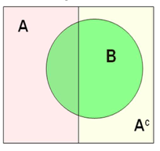
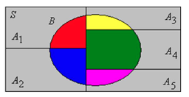
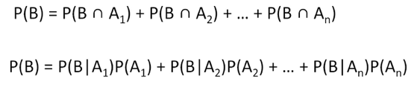
Law of Total Probability Diagram
P(B) = P(A ∩ B) + P(A^{c} ∩ B)

Slide 28
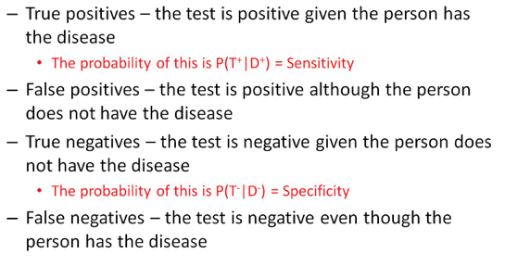
Using Probability: Diagnostic Tests
Notes:
Think of sensitivity as ‘ruling in’ the disease and specificity as ‘ruling out’ the disease

Slide 29
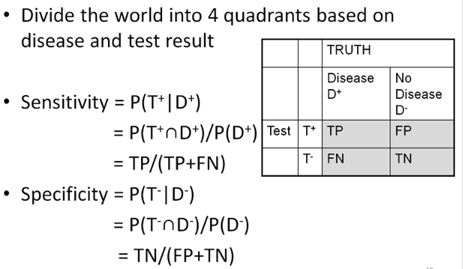
Diagnostic Tests
Other examples similar to this?
Notes:
Instead of testing for a disease we may be looking for a specific genetic variant that responds (or does not respond) to a treatment.

Slide 30
Applying probability to diagnostic test results
Suppose you have a panel of diagnostic tests that give false positive results 2% of the time.
If you test a disease-free patient, what is the probability of the correct negative result?
  This is the _____________
Notes:
If you have 2% false positives then you will have 98% true negatives

Slide 31
Applying probability to diagnostic test results
Suppose you test a disease-free patient twice with this test. What are the probabilities:
Negative Negative
Negative Positive
Positive Negative
Positive Positive
What is the P(1 or more tests are positive)?

Slide 32
Applying probability to diagnostic test results
Suppose you test a disease-free patient twice with this test. What are the probabilities:
Negative Negative = 0.98 * 0.98 = 0.9604
Negative Positive = 0.98 * 0.02 = 0.0196
Positive Negative = 0.02 * 0.98 = 0.0196
Positive Positive = 0.02 * 0.02 = 0.0004
What is the P(1 or more tests are positive)?
  Which of the above tests have at least 1 positive?
  = 0.0196 + 0.0196 + 0.0004 = 0.0396
Notes:
I am assuming here that the tests are independent

Slide 33
Applying probability to diagnostic test results
What is the P(1 or more tests are positive)?
This can also be written as 1 – (Neg Neg)
  0.0396 = 1 – 0.9604
Then the probability of at least 1 false positive if 5 tests are run = 1 – (0.98)⁵ = 0.096
Suppose the false positive probability was = 0.05 then = 1 – (0.95)⁵ = 0.226
Notes:
This shows that multiple testing here quickly shows that you might be mislead by the false positives.

Slide 34
Back to Bayes’ theorem
Suppose there is a super rapid HIV antibody test
  Sensitivity = P(T+|HIV+) = 0.96
  Specificity = P(T-|HIV-) = 0.99
You want to know the probability that someone with a positive test is truly HIV+
  P(HIV+|T+)
  Positive Predictive Value (PPV)
  You also know the P(HIV+) = 0.02 in this region

Slide 35

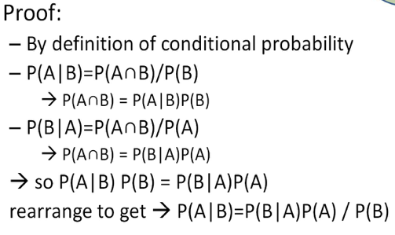
Recall Bayes’ Theorem
Notes:
Bayes theorem is an easy way to rearrange your conditional probabilities when you know P(A|B) and you are interested in P(B|A)

Slide 36
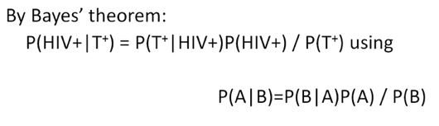
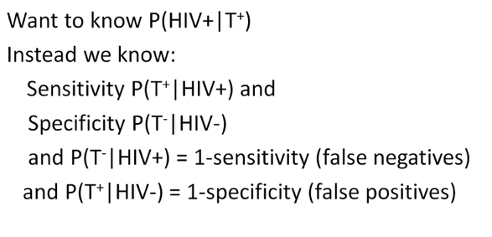
Bayes’ Theorem

Slide 37
Bayes’ theorem
P(HIV+|T⁺) = P(T⁺|HIV+)*P(HIV+) / P(T⁺)
P(T⁺|HIV+) = 0.96 (sensitivity)
P(HIV+) in region of study is = 0.02
P(T⁺) = the overall chances of having a positive test
P(T⁺) = P(T+|HIV+) P(HIV+) + P(T+|HIV-) P(HIV-) by the law of total probability (remember previous slides?)
= 0.96*0.02 + 0.01*0.98 = 0.029
So this gives us:
P(HIV+|T⁺) = 0.96*0.02/0.029 = 0.662

Slide 38
Moving from the prior to posterior probability
The prevalence of HIV+ was assumed to be = 2%
Prior to testing the probability that a randomly selected person is infected with HIV = 0.02
  This is the Prior probabiity
The probability that someone who tests positive is actually infected with HIV = 0.662
  This is the Posterior probability incorporating information gained from doing the test.
Notes:
While knowing that the probability increased 33 fold from 2% to 66% is reassuring but still not a sure thing

Slide 39
Random variables
A random variable is some numerical outcomes of a random process
Toss a coin 10 times
X=# of heads
Toss a coin until a head
X=# of tosses needed

Slide 40
More random variables
Toss a die
X=points showing
Plant 100 seeds of pumpkins
X=% germinating
Test a light bulb
X=lifetime of bulb
Test 20 light bulbs
X=average lifetime of bulbs

Slide 41
Types of random variables
Discrete or Countable valued
Counts, finite-possible values
Continuous
Lifetimes, time

Slide 42
Probability distributions
For a discrete random variable, the probability of for each outcome x to occur, denoted by f(x), with properties
0 ≤f(x)≤ 1, Σf(x)=1

Slide 43
Example
Roll a die, X=# showing
x 1 2 3 4 5 6
f(x) 1/6 1/6 1/6 1/6 1/6 1/6
y 1 2 3 4 5 6
f(y) 1/6 1/6 1/6 1/6 1/6 1/6

Slide 44
Binomial distribution
In many applied problems, we are interested in the probability that an event will occur x times out of n.

Slide 45
Binomial distribution
Roll a die 3 times. X=# of sixes.
S=a six, N=not a six
No six: (x=0)
NNN → (5/6)(5/6)(5/6)
One six: (x=1)
NNS → (5/6)(5/6)(1/6)
NSN → same
SNN → same
Two sixes: (x=2)
NSS → (5/6)(1/6)(1/6)
SNS → same
SSN → same
Three sixes: (x=3)
SSS →(1/6)(1/6)(1/6)

Slide 46
Binomial distribution
x f(x)
0 (5/6)³
1 3(1/6)(5/6)²
2 3(1/6)²(5/6)
3 (1/6)³

Slide 47
Binomial distribution
Roll a die 20 times. X=# of 6’s,
n=20, p=1/6
Flip a fair coin 10 times. X=# of heads

Slide 48
Hypergeometric distribution
Sampling with replacement
If we sample with replacement and the trials are all independent, the binomial distribution applies.
Sampling without replacement
If we sample without replacement, a different probability distribution applies.

Slide 49
Example
Hypergeometric distribution
52 cards. Pick n=5.
X=# of aces,
then a=4, b=48

Slide 50
Poisson distribution
Events happen independently in time or space with, on average, λ events per unit time or space.
Waiting for BART
λ=1 train per 10 minutes
Radioactive decay
λ=2 particles per minute
Lightening strikes
λ=0.01 strikes per acre

Slide 51
For next time
Review today’s slides for Lab Thursday
Lab this Thursday – Probability, identifying outliers
Lab 2 & Homework 1 are posted on the CLE
Next week’s material will cover important probability distributions: Binomial, Normal etc

