Slide 1
“Pain Management and Therapeutic Regimens for Pain and Palliative Care Patients”
Charity Hale, Pharm.D.
October 2019

Slide 2
Objectives
Didactic Portion
Review mechanisms for pain and therapy options for each of those mechanisms
Discuss medication pearls for specific agents
Discuss pain management assessment and monitoring
Case Based Activity
Identify correct mechanisms of pain
Develop an appropriate therapeutic pain management regimen
Provide pain a management assessment
Will provide appropriate monitoring strategies

Slide 3
Abbreviations
SNRI (serotonin norepinephrine reuptake inhibitor)
TCA (tricyclic antidepressants)
CrCL (creatinine clearance)
NG tube (nasogastric tube)
GT (gastrointestinal tube)
HD (hemodialysis)
PCA (patient controlled analgesia)
HD (hemodialysis)
IR (immediate release)
ER (extended release)
GI (gastrointestinal)
CV (cardiovascular)
BG (blood glucose)
OT (occupational therapists)
PT (physical therapists)
DVT (deep vein thrombosis)
PE (pulmonary embolism)
S/p (status post)

Slide 4
What are the different mechanisms of pain?

Slide 5
Neuropathic Pain
Antidepressants
  SNRIs
  TCAs
Gabapentinoids
  Gabapentin
  Pregabalin
NMDA Receptor Antagonists
  Ketamine
  Methadone
Anti Inflammatories
  NSAIDs
  Steroids
LidoDerm
Burning
Numbness
Tingling
Radiating
Pins/Needles

Slide 6
Pearls for SNRIs
Cymbalta (duloxetine)
Avoid if CrCl is less than 30 mL/min
Avoid in hepatic dysfunction
Effexor (venlafaxine)
Can be used in renal dysfunction including HD (adjust dose)
Can be used in hepatic dysfunction (adjust dose)
Available in ER and IR formulations
IR can be administered via NG tube, GT, etc
Monitor for headaches and hypertension

Slide 7
Pearls for TCAs
Nortriptyline
Initial dose: 10 to 25 mg po qhs
May increase as tolerated as soon as every 3 days up to 150 mg/day
Older class / dirty side effect profile
TCA: anticholinergic side effects (dizziness, drowsiness, constipation, etc)
TCA: cardiac side effects (QTc prolongation)

Slide 8
Pearls for Gabapentinoids
Neurontin (gabapentin) and Lyrica (pregabalin)
Can use in renal dysfunction (dose adjust)
Monitor for dizziness, drowsiness, and edema
Increase risk of suicidal thoughts
  Use with caution/monitor or avoid in patients with history of suicide ideation
Neurontin (gabapentin)
Typically less expensive than Lyrica
Lyrica (pregabalin)
Can achieve steady state and effective doses faster with Lyrica than with gabapentin
  Lyrica: may take 24-48 hours to achieve good analgesic benefit
  Gabapentin: start the dose low and increase slowly to improve side effect tolerability (may take weeks to achieve appropriate analgesic benefit)

Slide 9
Pearls for NMDA Receptor Antagonists
NMDA Receptor
When the NMDA receptor is stimulated by glutamate, there is an upregulation of the NMDA receptor
This is clinically important because it increases pain sensitivity
NMDA Receptor Antagonist (in brief)
Methadone and Ketamine
Work by decreasing pain sensitivity and opioid tolerance
If patient becomes drowsy after starting ketamine, hold or reduce the opioid dose before holding ketamine dose

Slide 10
Pearls for NMDA Receptor Antagonists
Ketamine
Commercially available in the IV formulation
Compounded/mixed into multiple formulations: topicals, SL/ PO including ketamine gummies
Can cause psychotomimetic side effects (hallucinations, vivid dreams, etc)
Can give a benzodiazepine to prevent these side effects (eg clonazepam 0.25 mg po BID)
Methadone
Formulations: PO/SL and IV
Prolongs QTc
  Monitor QTc
  IV formulation has a preservative that also prolongs the QTc
Good bioavailability and absorption
  Good option for patients who have poor GI absorption
Cheap/ less expensive option
Lot of drug-drug interactions
  If a patient is on methadone, check for drug interactions prior to starting a new medication or discontinuing a current medication

Slide 11
Pearls for NSAIDs and Steroids
Inflammation, edema, and tumors can press against nerves creating neuropathic pain that responds well to anti-inflammatory agents
Refer to therapies for inflammatory pain

Slide 12
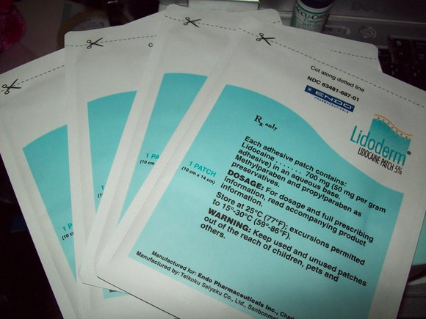
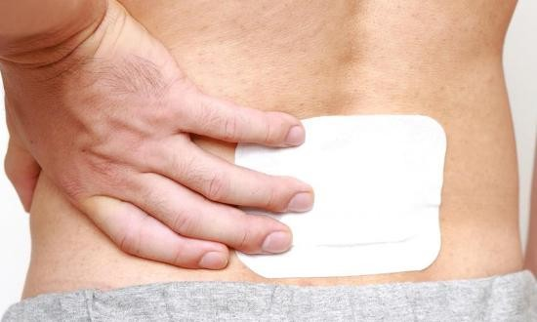
Pearls for LidoDerm
Unlike most patches, LidoDerm patches can be cut and applied to patient
May apply up to 3 patches topically to the most affected area
May leave on up to 12 hours per 24 hours then remove
Indicated for postherpetic neuralgia and minor localized pain

Slide 13
Inflammatory Pain
NSAIDs
Steroids
Throbbing
Pulsating
Stabbing
Stiffness

Slide 14
NSAIDs: What are Common Agents and Toxicities?
Common agents
Ibuprofen (PO and IV)
Naproxen
Toradol ​(PO and IV)
  Not to exceed 5 days of therapy due to risk of GI complications
Diclofenac (PO and topical)
Celecoxib
  No effects on platelets (COX-2 Selective)
  Contraindicated with Sulfa allergy
Common Toxicities
Cardiovascular
Renal
Gastrointestinal (GI)

Slide 15
NSAIDs: CV and Renal Toxicities
NSAIDs increase the risk of:​
Cardiovascular thrombotic events​
Myocardial infarction​
Stroke ​
Contraindicated following coronary artery bypass graft surgery (box warning)​
Naproxen and celecoxib appear to be the safest options from a CV standpoint
Renal toxicity
NSAIDs block the production of prostaglandins responsible for maintaining renal blood flow which may lead to renal insufficiency
Monitor SCr / renal function

Slide 16
NSAIDs: GI Toxicities
NSAIDs can cause many GI complications including heartburn, bleeds, and ulcerations
PPIs provide protection to the upper GI system by suppressing gastric acid secretions
  Use a PPI for GI protection while on NSAIDS (eg pantoprazole 40 mg po once daily)
Celecoxib has the lowest risk for GI toxicities

Slide 17
Steroids MOA and Indications
Inhibit prostaglandin synthesis which decreases inflammation, vascular permeability and tissue edema
Steroids decrease tumor size and inflammation associated with metastatic extradural spinal cord compression ​​
Patients with metastatic bone disease often present with both neuropathic and inflammatory pain since there are many nerves inside bones​
Steroids play a role in symptom management
  Decrease nausea and vomiting​
  Improve appetite in cancer patients
Notes:
Inhibit prostaglandin synthesis which decreases inflammation, vascular permeability and tissue edema

Slide 18
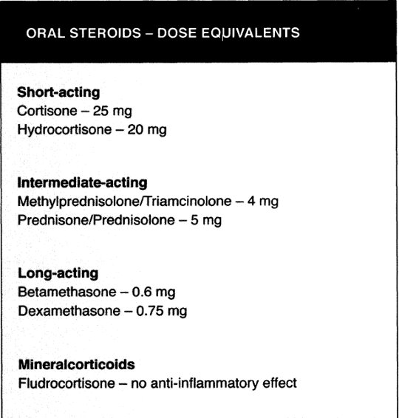
Steroids: Agents
Dexamethasone favored​
Lower mineralocorticoid activity (less sodium and water retention)​
Longer half-life​ / dosed less frequently
IV option (methylprednisolone, triamcinolone, and betamethasone are also commercially available as IV options)​
​

Slide 19
Steroids: SE
Dose and time dependent: if patient presents with a steroid induced side effect then either reduce the dose or discontinue the steroid​
Mood disturbances (depression, anxiety, delirium, insomnia, etc)​
  Dose no later than 17:00 or schedule the dose in the am to prevent insomnia ​
GI complications​
  Nausea, GI hemorrhage, perforation, hiccups, etc​
  Avoid using NSAIDs and steroids at the same time due to increased risk of GI bleed without added analgesic benefit
  Begin pantoprazole 40 mg PO/IV once daily while on steroids for GI protection ​
Weight gain​
  Increased appetite ​
  Water and sodium retention / potassium loss​
  Dexamethasone causes less fluid retention than other steroids due to its minimal mineralocorticoid effect​

Slide 20
Steroids: SE
Myopathy​
Osteoporosis with long term use​
Hyperglycemia (be mindful of this in diabetic patients)
  Monitor BG ​
Suppress immune system (be mindful of this in patient with or at risk for infection)

Slide 21
Spasmodic Pain
Baclofen
Cyclobenzaprine
Methocarbamol
Soma
Diazepam
Spasms
Tight
Charley Horses

Slide 22
Spasmodic Pain: Muscle Relaxants
Baclofen
MOA: Inhibits the transmission of reflexes at the spinal cord level
Renally dose adjusted
Cyclobenzaprine
Centrally acting skeletal muscle relaxant chemically structure like TCAs (similar side effects as TCAs)
Reduces tonic somatic motor activity
No renal adjustments
Use with caution or avoid in hepatic dysfunction
Methocarbamol
Causes skeletal muscle relaxation by general CNS depression
Use with caution in hepatic dysfunction
No renal dose adjustments with oral formulation however parenteral formulations are CI due to the presence of polyethylene glycol
Soma
Causes skeletal muscle relaxation by general CNS depression
Control substance (C-IV)
It metabolite meprobamate has anxiolytic and sedative effects
Diazepam
IV/PO/Rectal formulations
Binds to GABA-A receptor (in brief)
Control substance (C-IV)
Opioids + Benzodiazepines increase risk for respiratory depression

Slide 23
Visceral Pain
Levsin (hyoscyamine)
Cramping / Squeezing
Hard to Pinpoint
Pressure
Dull
Ache

Slide 24
Visceral Pain: Levsin
MOA
Blocks the action of acetylcholine in smooth muscle, secretory glands and the CNS
Uses
Reduces visceral pain secondary to pancreatitis, spastic colitis, peptic ulcer, irritable bowel, biliary and renal colic
Contraindications (include not limited to)
Obstructive GI disease
Paralytic ileus
Severe ulcerative colitis / toxic megacolon
Availability
SL and PO formulations

Slide 25
PCA
Acute perioperative pain
Patients who are strict NPO
To discover patient’s true opioid need if unknown due to poor absorption
Patient Controlled Analgesia
A Platform for Drug Delivery

Slide 26
PCA Settings
Continuous rate: provides a continuous / basal rate
PCA Dose: patient presses the patient controlled analgesia to receive a bolus dose
Lock out interval: the interval before the pump provides the next PCA dose
  For example, if a PCA is set with a 15 minute lockout, the soonest a patient can receive a PCA dose is q 15 minutes regardless of how many times the patient presses the button

Slide 27
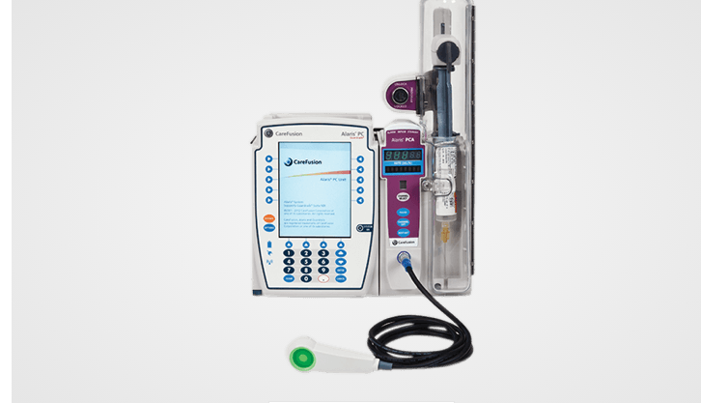
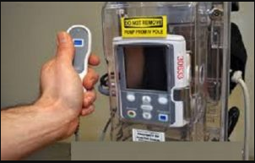
PCA
Route of administration: IV
PCA are often associated with medication errors
  RNs should be doing a double check to ensure correct patient, drug, and settings
Some brands have lock boxes to prevent patients increasing PCA settings

Slide 28
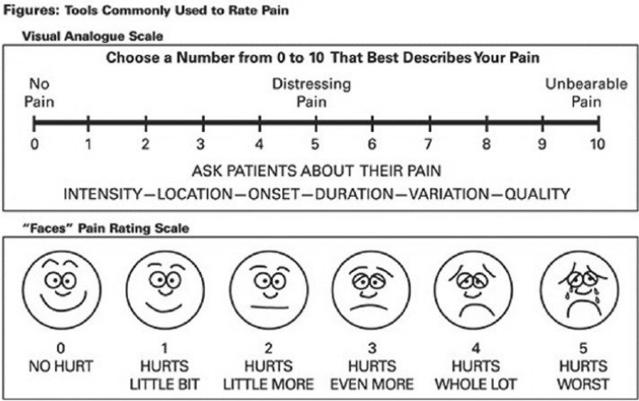
Pain Assessment
Historical and Current
Numeric Rating Scale, where 0 is no pain and 10 is the worst pain imaginable
“Faces” Pain Rating Scale
Many more subjective scales out there

Slide 29
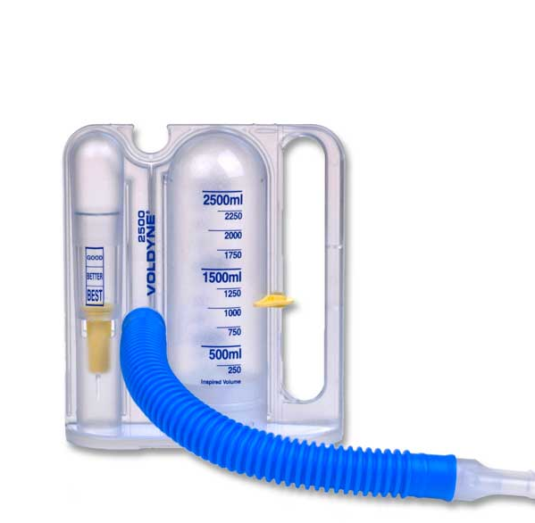
Pain Assessment
Current and Future is to monitor functional status
Is the patient able to ambulate?
Is the patient able to work with PT and OT?
Is the patient sleeping through the night or waking up secondary to pain?
Is the patient eating well or unable to eat due to pain?
When appropriate, is the patient progressing with incentive spirometer
  Use in patients with chest tubes, pneumonia, s/p chest or abdominal surgery
Discuss functional goals with patients and write the functional goals on the whiteboard in the patient’s room (shift the patient’s focus to working toward functional goals)

Slide 30
Why is it Important to Adequately Control Pain?
Poor pain control can increases the risk of
Patients developing pneumonia
Patients developing DVT or PE
Acute pain developing into the memory of pain / chronic pain

Slide 31
Patient Case

Slide 32
Patient Case
You are on the Pharmacy Pain Management Rotation and get consulted on the following patient. The team wants an oral pain management regimen that the patient can be discharged with.
PMH
35 old male with history of rhabdomyosarcoma of the pelvis at 6 y/o now s/p chemo/radiation. Patient recently had a right above the knee amputation secondary to poor wound healing in the setting of vascular compromise. He now presents with multiple non-healing wounds, pressure ulcers and sepsis.
Refer to handout

Slide 33
Patient Case
During the current hospitalization patient has received
Surgical debridement and revision of his right above the knee stump
High calorie/high protein diet to optimize nutrition
Q 3 day dressing changes
Sepsis management
Drug Allergies
All NSAIDs (anaphylaxis)
Results
Weight = 34 kg
BMI: 12 (underweight)
QTc history: 510 msec (2 days ago). During his last hospitalization (4 months prior), his QTc fluctuated and ranged from 410-520 msec (unknown cause for QTc prolongation however possibly due to electrolyte abnormalities - not evaluated)
Elevated WBC
Labs currently WNL: SCr, INR, total bilirubin, direct bilirubin and LFTs

Slide 34
Patient Assessment
Patient appears: uncomfortable, grimacing, sitting on bedside commode, shifting from one side to the other due to painful wounds/pressure ulcers. He is awake, alert, and answers questions appropriately
Patient complains of pain at: right stump (possibly due to recent stump revision), pelvis, right and left hip (possibly due to wounds/pressure ulcers)
Patient's pain is 10 at rest and 10 with movement where 0 is no pain and 10 is severe pain.
  Pain gets worse following wound dressing changes
Patient describes pain as:
  Right stump: burning
  Pelvis, right and left hip: tight, squeezing, throbbing and aching

Slide 35
Patient Assessment
Patient reports the following symptoms: denies n/v, dizziness, drowsiness, and itchiness
Diet/Nutrition:
  When pain is well controlled, patient reports consuming 3000-4000 calories daily to promote wound healing
  When pain is not well controlled, patient is unable to eat
Last Bowel Movement: has had diarrhea for the last several days likely secondary to antibiotics

Slide 36
Patient Assessment
Sleeping: poorly due to pain
Pain impact on Physical Therapy/Incentive Spirometry:
  When pain is controlled, patient can transfer to bedside commode or chair independently
  Currently, patient needs nursing assistance to transfer to bedside commode or chair due to increased pain

Slide 37
Patient Case
Analgesics prior to admission
Norco 10/325 mg ~ 8 tablets/day (confirmed with CURES report)
Gabapentin 600 mg po TID
Patient denies all other analgesics prior to admission including antidepressants and anxiolytics
Timeline of analgesics during admission
Patient was started on OxyContin SR and titrated to 30 mg po BID and has been on this dose for the last 7 days
Hydromorphone 2 mg po q 2 hours prn moderate to severe pain
During the patient interview, patient reports he can not tell a difference in his pain level since starting or uptitrating OxyContin SR or after taking the prn po hydromorphone however his pain is controlled when given IV hydromorphone

Slide 38
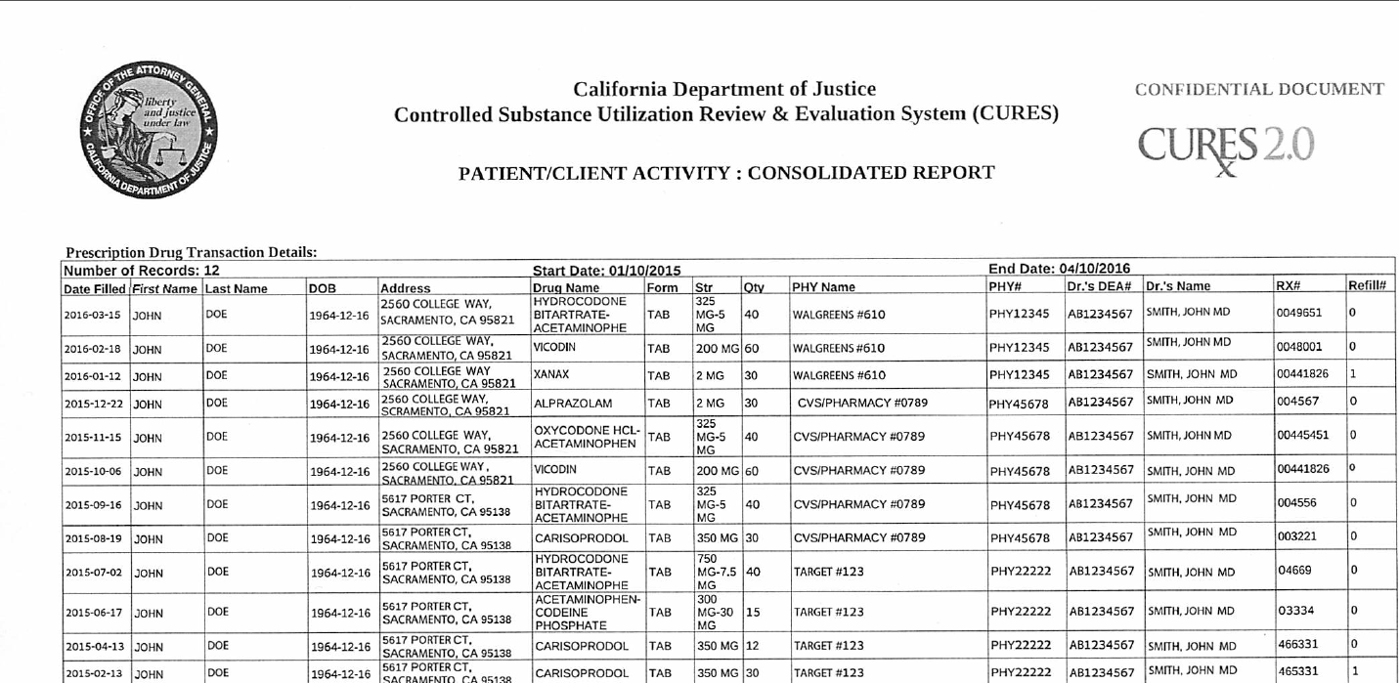
CURES Report

Slide 39
Patient Case
Current Analgesic Regimen Received (08:00- 08:00)
Acetaminophen 1000 mg po q 6 hours 2000 mg
Baclofen 5 mg po BID 10 mg
Gabapentin 600 mg po TID 1800 mg
OxyContin SR 30 mg po q 12 hours 60 mg
Hydromorphone 2 mg po q 2 hours prn 24 mg
Discontinued Analgesic Regimen:
Hydromorphone 1 mg IV once 1 mg
Hydromorphone 2 mg po once 2 mg
Hydromorphone 4 mg po premed 4 mg
Analgesics received in the last 24 hours

Slide 40
Q1.What are the possible mechanisms of pain for this patient?
Neuropathic Pain
Inflammatory Pain
Spasmodic Pain

Slide 41
Q2. What are analgesic options to treat this patient’s neuropathic pain?
Increase gabapentin to 800 mg po QID
  Q 6 hour dosing due to gabapentin’s saturable absorption
Ketamine:
  Consider ketamine 5 or 10 mg po BID (avoid if patient has an arrhythmia)
  Pearl: may give SL if there are concerns the patient is not absorbing po medications well
SNRI
  Duloxetine 60 mg po once daily
  Venlafaxine XR 37.5 mg or 75 mg po once daily
  Venlafaxine IR 37.5 mg po BID
  Titrate venlafaxine to 225 mg based on patient’s response and tolerability (for XR and IR formulations)
  Monitor for headaches and hypertension
TCA (eg nortriptyline)

Slide 42
Q3. What are analgesic options to treat this patient’s inflammatory pain?
Steroids
Can impair wound healing therefore would not suggest steroids for this patient
NSAIDs
Would not suggest NSAIDs for this patient due to anaphylaxis to NSAIDs

Slide 43
Q4. What are analgesic options to treat this patient’s spasmodic pain?
Baclofen
Increase baclofen to 5 mg po TID
Diazepam
Begin diazepam 2 to 10 mg po/IV 3 or 4 times daily
In practice, if possible avoid ranges on dosing frequency due to audits and surveys conducted by regulatory bodies

Slide 44
Q5. What are other OTC options to treat this patient’s pain?
Acetaminophen
Pearls: acetaminophen is opioid sparing, may mask fever (patient admitted for sepsis) and is dosed based on weight less than 50 kg
Dose: 15 mg/kg every 6 hours with a maximum daily dose: 75 mg/kg/day
Patient’s weight = 34 kg
Suggestion: decrease acetaminophen dose to 500 mg po q 6 hours around the clock

Slide 45
Let’s circle back to the patient interview to develop an opioid regimen

Slide 46
Developing an opioid regimen
Per patient report
Pain is not controlled with either OxyContin SR or po hydromorphone
Pain is controlled with IV hydromorphone
Questionable absorption
Patient reports oral medications do not decrease pain (only IV)
Patient is consuming 3,000-4,000 calories daily however not gaining weight
Team asks
Is a fentanyl patch, SL methadone or SL buprenorphine an appropriate opioid option for this patient?

Slide 47
Developing an opioid regimen
Since it’s unclear if the patient is absorbing po opioids it is also unclear what opioid doses to initiate
To determine true 24 hour oral morphine equivalence
All oral opioids were discontinued (OxyContin SR and po hydromorphone)
Hydromorphone PCA was started
- Continuous rate: 0.2 mg / hour
- PCA dose: 0.3 mg
- Lock out: 10 minutes
Hydromorphone 0.5-1 mg IV q 2 hours prn pain not relieved by hydromorphone PCA and 15 minutes prior to wound dressing changes (was also started)

Slide 48
24 hours go by...
Patient received 17 mg of IV hydromorphone

Slide 49
Q6. What is this patient’s current 24 hour oral morphine equivalence?
1.5 mg IV Dilaudid = 17 mg IV Dilaudid
30 mg PO morphine X mg PO morphine
Cross multiply
510 = 1.5X
Divide to solve for X
X = 340 mg of OME in the last 24 hours

Slide 50
Q7. Is this patient opioid tolerant or opioid naive?
Opioid tolerance (per FDA)
At least 60 mg of oral morphine equivalents for 7 or more days
This patient received
OxyContin SR 30 mg po BID (which is equal to 90 mg OME) for 7 days + prn hydromorphone
This patient is opioid tolerant

Slide 51
Q8. Is a fentanyl patch an appropriate long acting opioid for this patient?
If so, what dose would you initiate? Please use around 50% of the total daily dose.
A fentanyl patch is not an appropriate option for this patient
To absorb into systemic circulation
Fentanyl leaves the patch and goes into the fat supply, then leaves the fat supply and goes into the blood
This patient is cachectic therefore the drug would not likely be absorbed

Slide 52
Q8. Is a fentanyl patch an appropriate long acting opioid for this patient?
If so, what dose would you initiate? Please use around 50% of the total daily dose.
Had a Fentanyl patch of been an appropriate option
25 mcg TD Fentanyl = X mcg TD Fentanyl
3 mg PO Morphine 340 mg PO Morphine
Cross multiply
8500 = 3X
Divide to solve for X
X = 2833
Divide by 2 to use 50% of total daily dose
X = 1417
Divide by 24 hours to get patch strength needed
427/24 = 59 (choose closes patch strength available)

Slide 53
Q8. Is a fentanyl patch an appropriate long acting opioid for this patient?
If so, what dose would you initiate? Please use around 50% of the total daily dose.
Fentanyl regimen
Apply one 50 mcg/hour patch transdermally q 72 hours
Fentanyl patch onset = ~ 12 hours
Discontinue the continuous rate on the PCA 10-12 hours after patch application
Counseling Pearl
“the adhesive side of the patch should be folded together and then the patch should be flushed down the toilet” - per FDA

Slide 54
Q9. Is SL methadone an appropriate long acting opioid for this patient?
If so, what dose would you initiate? Please use around 50% of the total daily dose.
Methadone is not an appropriate option for this patient
Prolonged QTc increases the risk of Torsades and sudden death
Methadone is known to prolong the QTc and the patient’s QTc is already greater than 500 msec
Reversible causes of QTc prolongation
Electrolyte abnormalities
Multiple medications that can cause QTc prolongation
Strategy: Reverse QTc Prolongation
Replace electrolytes
Discontinue other agents that prolong the QTc
Wait for QTc to normalize then trial SL methadone

Slide 55
Q9. Is SL methadone an appropriate long acting opioid for this patient?
If so, what dose would you initiate? Please use around 50% of the total daily dose.
Had SL methadone of been an appropriate option
1 mg SL Methadone = X mg SL Methadone
15 mg PO Morphine 340 mg PO Morphine
Cross multiply
340 = 15X
Divide to solve for X
X = 23
Divide by 2 to use 50% of total daily dose
X = 11
Divide by 2 for BID dosing
Methadone regimen
5 mg SL q 12 hours for pain
Methadone is available in 5 mg tablets

Slide 56
Q9. Is SL methadone an appropriate long acting opioid for this patient?
If so, what dose would you initiate? Please use around 50% of the total daily dose.
Methadone Pearls
High bioavailability / good absorption (good for patients who are strict NPO or have poor absorption)
Cheap / less expensive than other agents
If a patient is on methadone, check for DI before starting a new medication or discontinuing a current medication (lots of drug interactions with methadone)
Methadone has a stigma
Also treats opioid addiction (this patient requested to not be on methadone for this reason)
To gain patient acceptance, counsel on methadone indications and why methadone is being used for pain

Slide 57
Q10. Is SL buprenorphine an appropriate long acting opioid for this patient?
If so, what dose would you initiate? Please use around 50% of the total daily dose.
SL buprenorphine is an appropriate option for this patient
8 mg SL Buprenorphine = X mg SL Buprenorphine
100 mg PO Morphine 340 mg PO Morphine
Cross multiply
2720 = 100X
Divide to solve for X
X = 27
Divide by 2 to use 50% of total daily dose
X = 14
Divide by 3 for TID dosing
Buprenorphine regimen
4 mg SL q 8 hours for pain
SL buprenorphine is available in 2 mg and 8 mg films

Slide 58
Q10. Is SL buprenorphine an appropriate long acting opioid for this patient?
If so, what dose would you initiate? Please use around 50% of the total daily dose.
Pearls
SL buprenorphine is used off label for pain management therefore it’s often not covered by insurance plans
Before discharging a patient with buprenorphine, ensure it will be covered by their insurance plan
Prior to starting buprenorphine on this patients, a dummy prescription was sent to the pharmacy to see if the patient’s insurance would pay for SL buprenorphine and it was covered

Slide 59
Q11. How would you monitor function for this patient?
Patient’s ability to
Sleep throughout the night without waking up due to pain
Transfer to wheelchair or bedside commode independently
Eat calories to promote wound healing
Monitor for nonverbal signs of pain
During interview, the patient was shifting from left hip to right hip because he was unable to stay on his pressure ulcers for too long due to pain
Monitor for patient’s ability to appear comfortable and ability to sit still

Slide 60
Q12. From a safety standpoint, how would you monitor a patient after receiving an opioid?
Respiratory function
Hold opioid dose if RR is less than 10 breaths per minute
Level of sedation
Hold opioid dose if RASS between -2 and -5
Other side effects
Nausea, vomiting, dizziness, and itchiness
Time to peak effect (when to monitor patient)
1 hour after po administration
15 minutes after IV administration
5-15 minutes after IV Fentanyl administration

Slide 61
Thank you for participating!
Please contact with any questions
Charity Hale, Pharm.D.
chahale@ucdavis.edu

