Slide 1

Introduction to Pharmacist’s Role in Palliative Care
Mark Holtsman, Pharm.D.
Co-Director, Inpatient Pain Service
Clinical Professor
Anesthesiology and Pain Medicine
UC Davis Medical Center
Clinical Professor
UCSF School of Pharmacy
October 9, 2019
Mark Holtsman, Pharm.D.

Slide 2


Slide 3
How to start Pharmacy Student Pain and Palliative Care Education
Build Pharmacist Role in Pain Management
    Look for unmet needs
    Improve pain control
    Improve side effect management
    Improve Safety
Find mentors and advocates
  Physicians, pharmacists, and/or nurses
    Pharmacy Administration has to be open to new pharmacist roles

Slide 4

Pharmacy Student Pain and Palliative Care Education
History of Pain Management Pharmacist Service at UC Davis Medical Center
  My UCSF Pharmacy Residency Pain Management Rotation 1988 with:
  Peter Koo, Pharm.D.
  Clinical Pharmacist Specialist in Pain Management and my mentor!
  I started Operating Room Pharmacy at UC Davis Medical Center 1993
  I began working with Anesthesia Pain Service 1993. Develop credibility!
  Transition from patient monitoring service with physcian to pharmacist consult only service
  Transition from nurses requesting consult to physicians requesting consult

Slide 5
Pain Management Pharmacist Service Evolution
Focus on Patient Controlled Analgesia and Epidural Analgesia initially
Focus on Surgical Pain Control initially
Over time developed credibility with multiple groups of physicians from many specialties at UC Davis including Hematology/Oncology, Internal Medicine, Orthopedic Surgery, Neurosurgery, Trauma Surgery, Surgical Oncology, and Urology.

Slide 6
Palliative Care Pharmacist Role
Provision of Pharmaceuticals
Optimizing Medication Regimens
Education and Drug Information
Patient Safety
Administrative/Formulary Management
Walker KA, Scarpaci L, McPherson ML. American Journal of Hospice and Palliative Medicine. 2010. 27(8) 511-513

Slide 7
Palliative Care Pharmacist Role
Provision of Pharmaceuticals
  Stock formulations for unique patients
  Compound noncommercially available medications
Walker KA, Scarpaci L, McPherson ML. American Journal of Hospice and Palliative Medicine. 2010. 27(8) 511-513

Slide 8
Palliative Care Pharmacist Role
Optimizing Medication Regimens
  Recommend Appropriate Drug Therapy
  Perform Opioid Conversion Calculations
  Recommend Appropriate Dosing Strategies
  Anticipate Potential Complications – have alternative medication regimen planned.
Walker KA, Scarpaci L, McPherson ML. American Journal of Hospice and Palliative Medicine. 2010. 27(8) 511-513

Slide 9
Palliative Care Pharmacist Role
Education and Drug Information
  Update staff on new Clinical Practice Guidelines
  Educate patients, families, and caregivers on appropriate use of medications
  Participate in family meetings to address medication concerns
Walker KA, Scarpaci L, McPherson ML. American Journal of Hospice and Palliative Medicine. 2010. 27(8) 511-513

Slide 10
Palliative Care Pharmacist Role
Patient Safety
  Medication Reconciliation
  Investigate Medication Errors
  Screen for Drug Abuse and Diversion
Walker KA, Scarpaci L, McPherson ML. American Journal of Hospice and Palliative Medicine. 2010. 27(8) 511-513

Slide 11
Palliative Care Pharmacist Role
Administrative/Formulary Management
  Develop and maintain a medication formulary
  Implement quality improvement projects
  Develop pain and symptom management protocols to optimize medication use
Walker KA, Scarpaci L, McPherson ML. American Journal of Hospice and Palliative Medicine. 2010. 27(8) 511-513

Slide 12
Palliative Care Terminology
Palliative Care (defined by World Health Organization)
“An approach that improves the quality of life of patients and their families
facing life-threatening illness, through the prevention, assessment,
and treatment of pain and other physical, psychosocial, and spiritual
problems.”
Hospice (defined by Merriam-Webster)
  a facility or program designed to provide a caring environment for meeting the physical and emotional needs of the terminally ill

Slide 14
Palliative Care Terminology
Pain (defined by International Association for the Study of Pain)
“An unpleasant sensory and emotional experience associated with actual or potential tissue damage.”
Acute Pain
  Recent sudden onset
  Usually has obvious cause
  Short Duration (less than 1 month)
  Characteristic behavior such as crying, moaning, grimacing
Chronic Pain
  Persistent (generally greater than 3 months or beyond expected healing time)
  Usually due to chronic disease or condition (often more difficult to treat)
  May cause prolonged functional impairment (physical and psychological)
  May or may not be associated with characteristic behavior (insomnia, depression)
Vardeh, D. et al J Pain. 2016 Sep;17(9 Suppl):T50-69. doi: 10.1016/j.jpain.2016.03.001. Review.

Slide 15
Palliative Care Terminology
Somatic Pain
  Pain originating from somatic nociceptors located in structures such as ligaments, bones, and blood vessels.
  Descriptor: Dull
  Example: Blunt trauma from hammer hitting thumb
Visceral Pain
  Pain originating from organ-level nociceptors or visceral cavities resulting in diffuse pain.
  Descriptor: aching, pressure
  Example: Myocardial Infarction
Neuropathic Pain
  Pain caused by a primary lesion or dysfunction of the nervous system.
    Peripheral neuropathic pain (Example: Vincristine toxicity)
    Central neuropathic pain ( Example: Spinal Cord or Brain Tumor)
    Descriptor: Burning, pins and needles

Slide 16
Common Barriers to
Treatment of Chronic Pain
Patient-Related
Exaggerated fear of addiction, tolerance, side effects
Reluctance to report pain: stoicism, desire to “please” physician
Concerns about “meaning” of pain (associate increased pain with worsening disease)
(American Pain Society, 2001; Glajchen, 2001; Lister, 1996; Portenoy RK, 1996; Weinstein et al, 2000)

Slide 17
Palliative Care Terminology
Physical dependence
  Abstinence syndrome induced by administration of an antagonist or by dose reduction
  Assumed to exist after dosing for a few days but actually highly variable
  Usually unimportant if abstinence avoided
  Does not independently cause addiction

Slide 18
Palliative Care Terminology
Tolerance
  Diminished drug effect from drug exposure
  Varied types: associative vs pharmacologic
  Tolerance to side effects is desirable
  Tolerance to analgesia seldom a problem in the clinical setting
    Tolerance rarely “drives” dose escalation
    Tolerance does not cause addiction

Slide 19
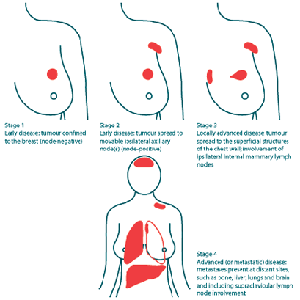
Disease Progression
http://www.cancerline.com/cancerlinehcp/9898_11092_4_1_1.aspx

Slide 20
US Food and Drug Administration Definition of Opioid Tolerance
Opioid Tolerance occurs after a patient has taken the equivalent of 60 mg per day of oral morphine for one week.
This equates to:
  40 mg oral oxycodone/day
  25 mcg/hr transdermal fentanyl

Slide 21
Palliative Care Terminology
Addiction
  Disease with pharmacologic, genetic, and psychosocial elements
  Fundamental features
    Loss of control
    Compulsive use
    Use despite harm
  Diagnosed by observation of aberrant drug-related behavior

Slide 22
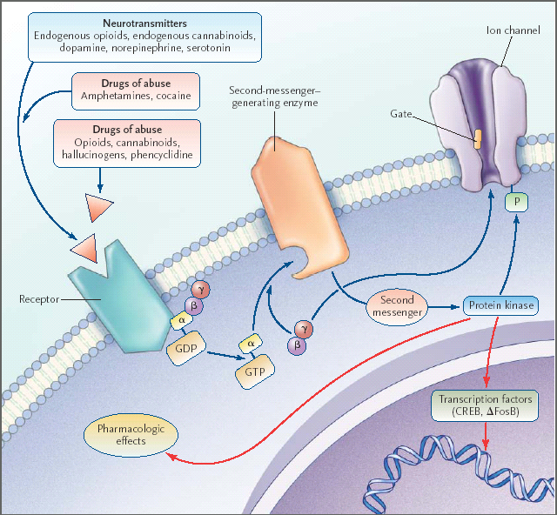
Cami J et al. N Engl J Med 2003;349:975-86

Slide 23
Palliative Care Terminology
Pseudoaddiction
  Aberrant drug-related behaviors driven by desperation over uncontrolled pain
  Reduced by improved pain control
  Complexities
    How aberrant can behavior be before it is inconsistent with pseudoaddiction?
    Can addiction and pseudoaddiction coexist?

Slide 24
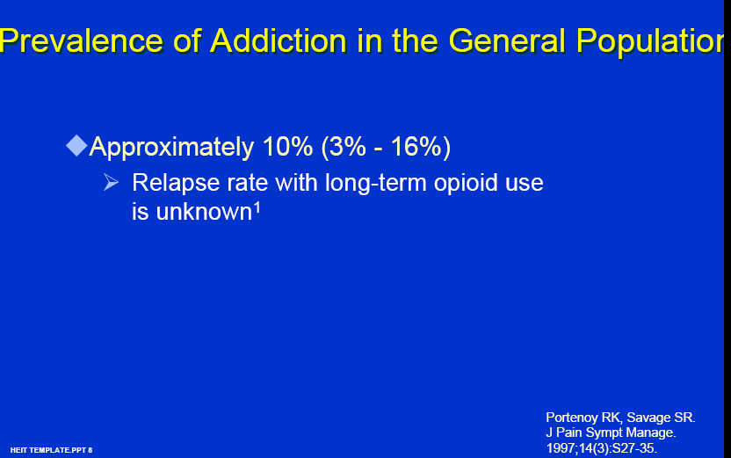

Slide 25
Opioid Therapy and Chemical Dependency
Risk of addiction: Evolving view
  Acute pain: unlikely
  Cancer pain: unlikely
  Cancer Survivor: evolving view
  Chronic noncancer pain:
    Surveys of patients without abuse or psychopathology show rare addiction
    Surveys that include patients with abuse or psychopathology show mixed results

Slide 26
Palliative Care Goals
Provide relief from pain and other distressing symptoms.
Affirm life and regard dying as a part of the life cycle.
Intend neither to hasten or postpone death.
Offer a support system to help patients live as actively as possible until death.
Offer a support system to help the family cope during the patient’s illness and in their own bereavement, including the needs of children.
Use a team approach to address the needs of patients and their families, including bereavement counseling, if indicated.
Enhance the quality of life that may also positively influence the
course of a patient’s illness.
Palliative care does not preclude aggressive treatment of
an illness, and provides comfort to patients and their loved ones.

Slide 27
Palliative Care Pharmacotherapy
Illness seen commonly in Palliative Care
  Cancer
  End Stage Renal Disease
  End Stage Hepatic Disease
  End Stage Lung Disease
  End Stage Heart Disease

Slide 28
Palliative Care Pharmacotherapy
Palliative Care Challenges
  Pediatrics
  Cognitively Impaired
  Non-Verbal
  Difficulty Swallowing
  Impaired Renal Function
  Impaired Hepatic Function

Slide 29
Palliative Care Pharmacotherapy
Palliative Care Pharmacist Opportunities
  Opioid equianalgesic conversions
  Pain Management
    Medication Selection
    Dose titration
    Side effect management
  Symptom Management
    Medication Selection
  Dose adjustments for decreased hepatic and renal function
Hammer K et al. Am J Health Syst Pharm. 2016 Sep 15;73(18):1434-41. doi: 10.2146/ajhp150770.

Slide 30
Patient with Severe
Nausea/Vomiting
Patient with Breast Cancer Taking Extended Release Morphine 90 mg po TID for Chronic Severe Pain. Pain Score = 3/10 Comfortable.
Having Difficulty with nausea/vomiting for past two days. HR 120 BP 145/95 RR 20
Pain has increased to 10/10
Important PMH: Patient started course of Chemotherapy two days ago that includes Doxorubicin.

Slide 31
Opioid-Induced Nausea and Vomiting
Constipation
  Opioids decrease GI motility
Medications
  Opioids stimulate chemoreceptor trigger zone
Movement
  Opioids stimulate vestibular apparatus

Slide 32
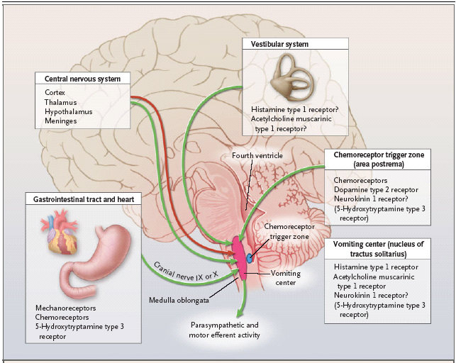
Nausea Mechanisms

Slide 33
Comparative Opiate Agonist Dosage with Oral or Parenteral Administration
Equianalgesic Dose (in mg)*
Opiate Agonist Oral IM
Morphine 30 10
Hydromorphone 7.5 1.5
Oxycodone 20 –
Methadone 20 (acute) 10 (acute)
Levorphanol 4 (acute) 2 (acute) 1 (chronic) 1 (chronic)
Fentanyl _ 0.1 (acute)
Oxymorphone – 1
Meperidine 300 75
AHFS Drug Information 2007

Slide 34
Opioid Conversion Calculators
http://www.globalrph.com/narcotic.cgi
http://http://www.hopweb.org.
http://www.painphysicians.org/calc/Calculator.php
http://www.lexi.com
http://medicalconverters.com

Slide 35
Equianalgesic Table
PO (mg) Analgesic SC/IV/IM (mg)
30 Morphine 10
10 Oxymorphone 1
4 Hydromorphone 1.5
20 Oxycodone 14
(2-8) Methadone (2-8)
- Fentanyl* 100 μg/hr parenteral or transdermal ≡ 4 mg/hr morphine parenteral
* chronic
Pereira, MB et al. J Pain Symptom Manage 2001;22:672-687 .Mercadante S, et al. J Clin Oncol 2001 19:2898-2904 Indelicato, RA, Portenoy RK. J Clin Oncol 2002 20(1):348-352 Opana ER PI Endo Pharmaceuticals 6/06 Palladone PI Purdue Pharma 11/04

Slide 36

Equianalgesic Conversions
Require Basic Math

Slide 37
Equianalgesic Conversions
Example:
Patient with a total 24-hr dose of Morphine ER 270 mg PO
What is the equivalent 24-hour dose of IV morphine?

Slide 38
Equianalgesic Conversions
Example:
Patient with a total 24-hr dose of Morphine ER 270 mg PO
What is the equivalent 24-hour dose of IV morphine?
Morphine 30 mg PO = Morphine 270 mg PO
Morphine 10mg IV X
X = morphine 90 mg IV per 24 Hours

Slide 39
Equianalgesic Conversions
Example:
Patient with a total 24-hr dose of Morphine ER 270 mg PO
What is the equivalent 24-hour dose of IV morphine?
Morphine 30 mg PO = Morphine 270 mg PO
Morphine 10mg IV X
X = morphine 90 mg IV per 24 Hours
Determine starting IV dose of morphine based on above. Consider starting at 3- 4 mg/hr IV Morphine after getting patient comfortable with Bolus doses of IV Morphine.

Slide 40
Opioid Conversion
for Nausea/Vomiting
Patient with Breast Cancer Taking Extended Release Morphine 90 mg po TID for Chronic Severe Pain. Now admitted for severe nausea
Opportunity for pharmacist to help
Nausea
  Triggered by Doxorubicin
  Exacerbated by opioid withdrawal
Convert patient to IV/SC Morphine
Suggest Antiemetic Regimen

Slide 41
Opioid Conversion
for Nausea/Vomiting
Patient with Breast Cancer Taking Extended Release Morphine 90 mg po TID for Chronic Severe Pain. Now admitted for severe nausea
Challenge: Patient has no IV Access
  Subcutaneous Route limited to 2 ml/hr maximum infusion rate. Patient may need concentrated formulation.
  Suggest Morphine 5 mg/ml concentration for Subcutaneous infusion. Dose = 4 mg/hr = 0.8 ml/hr

Slide 42
Opioid Conversion
for Nausea/Vomiting
Patient with Breast Cancer Taking Extended Release Morphine 90 mg po TID for Chronic Severe Pain. Now admitted for severe nausea
Challenge: Suggest Antiemetic Regimen
Promethazine 25 mg PO/PR Q 6 hours prn
Scopolamine Patch 1.5 mg Change Q 72 hours

Slide 43
Opioid Conversion
for Delirium
Patient with Breast Cancer Taking Morphine 4 mg/hr SC for Severe Pain. Pain under control with SC morphine. Nausea under control with Scopolamine
Patient stable for 2 days and then noted to having jerking movements in extremities as well as mild confusion.
Patient noted to have decreasing urine output
Serum Creatinine = 3.0

Slide 44
Opioid Conversion
for Delirium
Patient with Breast Cancer Taking Morphine 4 mg/hr SC for Severe Pain. Pain under control with SC morphine. Nausea under control with Scopolamine
  What could be causing myoclonus?
  What could be causing delirium?

Slide 45
DELIRIUM
Acute onset of days to hours
Fluctuating course
Disturbance or disorientation that is not accounted for by an established dementia
Reduced ability to focus, sustain or shift attention
Generally a reversible condition

Slide 46
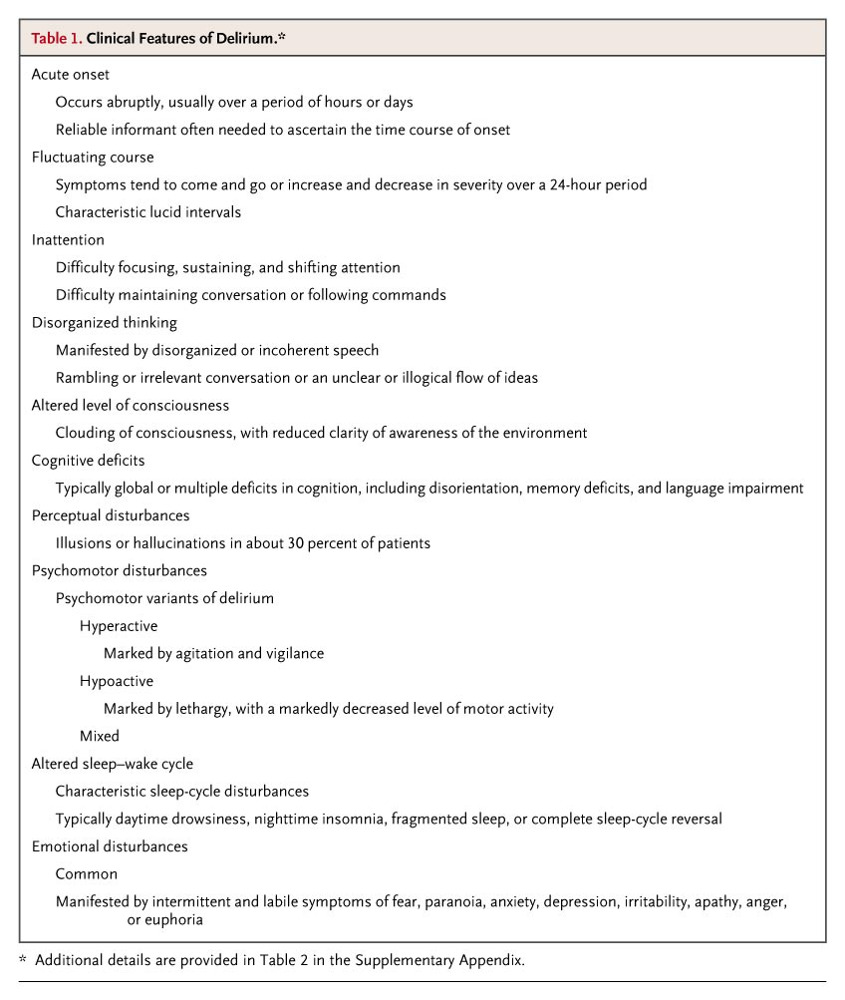
Inouye, S. K. N Engl J Med 2006;354:1157-1165

Slide 47
Treatment of Delirium in Cancer Patient
Delirium
  Reversible Causes
    Medications
    Dehydration
    Infection
Lawlor et al. Arch Intern Med 160:786-794, 2000

Slide 48
Potential Mechanisms of Morphine Metabolite Toxicity
Morphine-6-Glucuronide
Drowsiness
Nausea and Vomiting
Coma
Respiratory Depression
Morphine-3-Glucuronide
Agitation
Myoclonus-Seizures
Hyperalgesia
Delirium
Mercadante,S Palliative Medicine 1999;13:95-104

Slide 49
Increased Plasma Morphine Metabolites in Terminally Ill Cancer Patients with Delirium
Investigators looked at 131 consecutive hospice patients
8 patients had blood samples drawn before and after development of delirium
Plasma concentrations of M-6-G and M-3-G significantly increased after development of delirium within the same patient.
Morita, T et al. J Pain Symptom Manage 2002:23:107-113

Slide 50
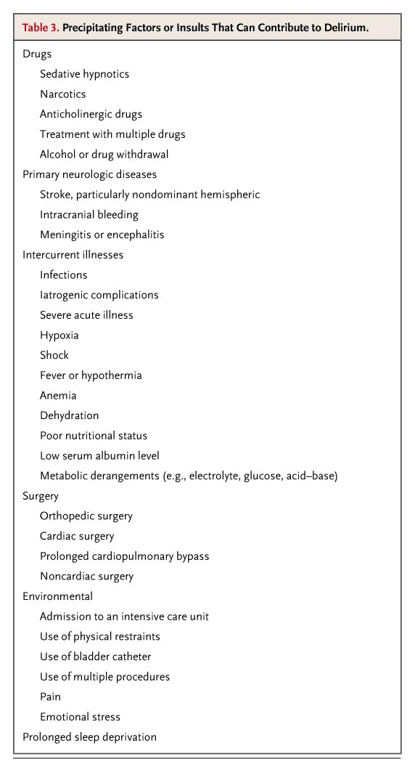
Inouye, S. K. N Engl J Med 2006;354:1157-1165

Slide 51
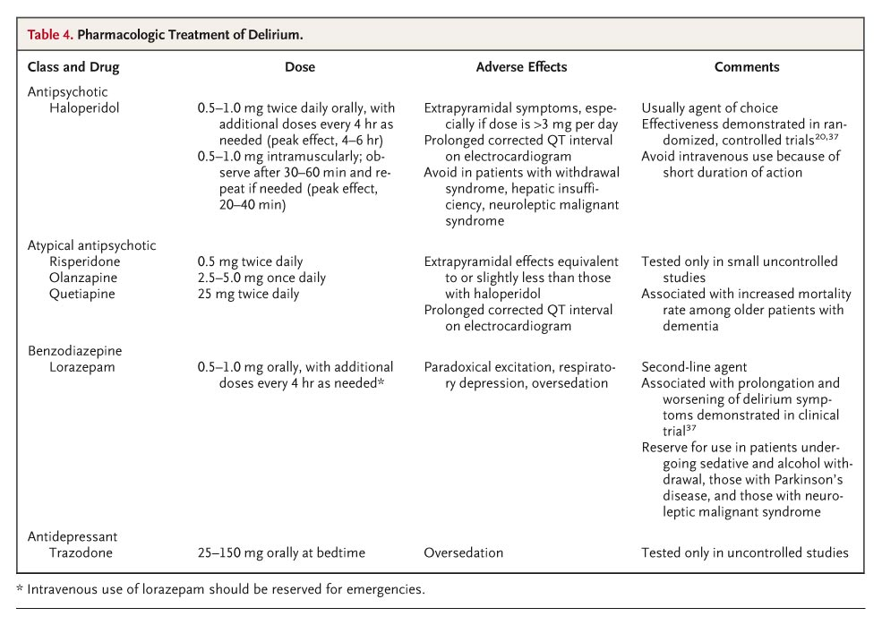
Pharmacologic Treatment of Delirium
Inouye, S. K. N Engl J Med 2006;354:1157-1165

Slide 52
Opioid Conversion
for Delirium
Patient with Breast Cancer Taking Morphine 4 mg/hr SC for Severe Pain. Pain under control with SC morphine. Nausea under control with Scopolamine
  Which opioid analgesic should we use for this patient?
  What should we do with the patient’s scopolamine?

Slide 53
Opiate Pharmacology
Opiates with Active Metabolites
  morphine
  meperidine
  codeine
  hydrocodone
  oxycodone
  oxymorphone
  Propoxyphene

Slide 54
Opiate Pharmacology
Opiates with Active Metabolites
  Morphine to M6G and M3G
  Meperidine to Normeperidine
  Codeine to Morphine
  Hydrocodone to Hydromorphone
  Oxycodone to Oxymorphone
  Oxymorphone to 6-OH-OXM
  Propoxyphene to norpropoxyphene
  Hydromorphone to H3G
Davison SN. Am J Kidney Dis 2003 Dec; 42(6):1239-47

Slide 55
Equianalgesic Table
PO (mg) Analgesic SC/IV/IM (mg)
30 Morphine 10
10 Oxymorphone 1
4 Hydromorphone 1.5
20 Oxycodone 14
(2-8) Methadone (2-8)
- Fentanyl* 100 μg/hr parenteral or transdermal ≡ 4 mg/hr morphine parenteral
* chronic
Pereira, MB et al. J Pain Symptom Manage 2001;22:672-687 .Mercadante S, et al. J Clin Oncol 2001 19:2898-2904 Indelicato, RA, Portenoy RK. J Clin Oncol 2002 20(1):348-352 Opana ER PI Endo Pharmaceuticals 6/06 Palladone PI Purdue Pharma 11/04

Slide 56
Opioid Conversion Calculators
http://www.globalrph.com/narcotic.cgi
http://opioidcalculator.practicalpainmanagement.com/
https://medicalconverters.com/analgesic-converter
*http://www.hopweb.org
*http://www.lexi.com
*Login required for access.

Slide 57
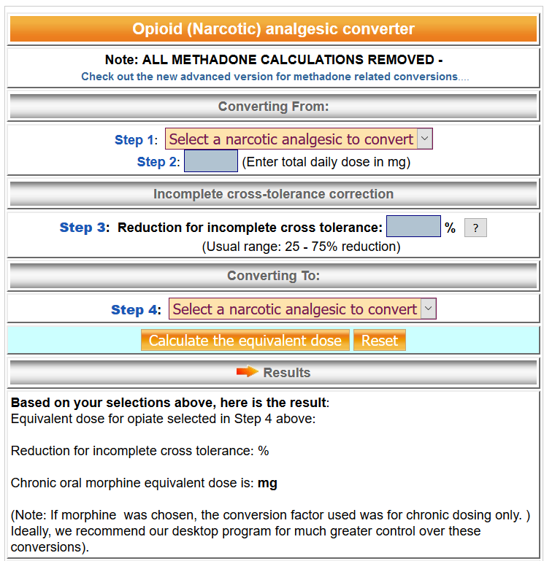
Opioid (Narcotic) Analgesic Converter
http://www.globalrph.com/narcotic.cgi.

Slide 58
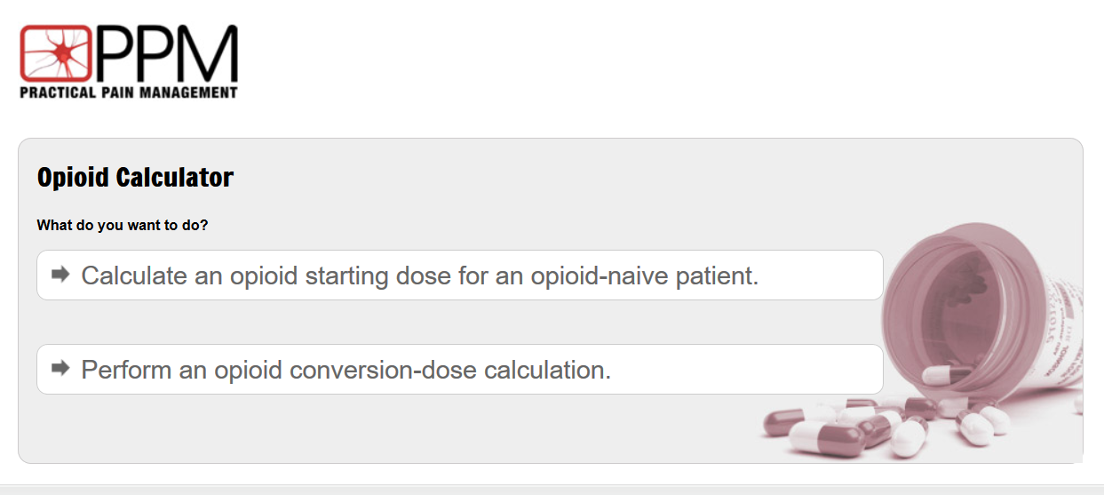
Practical Pain Management
Opioid Calculator
http://opioidcalculator.practicalpainmanagement.com/

Slide 59
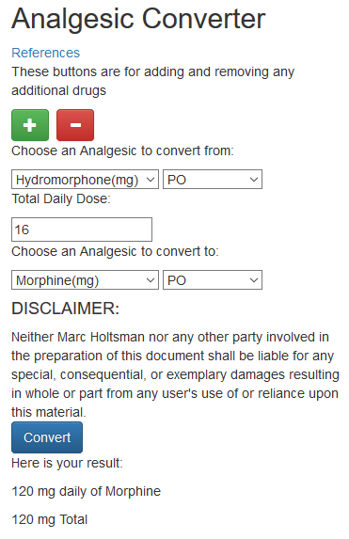
Opioid Analgesic Converter
https://mholtsma.pythonanywhere.com/converter/default/index
medicalconverters.com Google Play store: Analgesic Converter

Slide 60
Equianalgesic Conversions
Example:
Patient with a total 24-hr dose of Morphine IV 90
What is the equivalent hourly dose of transdermal fentanyl?
Morphine 4 mg/hr IV = Morphine 4mg/hr IV
Fentanyl 100 mcg/hr transdermal X
X = Fentanyl 100 mcg/hr transderamal
Determine starting dose of fentanyl based on above. Consider starting at 75-100 mcg/hr.

Slide 61
Palliative Care Pharmacist Role
Provision of Pharmaceuticals
Optimizing Medication Regimens
Education and Drug Information
Patient Safety
Administrative/Formulary Management
Walker KA, Scarpaci L, McPherson ML. American Journal of Hospice and Palliative Medicine. 2010. 27(8) 511-513

Slide 62
Online Resources
painEDU.org (online pain textbook)
ampainsoc.org (American Pain Society)
painmed.org (American Academy of Pain Medicine)
cancer.org (American Cancer Society)
https://www.youtube.com/watch?v=Wm_3Y6IvGTA

Slide 63

Arigato

Slide 64


