Slide 1

Pharmacotherapy of Pain Management in Palliative Care
Part II
Mark Holtsman, Pharm.D.
Co-Director, Inpatient Pain Service
Clinical Professor
Anesthesiology and Pain Medicine
UC Davis Medical Center
October 14, 2017
Mark Holtsman, Pharm.D.

Slide 2
New Developments in Palliative Care Pharmacotherapy
Opioid Equianalgesic Conversions
  Which patients are good candidates for conversion?
  Equianalgesic Conversion Tools
Advances in Breakthrough Pain Treatment
  Determine Effective Opioid Doses For Episodic Pain
Opportunities for Pharmacists
  Suggest analgesic dose titration for uncontrolled pain
  Suggest opioid conversion doses when needed
  Suggest optimal opioid breakthrough pain dose

Slide 3
Opioid Conversion Concepts
Identify Candidates For Opioid Conversion
Opioid Conversion Calculators
Equianalgesic Opioid Conversion Tables
  Strengths/Weaknesses
  Unique challenges with fentanyl
  Updated to include:
    Chronic fentanyl dosing vs. acute fentanyl dosing
    Buprenorphine

Slide 4
Which Pain Management Patients are Candidates for Opioid Conversion?
Patient on chronic opiates unable to take oral analgesics
  Trauma
    Abdominal Injury
  Cancer Patient
    Dysphagia
  Severe Nausea/Vomiting
    Chemotherapy

Slide 5
Which Pain Management Patients are Candidates for Opioid Conversion?
Patients with pain that is not responsive to current opioid therapy
  Disease Progression
  Opioid Tolerance

Slide 6
Which Pain Management Patients are Candidates for Opioid Conversion?
Patient with intolerable side effects to an opioid
Nausea
Vomiting
Sedation
Dysphoria
Delirium
Myoclonus
Hyperalgesia

Slide 7
Indications For Opioid Conversion
Uncontrolled Pain resulting from:
  Expensive Medication Regimen Noncompliance.
  Poor absorption of oral opioid
  Low Bioavailability of Transdermal Delivery System
    Education on proper placement/use is critical

Slide 8
Indications For Opioid Conversion
Patient Compliance/Quality of Life
  Convert from short acting to long acting opiates
Local Toxicity
  Subcutaneous Route
  Rectal Route
  Transdermal Route

Slide 9
Opioid Equianalgesic Dose Tables
Evidence Based Values for the Relative Potencies Among Different Opioids
Most Opioid Conversion Studies involve Cancer Patients that are:
  Clinically Stable
  Experiencing Chronic Stable Pain
Large Interindividual Variabilty
  Pharmacokinetics
  Pharmacodynamics
Patanwala AE, et al. Ann Pharmacother 2007;41:255-67

Slide 10
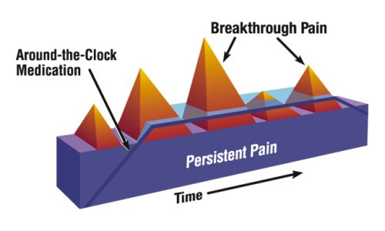
Breakthrough Pain Management
Challenges

Slide 11
Breakthrough Pain Subtypes
Incident, predictable
Incident, unpredictable
Idiopathic
End-of-dose
Bennett, D et al. P&T 2005 30(5):296-301

Slide 12
Episodic (Breakthrough) Pain Dose Study
Open Label Study Enrolling Patients on Oral Morphine
Breakthrough Pain (BTP) Dose of Morphine IV Given Using Equianalgesic Ratio of 1/3 (IV/Oral)
Pain Intensity Was Recorded at Start of BTP, at Time of Maximum Pain Relief, and one hour later
Mercadante, S et al. J Pain Symptom Manage 2004 27(4):352-359

Slide 13
Equianalgesic Table
PO (mg) Analgesic SC/IV/IM (mg)
30 Morphine 10
10 Oxymorphone 1
4 Hydromorphone 1.5
20 Oxycodone 14
(2-8) Methadone (2-8)
- Fentanyl 100 μg/hr parenteral or transdermal ≡ 4 mg/hr morphine parenteral
Pereira, MB et al. J Pain Symptom Manage 2001;22:672-687 .Mercadante S, et al. J Clin Oncol 2001 19:2898-2904 Indelicato, RA, Portenoy RK. J Clin Oncol 2002 20(1):348-352 Opana ER PI Endo Pharmaceuticals 6/06 Palladone PI Purdue Pharma 11/04

Slide 14
Episodic (Breakthrough) Pain Dose Study
In 162 Episodes, Pain Intensity Reduced 33% and mean time was 17.7 minutes from mean of 7.9/10 to 3/10
In 136 Episodes, Pain Intensity Reduced Greater Than 50% and mean time was 16.6 minutes from mean of 7.9/10 to 2.6/10
Twenty Episodes in Ten Patients Required an Additional Dose within 2 hours.
Mercadante, S et al. J Pain Symptom Manage 2004 27(4):352-359

Slide 15
Episodic (Breakthrough) Pain Dose Study
Adverse Effects
Drowsiness 25 Episodes
Moderate to Severe Nausea/Vomiting 12 Episodes
Confusion 1 Episode
Mercadante, S et al. J Pain Symptom Manage 2004 27(4):352-359

Slide 16
Episodic (Breakthrough) Pain Dose Study
Conclusions
Morphine Administered IV at a Dose Equivalent to 20% of the basal oral dosage is safe and effective.
This Dose Prevented the Occurrence of other Breakthrough Pain Episodes Within Two Hours in Almost All Patients.
Mercadante, S et al. J Pain Symptom Manage 2004 27(4):352-359

Slide 17
Episodic (Breakthrough) Pain Dose Study
Prospective Cohort Study to verify safety and effectiveness of breakthrough pain dose
Breakthrough Pain Dose Equal To 20% of Total Daily Morphine Dose
Enrolled 99 Cancer Pain Patients
945 Breakthrough Pain Episodes Were Recorded
Mercadante, S et al. J Pain Symptom Manage 2008 35(3):307-313

Slide 18
Episodic (Breakthrough) Pain Dose Study
Only 469 Breakthrough Episodes had complete assessment
In 287 Episodes, Pain Intensity Was Reduced by greater than 33% at 15 minutes
In 115 Episodes, Pain Intensity Was Reduced Greater Than 50%
The mean pain intensity decreased from 7.2 (T0) to 2.7 (T15)
In eight episodes no change in pain intensity was observed and an additional dose of morphine was given.
Mercadante, S et al. J Pain Symptom Manage 2008 35(3):307-313

Slide 19
Episodic (Breakthrough) Pain Dose Advances
We now have published studies to Guide the dosing ratios we use to treat Breakthrough Pain
How Should We Apply This?
Change Breakthrough Dose Ratio from 5 – 15% of Daily Opioid Dose to 10-20% of Daily Opioid Dose.
Mercadante, S et al. J Pain Symptom Manage 2004 27(4):352-359 Miaskowski, C. et al. (2005) (3) 44-45. Guideline For The Management of Cancer Pain in Adults and Children. American Pain Society

Slide 20
Episodic (Breakthrough) Pain Dose Example
Patient with Breast Cancer Taking Morphine Extended Release 180 mg po Daily for Chronic Severe Pain.
Breakthrough Pain Dose = 18 – 36 mg po Morphine = 10 – 20 % of Daily Morphine Dose.
Conservative Regimen: 20 mg po morphine now and repeat in 60 minutes if pain not decreased by 50%
Mercadante, S et al. J Pain Symptom Manage 2004 27(4):352-359

Slide 21
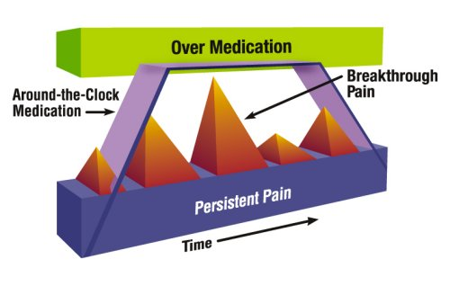
Breakthrough Pain Management
Challenges

Slide 22
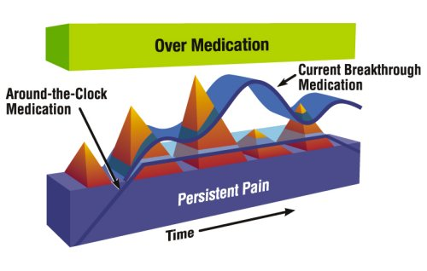
Breakthrough Pain Management
Challenges

Slide 23
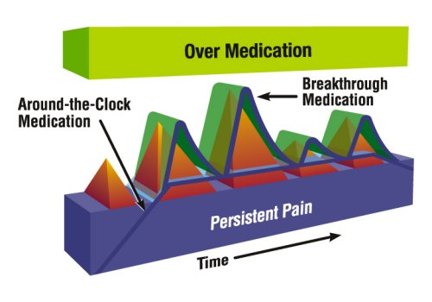
Breakthrough Pain Management
Challenges

Slide 24
Episodic (Breakthrough) Pain Dose Advances
We now have a published study to Guide the dosing ratios we use to treat Breakthrough Pain
The Breakthrough Dose is 10-20% of Daily Opioid Dose when the breakthrough medication is morphine or oxycodone.
Mercadante, S et al. J Pain Symptom Manage 2004 27(4):352-359 Miaskowski, C. et al. (2005) (3) 44-45. Guideline For The Management of Cancer Pain in Adults and Children. American Pain Society Aronoff G. et al. (2007) J Pain 8: 4 (April) Supplement 1 S43

Slide 25
Why is oxycodone 5-10 mg often ineffective for breakthrough pain in patients on higher doses of scheduled long - acting opioids?
Patient on MS Contin 240 mg per day
Oxycodone 5 - 10 mg po q 4 hr prn pain
Pain Score = 10/10 with movement

Slide 26
Equianalgesic Table
PO (mg) Analgesic SC/IV/IM (mg)
30 Morphine 10
10 Oxymorphone 1
4 Hydromorphone 1.5
20 Oxycodone 14
(2-8) Methadone (2-8)
- Fentanyl 100 μg/hr parenteral or transdermal ≡ 4 mg/hr morphine parenteral
Pereira, MB et al. J Pain Symptom Manage 2001;22:672-687 .Mercadante S, et al. J Clin Oncol 2001 19:2898-2904 Indelicato, RA, Portenoy RK. J Clin Oncol 2002 20(1):348-352 Opana ER PI Endo Pharmaceuticals 6/06 Palladone PI Purdue Pharma 11/04

Slide 27
Opioid Conversion Calculators
http://www.globalrph.com/narcotic.cgi
http://http://www.hopweb.org.
http://www.painphysicians.org/calc/Calculator.php
http://www.lexi.com
medicalconverters.com

Slide 28
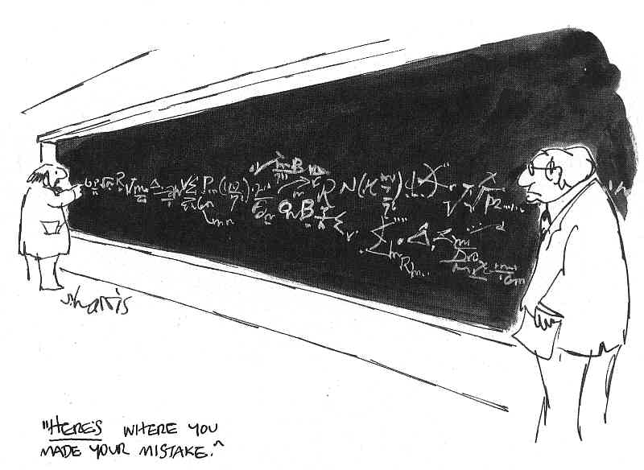

Slide 29
Why is oxycodone 5 - 10 mg often ineffective for breakthru pain?
Patient on MS Contin 240 mg per day
Breakthrough pain dose is 10-20 %
Dose is 24-48 mg Morphine q 2-3 hrs
10 mg oxycodone = 15 mg morphine
Thus any patient requiring >15 mg oral morphine may suffer

Slide 30
Pain Management
in Patient with Breast Cancer
Patient S/P Mastectomy of left breast with severe pain. She is taking oxycodone 20 mg Q 4 Hours for Chronic Severe Pain X 4 months. Pain Score = 3-5/10 She reports being nauseated at home with vomiting multiple times in past 24 hours.
Patient is scheduled for radiation therapy.
Patient appears fatigued.
Important PMH: Patient with poor renal function (Cr = 2.8)
Recommend analgesic plan for this patient.

Slide 31
Pain Management
in Patient with Breast Cancer
Mechanism of Pain
  Inflammatory
  Neuropathic?
  Spasm?
Important Factors
  Poor Sleep due to pain
  Decreased Renal Function
  Opioid tolerance
  Nausea/Vomiting

Slide 32
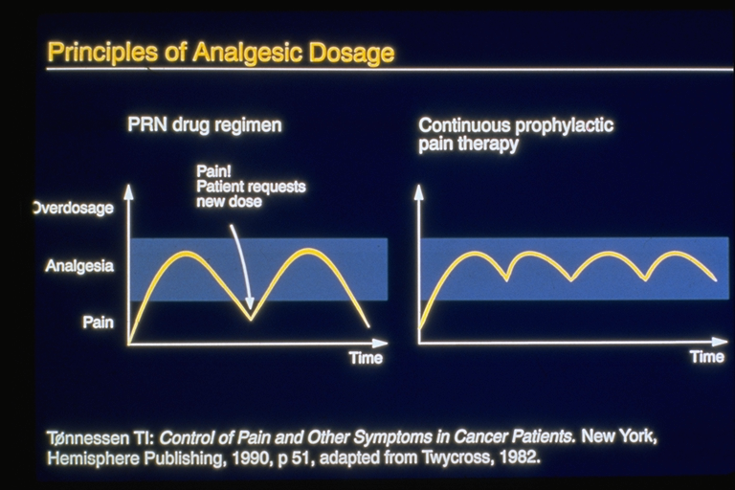

Slide 33
Pain Management
in Patient with Breast Cancer
Which analgesics may safely reduce pain?
  NSAIDs ( Cr = 2.8)
  PCA
    Fentanyl vs Morphine
  Acetaminophen
    Oral Acetaminophen

Slide 34
Equianalgesic Table
PO (mg) Analgesic SC/IV/IM (mg)
30 Morphine 10
20 Hydrocodone NA
4 Hydromorphone 1.5
20 Oxycodone 14
(2-8) Methadone (2-8)
- Fentanyl* 100 μg/hr parenteral or transdermal = 4 mg/hr morphine parenteral
* chronic
Pereira, MB et al. J Pain Symptom Manage 2001;22:672-687 .Mercadante S, et al. J Clin Oncol 2001 19:2898-2904 Indelicato, RA, Portenoy RK. J Clin Oncol 2002 20(1):348-352 Opana ER PI Endo Pharmaceuticals 6/06 Palladone PI Purdue Pharma 11/04

Slide 35
Equianalgesic Conversions
Example:
Patient with a total 24-hr dose of oxycodone 120 mg PO
What is the equivalent 24-hour dose of PO morphine?
Morphine 30 mg PO = X PO
oxycodone 20mg PO oxycodone120 mg PO
X = morphine 180 mg PO per 24 Hours

Slide 36
Equianalgesic Conversions
Example:
Patient with a total 24-hr dose of Morphine 180 mg PO
What is the equivalent 24-hour dose of IV morphine?
Morphine 30 mg PO = Morphine 180 mg PO
Morphine 10mg IV X
X = morphine 60 mg IV per 24 Hours

Slide 38
Which Fentanyl Patch dose would you suggest for this patient utilizing the equivalent of 60 mg IV morphine per day or 2.5 mg/hr IV morphine?
Fentanyl Transdermal Patch 12.5 mcg/hr
Fentanyl Transdermal Patch 25 mcg/hr
Fentanyl Transdermal Patch 50 mcg/hr*
Fentanyl Transdermal Patch 75 mcg/hr
Fentanyl Transdermal Patch 37.5 mcg/hr

Slide 39
What medication and settings would you select for this patient’s PCA utilizing the equivalent of 60 mg IV morphine per day or 2.5 mg/hr IV morphine?
Fentanyl PCA: PCA Dose = 25 mcg, Continuous Infusion = 25 mcg/hr, lockout = 10 minutes

Slide 40
Pain Management
in Patient with Breast Cancer
Follow - up on PCA Utilization with the Fentanyl PCA 10 mcg/ml settings: Basal = 25 mcg/hr, PCA dose = 25 mcg, lockout = 10 minutes
  EMR Data shows:
    60 Attempts and 50 injections over 24 hours
Important Discrepancy
  PCA Pump interrogation provides following data:
    PCA doses (injections) = 20 over 24 hours

Slide 41
Equianalgesic Conversions
Example: 50 PCA Doses (Charted in error by Nurse)
Patient with a total 24-hr dose of fentanyl 1850 mcg IV
What is the equivalent 24-hour dose of IV morphine?
Morphine 1 mg IV = X IV
Fentanyl 25 mcg IV Fentanyl 1850 mcg IV
X = morphine 74 mg IV per 24 Hours
X = morphine 222 mg PO per 24 hours (Wrong!!!)

Slide 42
Equianalgesic Conversions
Example: 20 PCA doses (Actual per pump)
Patient with a total 24-hr dose of fentanyl 1100 mcg IV
What is the equivalent 24-hour dose of IV morphine?
Morphine 1 mg IV = X IV
Fentanyl 25 mcg IV Fentanyl 1100 mcg IV
X = morphine 44 mg IV per 24 Hours
X = morphine 132 mg PO per 24 hours (Correct!!!)
Consider starting Fentanyl Patch 50 mcg//hr or OxyContin 40 mg PO Q 12 Hours plus
Oxycodone 10 – 15 mg PO Q 3 Hours prn BTP

Slide 43


Slide 44
New Developments in Palliative Care Pharmacotherapy
Opioid Equianalgesic Conversions
  Which patients are good candidates for conversion?
  Equianalgesic Conversion Tools
Advances in Breakthrough Pain Treatment
  Determine Effective Opioid Doses For Episodic Pain
Opportunities for Pharmacists
  Suggest analgesic dose titration for uncontrolled pain
  Suggest opioid conversion doses when needed
  Suggest optimal opioid breakthrough pain dose

