Slide 1

Symptom Management in Palliative Care
Jack MacMillan, Jr., M.D., FACP
Clinical Professor
Hospital & Palliative Medicine

Slide 2
Types of Symptoms
Respiratory
  Dyspnea, Cough, Secretions
GI
  N/V, Bowel Obstruction, Constipation, Anorexia
Psychological
  Depression, Anxiety, Delirium
Misc
  Hiccups, Ascites, Pruritus, Fatigue

Slide 3
Essential Elements of Symptom Management
Ongoing assessment & evaluation
Requires interdisciplinary teamwork
  Symptoms create suffering & distress
  Psychosocial intervention is key to complement pharmacologic strategies
Requires knowledge of patients goals
Requires knowledge of prognosis

Slide 4
Dyspnea

Slide 5
Dyspnea
Defined by the American Thoracic Society: “a subjective experience of breathing, discomfort that consists of qualitatively distinct sensations that vary in intensity”
Distinct sensation of breathing are produced by stimulation of various neurophysiologic pathways
Dyspnea occurs if the degree of motor output required is perceived to unsustainable or disproportionate to the sensory information received.

Slide 6
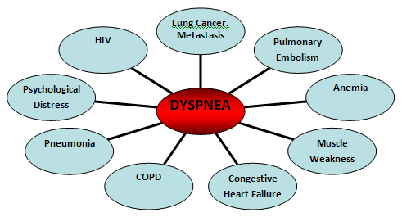
Dyspnea Common Causes

Slide 7
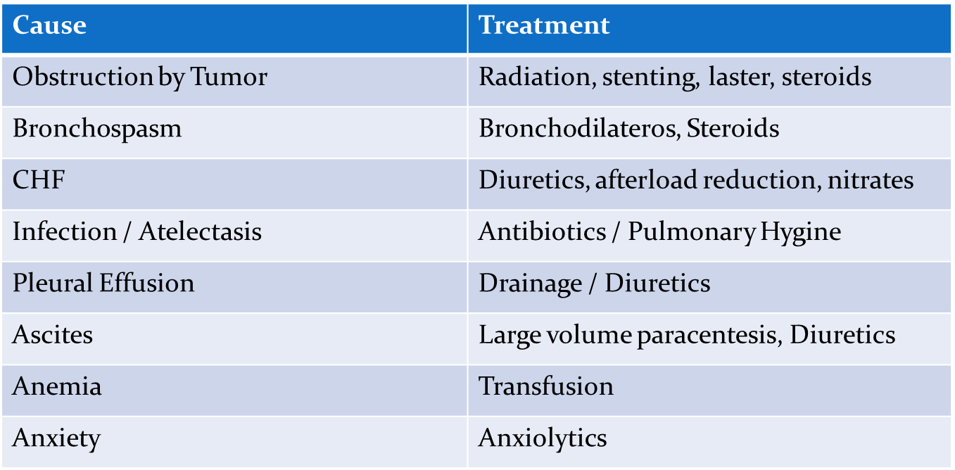
Dyspnea Treatments

Slide 8
Non-pharmacological treatments for dyspnea
Oxygen
Counseling
Positioning: Pursed lip breathing, elevation
Energy conservation
Fans
Cognitive Behavioral Interventions
Complementary Therapies: Acupuncture

Slide 9
Case:
Patient presents to the hospital 6 months after the last clinic visit. On admission her respiratory rate was 24-32, pulse of 110 and pulse oximetry was 89% saturated on 2 liters oxygen by nasal prongs. On the 4th day of the hospitalization. An evaluation for reversible causes of dyspnea was not successful and the pulmonary consultant believes the dyspnea is irreversible, caused by the underlying lung disease.

Slide 10
Case Continued
The patient has previously expressed a wish for No Code status. Current treatments for the dyspnea include oxygen by nasal prongs and hand-held inhalers.
On the fourth hospital day while you are making rounds, a nurse interrupts to tell the team that the patient is breathing at a rate of 50/min and is very agitated, sitting on the edge of bed gasping for air.

Slide 11
Case Continued
The resident tells the nurse to
  1) check pulse oximetry
  2) increase the oxygen to a 50% facemask and
  3) call him in one hour to report any changes.
What should be included in your assessment of this acute exacerbation of dyspnea?
Is the proposed treatment plan appropriate, if not? Why?
Suggest an alternative treatment approach; specify non-drug and drug orders (drug/dose/schedule)

Slide 12
Treatment of Dyspnea: Opioids
Opioids remain the class of medications with the best level of evidence of benefit in refractory breathlessness.
The proposed mechanism for the effect of opioids on dyspnea include
  Alteration in perception of breathlessness,
  Decrease in the ventilatory drive and response to
  stimuli such as hypoxemia and hypercapnia
  Decrease in oxygen consumption at any level of exercise.
Start on an oral immediate release formulation on regular basis, with breakthrough doses as needed.
Once effective dose determined, therapy shouldinclude a sustained release opioid and immediate

Slide 13
Refractory Dyspnea: Anxiolytic Therapy
Lorazepam
  0.5-1 mg PO Q1 hr until controlled then dose Q4-6 hours as needed
Diazepam
  5-10 mg PO Q1 hr until controlled then dose Q6-8 hours as needed
Midazolam
  0.5mg IV every 15 minutes then can startcontinuous infusion

Slide 14

Cough

Slide 15
Cough
40% of cancer patients report cough
Can lead to dyspnea, sleep disturbance, chest pain, sore throat, vomiting
Common causes- infections, COPD, asthma, lung cancer or mets, GERD, aspiration, pulmonary edema
Drugs associated with cough include ACE inhibitors, NSAIDS, inhaled medications

Slide 16
Causes of Cough
Assess underlying cause
  Infection, sinusitis, reflux
Assess type of cough
Assess associated symptoms
Diagnostic tests may be needed

Slide 17
Non-Pharmacologic Interventions for Cough
Chest PT
Humidifier
Positioning

Slide 18
Opioids for cough
Only central active therapy- suppress brain stem cough center
First line therapy for severe cough
All opioids have anti-tussive activity
  No evidence one is better than the other
  Not clear that if already on opioid whether adding another is effective
    1 study- hydrocodone effecitve in this setting
  Dextromethorphan and Codeine most commonly used
    Dose 10-20 mg every 4-6 hours

Slide 19
Peripherally active Rx for Cough
Expectorants thin secretions- best used with wet coughs
  Guaifenesin, nebulized acetylcysteine and hypertonic saline most commonly used
  Caution if impaired cough reflex
Benzonate- anesthetizes stretch receptors
  Effect 4-8 hours – dose 100-200 mg TID
  Recommend adding it to an opioid
Anticholinergics play a role if upper airway secretions contributing to cough
  Scopolomine, glycopyrrolate, hyoscyamine most commonly used

Slide 20
Peripherally active Rx for Cough
Nebulized local anesthetics – block afferent receptors in airways
  No trials evaluating this therapy but anecdotally work
  Lidocaine 2% solution, 5 ml nebulized every 6 hours or bupivacaine 0.25%, 5ml every 8 hours
  Aspiration a risk so recommend patient does not eat or drink for 1 hour post inhalation
Bronchospasm potential side effect
Bronchodilators not effective except for specific indications
Steroids help with inflammation, SVC, COPD or asthma exacerbations

Slide 21
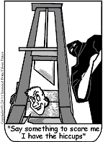
Hiccups

Slide 22
Hiccups
Involuntary reflex
  Mediated by vagus nerve and phrenic nerve
    Diaphragmatic irritation
  CNS causes involve the brainstem
Persistent- lasts longer than 48 hours
Intractable – longer than 1 month
Leads to pain, nausea, dyspnea, poor sleep, anxiety

Slide 23
Hiccups Causes
Cancer of chest
Esophageal or gastric distention
Liver disease
Uremia
Corticosteroids
CNS Lesions
Stress / anxiety
idopathic

Slide 24
Hiccups: Non Pharmacologic Therapy
Vagal stimulation
  Carotid massage or Valsalva
  Interruption of Phrenic nerve stiumulation
    Rubbing over the 5th cervical vertebrae
  Interrupt respiratory cycle
    Sneezing, coughing hold breath, hyperventilating

Slide 25
Hiccups: Pharmacologic Therapy
Only baclofen been studied in RDB placebo trial
  Provided symptomatic relief but did not eliminate
Antipsychotics
  Chlorpromazine only FDA approved drug 25-50 mg TID/QID
  Haloperidol 2-5 mg po/sq load with 1-4 mg po/sq TID
Anticonvulsants
  Gabapentin 300-400 mg TID
  Case reports of dilantin, valproate, carbamazepine

Slide 26
Hiccups: Pharmacologic Therapy
Miscellaneous
  Baclofen – 5-10 mg po Q 8 hours
  Metoclopramide 5-10 QID – especially if distention the culprit
  Promethazine 12.5-25 mg po/pr TID

Slide 27
FOLKLORE REMEDIES
PEANUT BUTTER ROOF OF MOUTH
FORCED COUGHING
SWALLOWING SUGAR
SCARING FOLKS
RUBBING OVER 5TH CERVICAL VERTEBRAE (PHRENIC NERVE)
CAROTID MASSAGE OR VALSALVA (VAGAL STIMULATION)

Slide 28
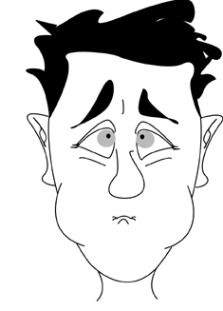
Nausea & Vomiting

Slide 29
Nausea and Vomiting
50-60% of patient with advanced cancer suffer from it
More common in patients under 65 years old, in woman, and in those with cancer of the stomach or breast.
Understanding of the emetic process and the main neurotransmitters involved is important
  Antiemetic drugs are predominately neurotransmitter blocking agents.
Cause of vomiting can usually be determined from careful H&P and clinical examination.

Slide 30
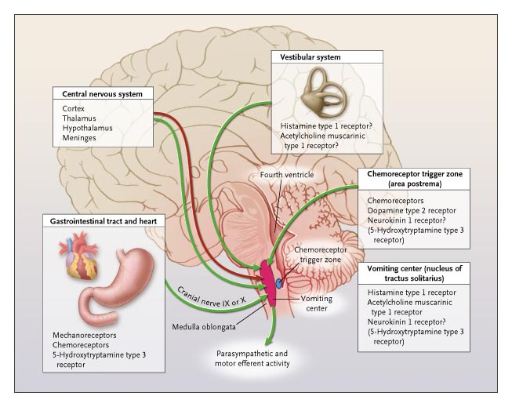

Krakauer, E. L. et al. N Engl J Med 2005;352:817-825

Slide 31
Nausea and Vomiting
GI Causes:
  Gastroparesis
  Blood in stomach
  Bowel obstruction
  Constipation
  Ascites
  Gastric irritation
  PUD
Metabolic
  Hypercalcemia
  Renal Failure
  Hyponatremia
Increased Intracranial Pressure
Pain
Anxiety
Drugs
Chemotherapy
Radiation
Cancer
Cough
Infection
Vestibular/Motion

Slide 32
Stimuli of Vomiting Pathways
Baines MJ. L. ABC of Palliative Care: Nausea, vomiting, and intestinal obstruction. BMJ 1997;315:1148
Notes:
The Pathophysiology of Nausea and Vomiting. Vomiting is caused by noxious stimulation of one or more of four sites: the gastrointestinal tract, the vestibular system, the chemoreceptor trigger zone in the area postrema of the floor of the fourth ventricle, and higher centers in the central nervous system (CNS).. The vestibular system activates the vomiting center when stimulated by motion or disease such as labyrinthitis or, rarely, when sensitized by medications such as opioids. Histamine (H1) and acetylcholine M1 receptors are thought to exist on vestibular afferents. Higher CNS centers may either activate or inhibit the vomiting center. Activation is denoted by green arrows, and inhibition by red. The question marks that appear after some of the receptor names denote that the presence or role of the receptor has not been proved. The parentheses around the name of a receptor denote that the receptor is present but probably does not have a role in nausea or vomiting at this site.
BMJ 1997;315:1148

Slide 33
RELATIVE ANTIEMETIC RECEPTOR AFFINITIES

Slide 34
Cortical N/V: no single receptor / learned responses
Cause | Non-Rx Tx | Rx Treatment | Class / Receptor
Tumor in CNS or Meninges | Radiation Therapy | Dexamethasone | Steroid
Increased ICP | VP Shunt | Dexamethasone | Steroid
Anxiety, other conditioned responses | Counseling, cognitive behavioral therapy | Lorazepam | Benzodiazepine
Pain | Acupuncture | Morphine | Opioids

Slide 35
Vestibular N/V: Histamine (H1) / Acetylcholine
Cause | Non-Rx Tx | Rx Tx | Receptor
Vestibular Disease | ENT Consult | Meclizine | Anti-histaminic & Anti-Cholinergic
Motion Sickness | Cognitive Behavioral | Scopolamine Promethazine (Phenergan) | Anti-Cholinergic Anti-cholinergic & anti-histaminic
Middle ear infection |  | Diphenhydramine Antibiotics | Anti-histaminic
Opioids: increase sensitivity | Adjusting dose | Scopolamine Promethazine | Anti-cholinergic Anti-cholinergic & anti-histaminic
Notes:
Promthazine = phenergan
The vestibular system activates the vomiting center when stimulated by motion or disease such as labyrinthitis or, rarely, when sensitized by medications such as opioids. Histamine (H1) and acetylcholine M1 receptors are thought to exist on vestibular afferents. Higher CNS centers may either activate or inhibit the vomiting center.

Slide 36
CTZ: Chemoreceptors, Dopamine type 2, 5HT3, Neurokinin 1
Cause | Non-Rx Tx | Drug Treatment | Recptors
Medications (eg, opioids, digoxin, antibiotics) | Discontinue medication or adjust dose | Haloperidol Ondansetron Prochlorperazine | Dopamine Serotonin Dopamine
Chemotherapy | Adjusting dose | Aprepitant Granisetron Ondansetron | NK1 Serotonin Serotonin
Toxins / Metabolic (eg, renal or liver failure) | Underlying Cause | Prochlorperazine Haloperidol Ondansetron Metoclopromide Chlorpromazine | Dopamine Dopamine Serotonin Dopamine Dopamine
Hyponatremia Hypercalemia | Underlying cause Rehydration | Prochlorperazine (Compazine) | Dopamine
Notes:
The chemoreceptor trigger zone lacks the blood-brain barrier that is otherwise present throughout the central nervous system, so that its chemoreceptors are stimulated by either endogenous or exogenous blood-borne toxins.
The activation of the chemoreceptor trigger zone is mediated by dopamine type 2 receptors.
Efferent stimuli from the chemoreceptor trigger zone then activate the vomiting center, which consists of the nucleus of the tractus solitarius and the reticular formation of the medulla oblongata.
Activation of the vomiting center is mediated by histamine type 1 (H1) receptors or acetylcholine muscarinic type 1 receptors, and the result is vomiting.
Neurokinin 1 receptors, for which substance P is a ligand, are also thought to be in the chemoreceptor trigger zone and the vomiting center and to mediate nausea and vomiting. The 5-HT3 receptors for serotonin in the chemoreceptor trigger zone and vomiting center, unlike those in the gastrointestinal tract, are not believed to have a major role in nausea and vomiting.
During chemotherapy mucosal enterochormaffin cells release serotonin, which stimulate 5HT3. This evokes the vagal afferent discharge and may induce vomiting.
Dopamine produced nausea & vomiting by stimulation of the medullary CTZ, and reglan blacks stimulation of CTZ by l-dopa.
Aprepitant – Selective high-affinity antagonist of substance P / Neurokinin 1 (NK1) Receptors
-Little or no affinity for 5-HT3, DA. Good for chemotherapy induced N/v (CNIV) and Postoperative n/v
-Augments the antiemetic activity of the 5-HT3 receptor antagonist (ondansetron and corticosteroids)
-Inhibits both the acute and delayed phase of cisplatin-induced emesis.
Granisetron (Kytril) 5-HT3 antagonist.
-5HT3 receptors are located peripherally on vagal nerve terminals and centrally in the CTZ.
Ondansetron = zofran
Prochlroperazine = compazine – has dopaminergic, cholinergic, and histamine receptor antagonisms.
NK1 receptor antagonists inhibit substance P release. Ameliorates acute emesis and nausea when added to 5HT3 receptor antagonists and dexamethasone.

Slide 37
GI N/V: mechanoreceptors, chemoreceptors, 5HT3, anticholinergic,
Cause | Non-Rx Tx | Drug Therapy | Receptor
Dysmotility of UGI | Avoiding Rx that slow down gut | Metoclopramide | Prokinetics/ DA
Infection / Inflammation |  | Scopolamine Promethazine | Anticholinergic Anticholinergic & antihistaminic
Constipation | Manual disimpaction Hydration | Laxatives & Enemas
Mechanical Obstruction | NGT/ G tube placement | Scopolamine Octreotide | Anticholinergic somatostatin agonist
Notes:
5HT3 on vagal nerve terminals
The gastrointestinal tract and heart can activate the vomiting center by stimulation of mechanoreceptors or chemoreceptors on glossopharyngeal or vagal afferents (cranial nerves IX and X) or by release of serotonin from gut enterochromaffin cells, which in turn stimulate 5-hydroxytryptamine type 3 receptors on vagal afferents.

Slide 38
Clinical case
68 yo man with Stage IV renal carcinoma with known bone mets presents with new severe nausea and vomiting.
Patient’s physician recently increased his opioids due to worsening pain
He reports abdominal distention and bloating with last BM few days ago
Having some dizziness and worsening morning headache

Slide 39
QUESTION
WHAT ARE SOME OF THE POSSIBLE CAUSES OF HIS NAUSEA AND VOMITING THAT YOU WOULD BE WORRIED ABOUT?

Slide 40
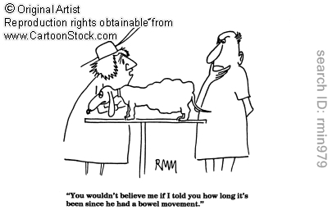
Constipation

Slide 41
Constipation Case:
Mr. J is ending a four day hospital stay for evaluation of progressive dyspnea due to metastatic lung cancer. He is now breathing comfortably on 3 L oxygen and 30 mg MS Contin Q12 h. He has been receiving the MS Contin for one week. The primary nurse pages the intern because he hasn’t had a bowel movement in 3 days. The intern orders colace 100mg BID and encourages the patient to take in more fluids

Slide 42
Constipation continued:
What should be included in your assessment?
Is this proposed treatment appropriate, if Not? Why?
Suggest an alternative treatment approach?

Slide 43
Constipation Pathophysiology
Pre-exisiting Constipation
  Elderly patients
Neurologic Abnormalities
  Spinal cord lesions
  Autonomic dysfunction
  Paraneoplastic
  Parkinson's
Medications
  Opioids
  Calcium Channel Blockers
  Anticholinergics
Metabolic
  Dehydration
  Hypercalcemia
  Hyporthyroidism
Structural
  Fibrosis from radiation
  Adhesions
  Tumors
Limited Mobility
Dietary
  Decreased Fiber
Notes:
Normal physiology of defecation is complex and involves the central and peripheral nervous system, hormones, and reflexes that are unique to the GI System.
Over 80% of the body’s serotonin resides in the GI Tract (5-HT-4)

Slide 44
Assessment of Constipation
Bowel History: color, odor, size.
Other Symptoms: nausea, vomiting, abdominal pain, diarrhea or bloating.
Medication review
Physical Examination: abdominal distention, rectal exam, palpable masses
Imaging: KUB, Abdominal Series, or CT Scan.

Slide 45
Treatment of Constipation
Treating: correct reversible causes, prevention, education, monitoring.
Fibers/Fluids: increase volume, triggers peristalsis, do not use if severely constipated or bloating. (Psyllium/Metamucil)
Stool Softeners: Detergents that break up the fat content and allow water to penetrate (Docusate sodium)
Stimulant Laxatives: increase intestinal propulsive activity. (Prune Juice, Senna and Bisacodyl)

Slide 46
Treatment of Constipation
Osmotic Laxatives: pull water into the bowel lumen, increase volume. (Golytely, lactulose, sorbitol, polyethylene gyclol, magnesium citrate / hydroxide).
Lubricants: suppositories and enemas work mechanically to soften the leading edge of hard, dry stool. (Glycerine / Phosphate / mineral oil / tap water)
Methylnaltrexone: Peripheral opioid antagonist
Prokinetics: Metoclopramide

Slide 47
CLINICAL CASE
54 YO WOMAN WITH STAGE IIIB OVARIAN CANCER PRESENTS WITH ABDOMINAL DISTENTION, NAUSEA WITH VOMITING OF FECAL MATERIAL
NO STOOL OR BOWEL MOVEMENT IN 5 DAYS
DENIES PASSING FLATUS

Slide 48
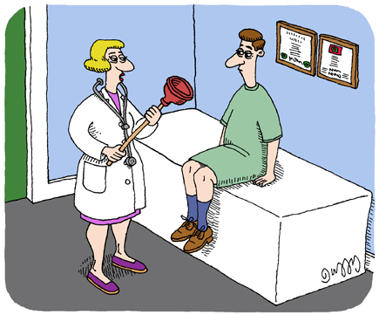
Malignant Bowel Obstruction (MBO)

Slide 49
MBO
Common in ovarian cancer and colon cancer
Management of patients with MBO is influenced by:
  The level of obstruction
  Pattern of disease & clinical stage of cancer
  Overall prognosis
  Prior and potentially future anti-cancer treatments
  Functional status & expected survival
  Patient goals

Slide 50
Vicious Cycle of MBO
Blockage
Distention
Uncoordinated peristalsis
Colicky pain
Mucosal secretions
VIP

Slide 51
Approaches to Management of MBO

Slide 52
MBO Goals of Care
Decrease nausea, vomiting and pain
Eliminate need for NG tube and IV Fluids
Try to restore patients ability to drink and eat.

Slide 53
Management: Initial Steps
Fluids
  Indicated only for patients who remain dehydrated and use to extend life is consistent with the patient’s goal.
Nasogastric (NG) decompression
Diagnostic studies:
  Abdominal radiographs
  Computed tomography (CT) to determine presence and level of obstruction and assess extent of cancer

Slide 54
Operative Interventions
Options:
  Laparotomy for tumor debullking and/or bowel resection with reanastomosis
  Bypass procedures
  Resection or bypass can be accompanied by gastrostomy placement
Indications:
  Tumor localized
  Without extensive vascular invasion or metastasis
  Patient with good performance status
Relative Contraindications
  Multiple obstruction sites
  Carcinomatosis
  Diffuse intra-abdominal masses
  Distant Metastases
  Pleural Effusion
  Age greater than 63 years
  Ascites
  Low Serum Albumin
  Prior Radiotherapy
  Poor nutritional status
  Short diagnosis to obstruction

Slide 55
Venting Procedures
NGT –temporary measure.
PEG – Long term decompression
  Estimated to improve nausea and vomiting control in 83-93% of patients.
  Avoided in patients with portal hypertension, large-volume ascites, or high bleeding risk.

Slide 56
Self Expanding Metallic Stents
Technically feasible locations for stents are limited to the gastric outlet, proximal small bowel, and colon.
Clinical success rates of 84-94%
Enteral stents are contraindicated if there are multiple stenosis or peritoneal carcinomatosis
May be used as a definitive palliative treatment or as a bridge to surgery
  As a bridge it would allow for decompressions and bowel preparation for an elective operation.

Slide 57
Medical Management of MBO
Goals:
  Relieve continuous abdominal pain and intestinal colic
  Reduce vomiting to an acceptable level for the patient without the use of NGT
  Relieve Nausea –Two Ways
    Drugs that reduce GI Secretions (anticholinergics and /or somatostatin analogues
    Anti-emetics
  Achieve Hospital discharge, and to allow for home/hospice care.

Slide 58
Pain Control in MBO
Analgesics - Continuous Pain
  Strong Opioids
    PCAs or Subcutaneous infusion
    Transdermal
    Sublingual - Buprenorphine
Anticholinergics – Colicky Pain
  Scopolamine Patch
  Hyoscyamine (Levsin)
Corticosteroids
  Both co-analgesic and antiemetic

Slide 59
Reduce the GI Secretions
  Anticholinergics - Scopolamine Patch or Glycopyrrolate
  And / OR
Somatostatin Analogue- Octreotide
  Decrease release of enzymes, gastric acid, secretions by inhibiting VIP and increases absorption of water and electrolytes at the intracellular level
  Inhibits enteric nervous system to decrease peristalsis and splanchnic blood blood flow
  Helps break down vicious cycle of distention-secretion-distention and bowel contractile hyperactivity
  100 mcg IV/SQ Q8 hours, max 900 mcg in 24 hours
  Response rate of 44% [4]

Slide 60
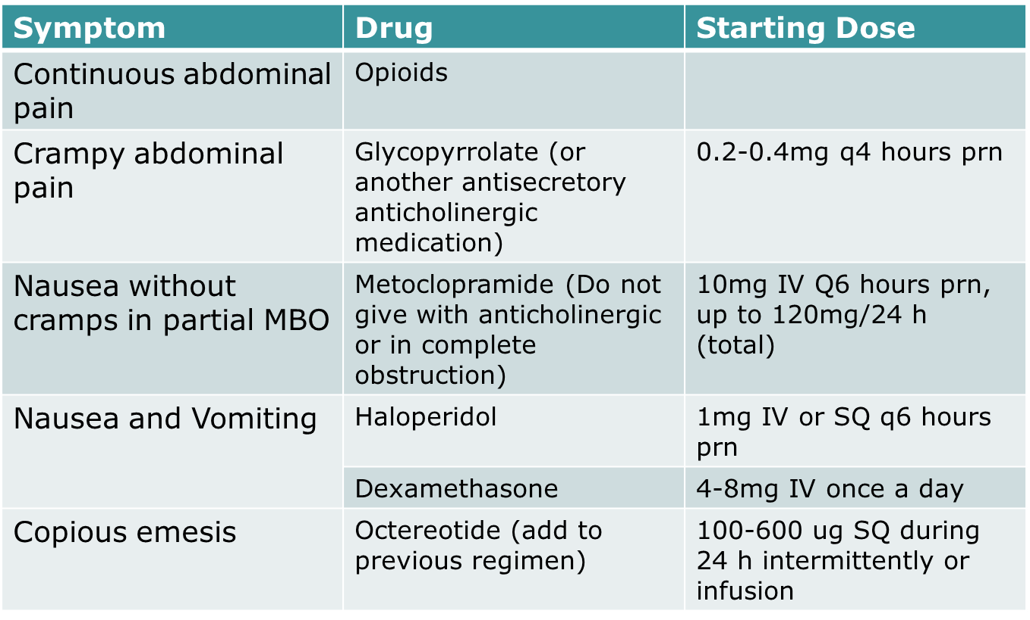
Summary of Medical Therapy for MBO

Slide 61
Depression
Experience by up to 40% patients at EOL
Often goes undiagnosed or undertreated
Not a “normal” part of a terminal disease
Can be misdiagnosed as anxiety d/o
Secondary symptom burden should help guide therapy

Slide 62
Depression
Life expectancy of weeks
Methylphenidate fastest acting medication
Dose 5 mg with breakfast (2.5 mg frail or heart dz)
Titrate to effect by 2.5-5 mg divided doses every 1-2 days
Effective dose 20-30 mg

Slide 63
Depression
Depression with neuropathic pain
  Duloxetine (cymbalata) and Venlafaxine (effexor)
Depression with psychomotor retardation
  Fluoxetine, Effexor are activating
Depression with insomnia
  Mirtazapine – sedating at low doses
    Additional benefit of stimulating appetite
Depression with anxiety
  Citalopram, escitalopram, paroxetine

Slide 64
CLINICAL CASE
72 YO MAN ADMITTED TO THE HOSPITAL FOR COMMUNITY AQCQUIRED PNEUMONIA
HE HAD A FALL AT HOME.
NO FRACTURES BUT SIGNIFICANT BRUISING OF RIBS AND LEGS. C/O DIFFUSE BODY PAIN
ON CEFTRIAXONE AND AZITHROMYCIN FOR PNEUMONIA
MEDICAL PROBLEMS INCLUDE DIABETES MELLITUS, HTN, CKD STAGE III, COPD

Slide 65
MEDICATIONS INCLUDE
  GABAPENTIN 300MG TID
  NORCO 5/325MG 1-2 TABS Q6 HOURS PRN
  GLIPIZIDE 5MG Q AM
  METFORMIN 500MG BID
  BENADRYL FOR ITCHING AS NEEDED
HOSPITAL NITE #2 PATIENT BECOMES CONFUSED AND AGITATED.
What is the diagnosis
Potential causes?

Slide 66
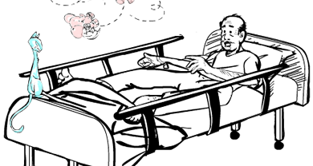
Delirium

Slide 67
Delirium
Acute onset of days to hours
Fluctuating course
Disturbance or disorientation that is not accounted for by an established dementia
Reduced ability to focus, sustain or shift attention
Generally a reversible condition
Subtypes:
  Hyperactive
  Hypoactive
  Mixed

Slide 68
Delirium vs. Dementia
 | Delirium | Dementia
Change in alertness | Yes | No
Onset | Hours to days | Gradual
Fluctuation | Yes | No

Slide 69
Causes of Delirium (I WATCH DEATH)
Infection | Encephalitis, meningitis, syphilis, HIV, Sepsis
Withdrawal | Alcohol, barbiturates, sedative-hypnotics
Acute metabolic | Acidosis, alkalosis, electrolyte disturbance, hypercalcemia, hepatic failure, renal failure.
Trauma | Closed head injury, burns, heatstroke
CNS Pathology | Abscess, hemorrhage, subdural hematoma, infection, seizure, stroke, tumors, metastases, vasculitis
Hypoxia | Anemia, CO Poisoning, pulmonary or cardiac failure
Deficiencies | Vitamin B12, folate, niacin, thiamine
Endocrinopathies | Hyper/hypoglycema, hypercalcemia, myxedema
Acute Vascular | Hypertensive Encephalopathy, stroke, arrhythmia, shock, dehydration
Toxins or drugs | Medications, chemotherpeutics, illicit drugs, pesticides
Heavy Metals | Lead, manganese, mercury

Slide 70
Medications Associated With Delirium
Anticholinergics
Antineoplastic agents
Benzodiazepines
Opiates
Sedative / hypnotics
Steroids
Antihistamines

Slide 71
Delirium Assessment
History:
  Context of the patient: Illness, Medications
  Symptoms: Quality, Severity, Temporal Profile, Effects of treatment
Mental Status Exam
Physical Exams: Asterixis, Tremor, Myoclonus.
Look for Reversible Causes:
  Workup

Slide 72
Pharmacological Rx of Delirium
No medication is FDA Approved
Typical Antipsychotics
  Haloperidol: Most commonly used. Can use for both hyperactive and hypoactive.
  Chlorpromazine
Atypical Neuroleptics:
  Risperidone: less risk of extrapyramidal symptoms
  Olanzapine: promotes weight gain, seizure threshold
  Quetiapine: can use in Parkinson's, hypotension
Benzodiazepines: Avoid, it can worsen the condition

Slide 73
Non-Pharmacologic Rx Delirium
Evaluate Medications
Reorientation
Relaxation / Distraction
Hydration

